Slide 1
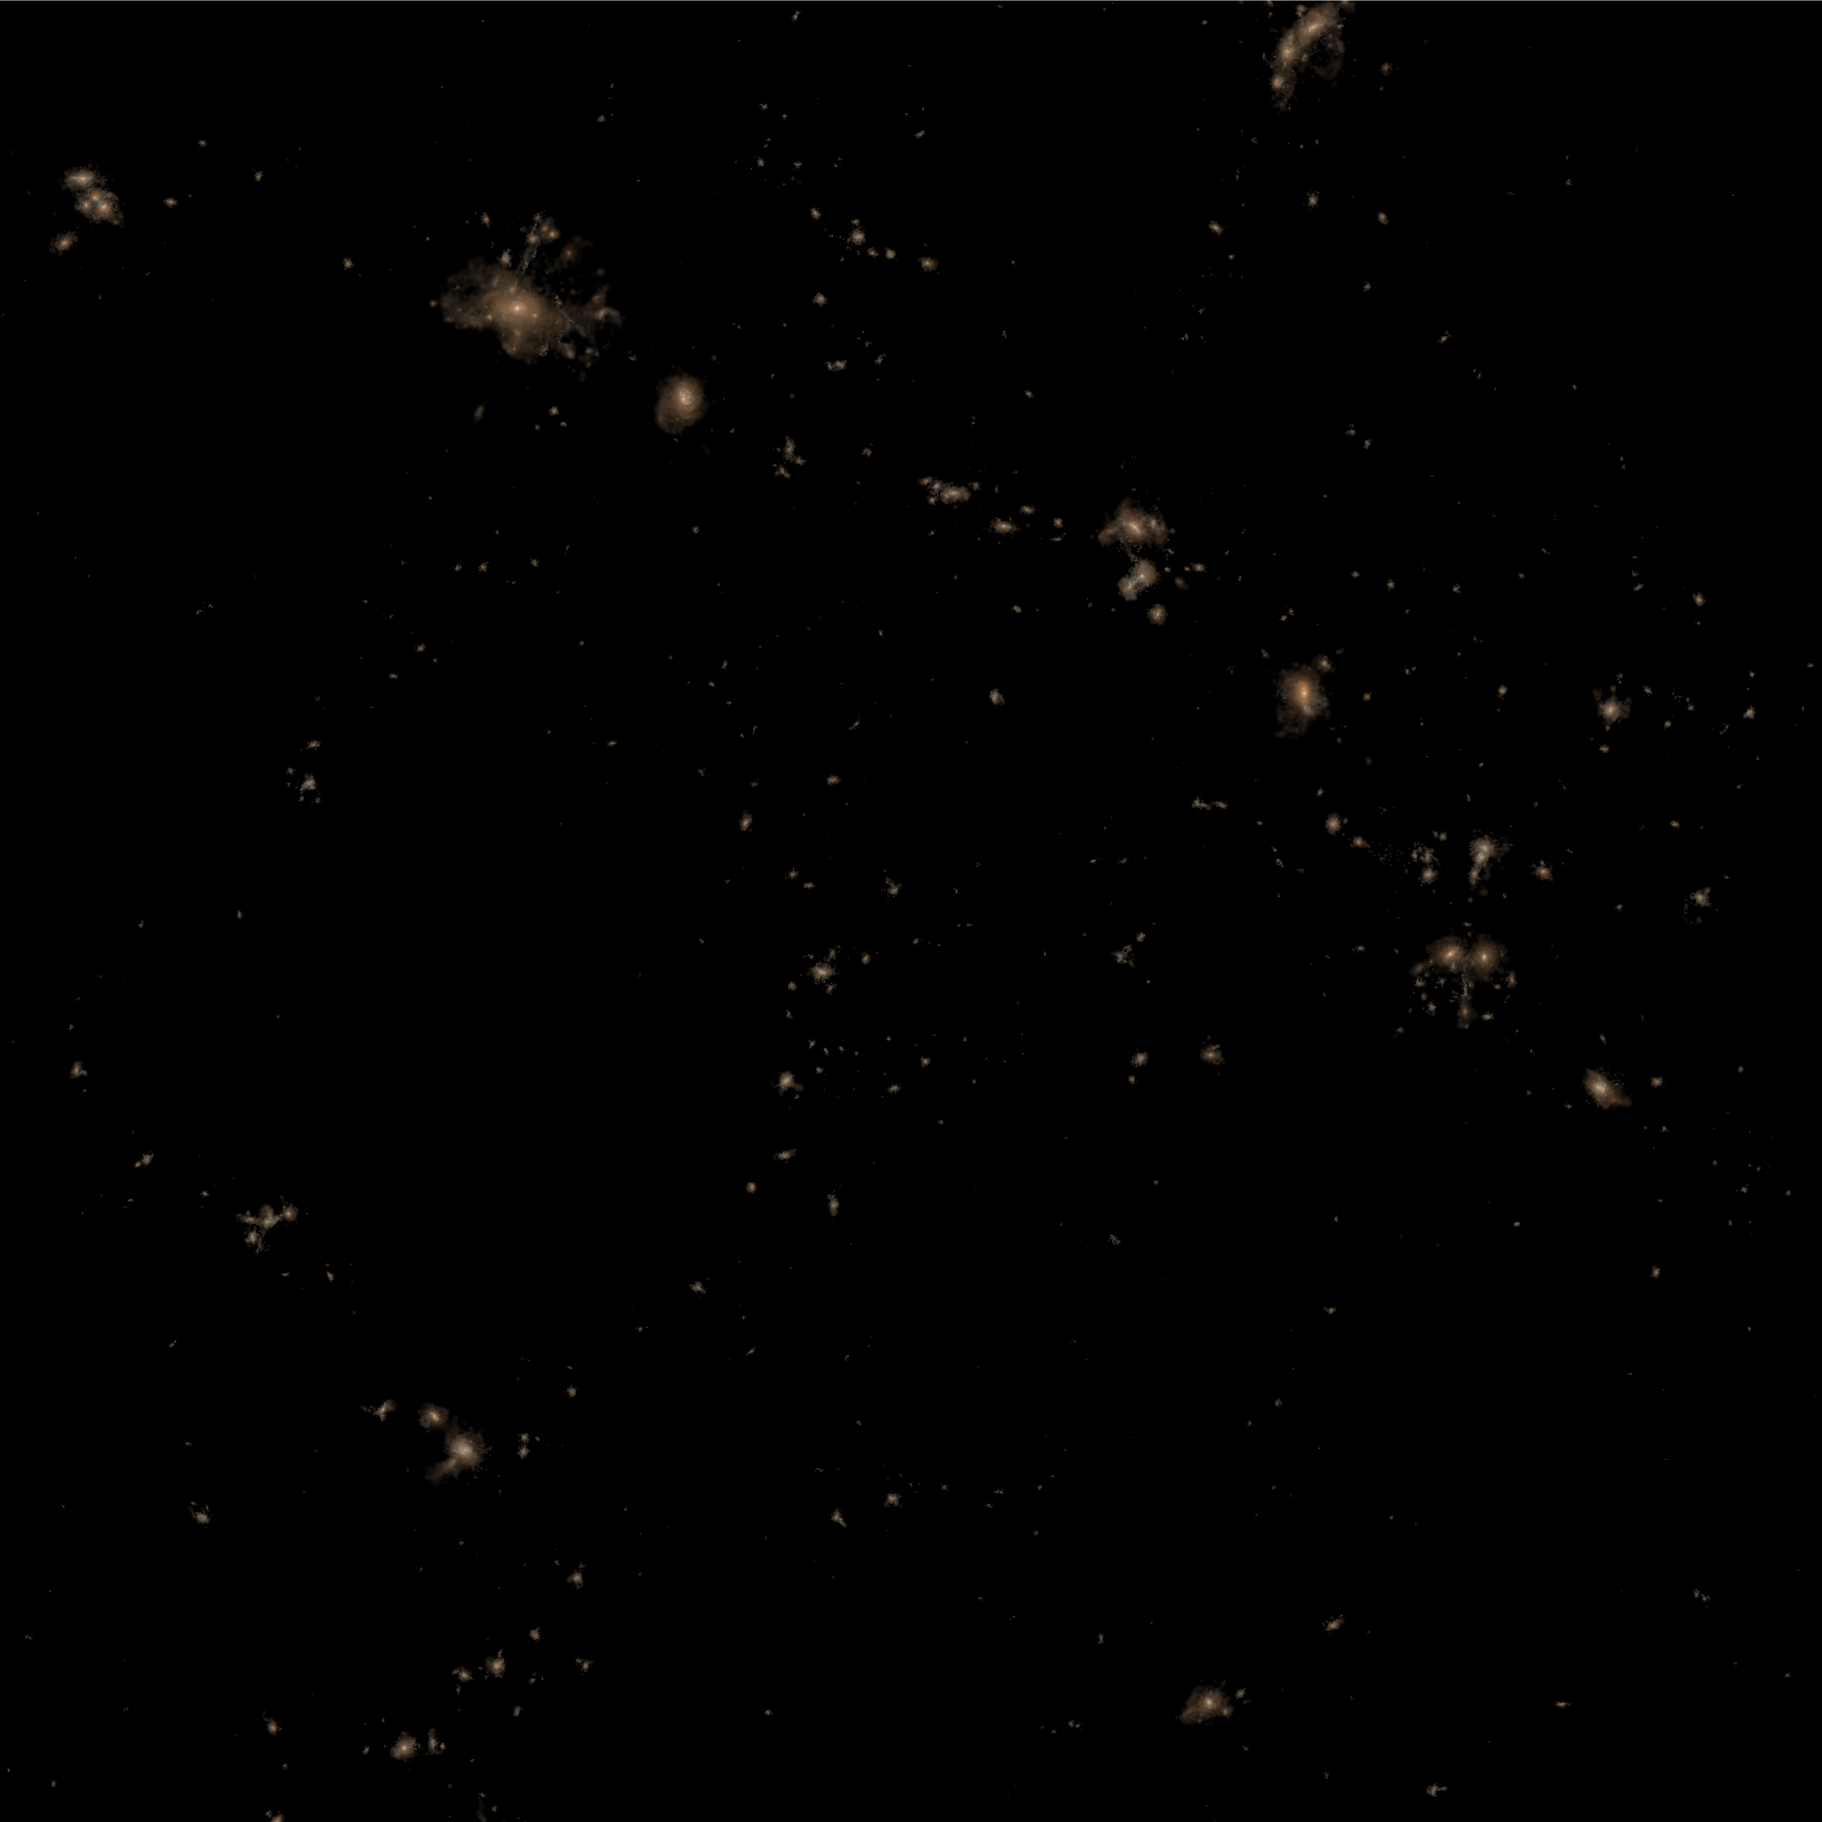

How Environment Affects Galaxy Metallicity:
Lessons from the
Illustris Simulation
Genel 2016, ApJ in press
(arXiv:1602.02773)
Shy Genel
Hubble Fellow
Columbia University

Slide 2

How Environment Affects Galaxy Metallicity:
Lessons from the
Illustris Simulation
Genel 2016, ApJ in press
(arXiv:1602.02773)
Shy Genel
Hubble Fellow
Columbia University

Slide 3
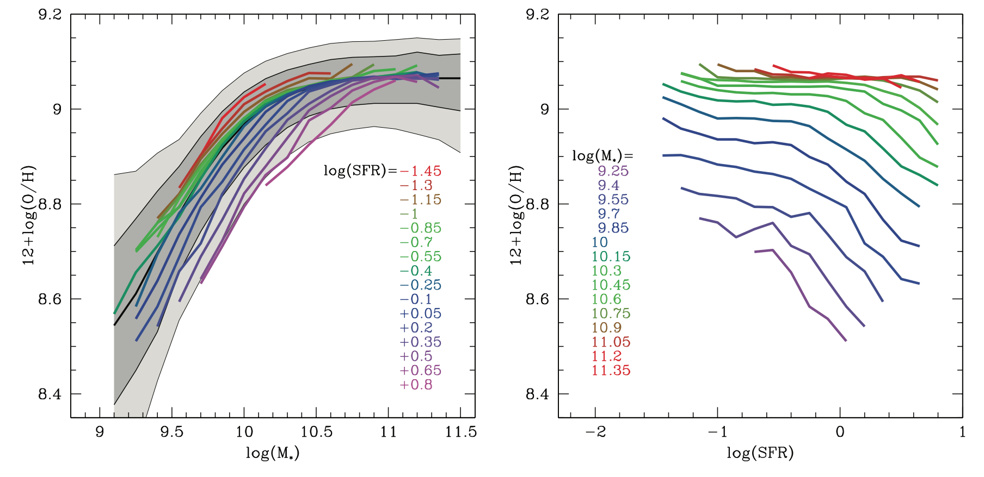
Motivation
Z increases with M*, decreases with SFR, independent of z (?)
Used to constrain models, BUT: systematics!
Motivations to look at other dependencies:
  Weaker/different systematics
  Constrain additional/different physical processes
Mannucci et al. 2010

Slide 4
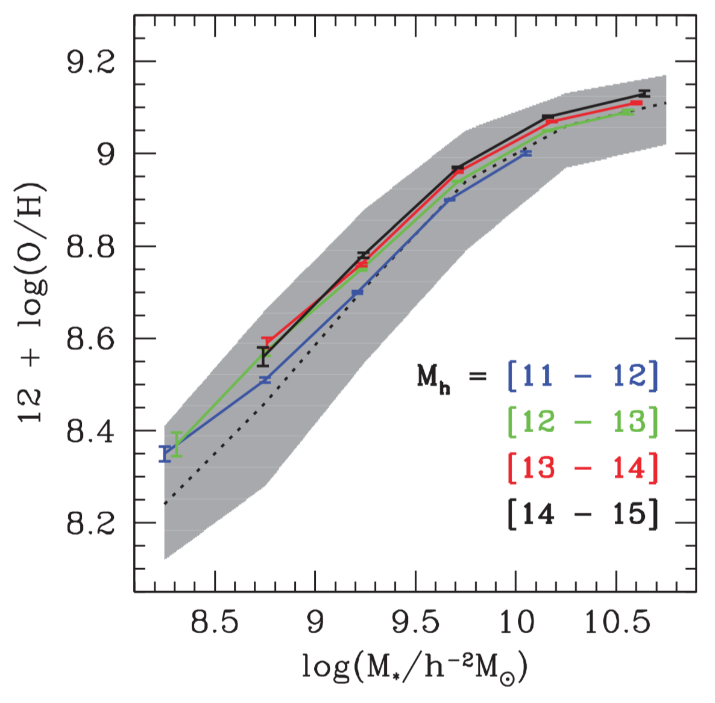
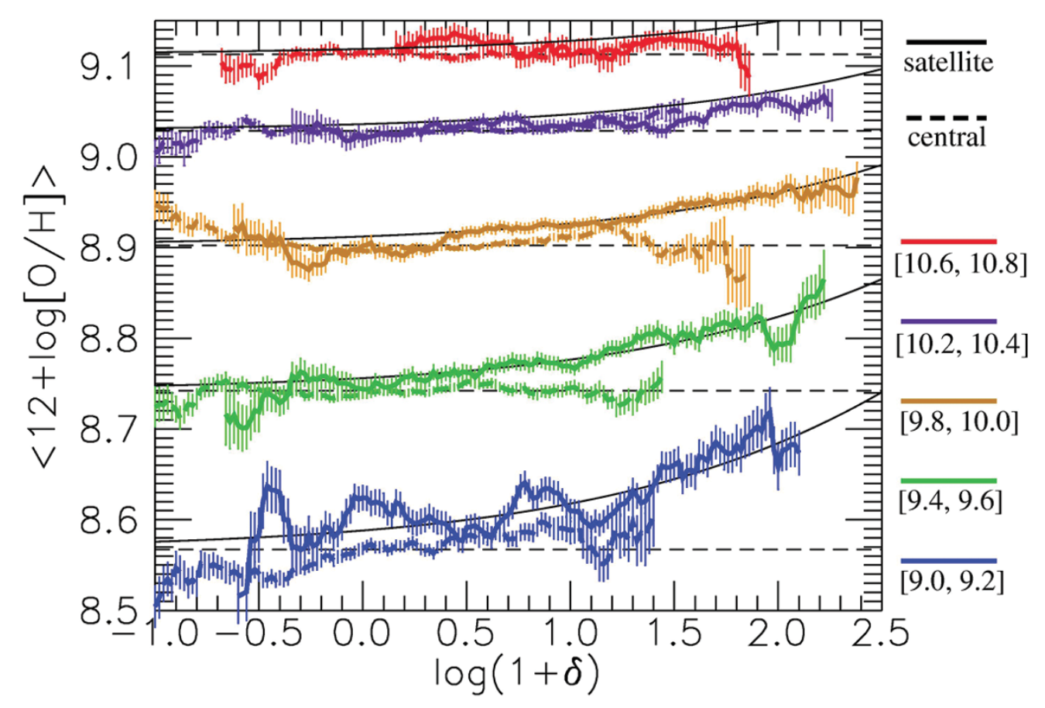
Metallicity and environment – z=0 obs.
The role of
cluster membership:
The role of
environmental density:
Pasquali et al. 2012
Peng et al. 2014

Slide 5
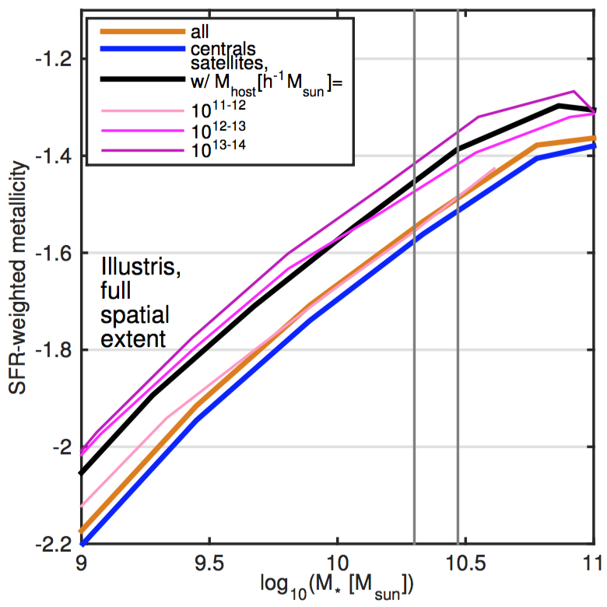
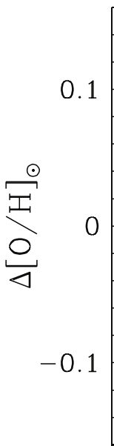
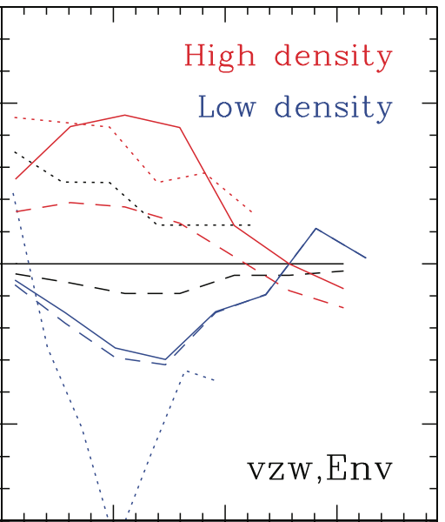
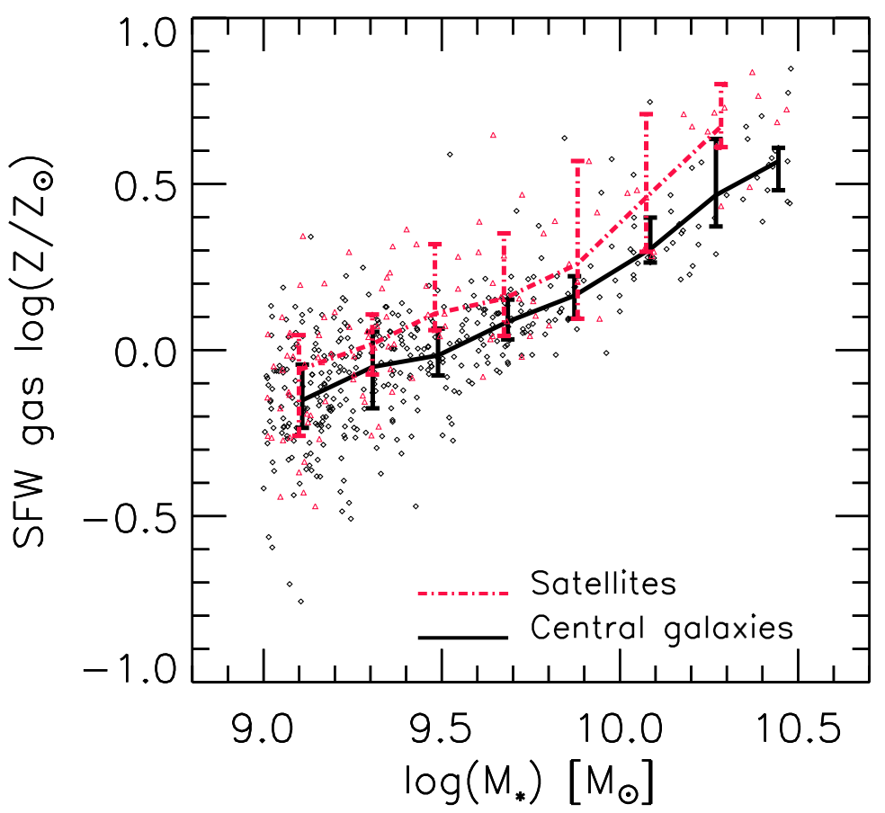
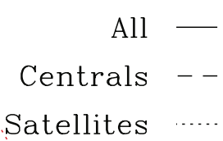
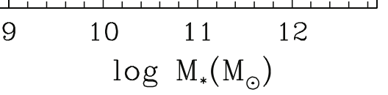
Metallicity of satellites – simulations
Illustris satellites have higher metallicities than centrals, at a given mass, by ≈0.1-0.15dex
Found in other simulations too, but never explained
≈0.15dex
Davé et al. 2012
De Rossi et al. 2015
Illustris
GIMIC
simulations

Slide 6
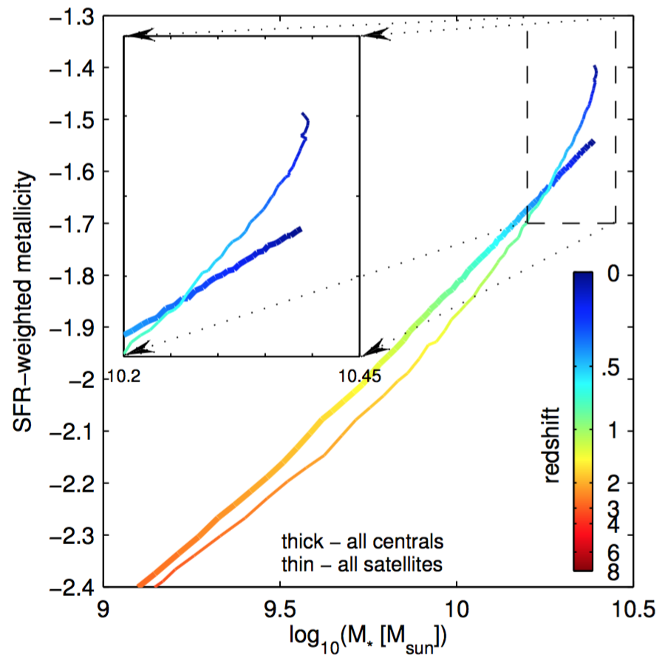
Metallicity evolution in Illustris
Thick – centrals
Thin - satellites
The metallicity of satellites increases at late times with very little increase in mass
Is this driven by the
anti-correlation of metallicity & SFR?

Slide 7
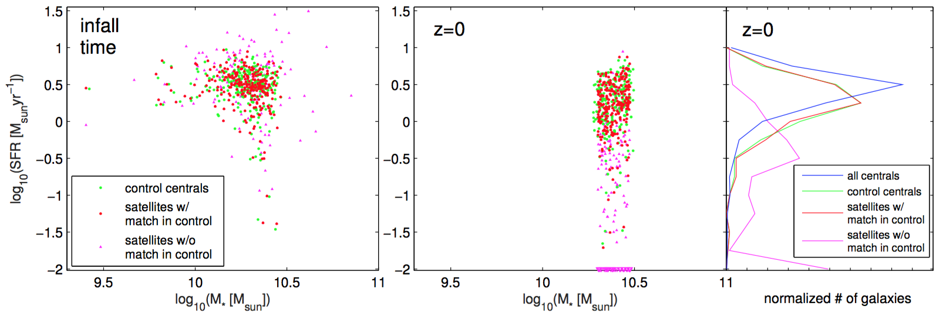
Samples: definitions
Define a control sample of centrals, selected to match the satellites in:
Both mass and SFR
Both at z=0 and at infall time
control
satellites with match in control
satellites without match in control

Slide 8
Samples: the role of SFR history
The metallicity difference between the ‘matched satellites’ and their ‘controls’ accounts for ≈2/3 of the total difference between satellites and centrals → differences in SFR history account for ≈1/3 of the difference
satellites without match in control
Cumulative metallicity
all satellites
satellites with match in control
control
centrals

Slide 9
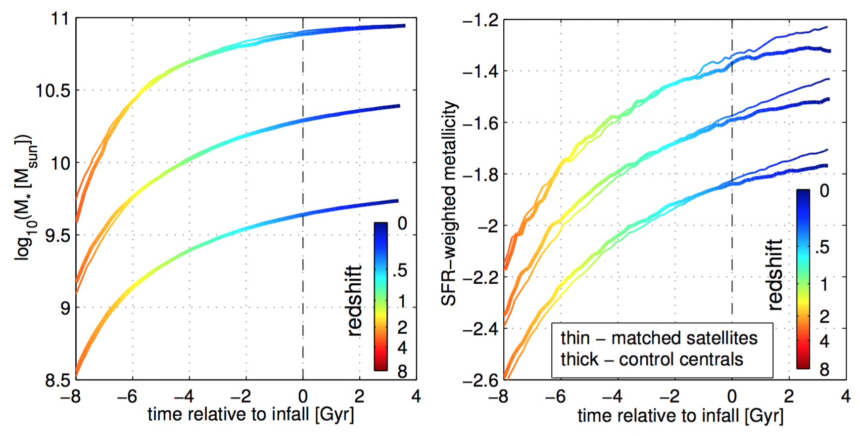
Metallicity evolution in Illustris
The metallicity evolutions of the ‘matched satellites’ and their ‘controls’ diverge after infall time,
approx. by the ‘required’ ≈0.1dex,
in spite of almost identical SFR histories
Thin - satellites with match in control
Thick - control

Slide 10
Metallicity profiles in Illustris
This metallicity difference between the matched samples emerges only in the ‘outer’ part,
while in the inner part the matched samples have the same metallicities
satellites without match in control
Cumulative metallicity
all satellites
satellites with match in control
control
centrals

Slide 11
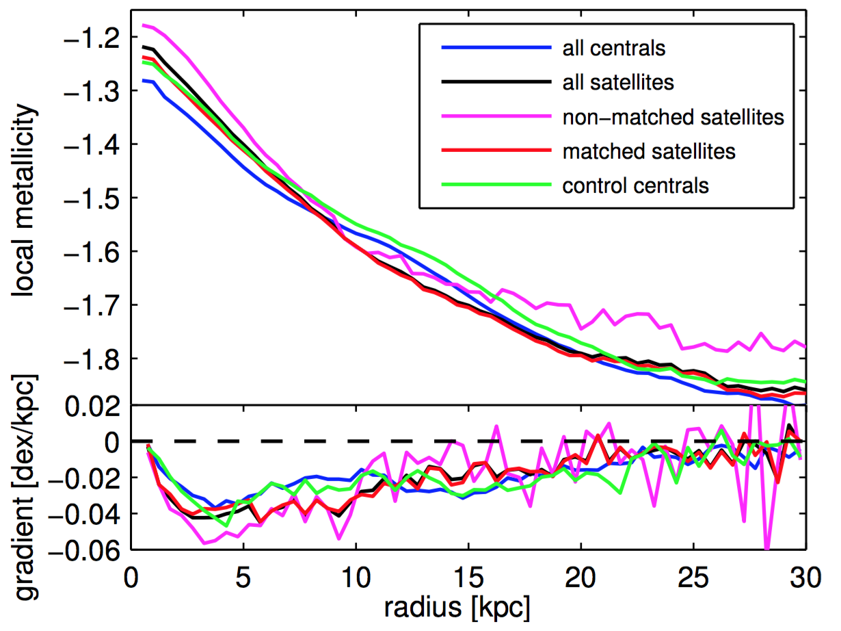
Metallicity profiles in Illustris
The local metallicity of the matched samples is essentially identical
Can only be reconciled through a different weighting of different radii
Enclosed
metallicity
satellites without match in control
Local metallicity
Enclosed metallicity
all satellites
satellites with match in control
control
centrals

Slide 12
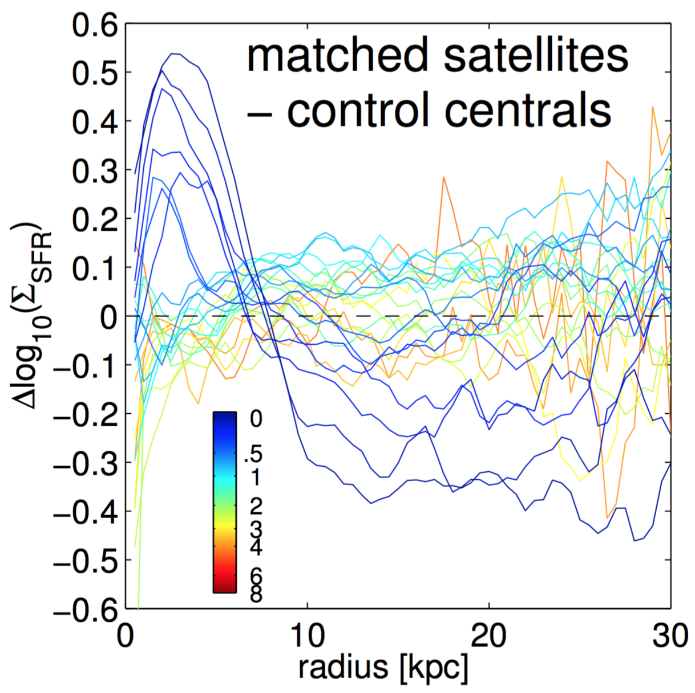
SFR profiles in Illustris
SFR profiles of satellites are more concentrated than those of centrals
The metallicity differences tell us about the physics of star-formation in satellites
Need data to compare to!
(CALIFA? SAMI? MaNGA?)

Slide 13
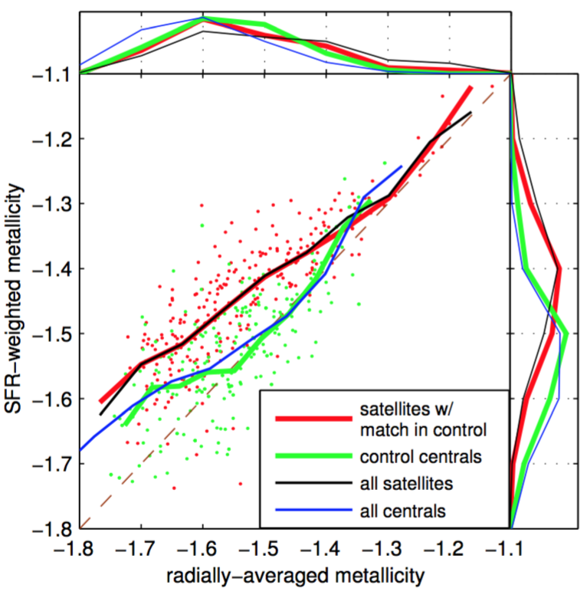
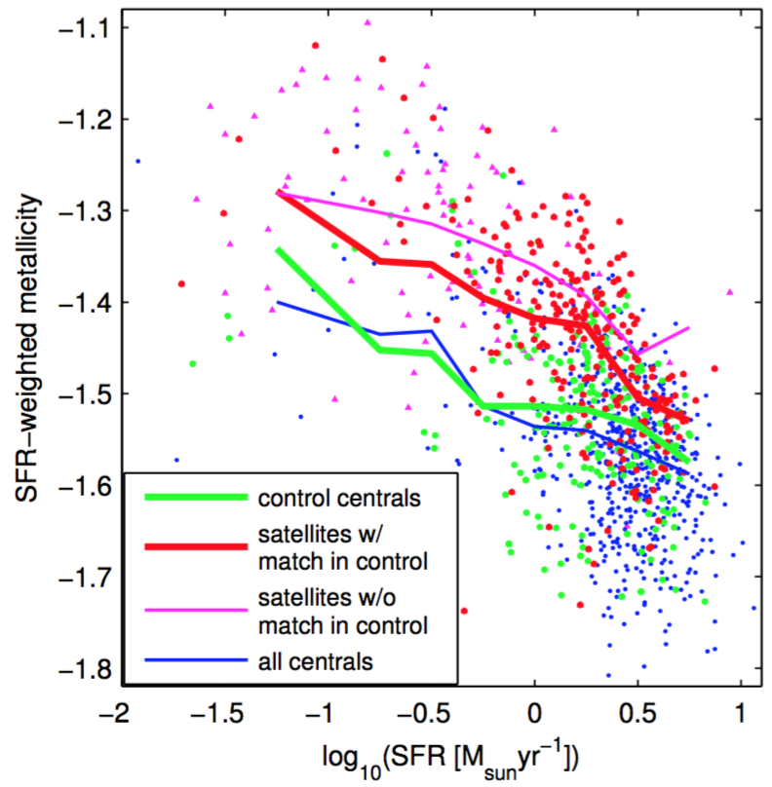
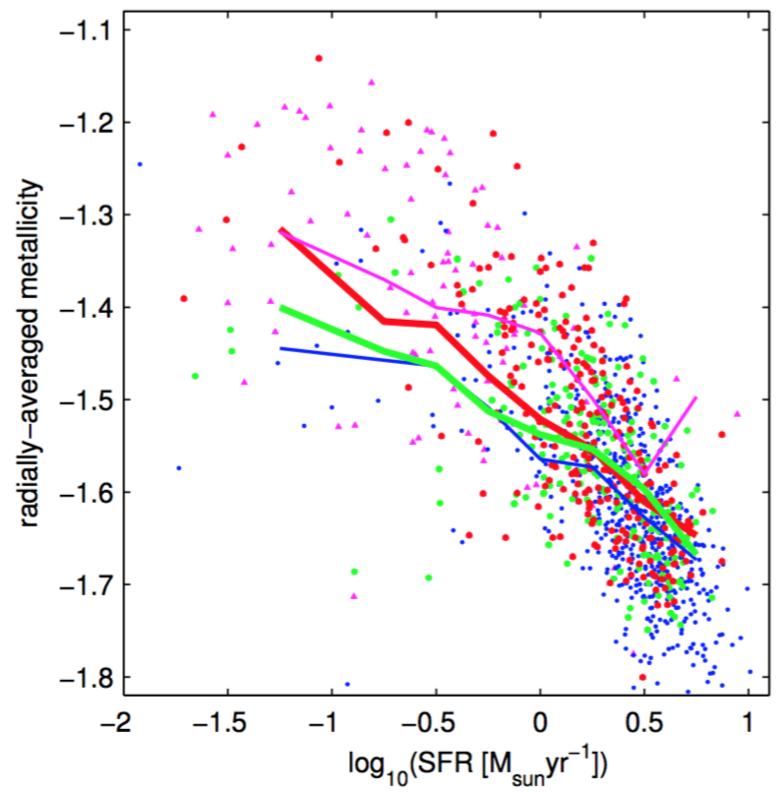
A new definition of metallicity
With a ‘radially-averaged’ metallicity, the gap between the metallicities of the ‘matched satellites’ and their ‘controls’ is almost closed
SFR-weighted
Radially-averaged

Slide 14
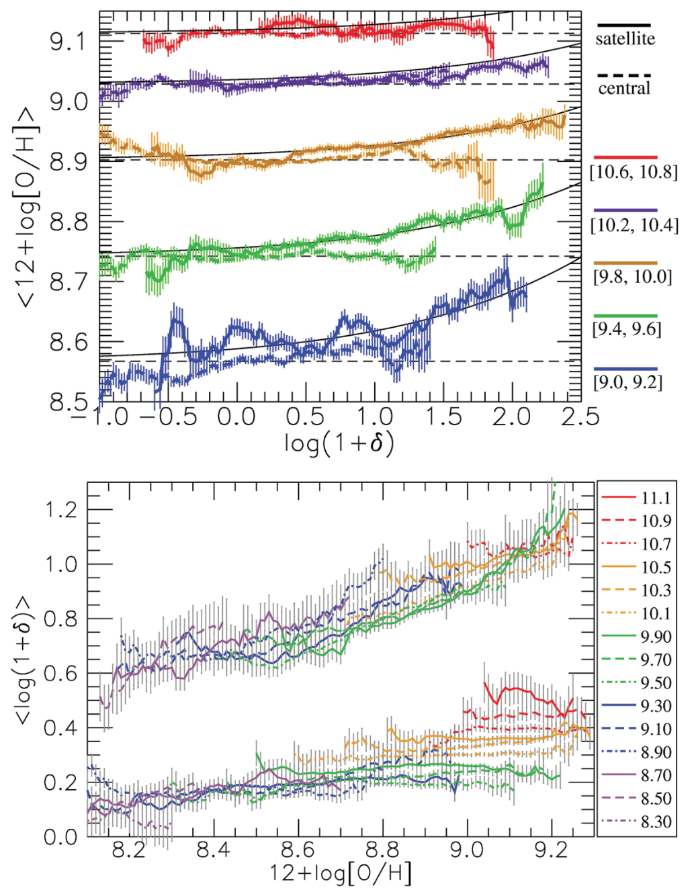
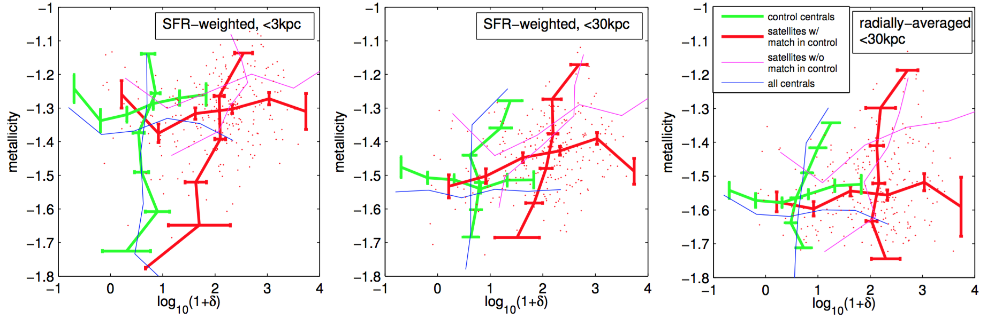
Metallicity and overdensity - Illustris
Metallicity vs. environment &
environment vs. metallicity:
positive correlation for satellites, none for centrals
The effects is weaker for smaller radii, and is gone for the matched samples with radially-averaged metallicity

Slide 15
Conclusions
Correlations between metallicity, galactocentric radius and environment provide independent constraints for models from the popular Z-M-z-SFR relations, and probe the physics of star-formation in satellites
In Illustris, the difference between satellite and central galaxies in terms of the SFR profile dominates the difference in metallicities, due to different weighting of the metallicity gradient
Weaker, ‘local’, metallicity differences are related to overall SFR history
Predictions:
  Radially-averaged metallicity differs less than SFR-weighted
  Smaller differences when considering smaller apertures

