Slide 1
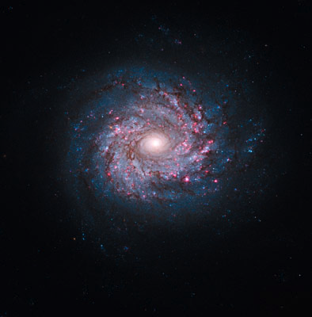
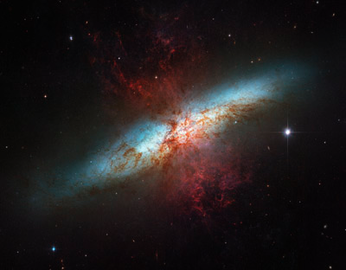
Physical Conditions in the ISM
Lisa Kewley
Australian National University

Slide 2

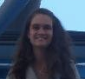



Thank you to the LOC and SOC
Credit
goes to
Jeff Rich
Rebecca Davies
I-Ting Ho
Anne Medling
Elise Hampton
David Nicholls

Slide 3

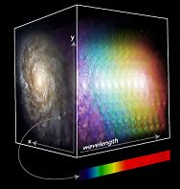
Results in this talk are from:
SAMI: Australian Astronomical Observatory
2016: 3000 galaxies
2025: 100,000 galaxies
(HECTOR)
S7: Australian 2.3m WiFeS
~140 AGN
WIGS: Australian 2.3m WiFeS
~40 U/LIRGS

Slide 4
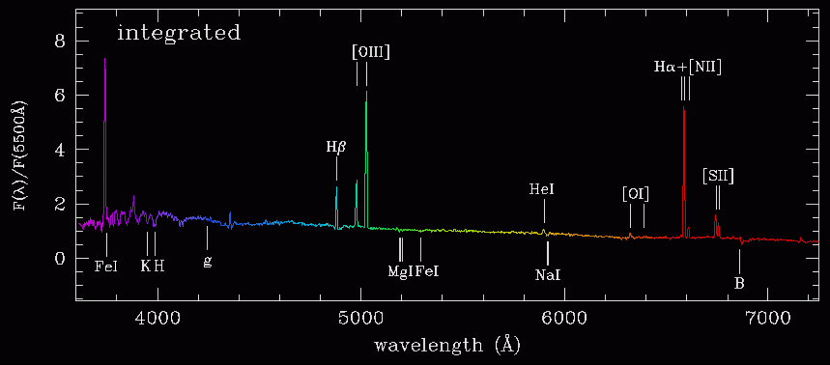
ISM Spectral Diagnostics
[OII]

Slide 5
ISM Spectral diagnostics
Metallicity (amount of metals)
[OII]

Slide 6
ISM Spectral Diagnostics
Metallicity
Star Formation Rate
[OII]

Slide 7
ISM Spectral Diagnostics
Metallicity
Star Formation Rate
Electron Density
[OII]

Slide 8
ISM Spectral Diagnostics
Metallicity
Star Formation Rate
Electron Density
Ionizing Source
[OII]

Slide 9
ISM Spectral Diagnostics
Metallicity
Star Formation Rate
Electron Density
Ionizing Source
Ionization Parameter
[OII]

Slide 10
ISM Spectral Diagnostics
Metallicity
Star Formation Rate
Electron Density
Ionizing Source
Ionization Parameter
Shock properties
[OII]

Slide 11
What can we learn from the ISM?
Gas inflow
AGN
Star formation

Slide 12
What can we learn from the ISM?
Gas inflow
AGN
Star formation
Outflows

Slide 13
What can we learn from the ISM?
Gas inflow
AGN
Star formation
Outflows
Metals

Slide 14
What can we learn from the ISM?
Gas inflow
AGN
Star formation
Outflows
Metals

Slide 15
What can we learn from the ISM?
Gas inflow
AGN
Star formation
Outflows
Metals

Slide 16
What can we learn from the ISM?
?
Gas inflow
AGN
When? How much?
Mechanism?
?
Star formation
Outflows
Metals

Slide 17
What can we learn from the ISM?
?
Gas inflow
AGN
When? How much?
Mechanism?
?
How common?
How much mass loss?
?
?
Star formation
Outflows
How common?
How much mass loss?
Metals

Slide 18
What can we learn from the ISM?
?
Gas inflow
AGN
When? How much?
What mechanism?
?
How common?
How much mass loss?
?
?
Star formation
Outflows
How common?
How much mass loss?
?
How do metals
Build up in disks?
Metals

Slide 19
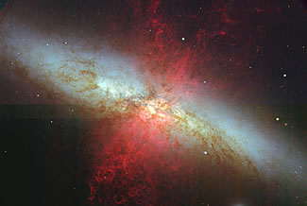
What can we learn from the ISM?
?
Gas inflow
AGN
When? How much?
What mechanism?
?
How common?
How much mass loss?
?
?
Star formation
Outflows
How common?
How much mass loss?
?
How do metals
Build up in disks?
?
Metals
How much
Metals/mass
lost? Effect on
Host?

Slide 20
What can we learn from the ISM?
?
Gas inflow
AGN
?
How common?
How much mass loss?
?
Connection?
?
Star formation
Outflows
How common?
How much mass loss?
?
How do metals
Build up in disks?
?
Metals
How much
Metals/mass
lost? Effect on
Host?

Slide 21
Gas Inflows through IFU data
?
Gas inflow
AGN
?
?
Connection?
?
Star formation
Outflows
?
?
Metals

Slide 22
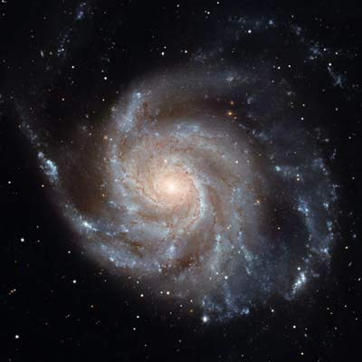
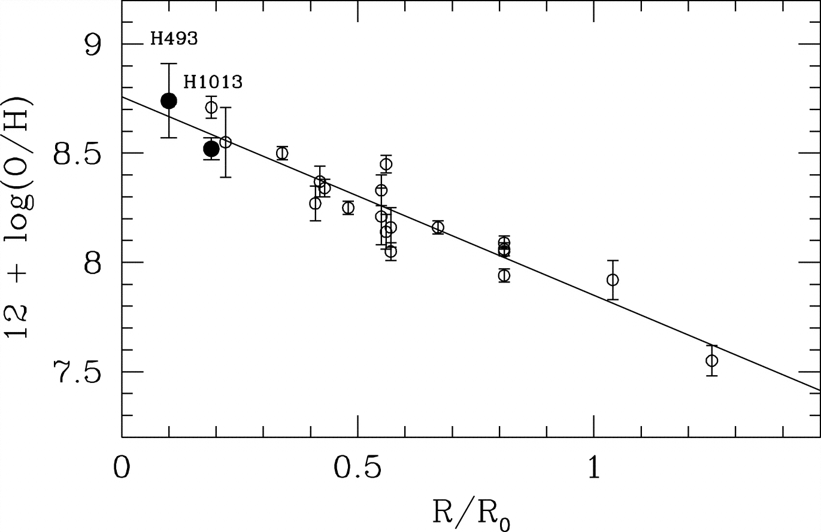
Spiral Galaxy Metallicities
HST view of M101
Image credit: Kunz et al. 2009
Bresolin (2007)

Slide 23
Inflows flatten gas-phase gradients
Gas flows down spiral arms
HST view of M101
Image credit: Kunz et al. 2009
Nuclear
metallicity diluted with pristine gas
Bresolin (2007)

Slide 24
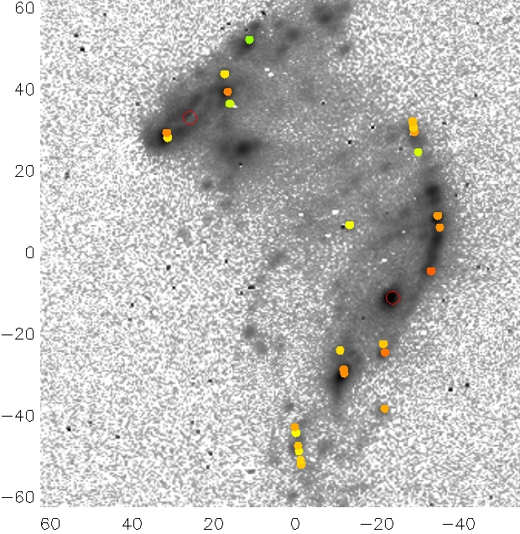
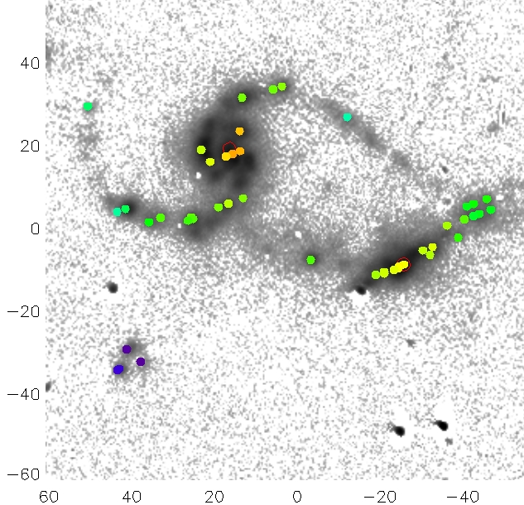
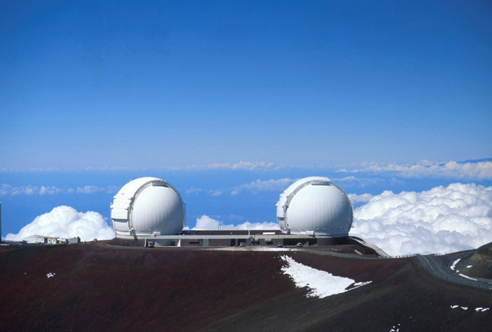
Metallicity Gradients:
A Smoking Gun for
major gas inflows
Isolated
Kewley et al. (2010, ApJL, 131, 2004)
Dotted, dashed
= mergers

Slide 25
Gas Inflows flatten gradients in U/LIRGs
Rich et al. 2012, ApJ, 753, 5
Using the ANU
WiFeS IFU
Also: Kewley+06,+10, Rosa+14,
Husemann+14, Ho+15
Isolated
Wide
Pair
Close
Pair
Late
Merger

Slide 26
Metallicity gradients in QSOs
Sanchez+12
Normal spiral gradient
Husemann+14

Slide 27
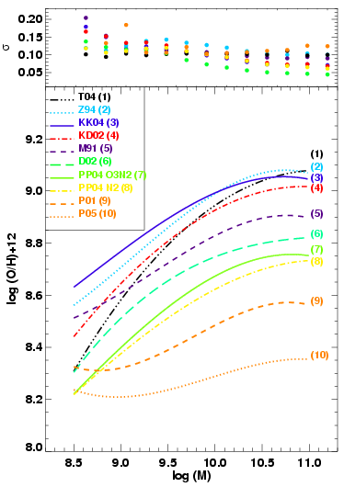
Side note on metallicity diagnostic discrepancies...
Kewley & Ellison (2008)

Slide 28
Metallicity Diagnostic Discrepancies... it is a bit like US politics

Slide 29

Metallicity Diagnostic Discrepancies... it is a bit like US politics

Slide 30

Metallicity Diagnostic Discrepancies... it is a bit like US politics

Slide 31

Metallicity Diagnostic Discrepancies... it is a bit like US politics

Slide 32

Metallicity Diagnostic Discrepancies... it is a bit like US politics

Slide 33

Metallicity Diagnostic Discrepancies... it is a bit like US politics

Slide 34
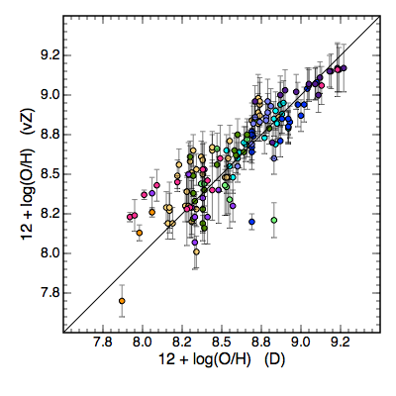
Resolution of discrepancies
Empirical Methods
e⁻ temperature fluctuations / gradients
- e⁻ temperature distribution
Strong Line Methods
- atomic data
- relative abundances
- depletion factors
- e⁻ temperature distribution
Nicholls et al.
(2012, 2013,
2016 in prep)

Slide 35
ISM conditions
?
Gas inflow
AGN
?
?
Connection?
?
Star formation
Outflows
?
?
Metals

Slide 36
Optical Diagnostic Diagram
log([OIII]/Hβ)
log([NII]/Hα)

Slide 37
Star-forming Abundance Sequence
Sensitive to:
Metallicity (Z)
Ionization parameter (q)
Electron density (n_{e})
Hardness of EUV
radiation field

Slide 38
Star-Forming Abundance Sequence
Kewley et al.
2013a, ApJ, 774, 110

Slide 39
AGN Mixing Sequence
Shape and position from:
Metallicity (Z)
Ionization parameter (q)
Power-law index (α)
(EUV hardness)

Slide 40
Photoionization Models
AGN position
& metallicity
Low Metallicity
AGN locus
depends
on metallicity
Kewley et al.
2013a, ApJ, 774, 110
High Metallicity

Slide 41
AGN Mixing Sequence
Shape and position from:
Metallicity
Metallicity (Z)
Ionization parameter (q)
Power-law index (α)
(EUV hardness)

Slide 42
AGN Mixing Sequence
Shape and position from:
Metallicity
Metallicity (Z)
Ionization parameter (q)
Power-law index (α)
(EUV hardness)

Slide 43
AGN Mixing Sequence
Shape and position from:
Ionization
parameter
Metallicity (Z)
Ionization parameter (q)
Power-law index (α)
(EUV hardness)

Slide 44
AGN Mixing Sequence
Shape and position from:
Ionization
parameter
Metallicity (Z)
Ionization parameter (q)
Power-law index (α)
(EUV hardness)

Slide 45
AGN Mixing Sequence
Shape and position from:
Ionization
parameter
Metallicity (Z)
Ionization parameter (q)
Power-law index (α)
(EUV hardness)

Slide 46
AGN Mixing Sequence
Shape and position from:
EUV
Hardness
Metallicity (Z)
Ionization parameter (q)
Power-law index (α)
(EUV hardness)

Slide 47
AGN Mixing Sequence
Shape and position from:
EUV
Hardness
Metallicity (Z)
Ionization parameter (q)
Power-law index (α)
(EUV hardness)

Slide 48
Nuclear spectra of 45,000 galaxies
Each data
Point is one
galaxy

Slide 49
Integral field spectra of one galaxy
Each data
Point is one
Spaxel
(spatial
pixel)

Slide 50
Integral field spectra of one galaxy
Each data
Point is one
Spaxel
(spatial
pixel)

Slide 51
Star formation vs AGN
Composite spaxels form
a clean ring of mixed
Starburst-AGN activity
Davies, Rich, Kewley & Dopita
(2014, MNRAS, 439, 3835)

Slide 52
IFU + Photoionization models
NLR radius
AGN contribution to each line
Subtraction of AGN (SFR, metallicities)
Subtraction of starburst (AGN luminosity, Eddington rate)
Measurement of AGN NLR properties (metallicity, U, α)

Slide 53
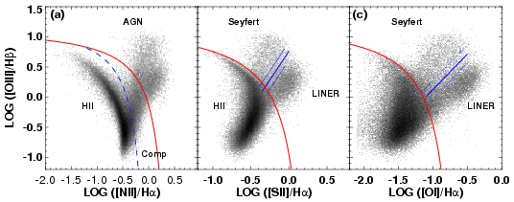
Composite Galaxies
Kewley et al. 2006

Slide 54
Composite Galaxies
Kewley et al. 2006

Slide 55
Composites are not Starburst+Sy2
They are mostly
Starburst + shocks
Hampton et al. (2016)

Slide 56
Gas Inflows through IFU data
?
Gas inflow
AGN
?
?
Connection?
?
Star formation
Outflows
?
?
Metals

Slide 57
Tracing Outflows with Shocks in SAMI
HII
Three velocity
dispersion peaks
??
Shocks
Ho et al. (2014); see also Ho et al. (2016)

Slide 58
SAMI Shocks: an isolated SF galaxy
Shocks
HII
??
log([NII]/Hα)
Ho et al. (2014); see also Ho et al. (2016)

Slide 59
SAMI Shocks: an isolated SF galaxy
Shocks
??
HII
log([NII]/Hα)
Ho et al. (2014); see also Ho et al. (2016)

Slide 60
SAMI Shocks: an isolated SF galaxy
HII
??
Shocks
Shock Mechanical luminosity = 10⁴² ergs/s
Starburst mechanical luminosity = 10⁴² – 10⁴³ ergs/s
Ho et al. (2014); see also Ho et al. (2016)

Slide 61
Shocks in mergers
Rich, Kewley
& Dopita,
(2014, ApJL,
781, 12)
These shocks
are from
star formation only
AGN contain <30%
shock contribution
Star
Formation
Shocks
Late
Merger
Isolated
Wide
Close

Slide 62
Cause of shocks?
“Zoom-in” IFU
Observations
Wide field +
narrow high res.
e.g., Medling et al.
2015, MNRAS, 448, 2301

Slide 63
Causes of shocks?
This galaxy:
Disk collision
(small scale)
+ starburst driven winds (large-scale)
Medling et al.
2015, MNRAS, 448, 2301
Notes:
Top Left: Continuum flux map of the central region of IRAS ′′ −1
F17207-0014 at high spatial sampling (0. 035 spaxel ) in the H n4
band (1.652–1.737 μm). The major axes of the two nuclear disks identi-
fied in Medling et al. (2014) are overlaid in black for context. Top Right:
H2/Brγ flux ratio calculated from two bottom panels, with continuum con-
tours overlaid; ratios indicate strong shocks (> 4) to the south surrounded
by a diffuse background of moderate shocks (> 0.6). Bottom Left: H2 2.12 ′′ −1
μm flux map (spatial sampling 0. 1 spaxel ) with contours from contin- uum overlaid. Bottom Left: Bottom Right: Brγ flux map (spatial sampling
′′ −1 0. 1 spaxel ) with continuum contours overlaid.

Slide 64
Summary: Science
Inflows & Metals: Metallicity gradient flattening
Dramatic signpost for galactic-scale gas inflows
Outflows: Shocks dominant at late merger stages
Outflows are starburst-driven or caused by gas
collisions.
Starburst-AGN: clean mixing sequences
Separation of starburst & Sy2 contribution
but composites are starburst+shocks

Slide 65
Summary: Techniques
IFU multiplexing: galaxy dissection
Large IFU Surveys with AGN (SAMI, MANGA, S7)
Physical Process Diagnostic Tools
Fuelling (Inflows) metallicity gradients, kinematics
Feedback (Outflows) shocks, kinematics
Starburst vs AGN line ratio mixing sequences
AGN properties line ratios, AGN models

Slide 66
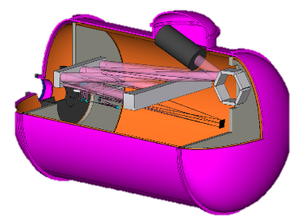
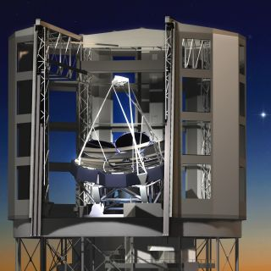
Future: Next Generation Telescopes
e.g., GMTIFS
z=2
Separation of SF, shocks
& AGN with
rest-frame
optical diagnostics
z>3
SF, shocks, AGN
Using lensing and UV
diagnostics

Slide 67
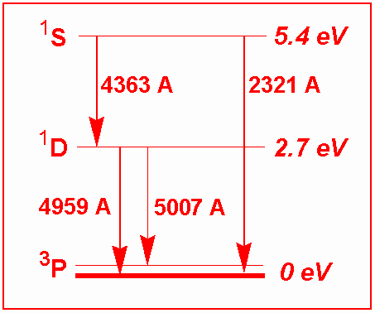
Background: Metallicity - Auroral Lines
[OIII] λ4363, [NII] λ5755, [SIII] λ6312, [OII] λ7325
Advantages:
Strong function of T_{e}
Direct
Disadvantages:
Weak
Saturation
T_{e} fluctuations

Slide 68
Empirical
Metallicity
Diagnostics
e.g., Pettini & Pagel (2004)
Pilyugin et al. (2001)
Assumes ISM conditions are same as local HII regions

Slide 69
Metallicity - Strong Lines
[OII] λ3727, [OIII] λ5007, [NII] λ6584, ...
Advantages:
Strong lines
No saturation
Disadvantages:
Model dependant
(Geometry, dust parameters,
abundance set, ionizing radiation field)

Slide 70
Metallicity
Diagnostic
Discrepancies
Kewley & Ellison (2008)
SDSS mass-metallicity
relation
Tremonti et al. (2004)

Slide 71
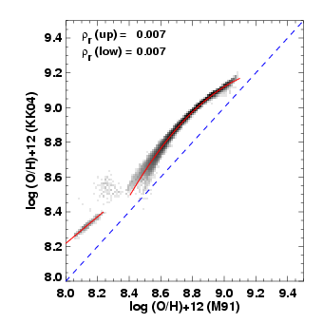

The current solution to metallicity calibration problems
Kewley & Ellison (2008)

Slide 72
Resolution of discrepancies?
Empirical Methods
e⁻ temperature fluctuations / gradients
- Kappa e⁻ temperature distribution
Strong Line Methods
- atomic data
- relative abundances
- depletion factors
- Kappa e⁻ temperature distribution
Nicholls et al. (2012, 2013)

