Slide 1
The impact of galactic fountain on disc evolution
Filippo Fraternali
Department of Physics and Astronomy, University of Bologna, I
Kapteyn Astronomical Institute, University of Groningen, NL
L. Armillotta (Bologna), J. Binney (Oxford), A. Marasco (Groningen), F. Marinacci (MIT)

Slide 2

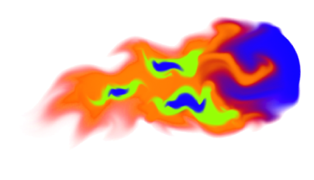
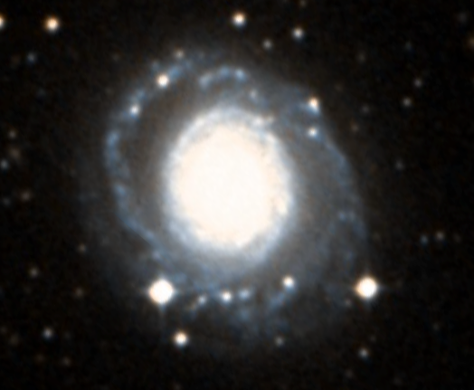
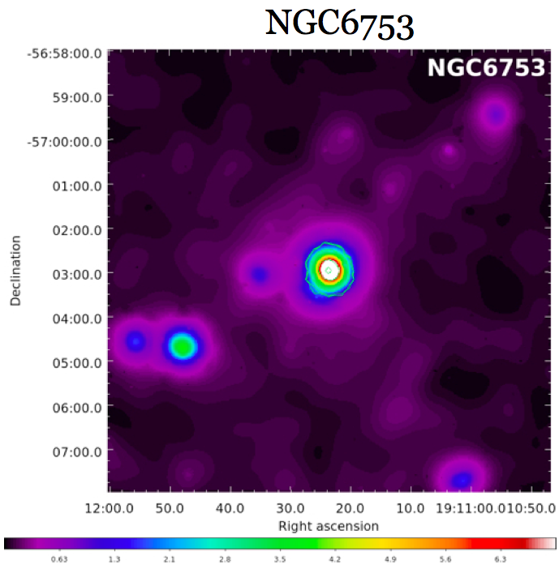
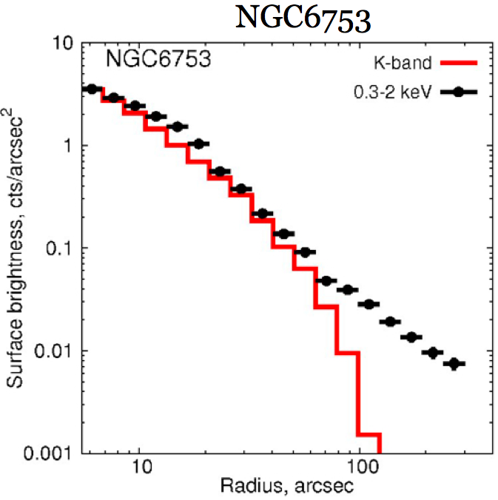
Disc-corona interplay
Interface layer:
disc and corona mix
Low-Z hot corona
Mixing: disc & coronal gas
Condensation knots
Short cooling time
Accretion
SNe
Cold disc
Anderson & Bregman 2012
Dai+ 2012, Anderson+ 2013
MW Miller & Bregman+ 2013, 2015; Gatto+13
Mass corona
~ 10-50% missing baryons
Cooling rate ~ 0.1 Mo/yr
~60 kpc
Bogdan+ 2012

Slide 3
Global process:
Fountain-driven gas accretion

Slide 4
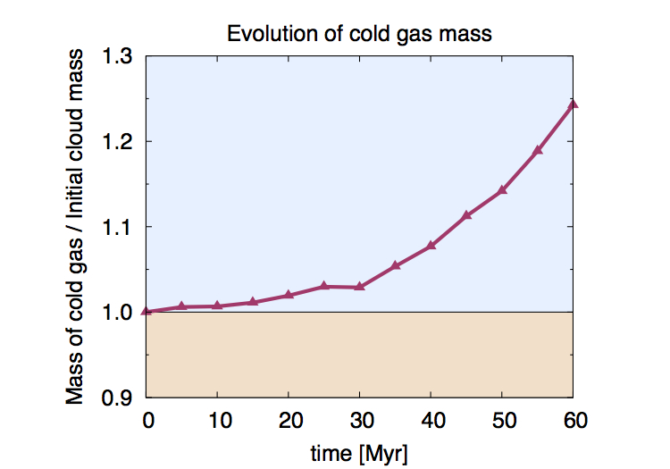

Disc-cloud corona interaction
T_{corona}=2x10⁶ K
Z_{corona}=0.1 Z
1 pc x 1 pc Grid!
Z_{cloud}=1 Z
2.0
1.5
CONDENSATION
1.0
EVAPORATION
0.5
1.0
3.0
5.0
7.0
Mass of cold gas increased by ~20%!
X (kpc)
Marinacci, et al. 2010, 2011, MNRAS
Lucia Armillotta

Slide 5
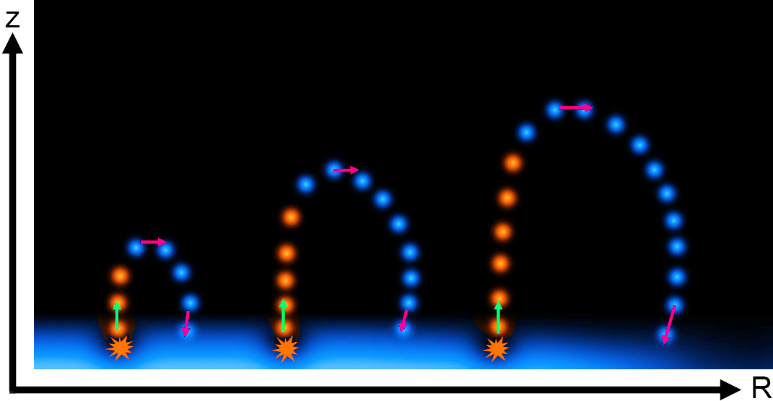
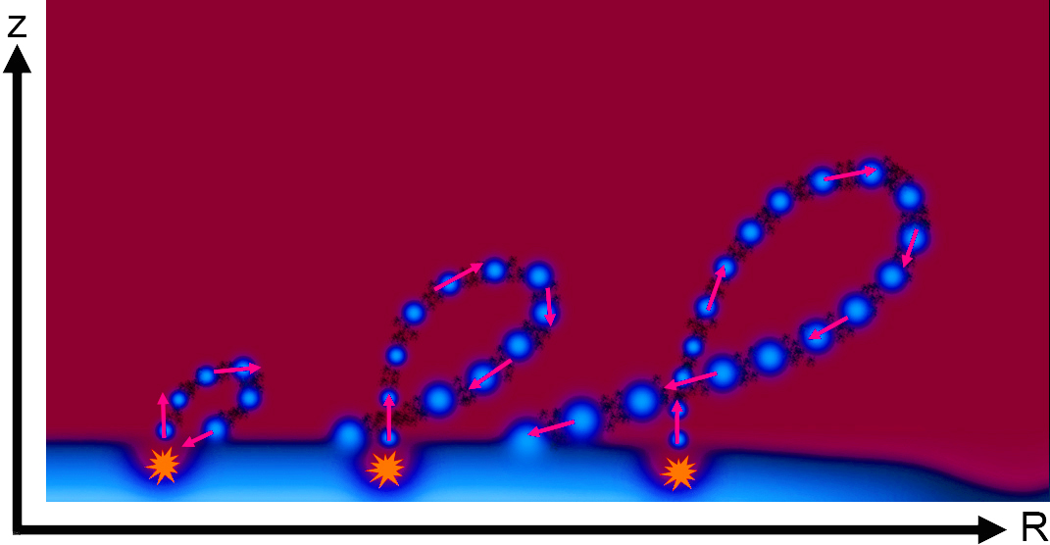
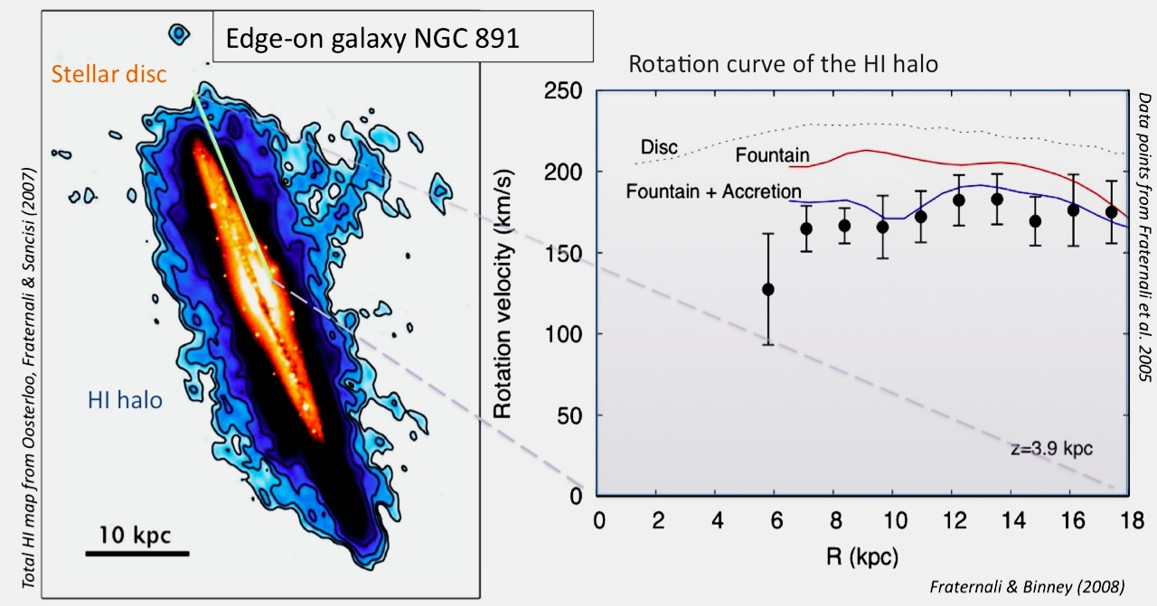
Global fountain
Pure fountain
Fountain + accretion
Neutral
Ionised
Best-fit Accretion Rate ~ 3 Myr⁻¹
Compare to SFR ~ 4 Myr⁻¹
Fraternali & Binney 2008, MNRAS; Marinacci, Fraternali+ 2011, MNRAS

Slide 6
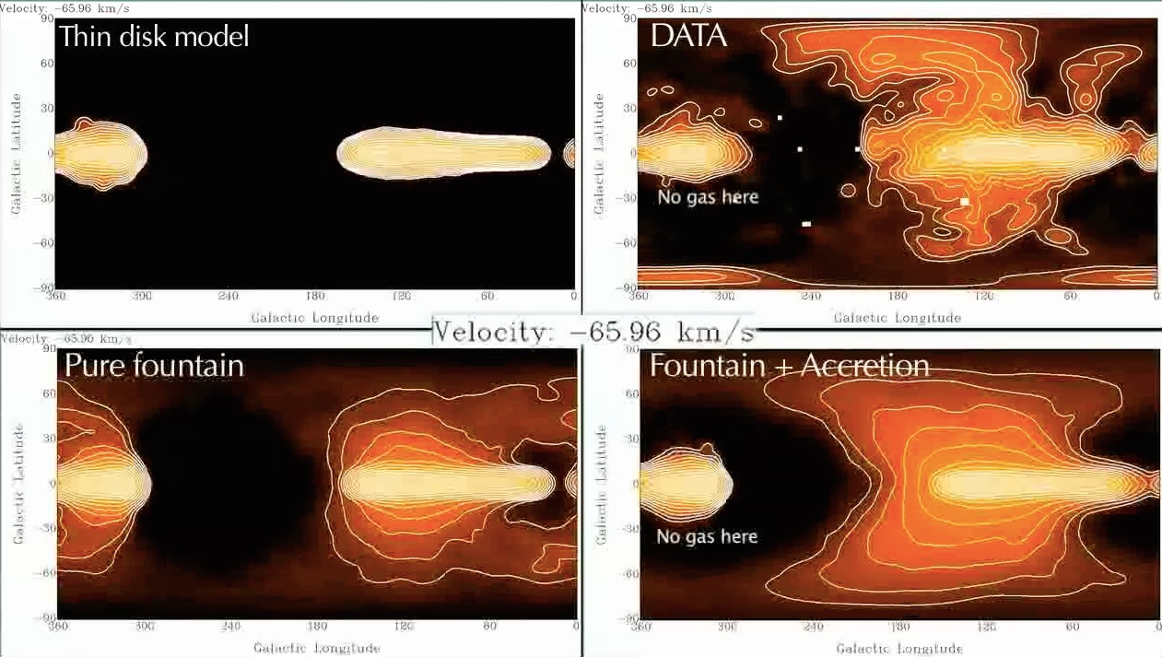
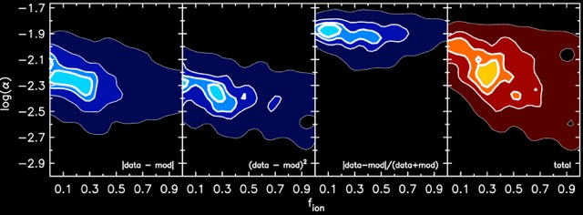
Extraplanar HI in the Milky Way
2.5
2.0
Accretion rate (M/yr)
1.5
1.0
Galactic fountain triggers cooling at the disk-corona interface:
Feeding star formation!
0.1 0.3 0.5 0.7 0.9
Ionization fraction
Marasco, Fraternali & Binney 2012, MNRAS
Best-fit Accretion Rate ~ 2 Myr⁻¹
Compare to SFR ~ 1-3 Myr⁻¹

Slide 7
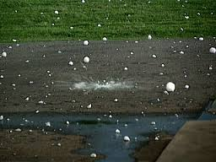
Local process:
Galactic hail: origin of the High Velocity Cloud complex C

Slide 8
Origin of HVCs
Oort 70 leftover of galaxy formation
Bregman 80 Galactic fountain
+ satellites (Olano 2001), thermal instabilities (Kaufmann+ 06), no thermal instabilities (Binney+ 09), filaments (Fernandez+ 12)
Wakker+ 1999, Nat
Z~0.1 Solar -> Accretion!
Gibson+ 2001 Z~0.3 Accretion?
Collins+ 2007 overabundance α elements (SN II?)

Slide 9
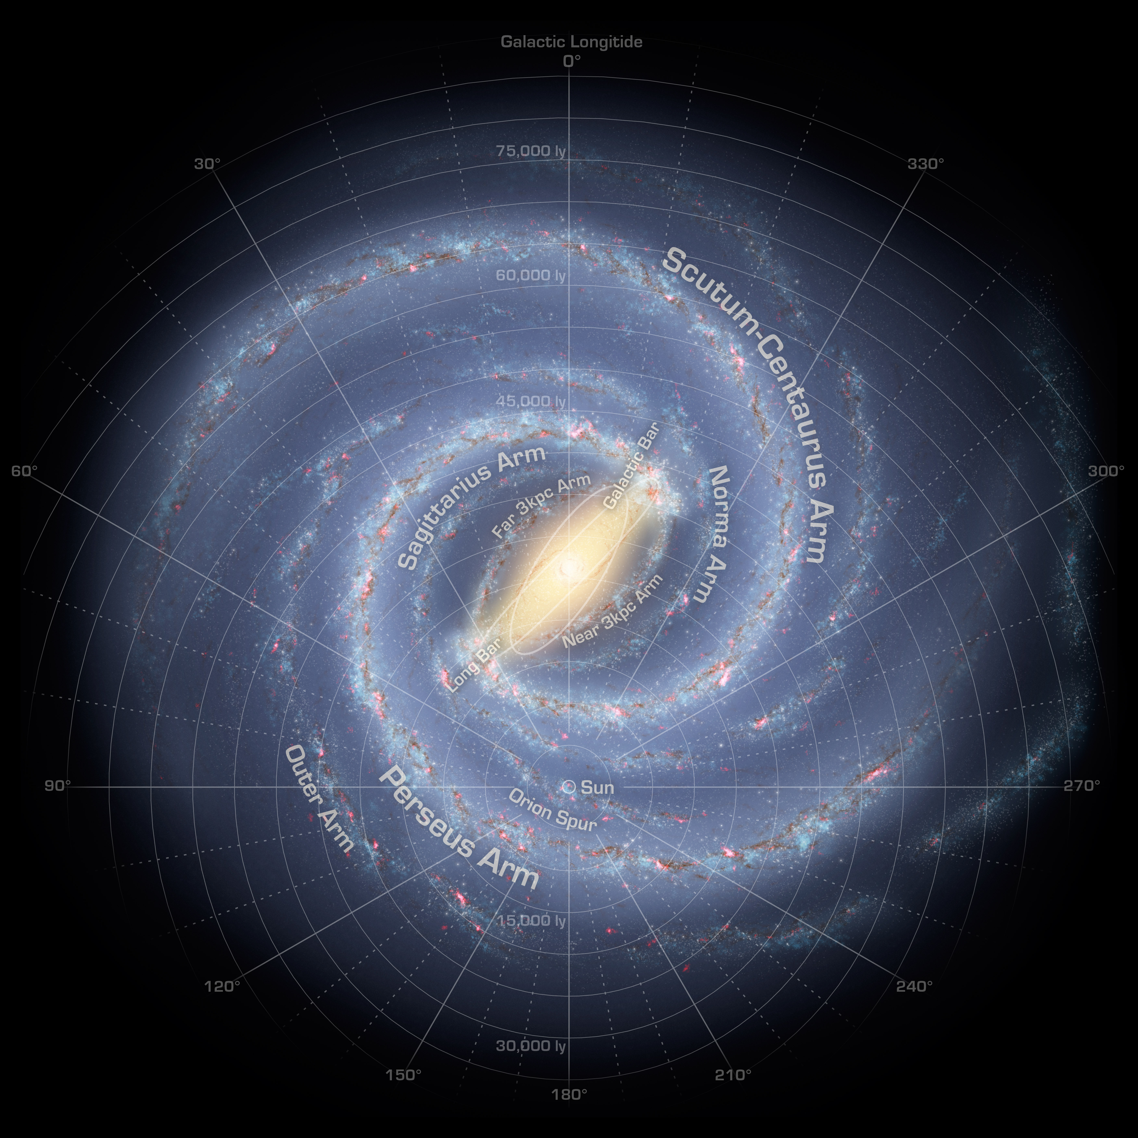
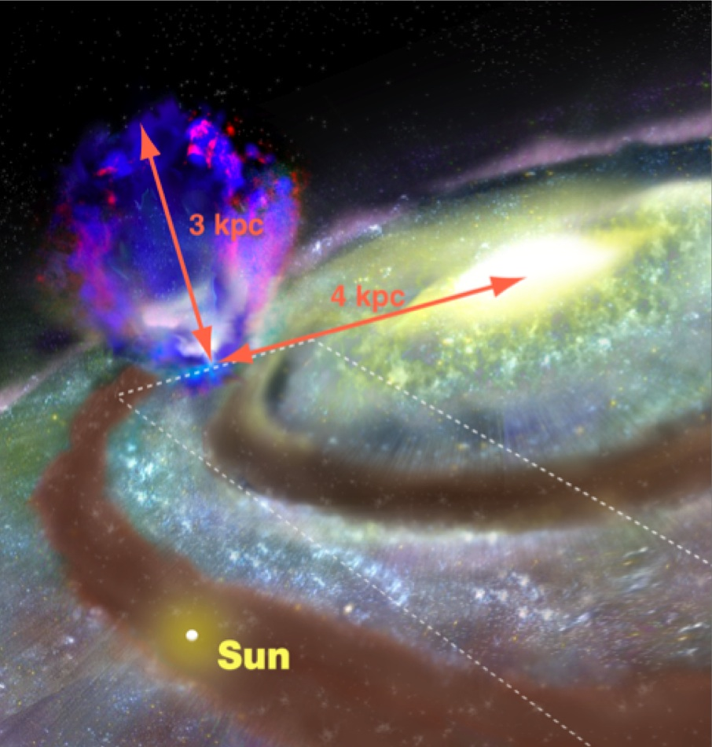
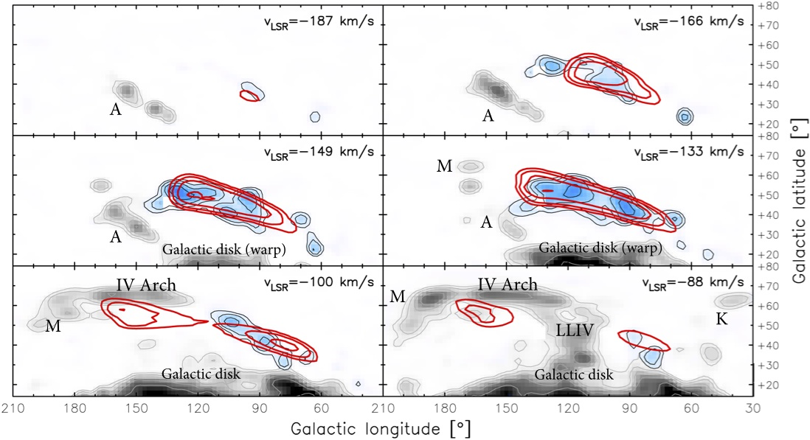
Formation of complex C
Six free parameters:
V₀ = ejection velocity
R₀ = ejection location
δR = size of the ejection
t₀ = time of ejection
Δt = duration
Condensation parameter
Fraternali, Marasco, Armillotta, & Marinacci 2015, MNRAS Letter, 447, 70

Slide 10
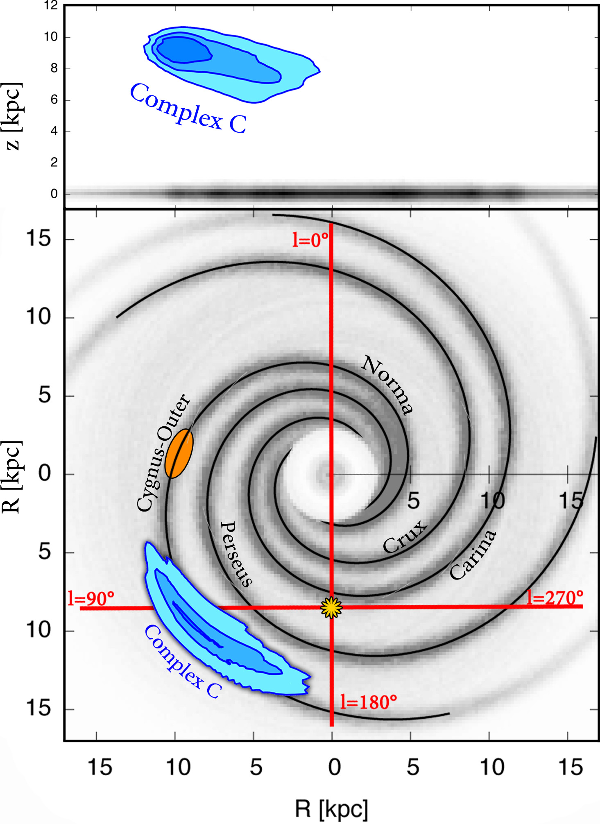
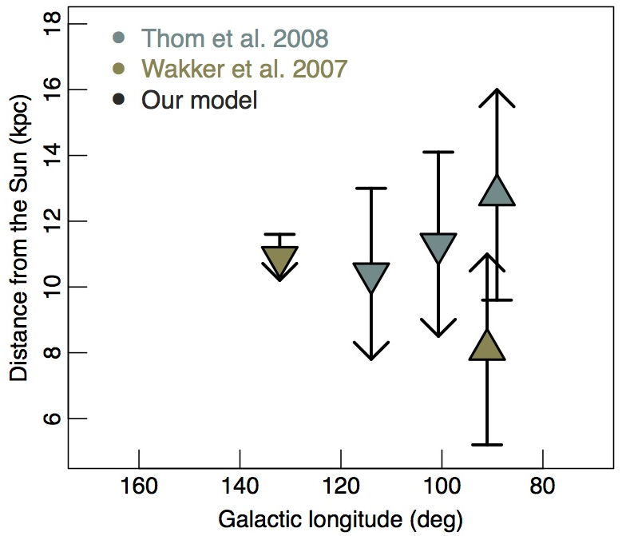
Origin & Location of complex C
Distance from the Sun
The distance is a completely independent confirmation
E_{kin} ~ 2 x 10⁵⁴ erg

Slide 11
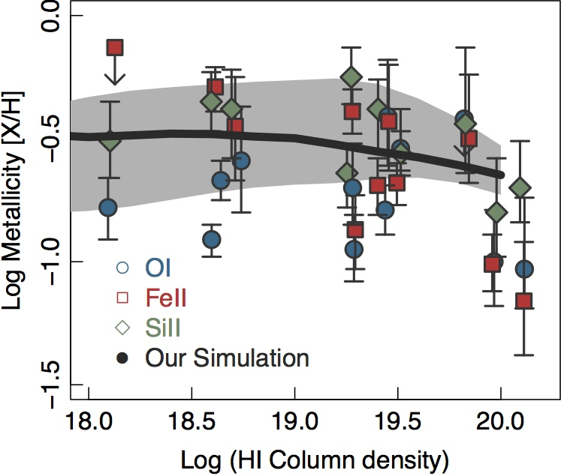
Hydrodynamical simulations
Complex C formed by a superbubble + corona condensation
Local manifestation of fountain-driven accretion
Average metallicity at the end: 0.27 Solar
Compared to complex C: 0.1-0.3 Solar

Slide 12
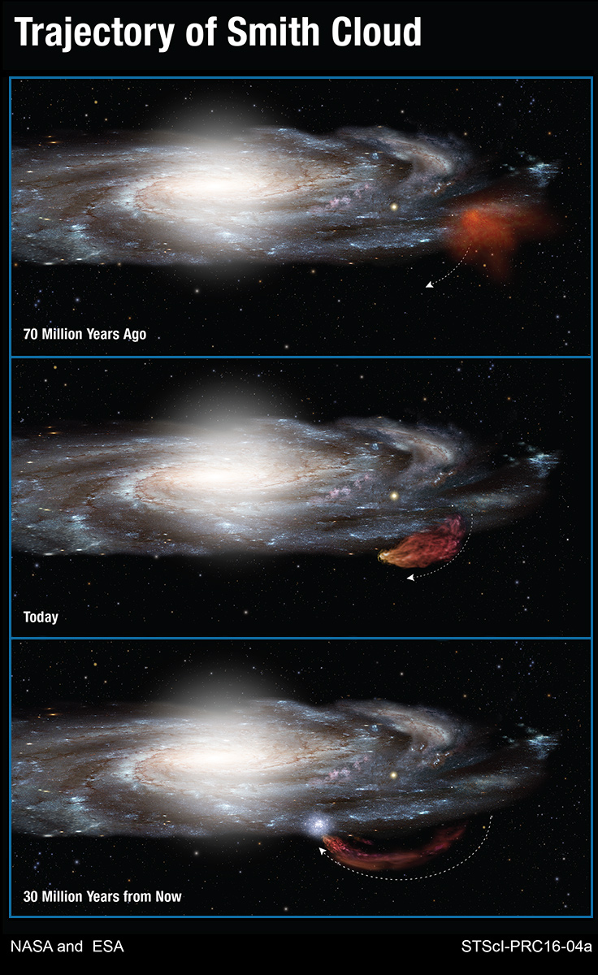
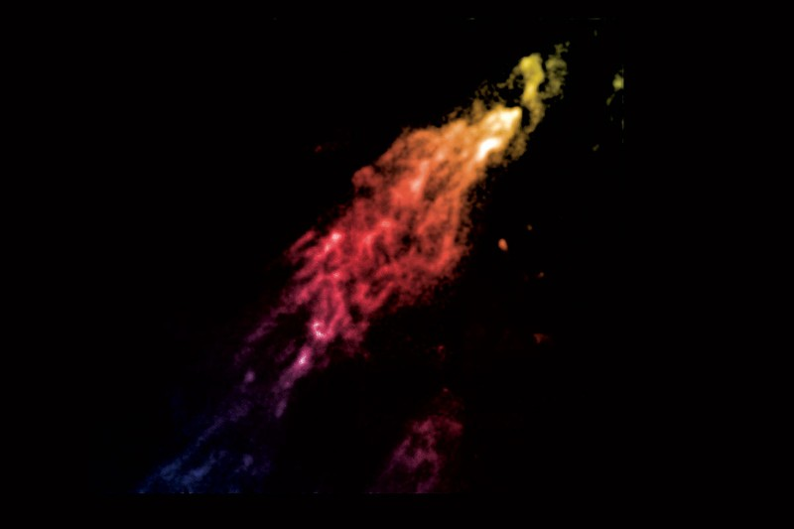
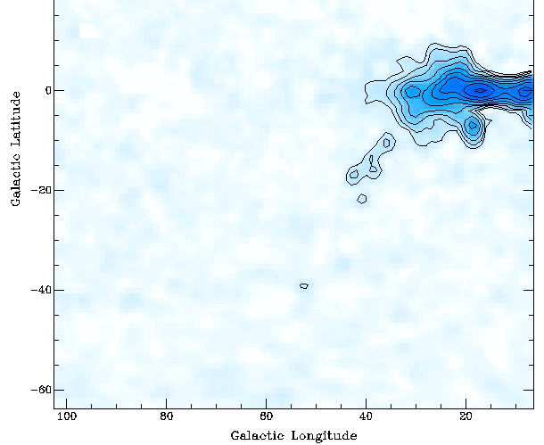
Smith cloud
Preliminary!
Metallicity ~ 0.53 Solar
Mixture of Galactic fountain and external material
Fox et al. 2016, ApJL
Marasco, Fraternali+

Slide 13
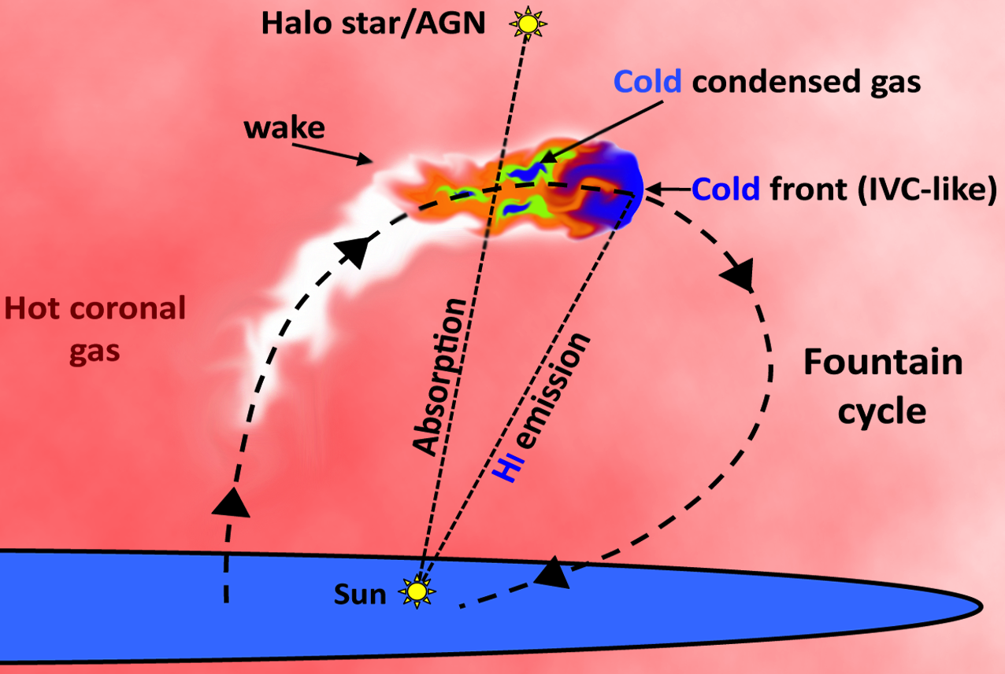
Conclusions
Galactic fountain can cool the corona and feed the star formation in disc galaxies like the MW
Local features like HVCs can form (condense) out of this non-linear perturbation of the corona
Very good fit for the prototypical complex C, promising results for Smith cloud

Slide 14


Slide 15
Thanks

Slide 16
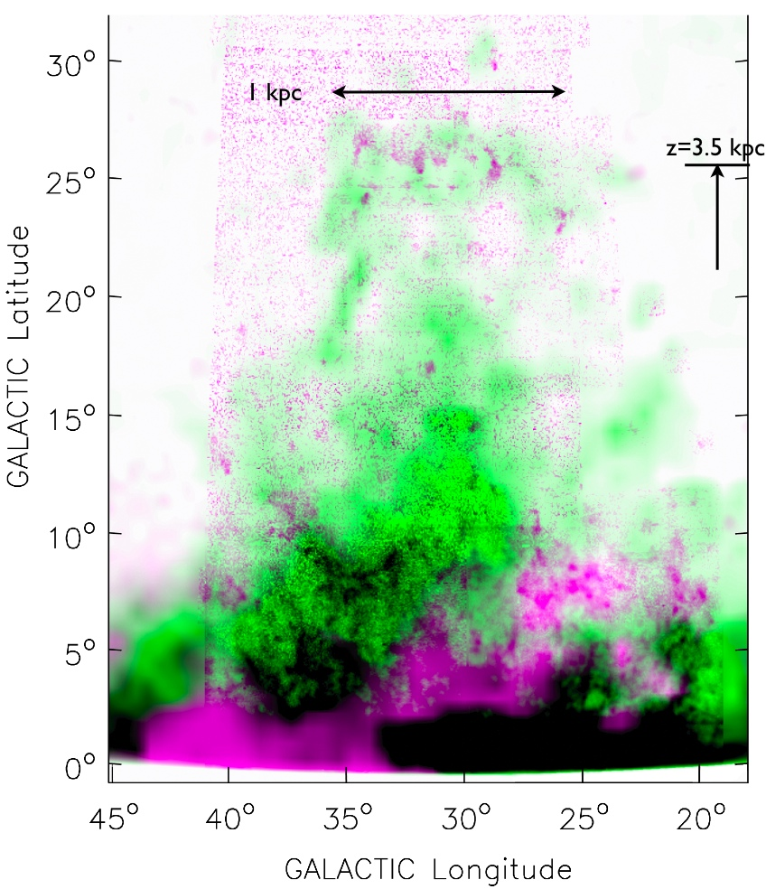
Ophiucus superbubble
Purple HI
Green Halpha
Energy to produce the holes:
E ~ 1 x 10⁵³ – 1 x 10⁵⁵ erg
Pidopryhora et al. 2007, ApJ
Boomsma et al. 2008, A&A

Slide 17
Our galactic fountain model
High Velocity Clouds
V_{LSR}= - 144 km/s
Intermediate Velocity Clouds
V_{LSR}= - 66 km/s
Marasco, Fraternali & Binney 2012, MNRAS

Slide 18
Effect of spiral arms
Two limitations of our model:
1. Axisimmetry
2. Average ejection velocities
We introduced spiral arms
Disk gas
Fountain gas
Global model unchanged!
Best-fit Accretion Rate ~ 2 Myr⁻¹
y
x
x

Slide 19
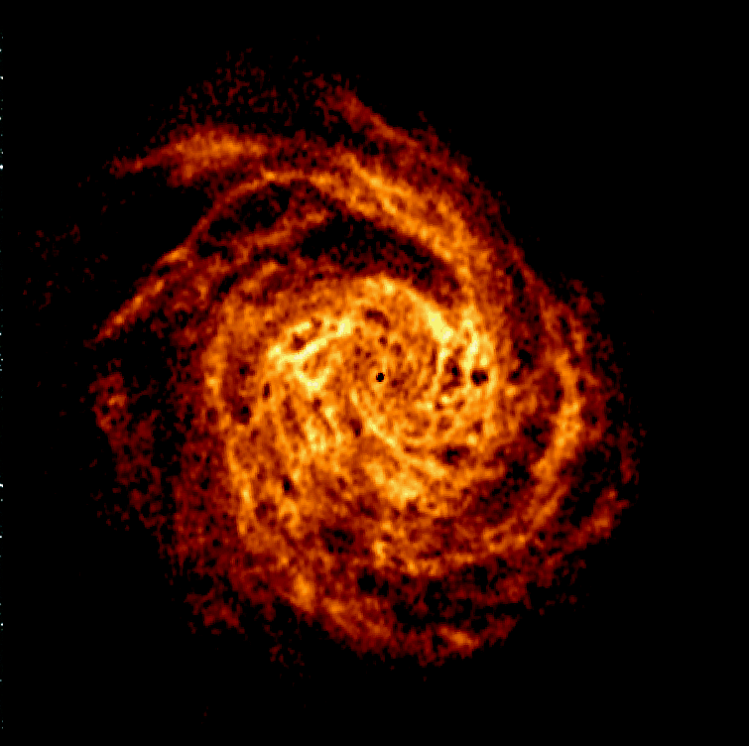
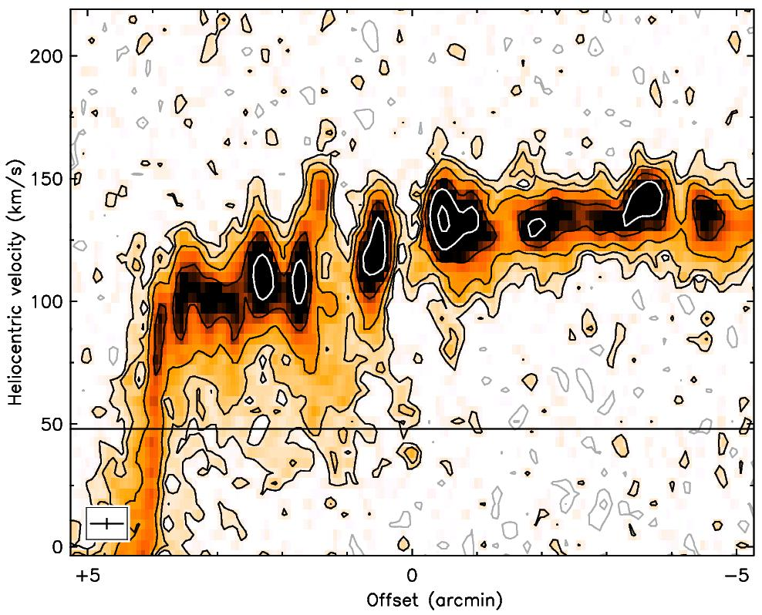
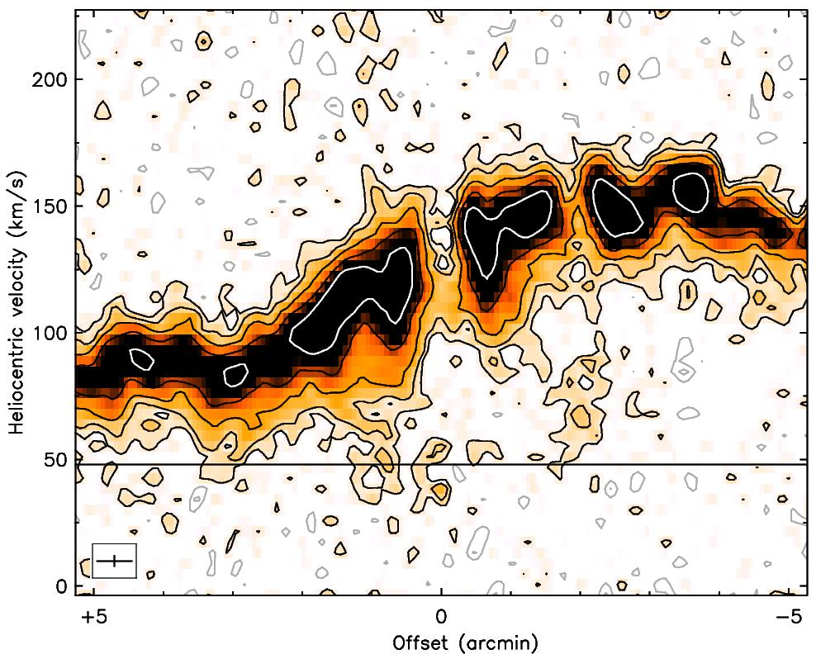
NGC 6946
Boomsma et al. 2007

Slide 20
SN-driven accretion in other sims
Modified SPH
No formation of clumps
“Cold gas condenses from the halo at the intersection of supernovae-driven bubbles. This positive feedback feeds cold gas to the galactic disc directly, fuelling SF.”
Hobbs et al. 2013, MNRAS
MaGICC - GASOLINE
Halos enriched by galactic fountain
Gas in the fountain cycle comes back to the disk more metal poor!
Brook+12, Brook+13

Slide 21
Impact of galactic fountain on disc evolution
Corona-disc interface
Global process: supernova-driven accretion
Local process: formation of condensed clouds
  - Origin of the high-velocity cloud complex C

Slide 22
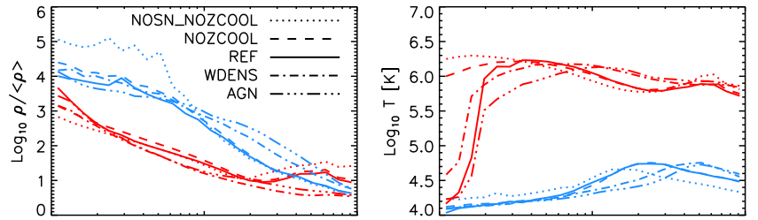
Positive feedback is there
z=2
Cooling induced close to galaxies by metals ejected by feedback
OWLS
GADGET-3
Hot mode
Cold mode
van de Voort & Schaye 2012

Slide 23
Lyα absorbers
HST/COS data
Thom+ 2012, ApJL
Impact parameters
Bound to the potential wells
Mass > 10⁹ Mo

Slide 24
Early types vs star-forming
Cold gas (log(T)<5)
Hot gas (log(T)~5.5)
Thom+ 2012, ApJL
Tumlinson+ 2013
Werk+ 2013
Is this cold gas used for star formation?

Slide 25
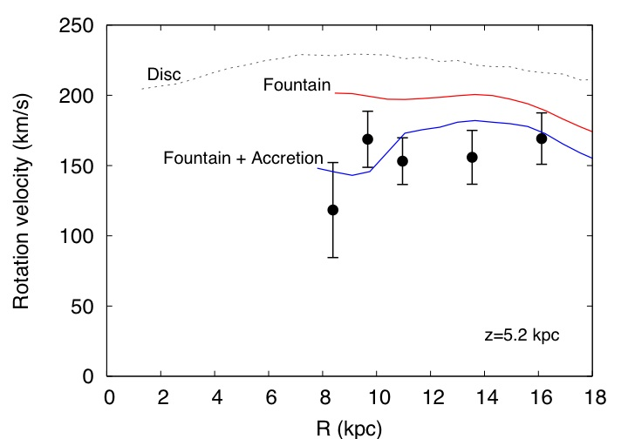
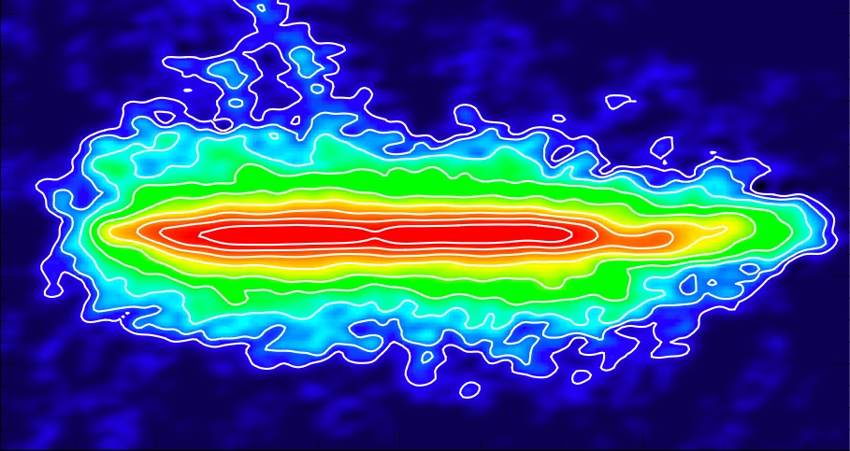
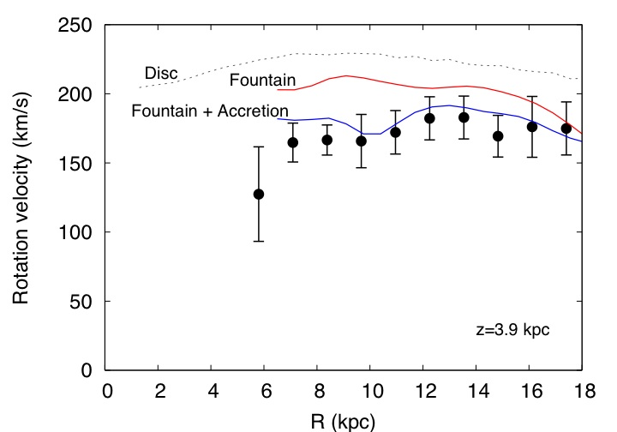
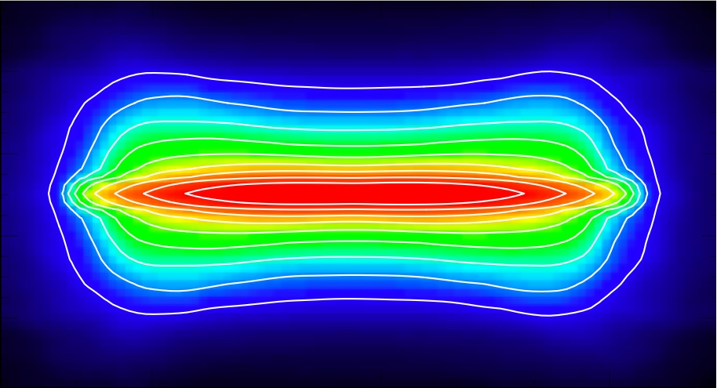
Fountain-driven accretion model
1. kick velocities (v_{k})
2. Ionised fraction (f_{ion})
3. Accretion rate (dM/dt)
N891, total HI map
Fountain model
Fountain triggers coronal accretion at a rate ~ SFR
Best-fit Accretion Rate ~ 3 Myr⁻¹
Compare to SFR ~ 4 Myr⁻¹
Fraternali & Binney, 2008

Slide 26
HI High Velocity Clouds
Typical
Distances:
~10 kpc
h~few-10 kpc
Z~0.1-0.4 Z
M<10⁷ M
Wakker et al. 2007, 2008; Tripp et al. 2003
Accretion from High Velocity Clouds
~ 0.08 M/yr
Includes He and factor 2 of ionised gas!
HI HVCs cannot feed SF
Putman, Peek, Joung 2012, ARA&A

Slide 27
Implications for galaxy evolution

Slide 28
Global fountain
2.5
Fraternali & Binney 2008, MNRAS
Marinacci, Fraternali+ 2011, MNRAS
2.0
Accretion rate (M/yr)
1.5
1.0
0.1 0.3 0.5 0.7 0.9
Ionization fraction
Best-fit Accretion Rate ~ 2 Myr⁻¹
Compare to SFR ~ 1-3 Myr⁻¹
Marasco, Fraternali+ 2012, MNRAS

Slide 29
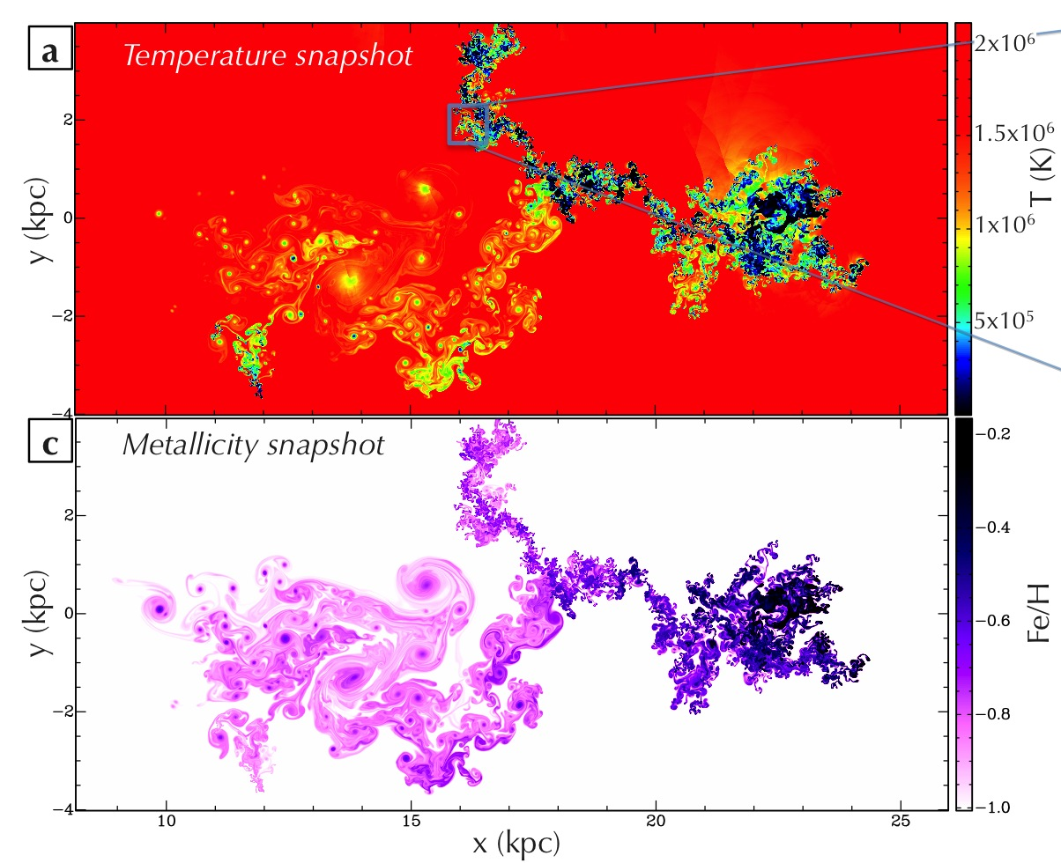
Metallicity
Supernova-driven cooling reproduces:
Extraplanar HI
Absorption features
And even HVCs
Average metallicity at the end: 0.27 Solar
Compared to complex C: 0.1-0.3 Solar

Slide 30
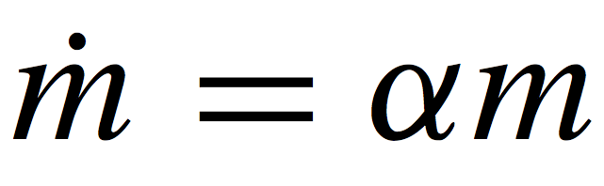
Galactic fountain model
Building of several model cubes -> minimization residuals with LAB
We fit:
1. kick velocities (v_{k}) scaleheight
2. Ionised fraction (f_{ion}) vertical motions
3. Accretion coefficient (α) radial motions
Pure fountain
Fountain + accretion
Free parameters
v_{k}, f_{ion}
Free parameters
v_{k}, f_{ion}, α
Neutral
Fitting α gives us the gas accretion rate
Ionised

Slide 31
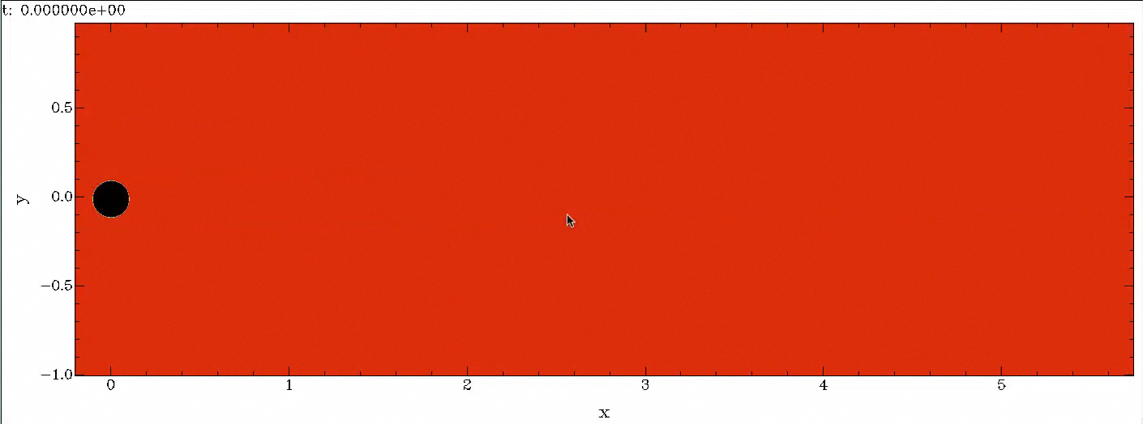
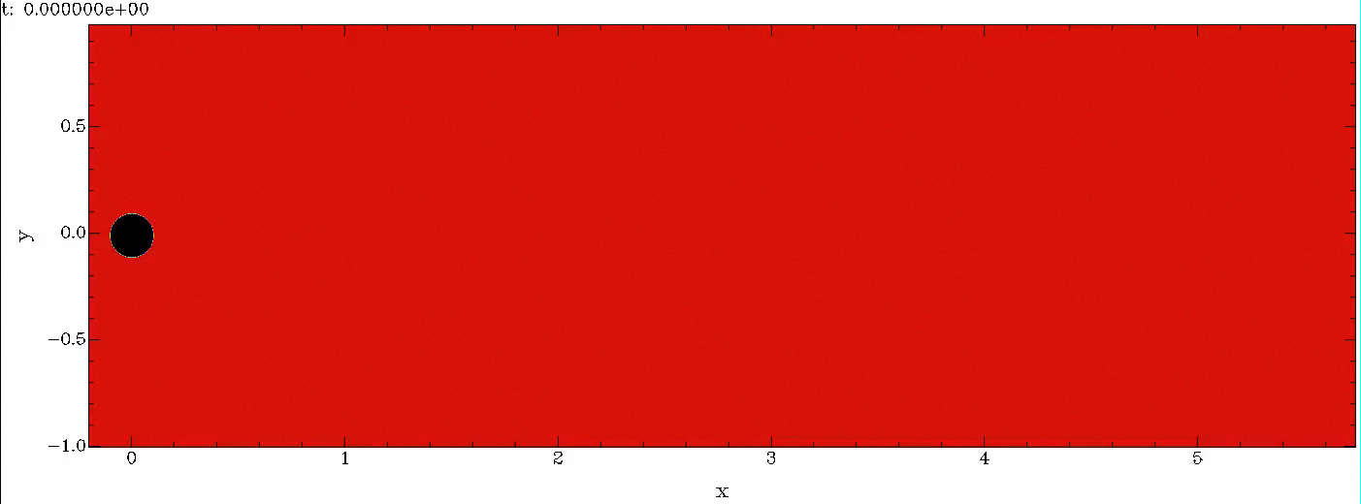
The effect of thermal conduction
Only cooling
T_{corona}=2x10⁶ K
Z_{corona}=0.1 Z
Z_{cloud}=1 Z
Cooling & thermal conduction

Slide 32
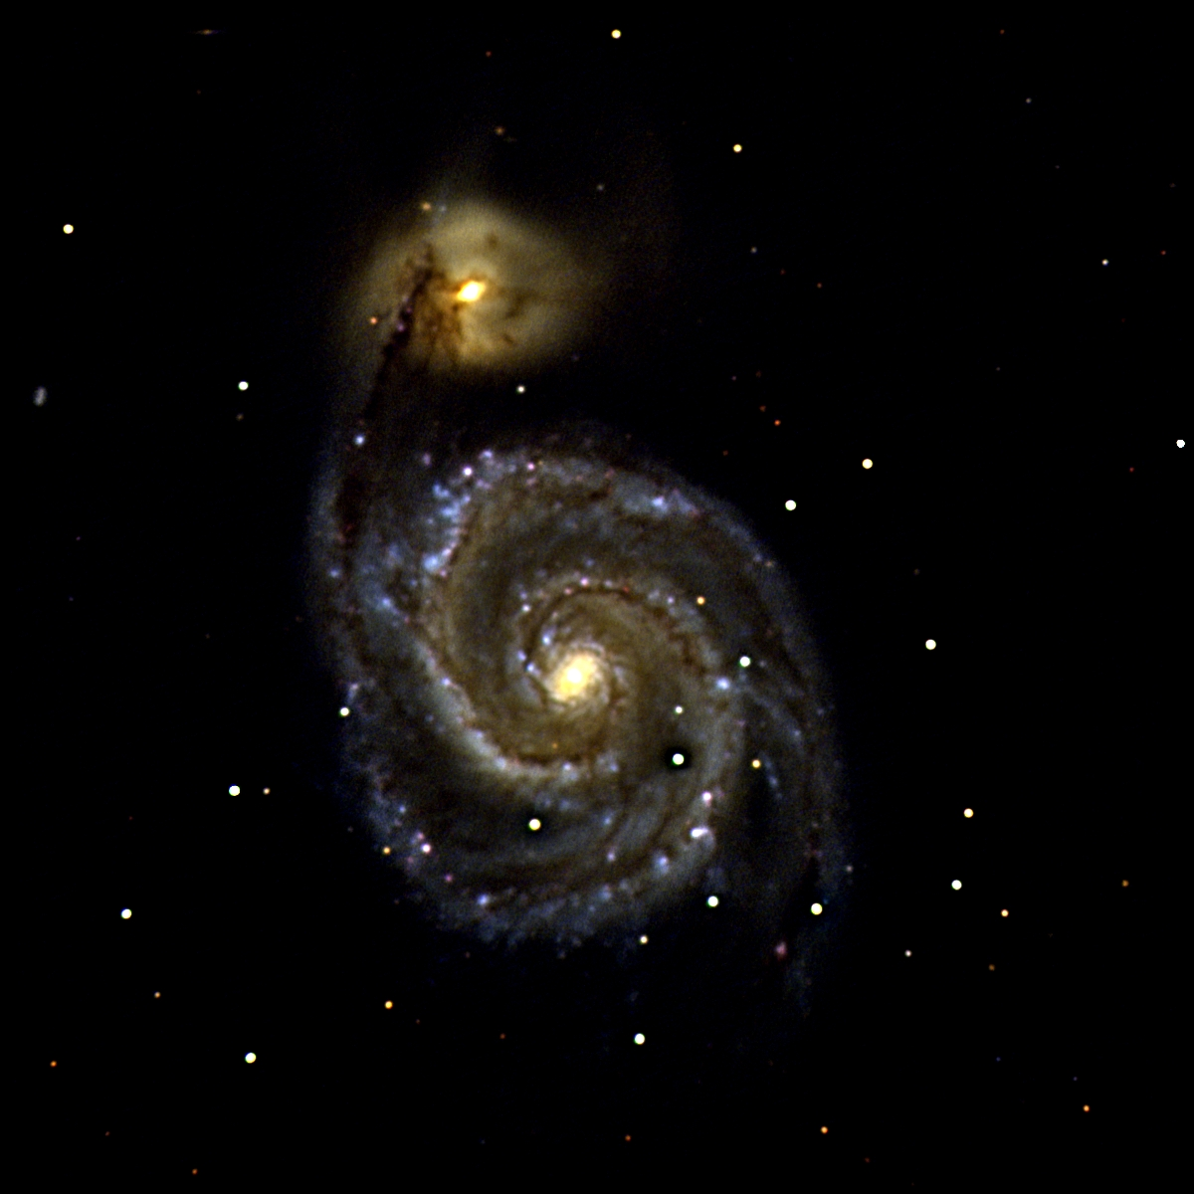
Galactic coronae
Hot-mode accretion
Keres+ 2009
Hot-mode accretion.
Similar to classical theory
(e.g. White & Rees 1978)
Anderson & Bregman 2012
Dai+ 2012, Anderson+ 2013
MW Miller & Bregman+ 2013, 2015; Gatto+13
Mass corona
~ 10-50% missing baryons
Cooling rate ~ 0.1 Mo/yr
~60 kpc
Bogdan+ 2012

Slide 33
Disc-corona interplay
Interface layer where disc and coronal materials mix
Low-Z hot corona
High metallicity “cold” gas (from the disc) mixes with low metallicity hot gas
Fraternali & Binney 2008, MNRAS
Marinacci, et al. 2010, 2011, MNRAS
Marasco, Fraternali & Binney 2012, MNRAS

Slide 34
Supernova-driven accretion
10 kpc
Galactic fountain
100 kpc
Galactic corona
Supernovae eject gas from the disc
Very long cooling time
Hot-mode accretion
1 kpc
Mixing: disc & coronal gas
Condensation knots
Short cooling time
SN-driven accretion
Accretion
SNe
Cold disc
Fraternali et al. 2013, ApJL

Slide 35
Efficiency of fountain-driven cooling
Convergence at ~ 2 parsec
CONDENSATION
EVAPORATION
Armillotta, Fraternali & Marinacci, in prep

Slide 36
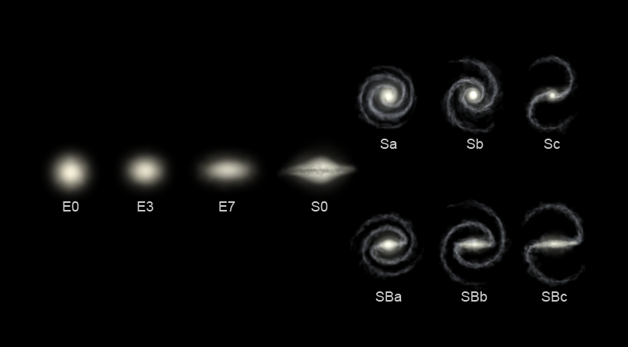
Efficiency of fountain-driven cooling
Condensation strongly depends on coronal temperature
MW
At T_{cor} > 4 x 10⁶ K
clouds evaporate
Armillotta, Fraternali & Marinacci, in prep
Role in the quenching of star formation?
Condensation efficiency as a function of T_{vir} M_{vir}
T_{vir}

Slide 37
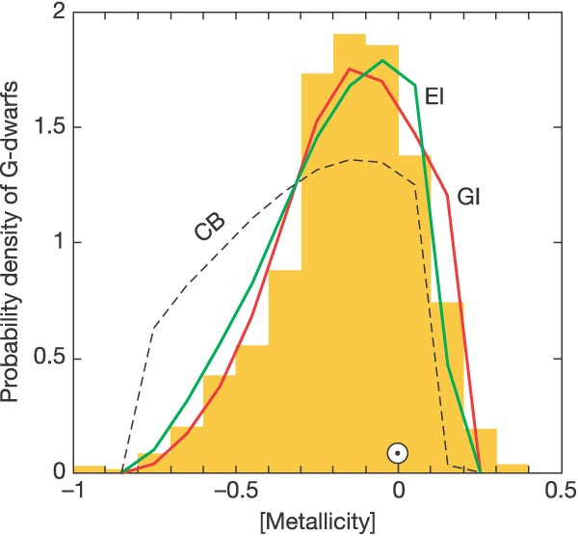
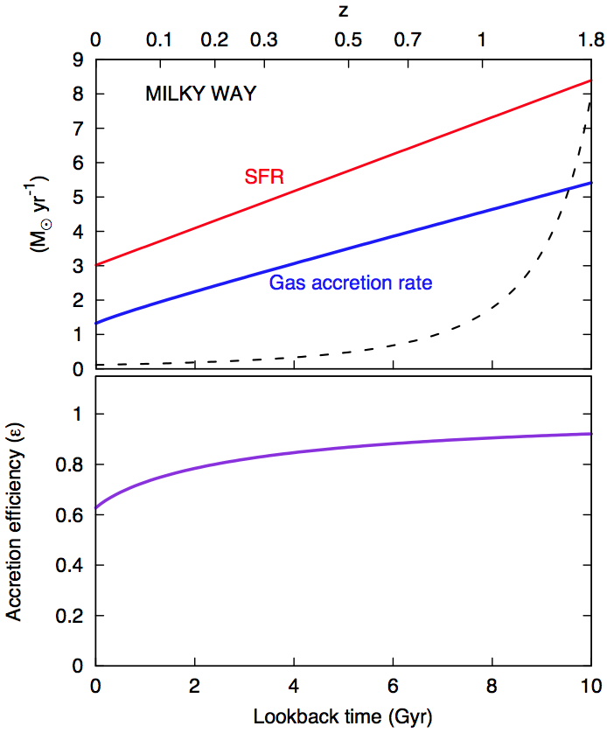
Milky Way evidence
Chemical evolution models
G-dwarf problem
Larson 1972, Tynsley 80, Chiappini+ 97, 01; Schoenrich & Binney 09
Infall models
Deuterium in local ISM appears to be re-supplied Linsky et al. 2006
Closed box
Need for gas accretion at Z<~0.1 Z
G-dwarfs
in the Solar Neighborhood
SFR
Dauphas et al. 2005, Nature
~ 1 M/yr
Fraternali & Tomassetti 2012, MNRAS

Slide 38
HI High Velocity Clouds
Typical
Distances:
~10 kpc
h~few-10 kpc
Z~0.1-0.4 Z
M<10⁷ M
Wakker et al. 2007, 2008; Tripp et al. 2003
Accretion from High Velocity Clouds
~ 0.08 M/yr
Includes He and factor 2 of ionised gas!
HI HVCs cannot feed SF
Putman, Peek, Joung 2012, ARA&A

Slide 39
Origin of HVCs
Oort 70 leftover of galaxy formation
Bregman 80 Galactic fountain
+ satellites (Olano 2001), thermal instabilities (Kaufmann+06), no thermal instabilities (Binney+09), filaments (Fernandez+12)
Wakker+ 1999, Nature
Z~0.1 Solar -> Accretion!
Gibson+01 Z~0.3 Accretion?
Collins+07 overabundance α elements (SN II?)

Slide 40
Cosmology evidence
Gas depletion time ~ 1 Gyr
Assembly of stellar mass in the Universe
Gas depletion time
t_{depl} = M_{gas} / SFR
Compilation from Madau & Dickinson 2014
Saintonge+ 15
Kennicutt+83, Genzel+ 10, Bigiel+11, Genzel+15

Slide 41
Cosmology evidence
Constant HI in galaxies
Accretion needed to keep forming stars at level of ~ SFR
Stellar density
Bathtub model
HI density
Zafar+ 13
Bouché+2010, Davé+ 2012, Lilly+13

Slide 42
Supernova-driven accretion in other sims

Slide 43
SN-driven accretion in other sims
Modified SPH
No formation of clumps
“Cold gas condenses from the halo at the intersection of supernovae-driven bubbles. This positive feedback feeds cold gas to the galactic disc directly, fuelling SF.”
Hobbs et al. 2013, MNRAS
MaGICC - GASOLINE
Halos enriched by galactic fountain
Gas in the fountain cycle comes back to the disk more metal poor!
Brook+12, Brook+13

Slide 44
Positive feedback is there
z=2
Cooling induced close to galaxies by metals ejected by feedback
OWLS
GADGET-3
Hot mode
Cold mode
van de Voort & Schaye 2012

Slide 45
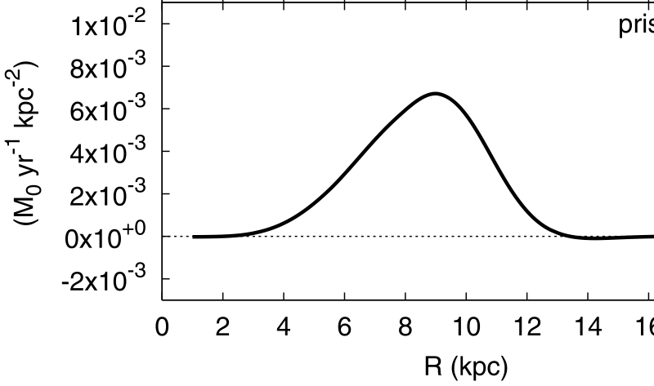
Extraplanar HI in the Milky Way
2.5
2.0
Accretion rate (M/yr)
1.5
1.0
0.1 0.3 0.5 0.7 0.9
Ionization fraction
Best-fit Accretion Rate ~ 2 Myr⁻¹
Compare to SFR ~ 1-3 Myr⁻¹
Marasco, Fraternali & Binney 2012, MNRAS
Accretion in the outer disc

Slide 46
Disc-corona interplay
Interface layer where disc and coronal materials mix
Cooling time of the corona (typically very long) decreases dramatically because it is mixed with:
1. cold gas
2. High Z gas
Fraternali & Binney 2008, MNRAS
Marinacci, et al. 2010, 2011, MNRAS
Marasco, Fraternali & Binney 2012, MNRAS

Slide 47
Implications for galaxy evolution

Slide 48
Evolution of discs
Red and dead
Hot-mode accretion
Cold-mode
If gaseous disc is lost
And the corona does not cool further
Hot mode + disc
Cold mode
Hot-mode accretion
corona
Disk with SF
The disk is the refrigerator of the corona
Dekel et al. 2009

Slide 49
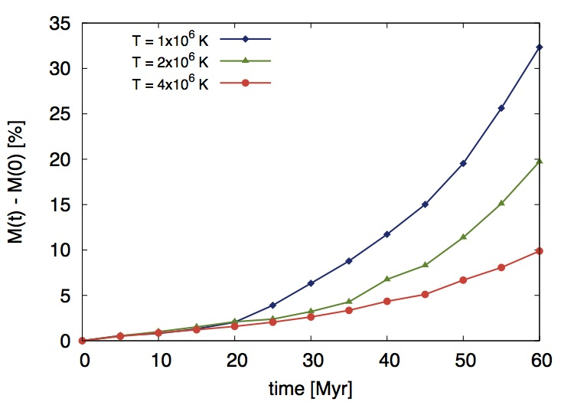
Efficiency of SN-driven cooling
PRELIMINARY
Armillotta+, in prep.
T_{vir}

Slide 50
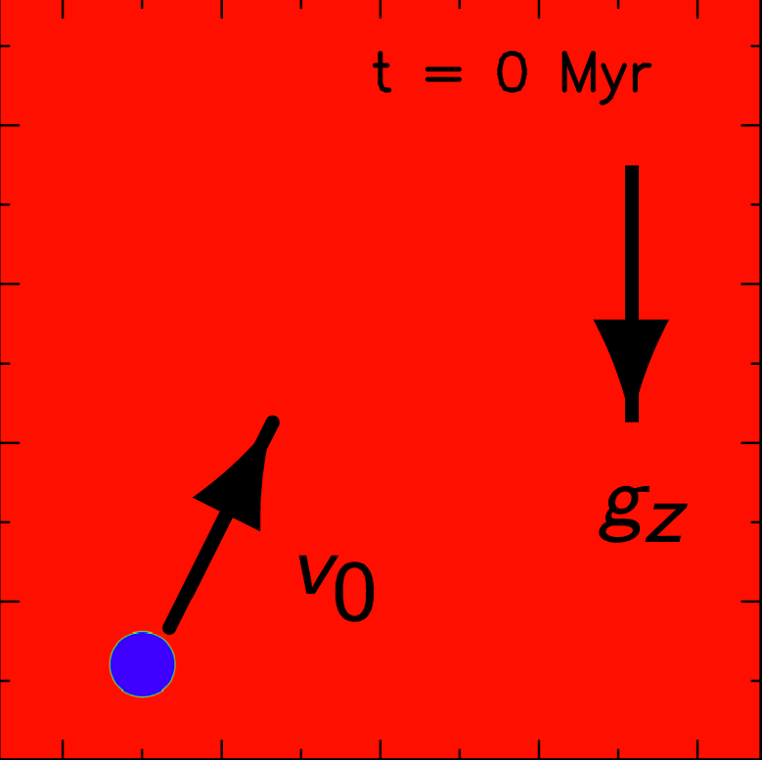

Conclusions
Supernova feedback cools the corona in star-forming galaxies like the MW
Very good fits:
    HI in the MW and external galaxies,
    ionized absorbers in the MW
This can be the way hot-mode accretion feeds star formation in disc galaxies

Slide 51
1. Extraplanar HI in the Milky Way

Slide 52
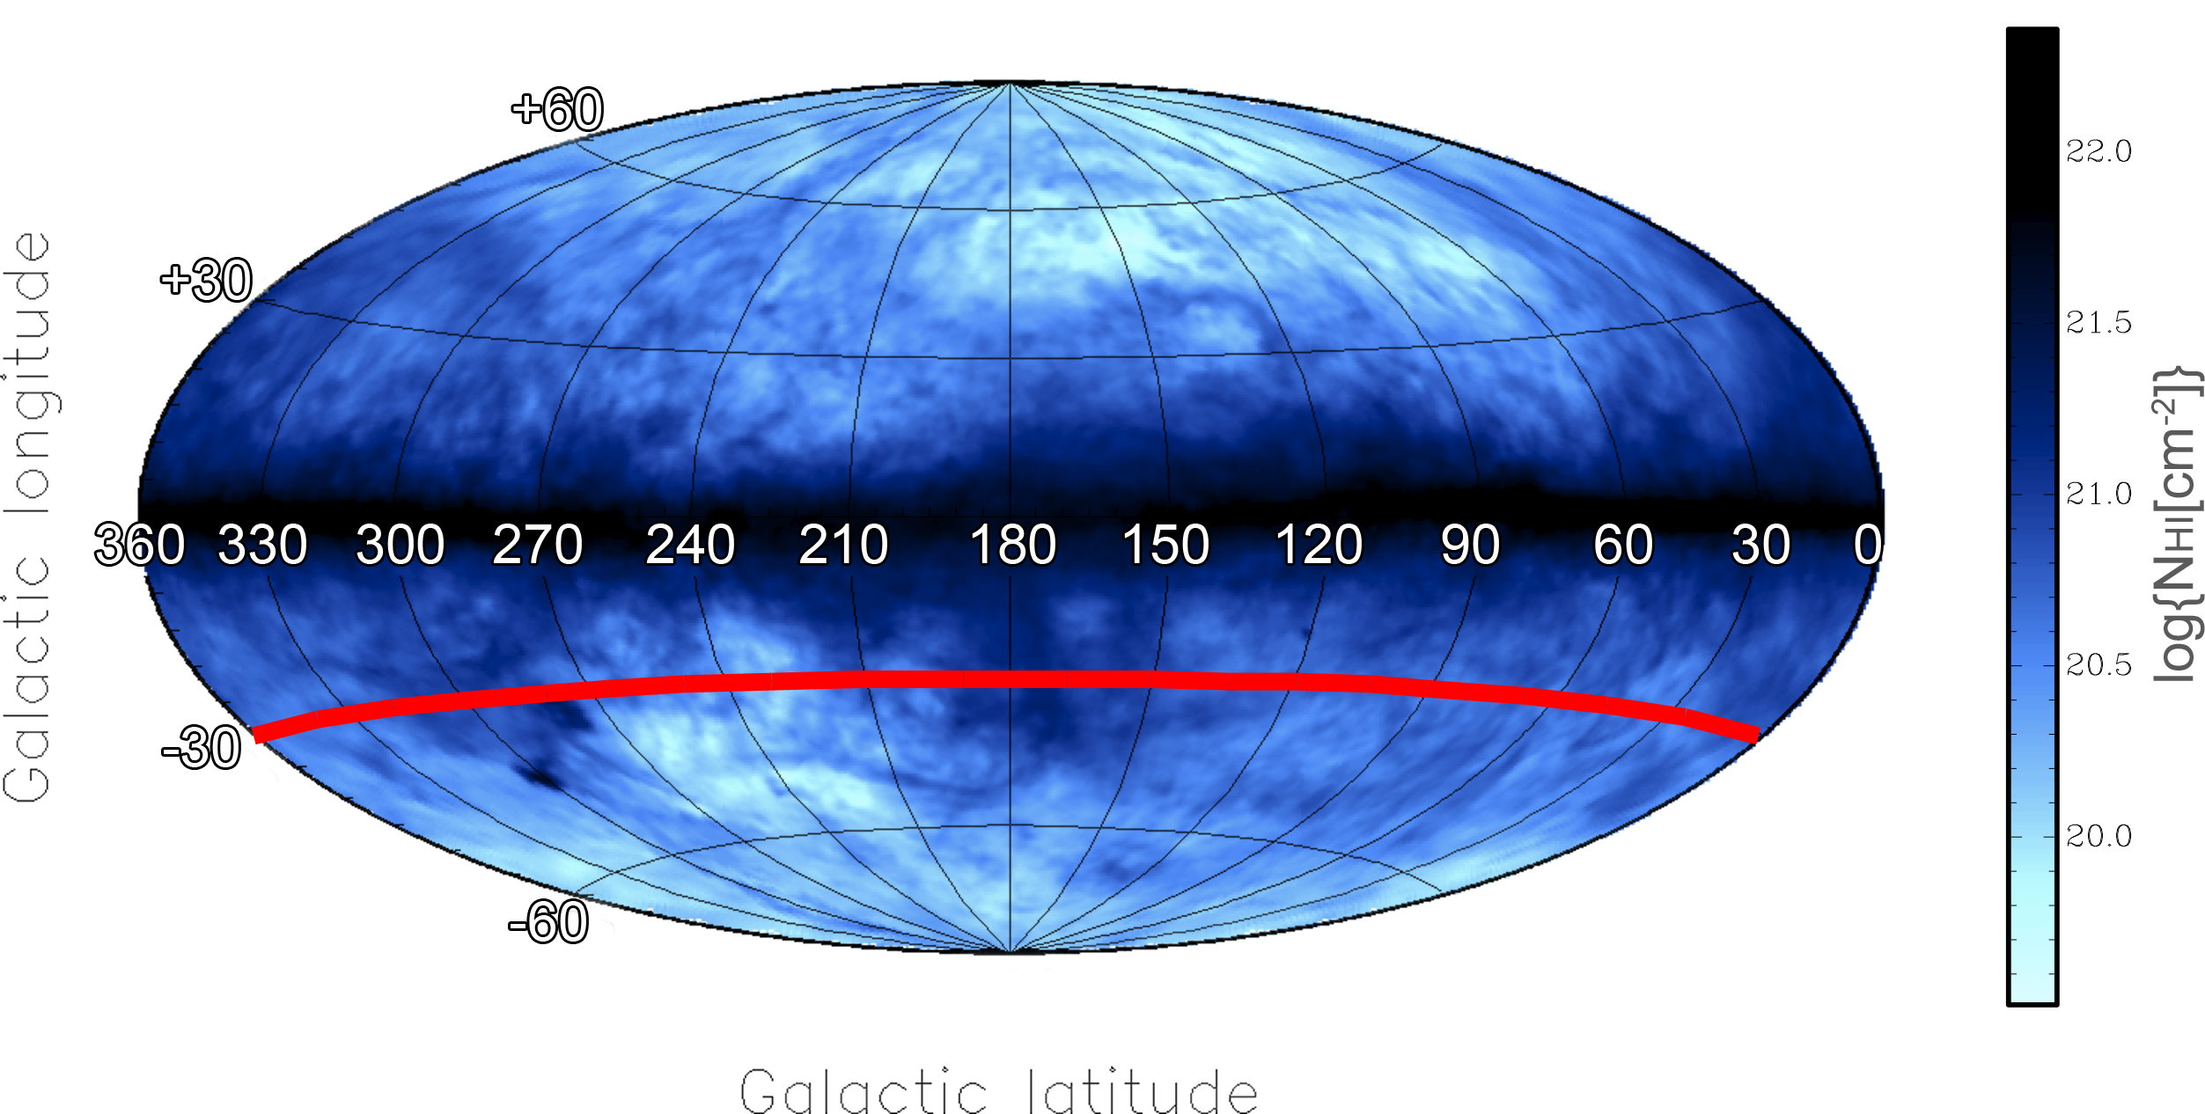
HI disk and halo in the Milky Way

Slide 53
HI halo – all-sky
Marasco & Fraternali 2011, A&A

Slide 54
Pure fountain
Fountain + accretion
HI data
Best fit
Velocity LSR (km/s)
v_{k}= 75 km/s
f_{ion} = 0.3
M_{cor} ~ 2 M/yr
•
Halo gas:
~80% from fountain
~20% from corona
360 270 180 90
360 270 180 90
360 270 180 90
Longitude (degrees)
Marasco, Fraternali & Binney 2012

Slide 55
2. Absorption feautures

Slide 56
Cooling in the wake
Fraternali et al. 2013, ApJL
Shull+ 2009, ApJ
Lehner & Howk 2011, Science
Lehner et al. 2012, MNRAS
C II, Si II, Si III, …
4.3<logT<5.3 K

Slide 57
Evolution of the wake
DYNAMICAL MODEL
for the IONISED GAS
(no free parameters)
Marasco, Marinacci & Fraternali 2013, MNRAS

Slide 58
Ionized gas in the MW
Marasco, Marinacci & Fraternali 2013, MNRAS
This model reproduces:
Positions & velocities of 95% absorbers
Average column density
Number of absorbers along the l.o.s.
High velocity dispersions of absorbers
‘Warm’ accretion: ~1 M/yr
V_{LSR} (km/s)
Data from Lehner et al. 2012, MNRAS

