Slide 1



Multi-Scale Environmental Influences on Galaxy Gas Content
David V. Stark
In collaboration with: Sheila Kannappan, Kathleen Eckert, Jonathan Florez, Kirsten Hall, Linda Watson, Erik Hoversten, Joseph Burchett, David Guynn, Ashley Baker, Amanda Moffett, Mark Norris, Martha Haynes, Riccardo Giovanelli, Andreas Berlind, Adam Leroy, D. J. Pisano, Lisa Wei, Roberto Gonzalez, Victor Calderon
Notes:
Notes about talk:
Total time is 15 minutes: 11 (+4 for questions)
I’m later in the session, so introductory material about resolve should be relatively limited

Slide 2
Environmental processes can influence galaxy gas content
“Small” (dark matter halo) scale
Gas replenishment
  cosmological accretion
  gas-rich mergers
Gas removal/exhaustion
  gas stripping
  starvation
How important are gas removal/consumption processes in low-mass groups?
Influence from larger-scale environment?
Flyby interactions between halos (e.g. Wetzel+12)
Competitive gas accretion (Hearin+15)
Ram-pressure stripping of halo gas by IGM (Bahe+13)
Variations in IGM temperature/cooling time (Cen+11)
Halo assembly bias: earlier halo formation time in overdense regions (Gao+05)
Notes:
I’ll keep background short, we’ve talked about it a lot already
-have processes that lead to gas resplenishment
-and removal/no more replensihment
-latter processes are largely studied in massive groups, are they important at low mass?
Last 5-10 years has also seen a lot of work on how interactions on scales larger than individual galaxies and groups can influence evolution
-flybys
-competitive gas acc
-rps from igm
-variations in igm temp
Generally speaking, concept of halo assembly bias/earlier formation time in overdense regions → might be reflected in galaxy properties

Slide 3
Key Questions
Are group-scale processes that lower gas content important in low-mass groups?
Is galaxy gas content entirely regulated by the group dark matter halo and its internal environment? Or does larger-scale environment also play a role?
Notes:
Two basic questions we posed based on the background
-need a specific type of survey…

Slide 4

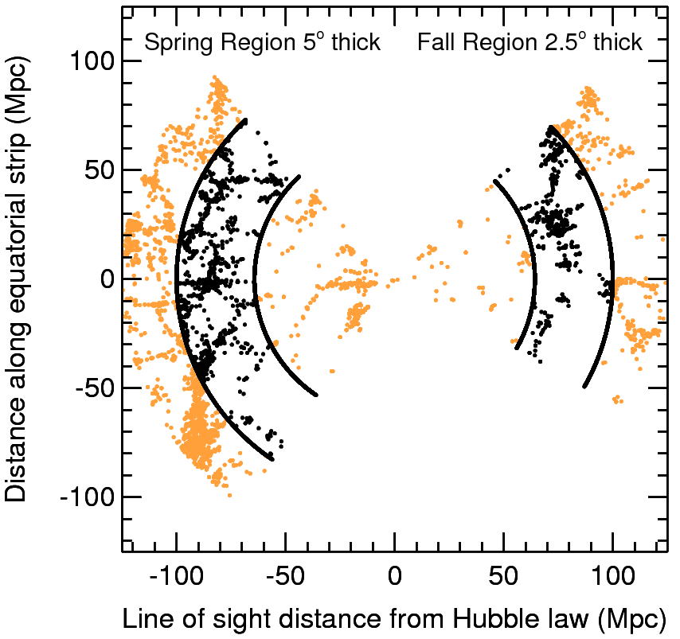
The Survey
PI: Sheila Kannappan (UNC)
Volume-limited census of mass (stars, gas, dark matter), kinematics, SF, metallicity in closed volume for statistically representative subset of z=0 galaxy population
Improved completeness over SDSS
  Baryonic mass > 10^{9.3}
  Stellar mass > 10^{8.9}
  ~1500 galaxies
http://resolve.astro.unc.edu
Notes:
Led by my former adviser at UNC, sk
Volume-limited survey, in two equatorial volumes
Goal is to account for everything about the galaxy (mass components, kinematics, metallicities, SF)
Latter three being done with spectrpscopic obs on the soar telescope, wont go into here, stars via new reprocessed photometry, and gas I’ll tell you about in a minute

Slide 5
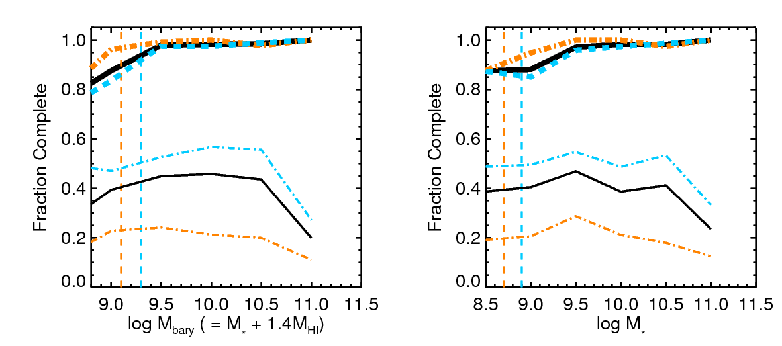
The RESOLVE Atomic Gas (HI) Census
Not flux limited
  Goal: strong detections or upper limits (5-10% of stellar mass) for all galaxies
  ~95% complete to date (Stark et al., submitted)
Current completeness
Original completeness (ALFALFA only)
Full Survey
Log baryonic mass
Log stellar mass
A semester
B semester
Notes:
Dominant gas mass component in dwarf dominated sample will be the atomic hydrogen or HI
Goal with gas census was to go beyond flux limited surveys and get strong detections or upper limits for ALL galaxies
By strong limit, I mean whether the gas mass is < 5-10% of the stellar (typically closer to 5%), i.e., allows us to say whether its gas depleted
Built off the alfalfa survey, was a flux limited survey, and went deeper with pointed observations with the gbt and arecibo telescopes

Slide 6
Environment Metrics
1) Group identifications via friends-of-friends algorithm (FoF)
2) Group dark matter halo mass (M_{h})
  Halo Abundance Matching (HAM) w/ integrated group stellar mass
  10¹¹ – 10¹⁴ M⊙
3) Relative large-scale structure density (ρ_{LSS})
  Projected mass density within distance to 3rd nearest group (not galaxy)
4) Large-scale structure classification
  FoF on groups + visual classification into filaments, walls, etc.
Notes:
Multiple environment metrics designed to span group-scale to large-scale structure

Slide 7
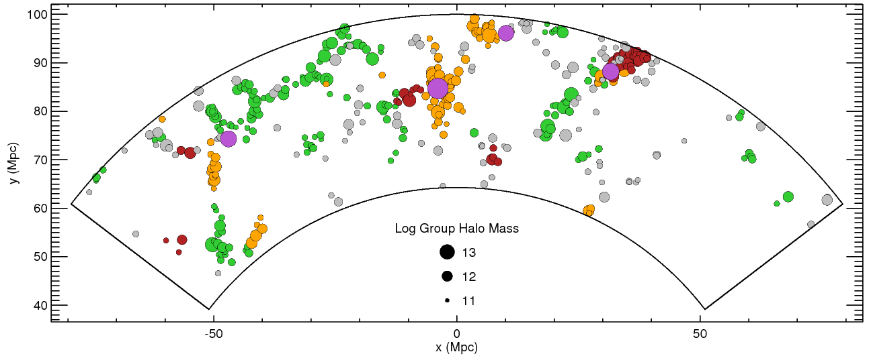
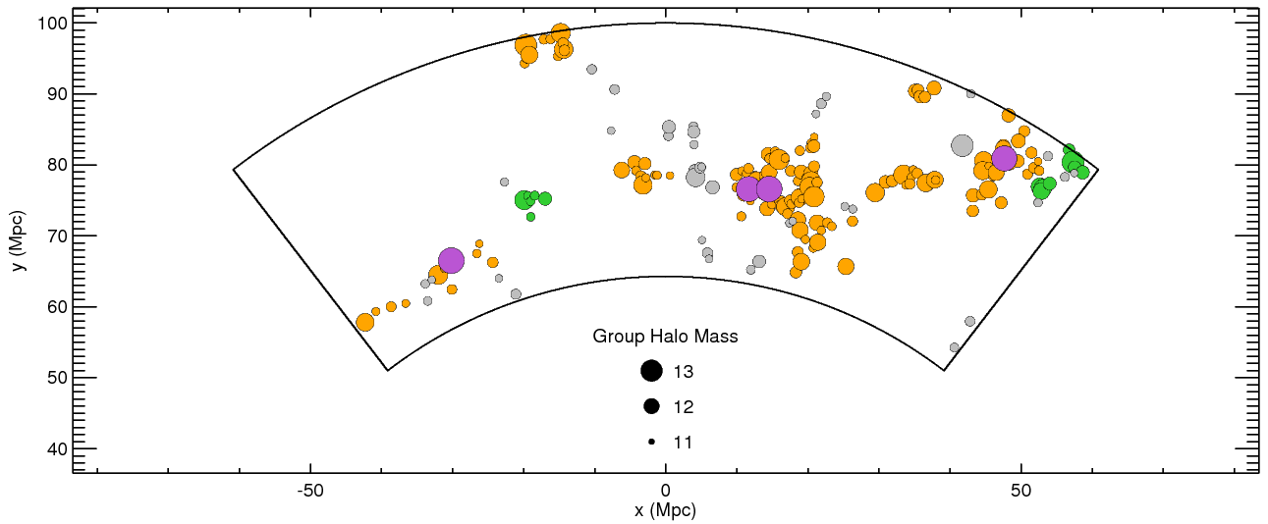
Filament
Wall
Blob
Cluster (M_{halo}>10¹³)
unclassified
RESOLVE-A
RESOLVE-B
Notes:
Describe structure plots
Note that we don’t just get high mass halos in high density regimes,we get a lot of low mass halos in high density regimes, gives us a chance to understand the impact of lss

Slide 8
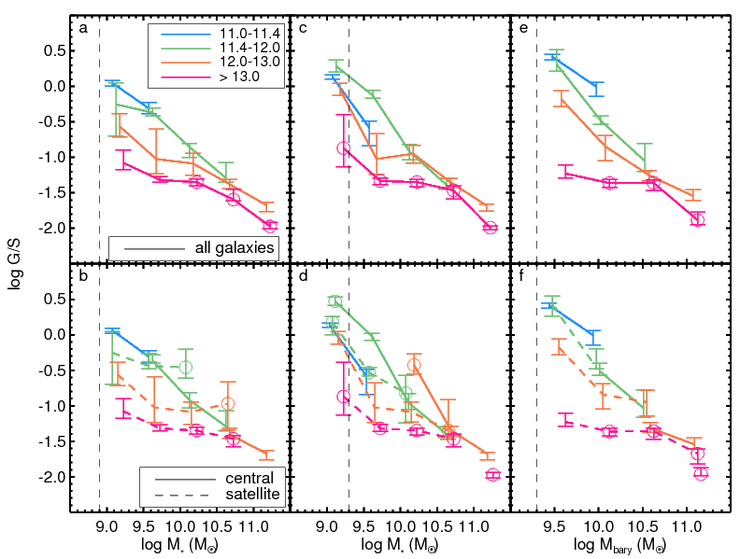
Influence of dark matter halo
G/S = gas-to-stellar mass ratio
Satellite gas deficiency in groups down to 10¹² M⊙ (MW-sized halos)
Smooth relation for centrals, but built in!
Log G/S
Group Halo Mass
Log stellar Mass
< 20 points in bin, bootstrapped
uncertainties less robust
Stellar mass completeness limit
Notes:
-First we examine the extent to which group environments deplete gas in their satellites
-Examine the median gas fraction as a function of stellar mass broken up by group halo mass
-solid line is centrals, dashed satellites
-satellite gas content is progressively descreasing with increasing halo mass, as you might expect, but we’re seeing systematic decline down to pretty moderate halo mass scales of 10^12 (MW-like groups)
-centrals show very smooth trend with halo mass, but I mus stress that this is built in

Slide 9
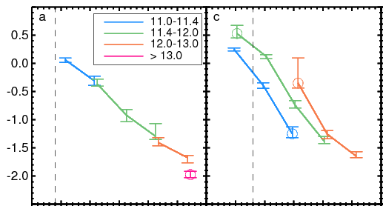
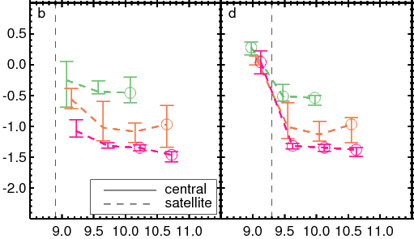
HAM w/ baryonic mass (stellar + gas mass)
HAM w/ stellar mass
Behavior of centrals strongly linked halo abundance matching approach
centrals
Log G/S
satellites
Consistent behavior for satellites independent of approach
Log stellar Mass
Log stellar Mass
Notes:
Plotting centrals alone on top two panels
Left panel: tying halo mass estimate to integrated group stellar mass, central dominates stellar mass, so halo mass closely correleated with stellar masss and you see no secondary dependence
Cannot disentangle the behavior of G/S, M*, and Mh from built in assumptions in HAM
Satellites show consistent behavior tthough, use green line as baseline, see deficiency down to 10^12, though not robust at lowest masses

Slide 10
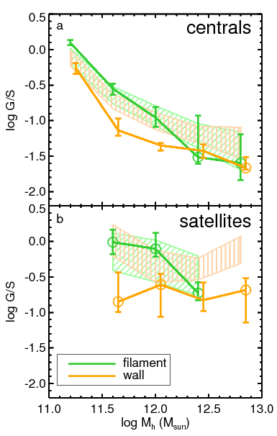
Median G/S in large-scale filaments vs. walls
M_{h}≤10¹²: Walls are more gas-poor compared to filaments
log G/S
Log halo mass
Log halo mass
Notes:
Reverting back to using HAM via M* -- subsequent results do not change significantly with different halo mass estimations approaches
Examine median G/S for centrals and satellites in walls, filaments, really just focuing on walls and filaments right now, not enough voids to really say a whole lot
-filaments centrals show higher average gas fraction compared to walls at same halo mass
-for satellites, integrated the stellar and gas content of an entire group satellites
-not driven by diffeernt stellar mass distributions , consistent between filaments and walls
-satellites hint at similar behavior, though low number statistics
-getting at second question I had – halo mass along does not seem to govern gas content of galaxies
Offsets not driven by different stellar mass distributions
Trend for centrals robust to HAM approach

Slide 11
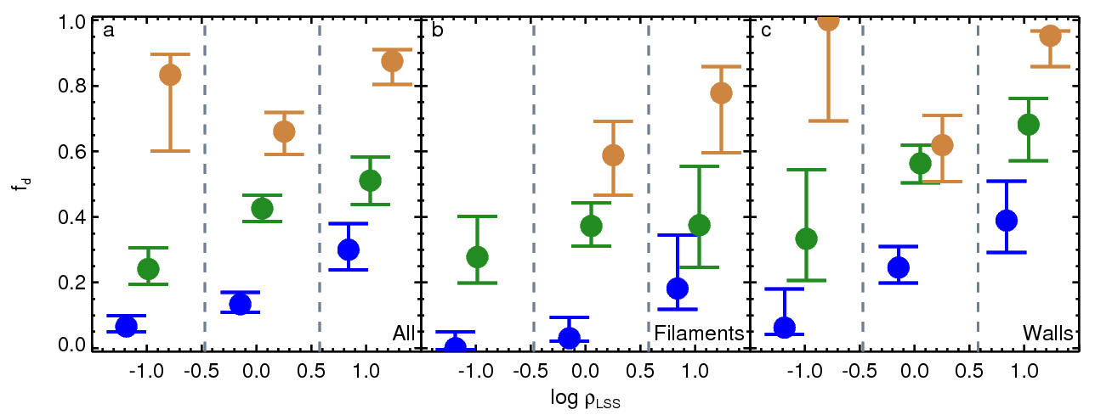
Gas deficiency and large-scale density
All Centrals
Filament Centrals
Wall Centrals
Fraction with G/S < 0.1
  log LSS density
Log Group Halo Mass
Notes:
Looking at gas deficient population (G/S < 0.1) broken up into underdense, average density, overdense regimes
Can see influence of lss dens clearly
Weaker for filaments
Gas-depleted fraction below 10^12 grows with increasing rho_lss
Particularly striking for the lowest halo mass population (these are supposed to be gas-rich groups!)

Slide 12
Gas deficiency and large-scale density
All Centrals
Filament Centrals
Wall Centrals
Fraction with G/S < 0.1
  log LSS density
Log Group Halo Mass
Walls more gas-poor at fixed halo mass and density
Many gas-poor galaxies in typically gas-dominated halo mass regime
Notes:
Look at average density regimes, walls filaments show different fractions of G/S poor galaxies independent of halo mass and lss densuty

Slide 13
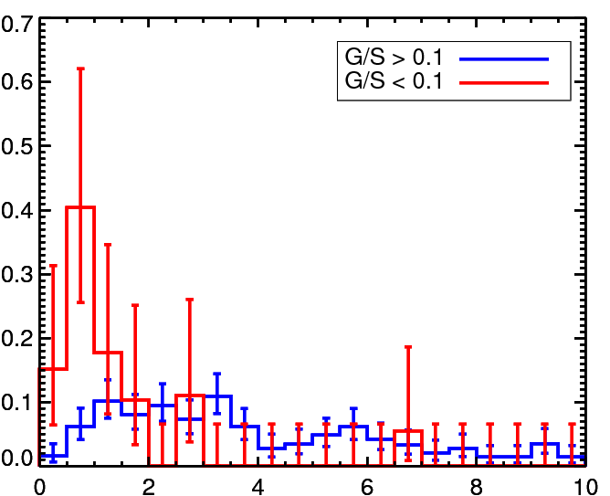
What drives low gas fractions?
Gas deficient centrals typically found close to more massive halos
  Flyby interactions?
  Competitive accretion?
Mostly found in walls
Should we consider these systems satellites?
  fall within “splashback radius” (More+2015)
M_{halo} < 10^{11.4} M⊙ centrals
Relative number
Splashback radius?
Distance to nearest >10¹² M_{sun} halo (R_{200m})
Notes:
To understand what drives gas deficiency, we isolate the popiulation where it is most striking, the <10^11.4 population, and examine their distribution
-looking at distribution of gas-deficient and gas normal groups relative to their nearest neighbors
We find that the gas-deficient groups tend to cluster closer to nearest significantly more massive halo
-already corrected for misclassification of centrals/satellites
-possible signature of flyby interactions (group falls in, has gas stripping, re-emerges as its own group (hard ot tell which)
-large fraction of them tend to cluster within 1.5*R200m, which corresponds to the splashback radius – radius infalling material reaches after its first passage, possibly more realisitic boundary for halo – i.e., the gas-deficient systems may really be satellites of the nearst larger group

Slide 14
Why are our walls more gas poor?
Walls have higher flyby interaction rate?
More competitive gas accretion?
Ram pressure stripping by IGM (unknown how this may vary between walls and filaments)?
Different gas accretion behavior in walls vs filaments?
Our walls are more evolved large-scale structures (assembly bias)?
Processes that deplete gas content at work longer?
  Plus hotter IGM in earlier forming structures (Cen+11) → longer gas cooling times
Notes:
Largest structures (by number of groups)
Highest overdensities
Most massive groups/clusters (>10¹³) typically found nearby

Slide 15
Summary
Systematic satellite gas deficiency in groups down to 10¹² M⊙. Detailed influence of halo mass on central G/S uncertain
G/S
Log stellar mass
Below group halo masses of 10¹² M⊙:
  Wall galaxies systematically more gas-poor than filament galaxies
  Fraction of gas poor centrals increases with LSS density (strongest dependence in walls, weak in filaments)
G/S
Log group halo mass
Unusually gas-poor centrals often found close to much more massive halos
  gas stripping and/or starvation due to larger group?
Distance to nearest >10¹² M_{sun} halo (R_{200m})

Slide 16
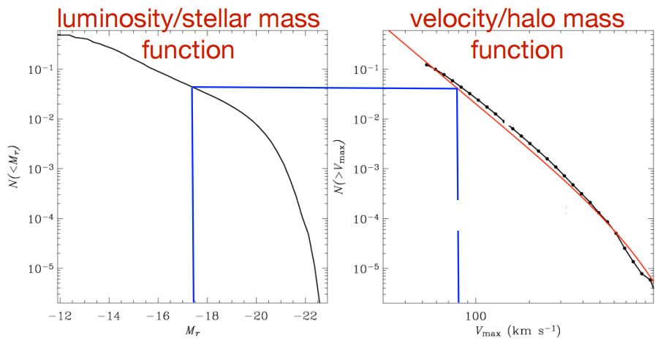
Halo abundance matching

Slide 17
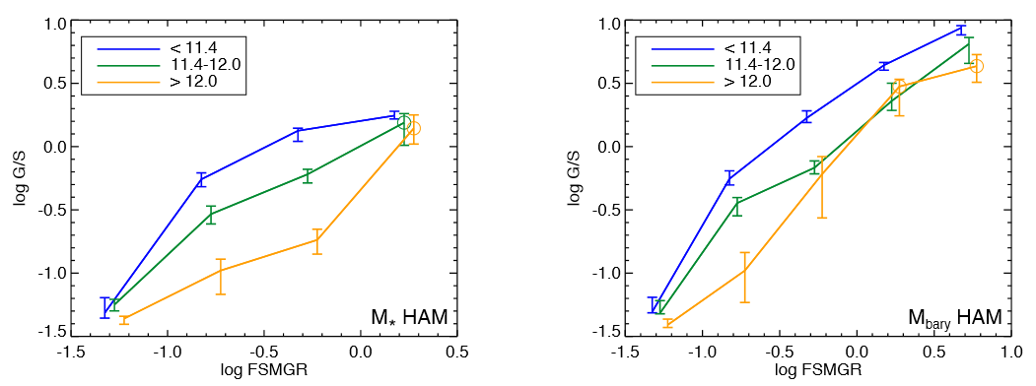
Fixed “fractional stellar mass growth rate” (like sSFR)
FSMGR = “fractional stellar mass growth rate” (Kannappan et al. 2013)
  FSMGR = M*(formed in last Gyr)/M*(formed before last Gyr)

