Slide 1
The KMOS Redshift One Spectroscopic Survey (KROSS):
The Evolution of the Tully-Fisher Relation Since z ~ 1

Slide 2
KROSS P.Is: Richard Bower (Dur), Martin Bureau (Ox)
Oxford: Andy Bunker, Matt Jarvis,
Georgios Magdis, John Stott
Durham: Mark Swinbank, Ian Smail,
Ray Sharples, Helen Johnson, Chris Harrison
Others: David Sobral, Philip Best

Slide 3
Overview
Motivation (why z~1?)
KROSS
- Modelling Velocity Fields
The Tully-Fisher Relations
Conclusions & Future Work

Slide 4
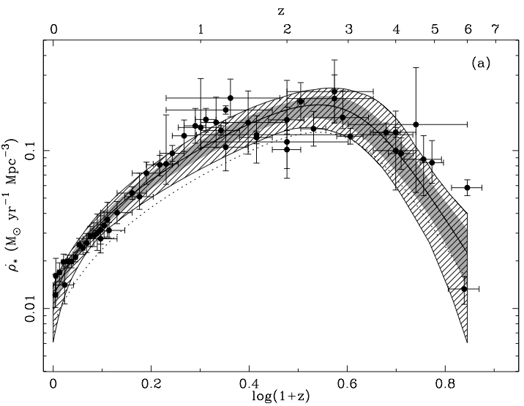
Galaxy Evolution – SFR(z)
Merger/Secular evolution?
Dynamics, chemistry, SFR, M*, gas, dark mass, winds/outflows
Hopkins & Beacom (2006)

Slide 5
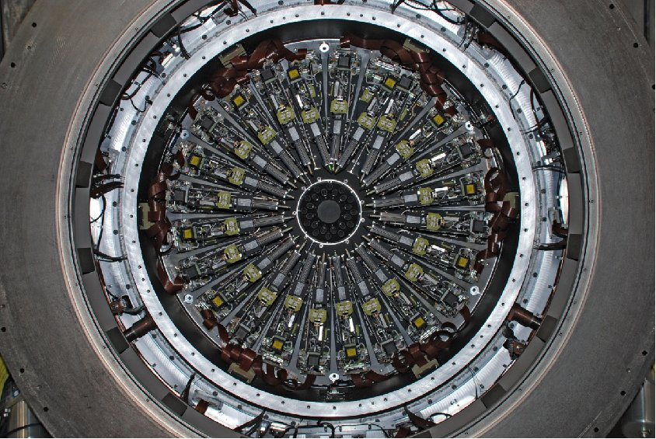
KROSS
Hα & [NII] in ~795 (584) “normal” star forming galaxies at z ~ 1

Slide 6
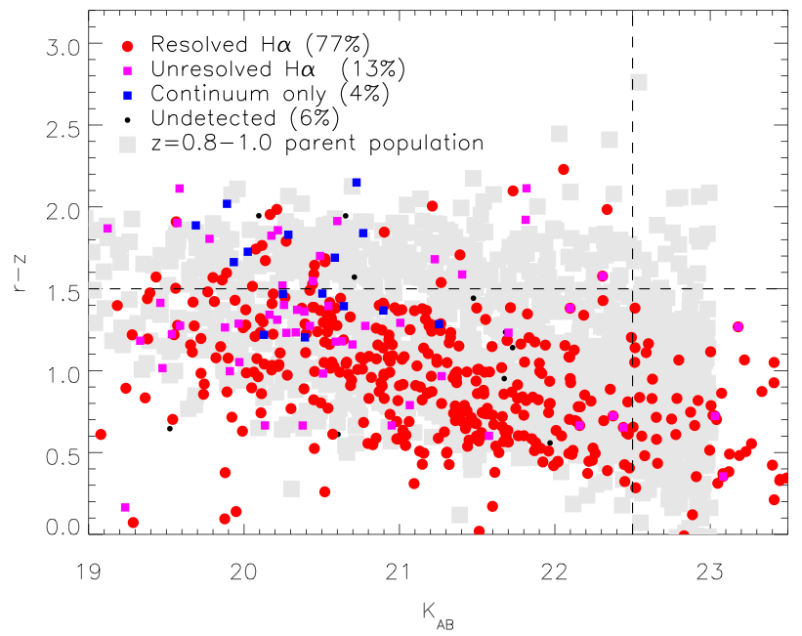
KROSS
Hα & [NII] in ~795 (584) “normal” star forming galaxies at z ~ 1
Stott et al. (2016)

Slide 7
Modelling Velocity Fields
Courteau (1997)

Slide 8
KROSS
Stott et al. (2016)

Slide 9
KROSS
Stott et al. (2016)

Slide 10
KROSS
Stott et al. (2016)

Slide 11
The Tully-Fisher Relation

Slide 12
The Tully-Fisher Relation
SED fitting
velocity field modeling

Slide 13
The Tully-Fisher Relation
but TFR assumes circular motion!

Slide 14
The Tully-Fisher Relation

Slide 15
Conclusions
For “disky” galaxies:
- no evolution in M_{K} TFR
evolution in M* TFR zero-point (-0.41 dex)
For a given M_{dyn}:
- galaxies had less stellar mass at z~1
- yet as bright in M_{K}

Slide 16
Conclusions
Secular evolution? M_{gas} ➔ M*?
- gas only accounts for 0.24 dex of 0.41 dex offset
- would need significant (but possible) amounts of gas accretion to account for observed stellar mass TFR offset

Slide 17
Future
IFU z=0 vs IFU z=1
- eliminate bias
Sample matching
- M*?
- SFR?

Slide 18
Thank you!
KROSS Publications:
Magdis et al., 2016, MNRAS, 456, 4533
Stott et al., 2016, MNRAS, 457, 1888
Tiley et al., 2016, MNRAS, submitted
Harrison et al., 2016, in prep.
Swinbank et al., 2016, in prep.
Johnson et al., 2016, in prep.
Questions?

Slide 19
The Tully-Fisher Relation

Slide 20
KROSS
all
The Tully-Fisher Relation
KROSS
disky

Slide 21
All – No selection for “disky”
The Tully-Fisher Relation
“disky”

Slide 22
The Tully-Fisher Relation

Slide 23
KROSS (KMOS)
24 IFUs
2.8’’ x 2.8’’ FOV (14x14)
D=7.2’
0.8-2.5μm
YJ R~4000
Hα, [NII]

Slide 24
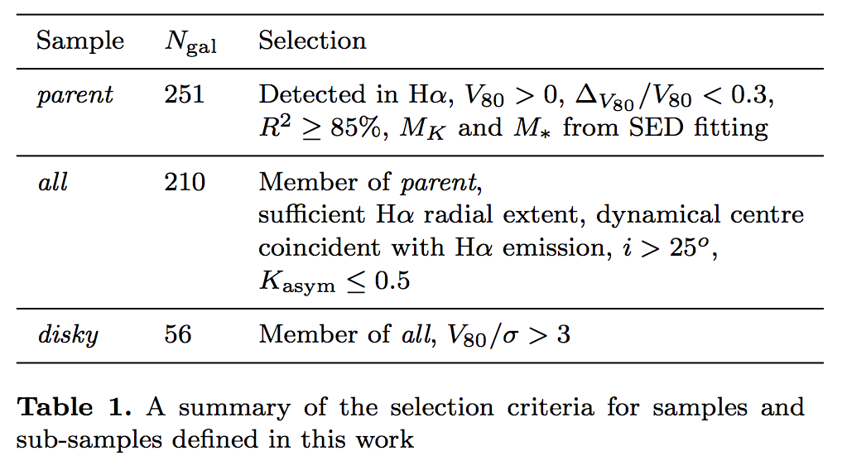
Sub-sample Selection

