Slide 1

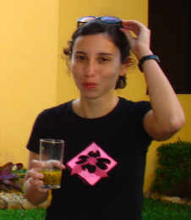


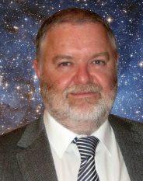

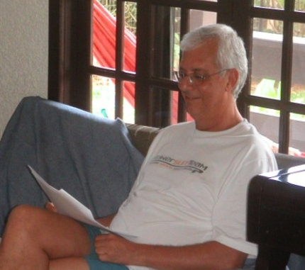






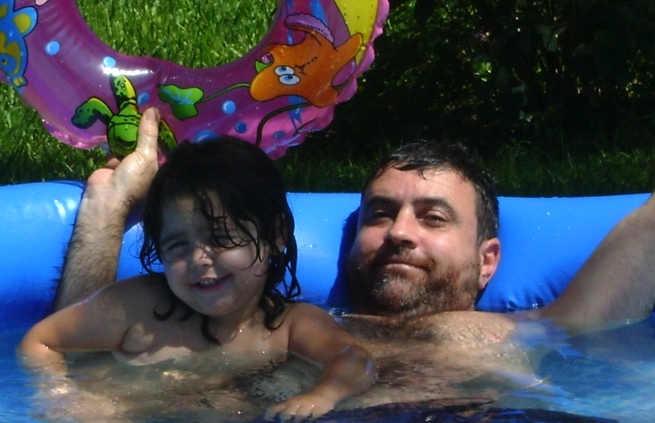

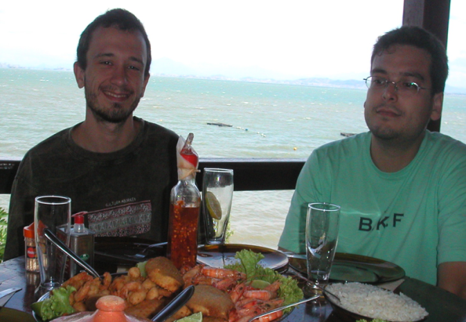
Lessons from (10 years of) spectral synthesis experiments with
STARLIGHT in 1, 2 & 3D
Rafael
López Fernández
Natalia
Vale Asari
Lesson #1: Gotta explore more constraints
Add photometry, emission lines, …
Lesson #2: Need a more realistic treatment of dust
Lesson #3: Gotta come to México more often!

Slide 2
STARLIGHT now can:
☑ Fit photometry: GALEX, 2MASS, …
☑ Fit (recombination) emission lines: Hα, Hβ, Hα/Hβ, …
☑ Fit dust-reprocessed (FIR) luminosity
all simultaneously to its λ-by-λ spectral synthesis.
☑ New constraints allow for more complex / realistic /
interesting modelling of galaxies.

Slide 3
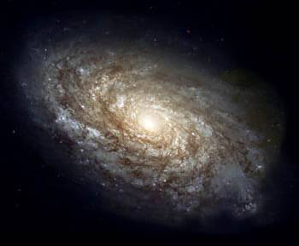
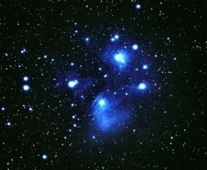
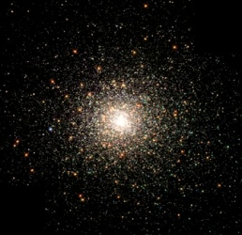
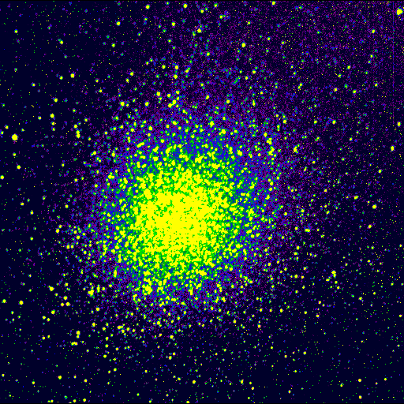


STARLIGHT: The (old) recipe
x₁ + x₂ + x₃ + ...
M(λ) = Σ x(t,Z) × Base(λ;t,Z) × e^{- τ(t,Z) ×} ^{q(λ)}
^{t,Z}
Optical spectrum
light or mass fractions
x = pop vector
Spectral Base
usually SSPs from BC03, MILES, …
Dust
τ (t,Z) ➔ τ
Notes:
PULAR SE NECESSARIO!

Slide 4
STARLIGHT
Physical properties & SFH recovered via full spectral fitting (optical or NIR)
SFH
Σ SSPs (BC03, ...)
CF et al 04, 05 …
log t [yr]
Asari et al 07
Notes:
This simple recipe produced several papers/results. All based on a very simple/simplistic galaxy-model.
Very flexible in SFHs but too rigid/simplistic in dust-geometry
ADD ANIMATION W/SEVERAL PLOTS OF PAPERS!

Slide 5
Caveats / weaknesses
☹ Limited λ-range (optical spectra)
☹ Fits only star’s light (no gas / dust emission)
☺ SFH very flexible (non-parametric)
☹ … but single τ attenuation model too simplistic
(? What does STARLIGHT’s τ mean, anyway ?)
New stuff
☺ Fit photometry: GALEX, 2MASS, …
☺ Fit (recombination) emission lines: Hα, Hβ, Hα/Hβ
☺ Fit dust-reprocessed (FIR) luminosity
☺ New constraints allow more complex/realistic 2 τ’s model

Slide 6
Part I
Adding photometry to
STARLIGHT

Slide 7
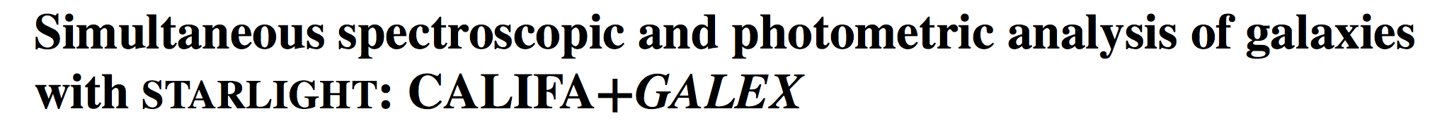
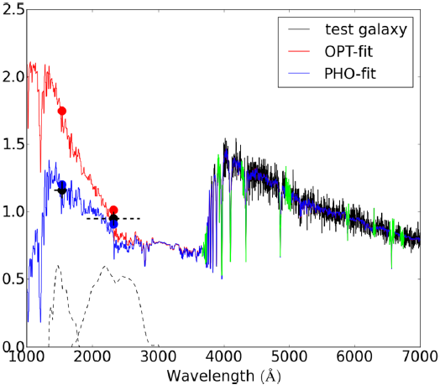
López Fernández et al 16
optical-only fit overestimates UV ☹
optical + UV fit matches both ☺
fits are ~ identical in the optical !
FUV
NUV
Notes:
Tendency to overpredict UV: Due to small (tea-spoon) fractions of young stars , irrelevant for optical but disastrous in the UV!

Slide 8
López Fernández et al 16
SFH changes are only significant for low mass, late type galaxies, which become a bit older with UV-data.
Empirical relations between mean age and observables become less dispersed with UV-data.
opt+UV
opt-only
opt-only
opt+UV
NUV – r
u – r
D_{n}(4000)
Notes:
UV-info helps in AGZ degeneracy
Dust & mass do not change (< 0.1 dex)

Slide 9
Parts II & III
The meaning of τ in STARLIGHT
Adding emission lines to STARLIGHT fits
Steps towards a realistic treatment of dust: fits w/2 τ’s

Slide 10
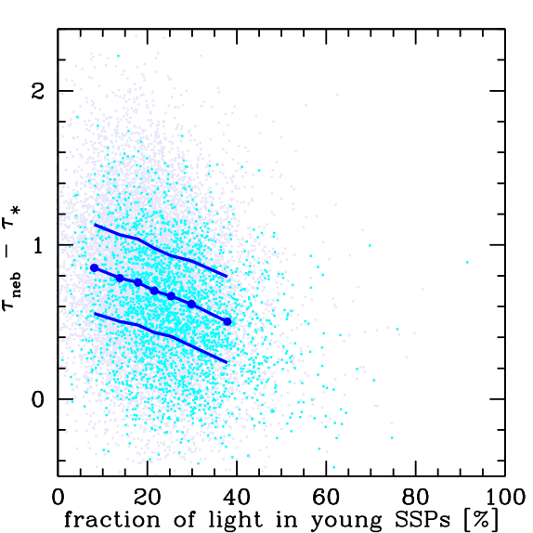

Dust x stellar populations in single τ fits
No differential extinction when looking at HII regions
Notes:
Both a nice result and a problem…
The meaning of STARLIGHT’s tau: A mix of st pop and dust… they become entangled because we do not differentiate tau_Y and tau_O

Slide 11
Towards a more realistic model: 2 τ’s
τ_{bc}
τ_{O}
τ_{Y}
τ_{Y} = τ_{o} + τ_{bc} t < 10⁷ yr
τ_{O} t > 10⁷ yr
τ(t,Z) ~ τ(t) =
τ_{Y} ≈ τ_{neb} = τ(Hα/Hβ)
Observed Hα/Hβ constrains τ_{Y}.
Continuum constrains τ_{O} & τ_{Y}.

Slide 12
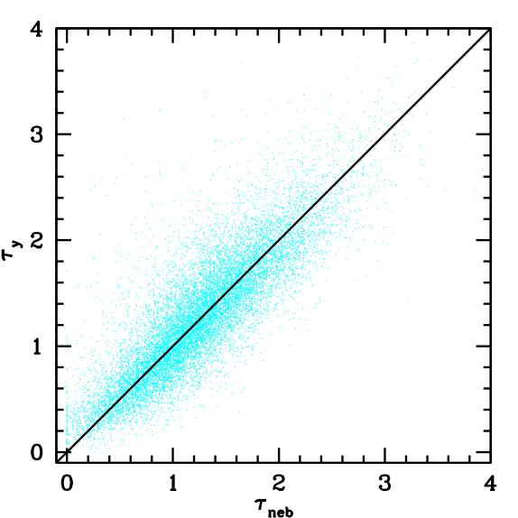
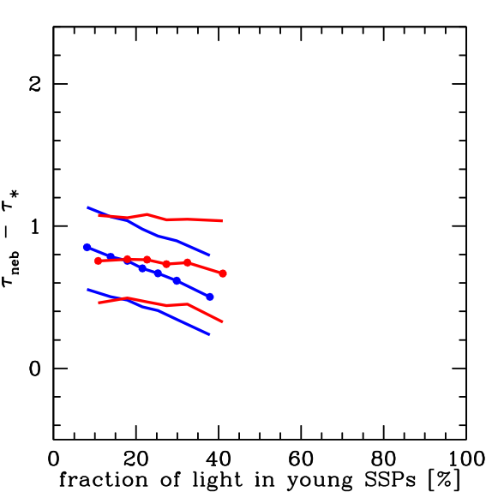
Tests w/14000 SF galaxies
STARLIGHT fits to optical spectra AND Hα/Hβ.
τ_{O}
τ_{Y}
τ_{neb}(Hα/Hβ)

Slide 13
STARLIGHT now can:
☑ Fit photometry: GALEX, 2MASS, …
☑ Fit (recombination) emission lines: Hα, Hβ, Hα/Hβ, …
☑ Fit dust-reprocessed (FIR) luminosity
all simultaneously to its λ-by-λ spectral synthesis.
☑ New constraints allow for more complex / realistic /
interesting modelling of galaxies.

