Slide 1



Blowin’ in the wind:
feedback from QSO outflows at high-z
Text by: G. Cresci, A. Marconi, M. Brusa,
V. Mainieri, S. Carniani, M. Perna et al.
Music by: B. Dylan
The interplay between local and global processes in galaxies
Cozumel, 12/4/2016

Slide 2
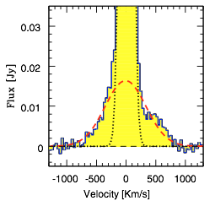
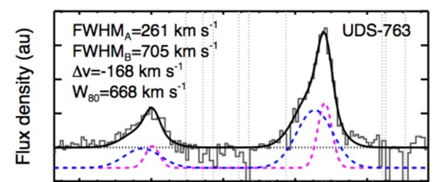
AGN Negative Feedback on host galaxies
Galaxy-scale Outflows routinely observed as broad wings of forbidden lines in ionized gas and in molecular/neutral gas
Local galaxies:
Feruglio et al. (2010): massive
molecular outflow from CO(1-0)
in Mrk231
(see also Feruglio et al. 2013, Cicone et al. 2014, Sturm et al. 2011, Rupke & Veilleaux 2012, Davies et al. 2014, Feruglio et al. 2015, Tombesi et al. 2015, also Rodriguez-Zaurin et al. 2011, Zakamska & Green 2014, Liu et al. 2012,2013, Greene et al. 2009, 2012, etc)
High-z galaxies:
Harrison et al. (2015): KMOS on z~1 AGNs
(see also Nesvadba et al. 2009, 2011, Alexander et al. 2010, Allen et al. 2011, Forster-Schreiber et al. 2014, Genzel et al. 2014, Maiolino et al. 2012, Harrison et al. 2012, 2016, Zakamska et al. 2015 etc.)
Many theoretical predictions, increasing evidences of widespread outflows,
but still few observations of feedback effects on host galaxies…

Slide 3
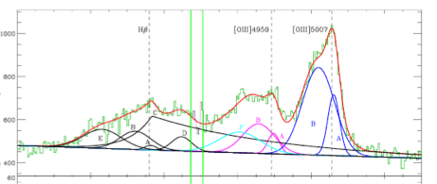
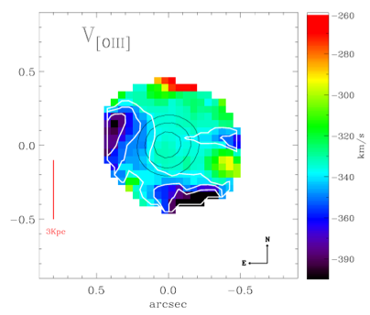
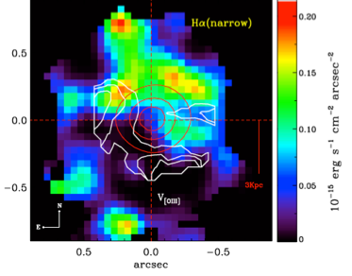
Negative Feedback: observational evidences
A first example of outflow effects on the SF in the host galaxy of a [OIII] luminous z=2.4 QSO
SINFONI H and K
observations:
very asymmetric and broad [OIII]
FWHM ~1500 km/s
Asymmetric blueshift in the velocity map
No star formation traced
by narrow Ha with fast outflow:
“negative” feedback
Cano-Diaz, Maiolino, GC et al. (2012)

Slide 4
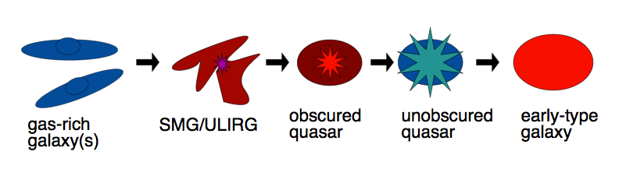
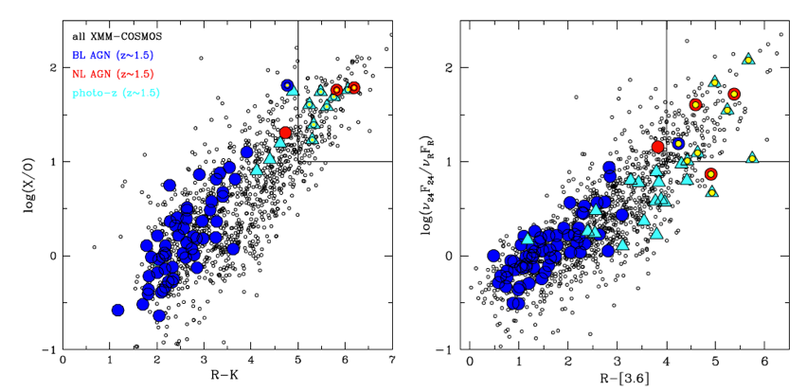

Selecting outflowing AGNs
Models predict:
short blow-out phase (<100 Myr)
BH growth and SF “simultaneous”
blow-out/feedback phase obscured but IR bright?
Selecting X-bright but optically obscured QSOs to catch feedback at its peak:
Large area X-ray survey: XMM-COSMOS
Selection based on X-ray to optical (luminous), MIR to optical (obscured) and NIR to optical (high-z) colors (Brusa et al. 2010)
10 brightest (Lx>44, K<19) targets at z~1.5
observed with
VLT X-Shooter
(Brusa, GC et al. 2015)
Massive (M*>10¹¹ M☉) but Main Sequence galaxies
All Radio-quiet
75% showing outflows
Brusa, Bongiorno, GC et al. (2014)

Slide 5
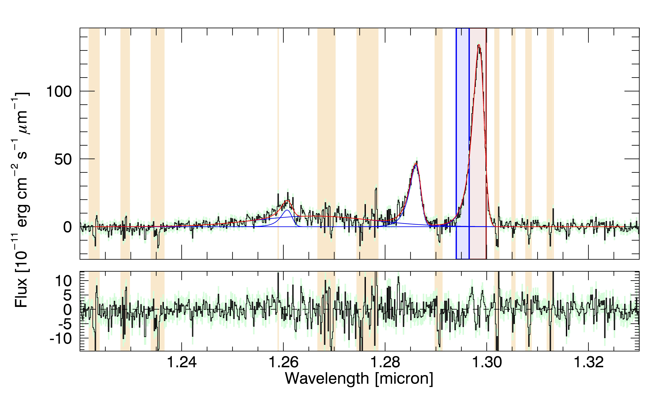
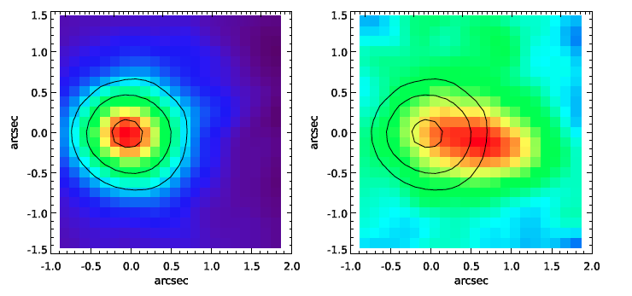
SINFONI observations of high-z feedback: XID2028
Integrated spectrum
on the central 1”x1”
J band, 6 hrs
Scale 0.125”x0.125”
PSF=0.6”
GC, Mainieri, Brusa, Marconi et al. (2015)
Integrated flux maps on the
line core (left)
and on the
line wing (right)

Slide 6
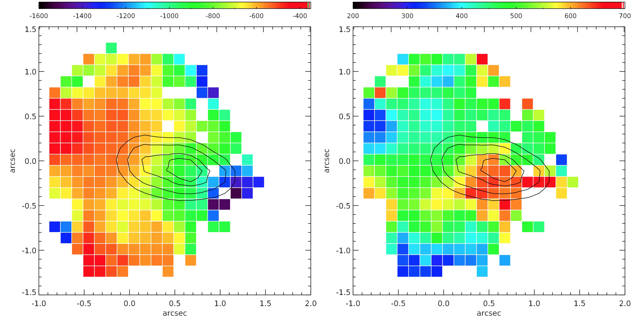
Outflow dynamics & energetics
Outflow with
v(out)~1500 km/s
out to 13 kpc
v10
W40
Dispersion peaking
at wing position
-> no rotation
high velocities and σ
-> outflow not infall
.
From Hβ luminosity we derive M_{(ion,out)}>300 M/yr
.
This translate in a mass loading factor M_{(out)}/SFR> 3
momentum flux P=M_{(out)}•v_{out}>10 L_{AGN}/c
Outflow velocity and energetics suggest AGN driven outflow
.
.

Slide 7
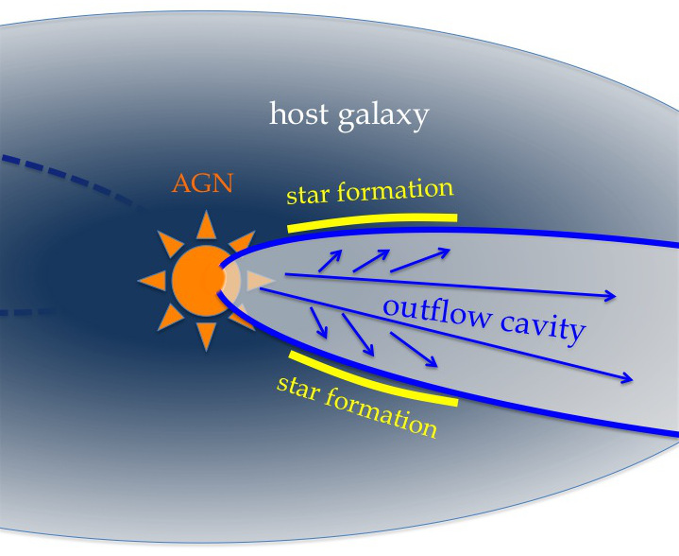
Outflow effects on the host galaxy
Line detected at 10σ
over SF regions
Low [NII]/Ha ratio
Log([NII]/Ha)<-1.1
supporting SF origin
Archival H band (20’)
integrated spectrum
on the central 1”x1”
Residual spectrum integrated on Regions A and B
Narrow Ha map with contours of:
Rest frame U band (HST)
[OIII] blue wing flux
Both “Positive” and “Negative” feedback in action

Slide 8
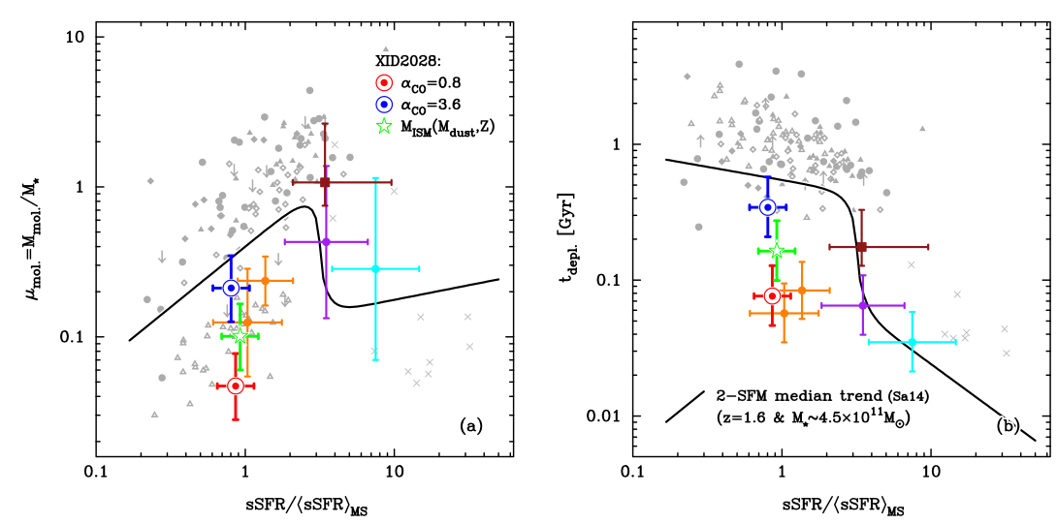
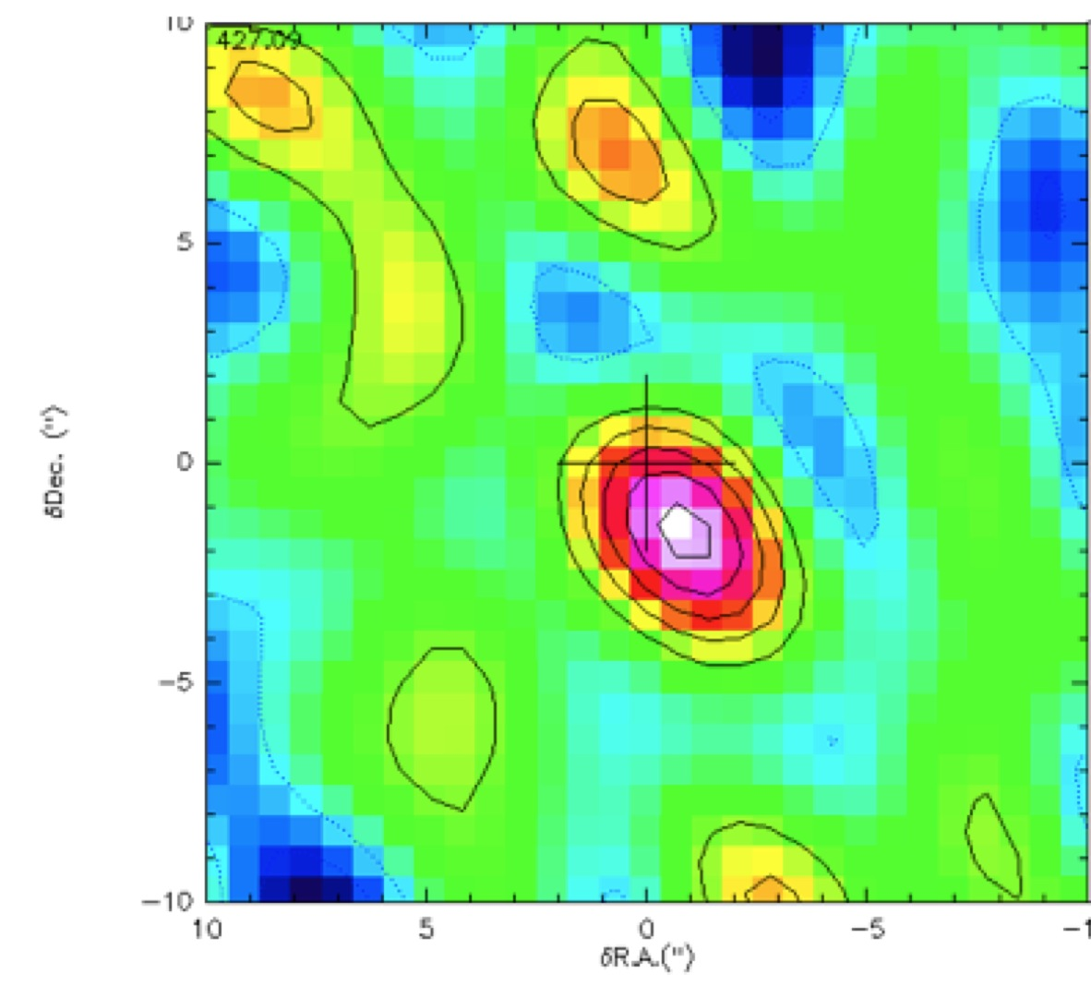
Gas content of XID2028
Depletion time scale vs.
“normalised” sSFR
IRAM PdBI observations
CO(3-2) observed @133.37 GHz; 5σ detection in 2.5 hrs
XID2028 is among the objects with the lowest gas fraction (<30%) for its sSFR detected so far at high-z and a clear outlier in the t_{depl}-sSFR plane, a factor ~2 to 10 below the expected position on the plot
Brusa, Feruglio, GC et al. 2015
Log L’(CO) ~ 10.55 K km/s pc²
M_{gas}~ 2-20 x 10¹⁰ M☉
(depending on α_{CO})
QSO feedback
Removing gas from the host

Slide 9
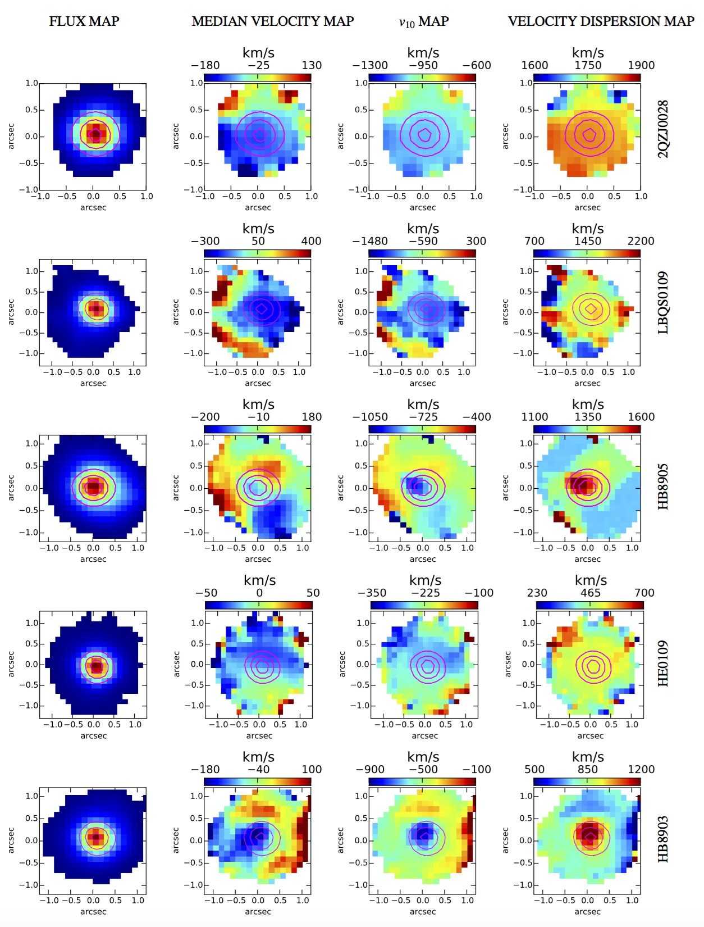
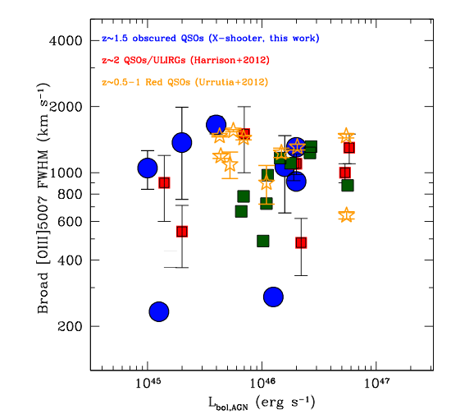
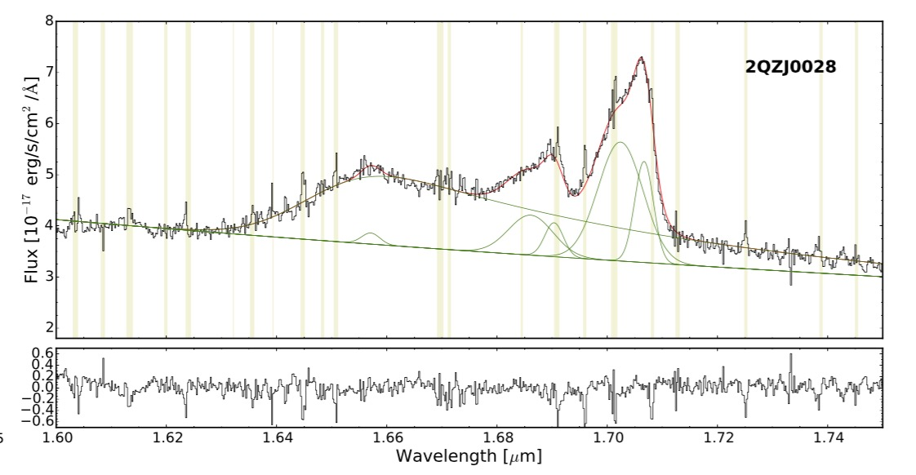
More outflows: High EW([OIII]) selection
Additional sample of 6 QSOs at z~2.4
selected for high EW([OIII])>10Å
observed with SINFONI:
5/6 show high velocity gas (v>500 km/s)
Carniani, Marconi, GC et al. 2015
Spatially resolved [OIII] kinematical maps for 5 objects:
Broad [OIII], FWHM ~ 1000-1500 km/s
Outflow velocities > 500 km/s

Slide 10
More feedback: High EW([OIII]) selection
Subtracting broad components from Ha
Line profile shows narrow components
At the same z and FWHM of [OIII] ones
No [NII] emission → Star Formation!
100-150 M_{sun}/yr
Narrow Ha
Narrow Ha emission tracing star formation is
anti-correlated with fast outflows:
“negative” (+ “positive”?) feedback revealed
Carniani, Marconi, GC et al. (2016)

Slide 11
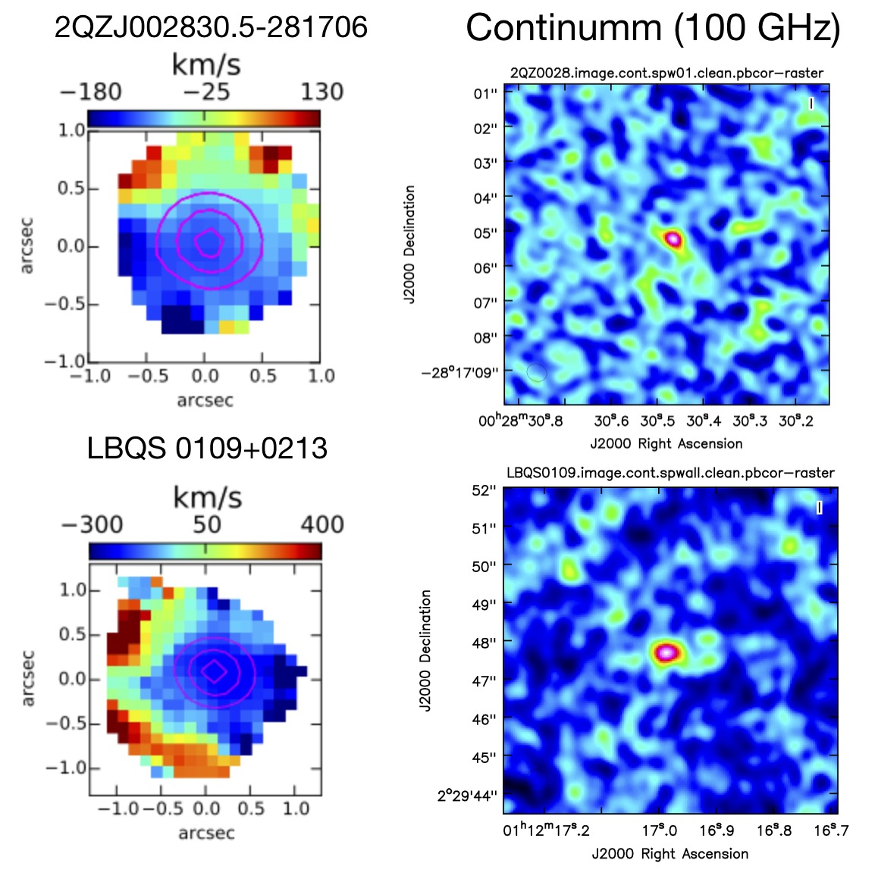
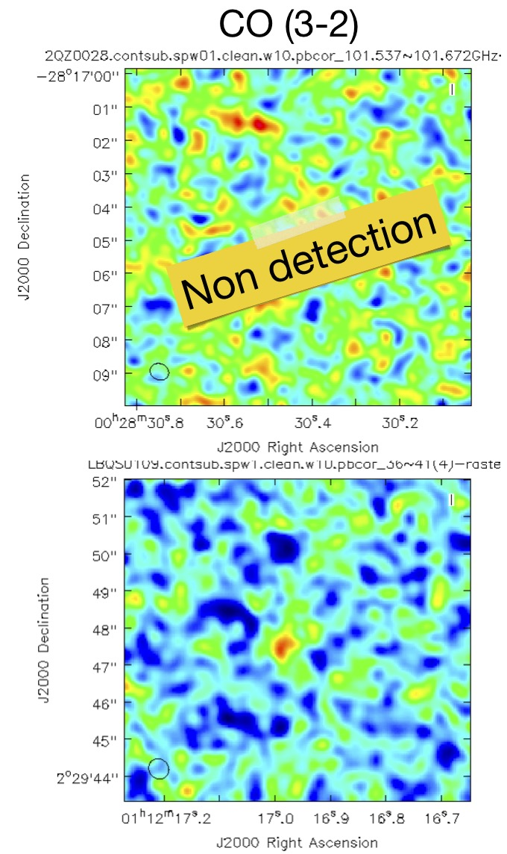
Preliminary results from ALMA Cycle 2
Follow-up of the two targets with Ha mapping: Band 3 0.5” beam (~ SINFONI PSF)

Slide 12
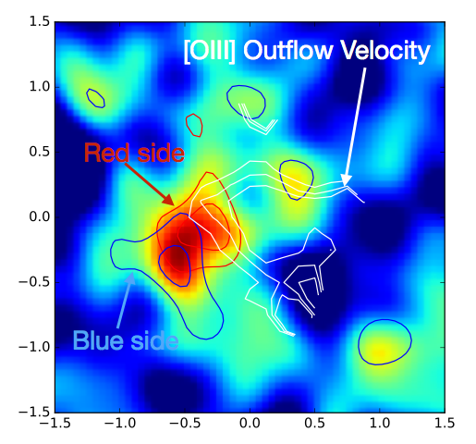
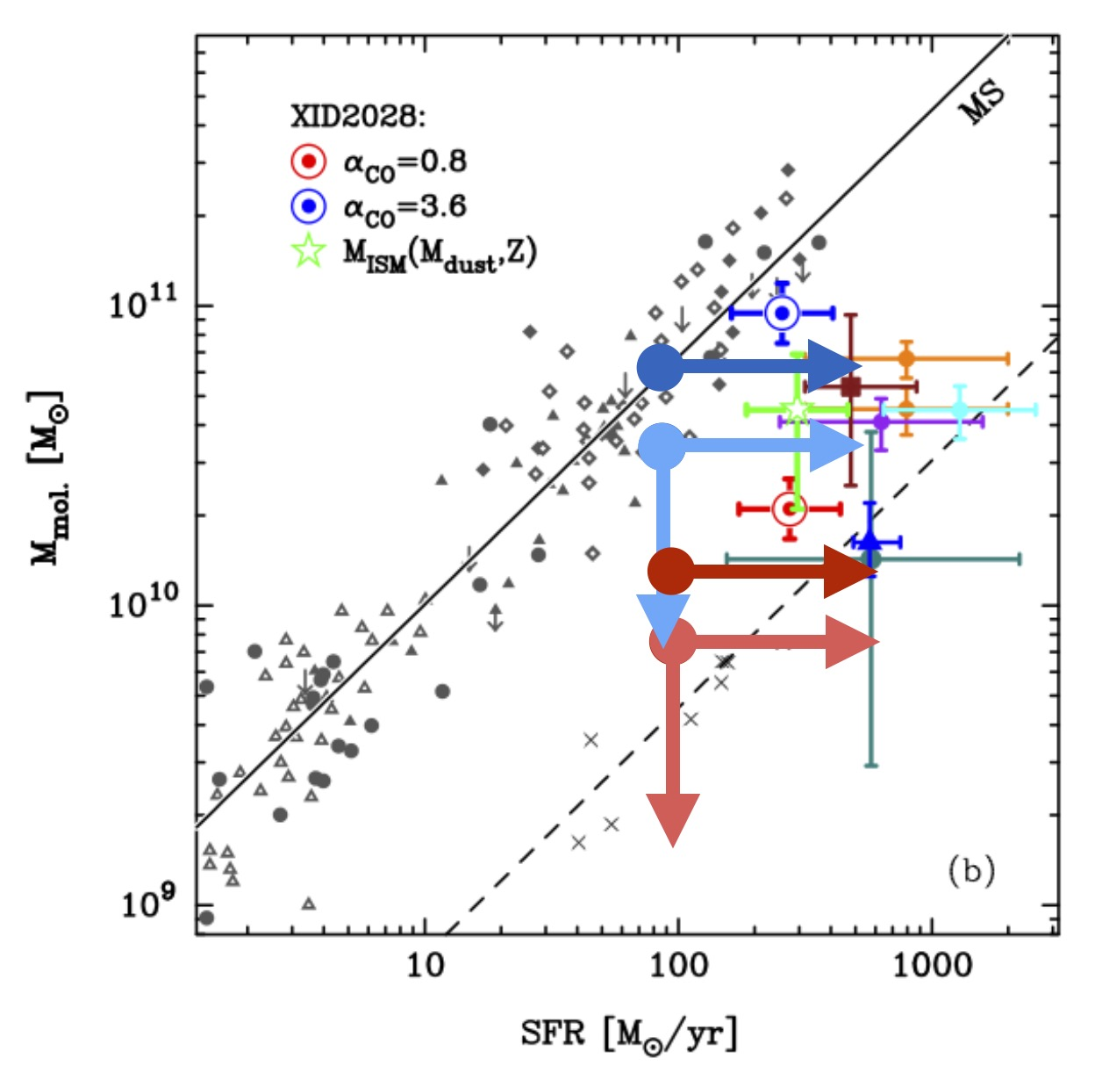
Preliminary results from ALMA Cycle 2
Expected velocity from narrow H𝛼
FWHM ~ 300 km/s
Horseshoe shape ~ anti-correlated
with outflow
Estimated H₂ mass: ~1.2 ×10¹⁰ M⊙:
QSO Feedback?

Slide 13
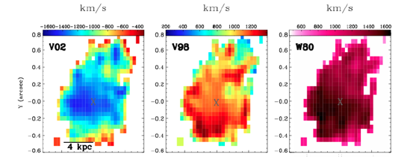
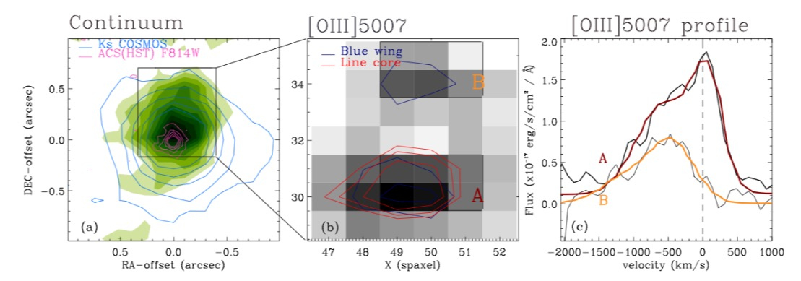
More outflows with different selections
An extreme [OII] emitter at z ∼1.47
observed with
SINFONI + NGS AO (~0.2”):
Both blue and red fast components (v>1000 km/s)
Brusa, GC et al. 2016
3 Obscured Compton-Thick QSOs at z ∼1-2.5
observed with SINFONI:
Fast (v~1500 km/s) extended (R~5 kpc) outflow in the highest S/N target
Perna, Brusa, GC et al. 2015

Slide 14

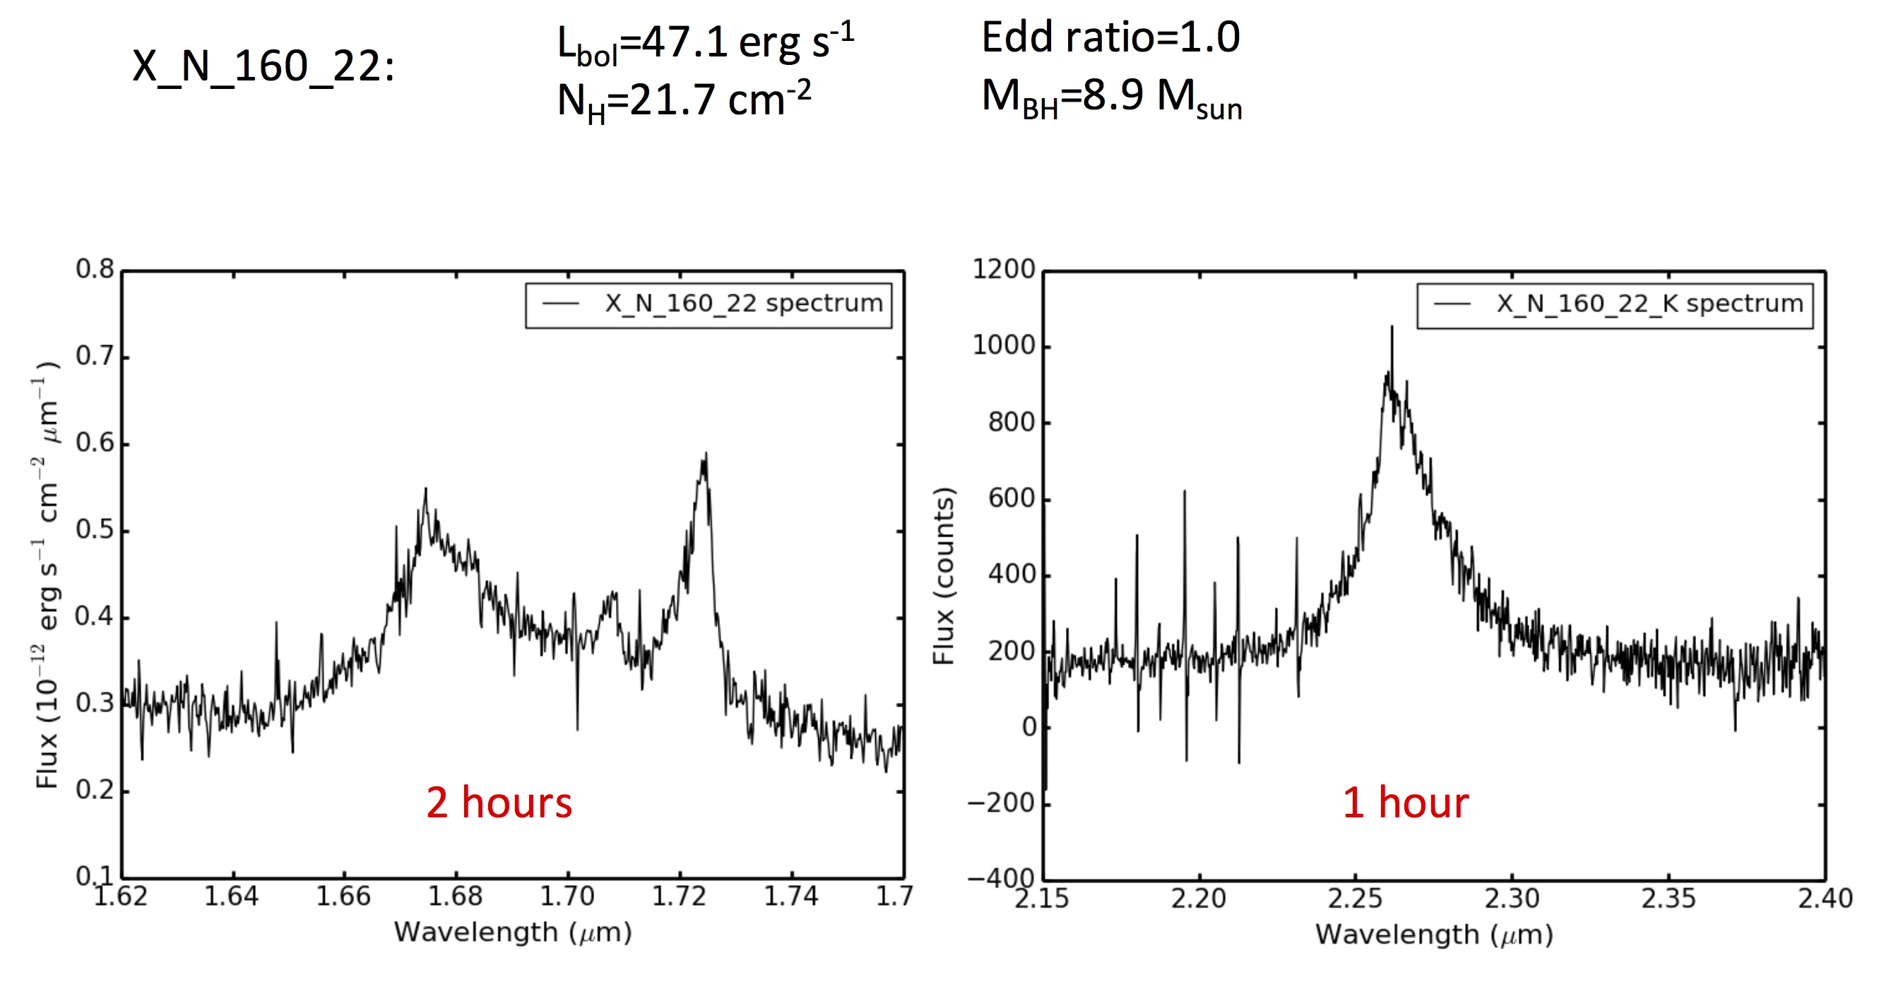
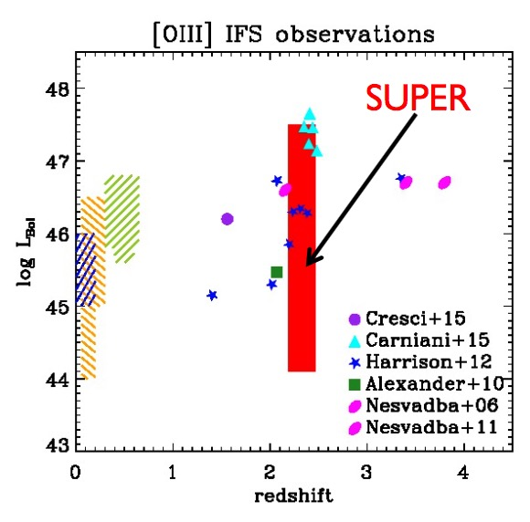
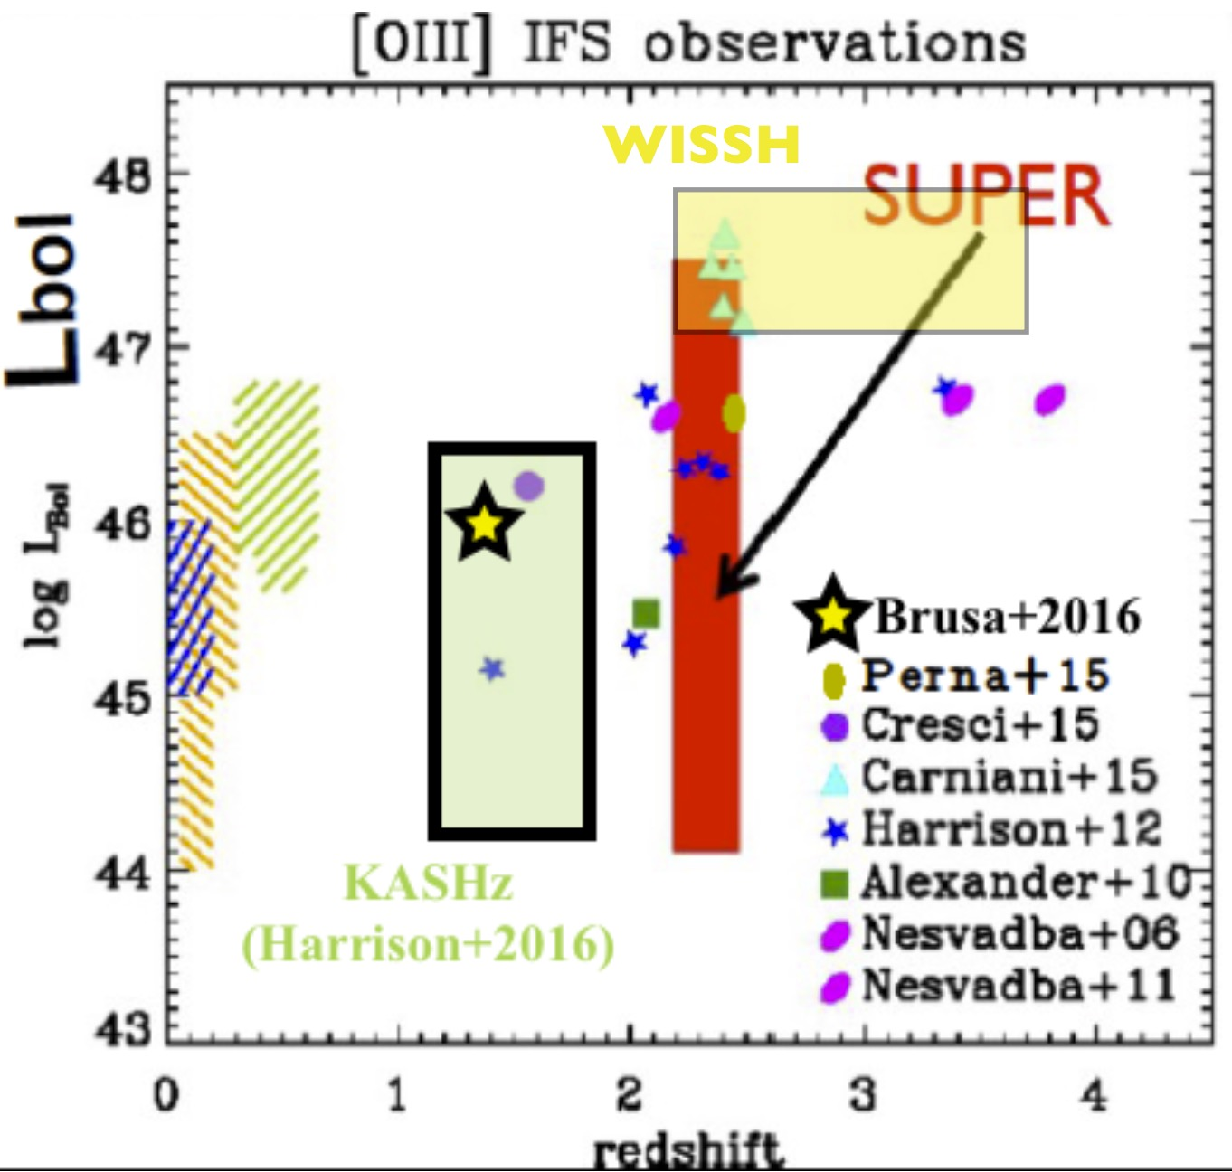
An unbiased search of outflowing AGNs: SUPER
a SINFONI Survey for Unveiling the Physics and Effects of Radiative feedback
An ESO large program, 280 hrs in 2 years
~7 hrs/obj in 40 X-ray selected AGNs at z=2.3
observing Large range in L_{BOL}, L_{edd}, Type 1 and Type 2, N_{H}
LGS-AO, H+K bands: both outflows from [OIII] and SF from Hα
Explore outflow power and demography as a function of AGN & host properties in unbiased sample
PI: V. Mainieri
Observations ongoing! First data from P96

Slide 15

Blowin’ in the wind: Summary
Negative feedback: the wind removes seeds from the flower head; you express desires, but the flower gets bold and dead… Finally observed in QSOs hosts as well, through IFU spectroscopy and ALMA CO mapping
Positive feedback: the wind spreads the seeds, that rapidly colonize the circumflower soil (CFS), resulting in several new offsprings… First evidences suggesting Star Formation induced by QSO outflows as well
Is feedback really affecting the whole galaxy as the dandelions?
Till now evidences of direct gas removal on part of the host gas reservoir More observations needed (ALMA, MUSE, SINFONI…) and statistical analysis on unbiased samples outflowing galaxies as the SUPER survey

Slide 16
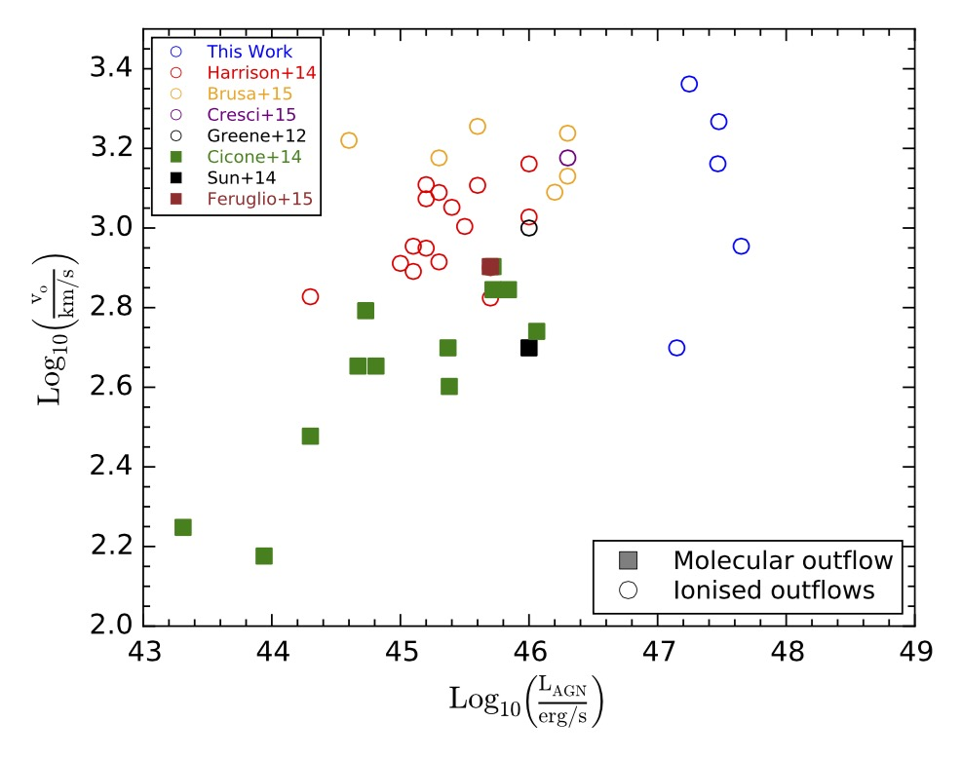
Ionised Outflows Vs Molecular Outflows
Outflow velocity
Outflow rate
Molecular
Momentum rate
Kinetic power
Ionized
Notes:
Edot = ½ Mdot v^2~~5% of LAGN according to King et al. to couple
Pdot= Mdot v =➔ outflow momentum rate, models → Pdot~20 Lagn/c in energy conserving

