Slide 1

Galaxy meets Halo
Mary Putman
(Columbia University)

Slide 2
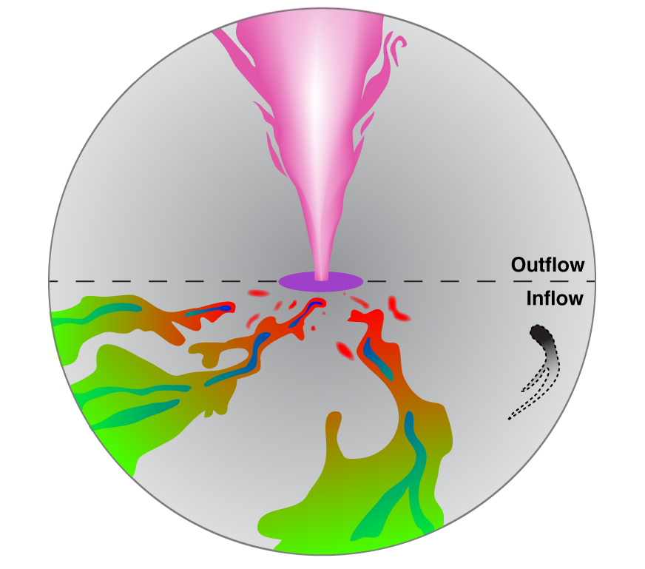
Putman, Peek, Joung (2012)

Slide 3
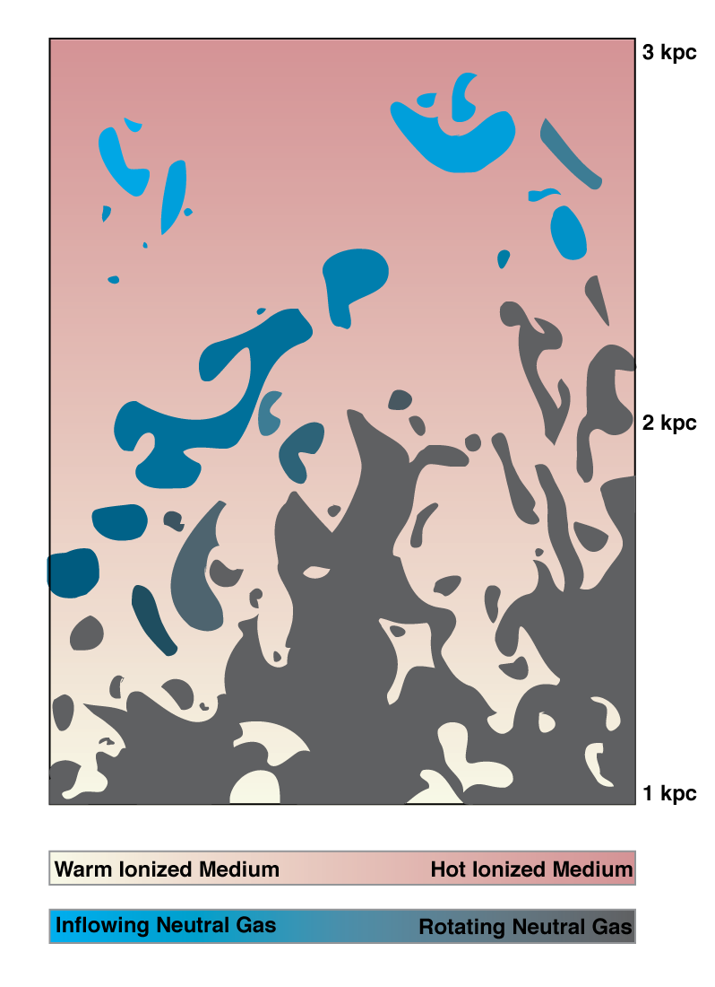
Halo
Disk
Notes:
Zoom in, gets messy, Temperature and rotation gradient as you approach the disk
Some general characteristics as you approach the disk (sticking with gas now)

Slide 4
Digging out the signatures of outflow and inflow
Outflows – see talks today
Inflows………..
  Mostly indirect evidence

Slide 5
Feeding Galaxies Star Formation Fuel: The Inflow Problem
Large SFR’s throughout the universe without the kinematic signatures of inflow (e.g., Amorin et al. 2012, Hopkins et al. 2008, Frye et al. 2002)

Slide 6
Feeding Galaxies Star Formation Fuel: The Inflow Problem
Large SFR’s throughout the universe without the kinematic signatures of inflow (e.g., Amorin et al. 2012, Hopkins et al. 2008, Frye et al. 2002)
Cold atomic gas not significantly decreasing with time

Slide 7
More stars forming over time with relatively constant cold atomic fuel (i.e., it must be continually replenished)
HI
ρ
(M_{o}/Mpc³)
STARS
1 2 3 4
z

Slide 8
Feeding Galaxies Star Formation Fuel: The Inflow Problem
Large SFR’s throughout the universe without the kinematic signatures of inflow (e.g., Amorin et al. 2012, Hopkins et al. 2008, Frye et al. 2002)
Cold atomic gas not significantly decreasing with time
Look for a relatively slow inflow of diffuse, warm gas at disk-halo interface of a galaxy (quiet accretion; Putman et al. 2012)
Notes:
How do you detect low density, warm inflowing gas

Slide 9
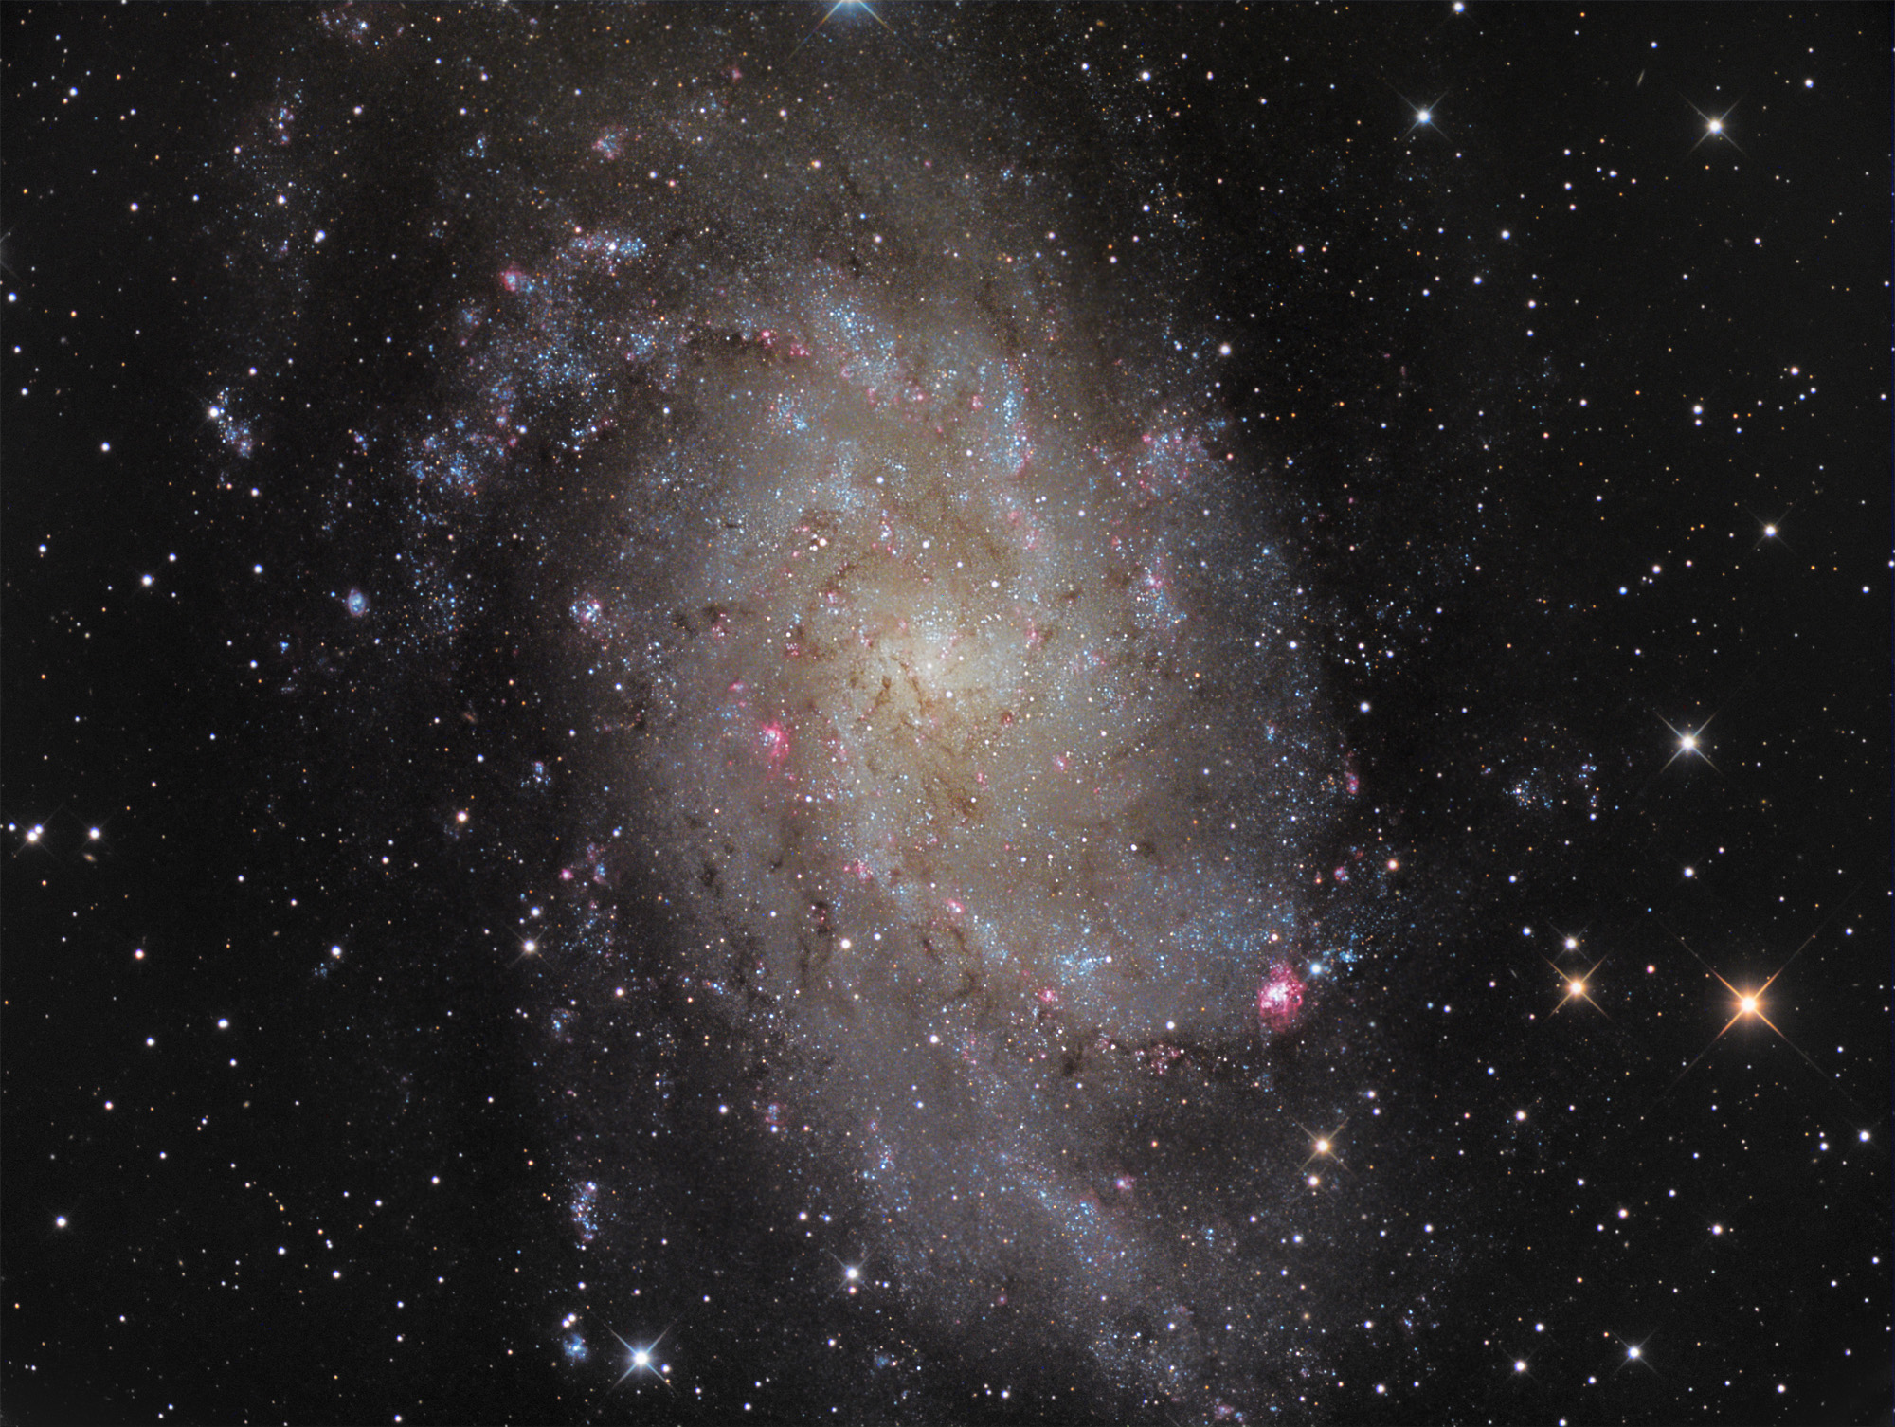
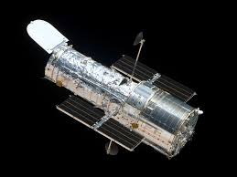
QSO
Notes:
Most absorption line experiments use a background QSO.
Detect an absorption line redshifted compared to the galaxy velocity, could be gas flowing in on the near side or out on the far side

Slide 10
Notes:
Star in galaxy, only one choice, redshifted velocity compared to galaxy indicates inflow

Slide 11
Flows at the Disk-halo Interface
M33
Small spiral galaxy (M_{tot} ~ 5 x 10¹⁰ M_{sun})
Close enough for UV bright stars (~840 kpc)
Face-on enough to make flows understandable (~55º)
Forming stars at 0.7 M_{o}/yr
Notes:
= red and dead in < 2 Gyr without inflow

Slide 12

HST/COS observations of M33 stars
8 O/WR type stars
  Resolution: 10-15 km/s
  Detect gas at ~10^{4-5.5} K in absorption (P II, S II, Fe II, Si IV CII, Si II, Si III)
Neutral Hydrogen data sets the central velocity
Zheng, Peek, Werk, Putman (in prep.)
Notes:
2.5” = 10 pc at M33, smaller than most OB assoc, but could be more than one star
So the red data points here show the location of our background stars, quite spread out in the disk from the center to the outskirt. We observed a number of ions, including weakly ionized PII, SII, FeII, while roughly trace cool gas at temperature of 1e4 K. Then we resolve intermediately ionized SiIV line, which loosely corresponds to gas with temperature of 1e5 K. These lines are all non-saturated; We have also two ions that are mostly saturated, including CII, and Si III, they are not in great use in this work.
On the other hand, we make use of two HI observation. VLA observation has angular resolution of 25 arcsec, which help to map the dense HII regions in the disk, we use this to derive the rotation velocity of the gas disk at the position of the stars. Then for GALFA-HI, the larger beam size enable us to capture the diffuse HI pervading the disk and above the disk, we use this data set to calculate the correponding HI column density related to the high velocity features we find from our ion absorption. I will get to this in a minute.
Most of our COS observation was done last year, and one of the target, S1 in this map was observed a couple of years ago by another group of author.

Slide 14
Direct Observation of Inflow
across the Disk
Notes:
Si IV warm gas at ~10^5 K

Slide 15

Nature of the Inflow – Kinematic Modeling
Accreting Layer at the Disk-Halo Interface
Start with M33 tilted ring model (Corbelli & Schneider 1997)
Add a layer with a given z-height and accretion velocity
Best Fit: z = 1.5 kpc, v_{acc} = 110 km/s
Notes:
This is the SiIV.
Most likely kinematic model given variation across disk in strength and velocity

Slide 16
Kinematic Modeling
CASE 2 - M33 Halo Cloud
V_{hc} ~ -110 km/s, 35 km/s to M33
D_{hc} ~ 130 kpc
R_{hc} ~ 4 kpc
M_{hc}~10⁶ M_{sun}
(Stocke+13; Werk+14)
Notes:
Cant see gas at these velocities in MW halo, but almost certainly there
Cloud is at same velocity relative to us, only 35 km/s relative to M33

Slide 17
M33’s accreting layer
Mass across disk ~ 2 x 10⁷ M_{o}
Accretion of ~1.5 M_{o}/yr
Explains M33’s current and past star formation (e.g. Magrini et al. 2007)
Clear kinematic signature of inflow across a star forming disk
Can we see this for other galaxies?
Potential in deep Hα observations
Similar UV observations show only outflow for the LMC (Lehner, Staveley-Smith, Howk 2009)
Notes:
metallicty of 0.1, Yong 0.16 both sides 2.5x10^7 and 1.9 Msun/yr
Large quantities of baryons in galaxy halos, but level of heating preventing cooling/inflow uncertain

Slide 18
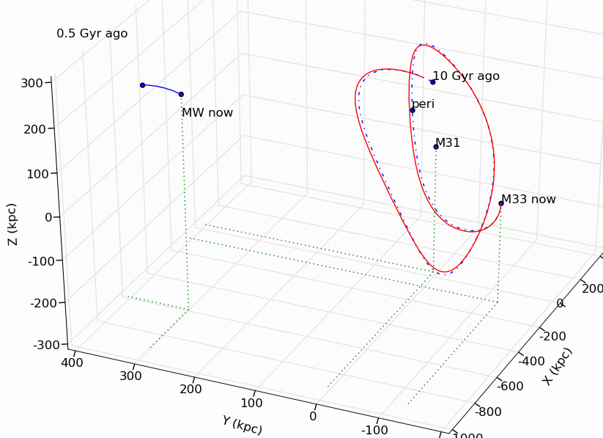
Reason we see it for M33? Fall back of fuel after interaction with M31
(Putman et al. 2009; see also van der Marel et al. 2012)
Notes:
Evidence for the opposite from the LMC which is currenlty being stripped and SFR ~0.2 Mo/yr
we find a previous close encounter (<100 kpc) between the two galaxies is highly likely (> 75% of the orbits for the most
likely V(M31)tan < 150 km s−1), resulting in a tidal radius for M33 of < 15 kpc. This
suggests a satellite of M33 would not remain bound to it and the gaseous features were
most likely tidally pulled directly from M33 in the past 3 Gyr.

Slide 19
M33’s accreting layer
Mass across disk ~ 2 x 10⁷ M_{o}
Accretion of ~1.5 M_{o}/yr
Explains M33’s current and past star formation (e.g. Magrini et al. 2007)
Clear kinematic signature of inflow across a star forming disk
Can we see this for other galaxies?
Potential in deep Hα observations
Similar UV observations show only outflow for the LMC (Lehner, Staveley-Smith, Howk 2009)
Halo gas initial sign of quenching (e.g. Yoon & Putman 2013)

Slide 20
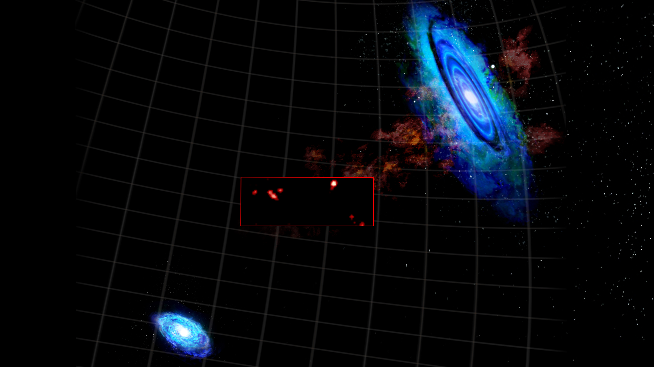
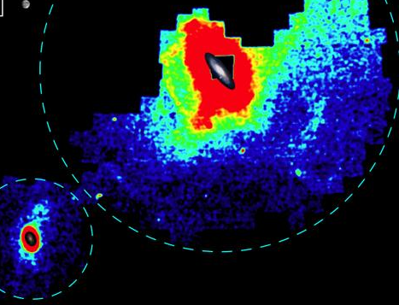
Disk Meets Halo
Wolfe et al.2013, Ibata et al. 2014
Notes:
Not a clear meeting point (sand/water isn’t really either)

Slide 21
Notes:
Shade represents relative column

Slide 22
Muzzin et al. 2013
Neelemann et al. 2016

Slide 23
A Close Look at M33
Why not MW?
  Galactic absorption/emission blocks the view
  Galactic rotation complicates the kinematics (Zheng et al. 2015)
Why M33?
  Small galaxy, Mtot ~ 5x10¹⁰ M_{sun}
  Active star forming: SFR ~ 0.7 M_{sun}/yr (Biltz & Rosolowsky 2006)
  Nearby: D ~ 840 kpc (Freeman et al. 1991)
  Free from MW contamination: V_{LSR} (M33) ~ -179 km/s (Corbelli & Schneider 1997)
  Inclination (49): study of both gas accretion and halo lagging
(Putman+ 2012)
Notes:
M33 is quite a active star former given it is stellar mass, it is forming stars at a rate of 0.7 Msun/yr. It is only 840 kpc away from the MW, and move at 180 km/s towards the MW, so, it is blue-shifted. At such a close distance, we can use HST/COS to obtain high S/N UV spectra, and the systemic velocity ensures that the UV absorption from M33 will be free from the MW contamination.

