Slide 1
Are WE CORRECTLY Measuring the Star formation in galaxies?
Kristen B. W. McQuinn
McDonald Observatory
University of Texas at Austin
April 12, 2016

Slide 2
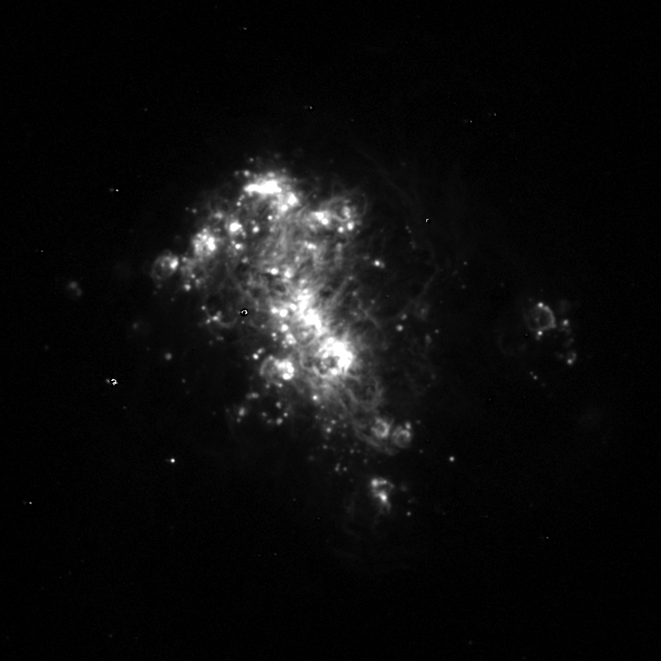
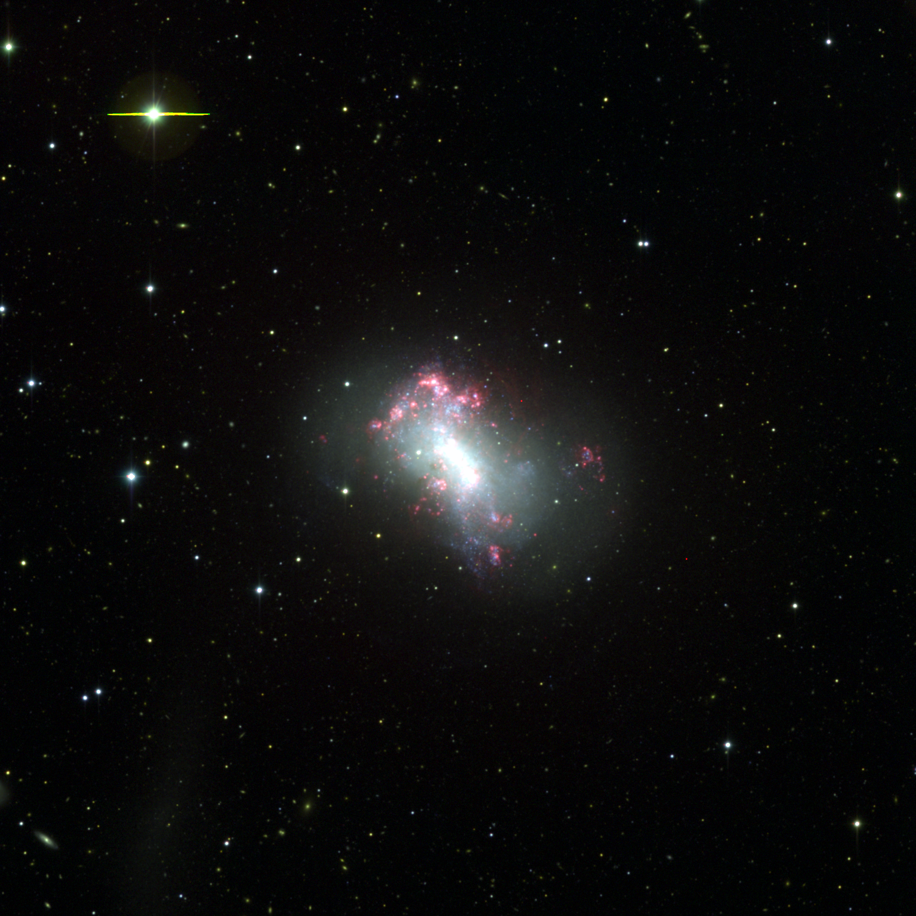
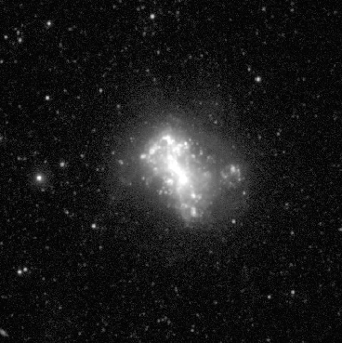
SFRs from Integrated light
Hα
NGC 4449
McQuinn et al. (in prep)
UV

Slide 3
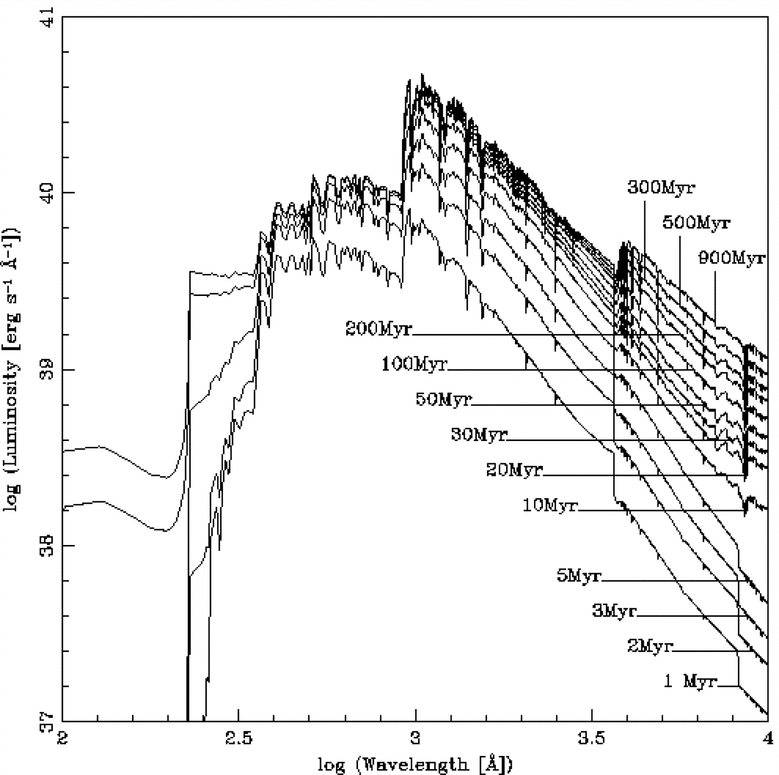
Synthetic spectra are used to calibrate the UV SFRs
Leitherer et al. (1999)
Starburst99
SFR (M/yr) | Ref.
1.4 x 10⁻²⁸ L_{FUV} | Kennicutt (1998)
1.33 x 10⁻²⁸ L_{FUV} | Hao et al. (2011) Murphy et al. (2011)
Where L_{FUV} is in units of erg s⁻¹ Hz⁻¹
Notes:
FUV 1528 A → log=3.18
NUV 2271 → log = 3.35
The "real" spectral synthesis capability was implemented in 1991, when we added Kurucz and Schmutz model atmospheres from the far-UV to the near-IR. This allowed us to calculate spectra and colors for young populations. Carmelle Robert included an IUE spectral library in the code in order to compute synthetic lines at 0.75 A resolution (ApJ, 418, 749 [1993], ApJS, 99, 173 [1995]).
Daniel Schaerer replaced the ancient Maeder (1990) tracks by the most recent (1992-94) model series of Geneva. He also implemented the capability to perform isochrone synthesis in addition to classical evolutionary synthesis. One of the subroutines used for this was written by Georges Meynet. We also decided to take advantage of the homogeneous atmosphere grid compiled by Lejeune et al. (1997) and replaced the original Kurucz models by the new set. The updated code was made available to the community via a spiffy website called Starburst99 (Leitherer et al. 1999, ApJ, 123, 3).
This isochrone synthesis technique is used in the Bruzual and Charlot models that do very similar things…
Indeed, models constructed using the BC03 code and the starburst99 code have been shown to produce consistent results (Hao et al. 2011)
Synthetic spectra are generated using isochrone synthesis (interpolation of isochrones over a mass grid). Spectra are calibrated using a database of empirical spectra of stars of difference stellar types (O, B, stars, etc.)
Look up SB99 and calibrations…atmospheres? Etc. stellar evolution libraries are used. IMF

Slide 4
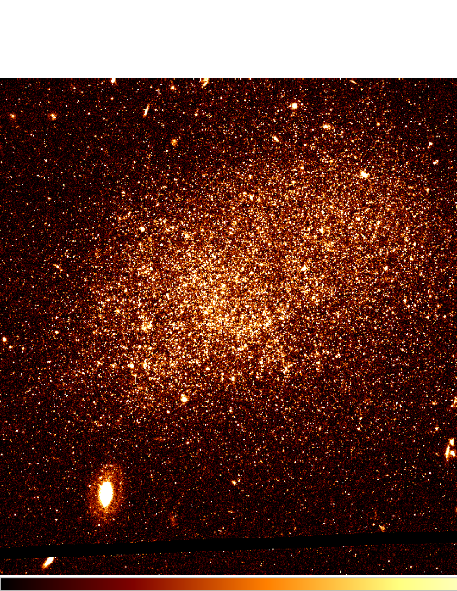
Star Formation Histories from stellar populations
The Story of UGC 9128
B
A
A
C
B
C
McQuinn et al. (2010)

Slide 5
Independent comparison is possible with
FUV SFRs and CMD-based SFRs
Sample Requirements
Quantified star formation histories
  Only possible in nearby galaxies (optically resolved stars)
Galaxies with recent star formation
  Ensures significant UV flux
Low extinction
  Galaxies with low metallicity
  Existing infrared data for best practice extinction estimates

Slide 6
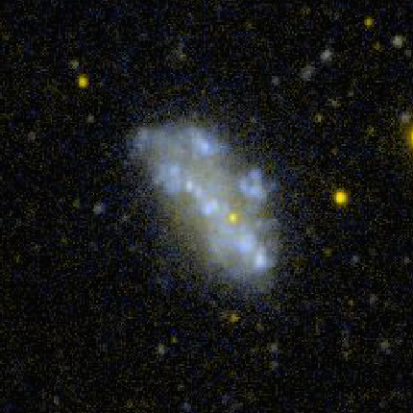
Integrated FUV SFR and CMD-based SFH
NGC 4068 GALEX UV Image
SFR_{FUV} = 1.33 x 10⁻²⁸ L_{FUV}

Slide 7
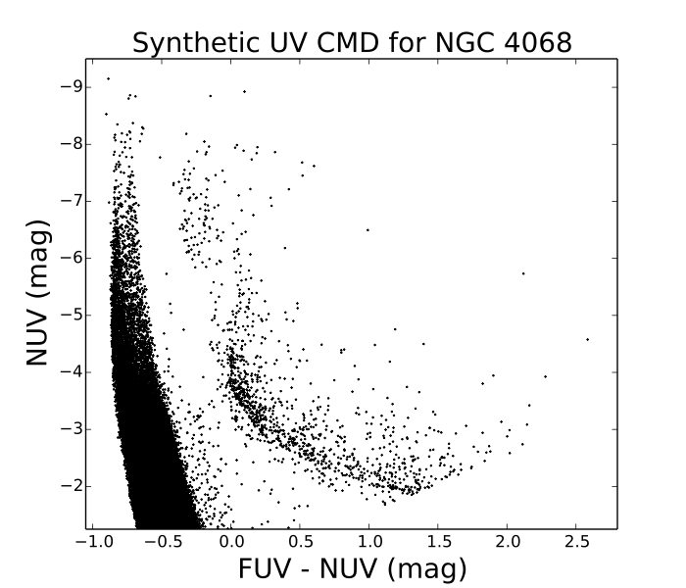
Check the inputs and the models
Input the CMD-SFRs into different models to predict the UV fluxes
Compare the UV fluxes to the observations
Synthetic Spectral Model
Synthetic Stellar Populations
Notes:
Checking:
Are the CMD-based SFRs accurately measuring the SF?
Are the extinction corrections accurate?
Are the SFRs affected by stochasticity?
Used 4 models
Pegase
Match
Slug
Bc03

Slide 8
Comparison of NUV Predictions with Observations
Extinction | ✔
Stochasticity | ✔
Stellar Evolution Models | ✔
CMD-based SFRs | ✔
Notes:
Overall, it’s pretty good.
Distinct model differences.
Pegase → biggest discrepancy in the FUV
Factor of ~2 between synethtic stellar pops and BC03
SLUG → Stochastic effects better modelled don’t change the result significantly

Slide 9
Comparison of FUV Predictions with Observations
Notes:
Overall, it’s pretty good.
Distinct model differences.
Pegase → biggest discrepancy in the FUV
Factor of ~2 between synethtic stellar pops and BC03
SLUG → Stochastic effects better modelled don’t change the result significantly

Slide 10
Comparison of CMD-based SFRs and FUV SFRs
Notes:
2 things to note:
General offset (not a scatter plot).
4 galaxies with very young massive clusters
Dispersion of the measurements
Note the small difference in calibrations being discussed in the literature.

Slide 11
Quantifying the difference between integrated FUV SFRs and CMD-based SFRs
McQuinn et al. 2015b
FUV SFR = 2.04 ± 0.81 x 10⁻²⁸ L^{O}_{FUV} (erg s⁻¹ Hz⁻¹)

Slide 12
Summary
Comparison between CMD-SFRs and integrated FUV SFRs are off by ~50%
Differences between SFR indicators are not due to poorly met assumptions or extinction
The UV SFR scaling relation, while easy to use, does not strictly hold. Secondary (non-linear) factors are not well-quantified yet.
McQuinn et al. 2015a,b UT at Austin

Slide 13
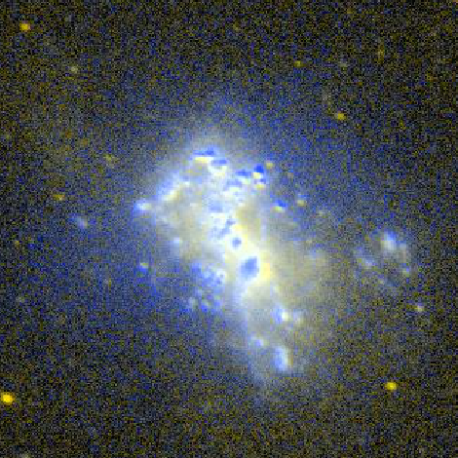
Is a scaling relation all that’s needed?
Notes:
High Surface Brightness Regions
Diffuse Emission – source of emission not understood; how does this impact a scaling relation?
Shape of SED over FV bandbass
Metallicity ~25%

Slide 14
Comparisons with other SFR Indicators can be uncertain…
Unknown star formation history
  UV based on constant SF over 100 Myr
UV and Hα can be significantly affected by extinction (and by differing amounts)
Possible stochastic sampling of IMF impacting observables
Integrated optical light does not scale linearly with SFR
Comparisons of stellar light with reprocessed stellar light
Differences between SFRs are often attributed to these uncertainties
Many of the indicators are calibrated using the same theoretical model…

Slide 15
Star Formation on Cosmic Scales…the ‘Lilly-Madau’ plot
Finkelstein et al. (2015)

