Slide 1
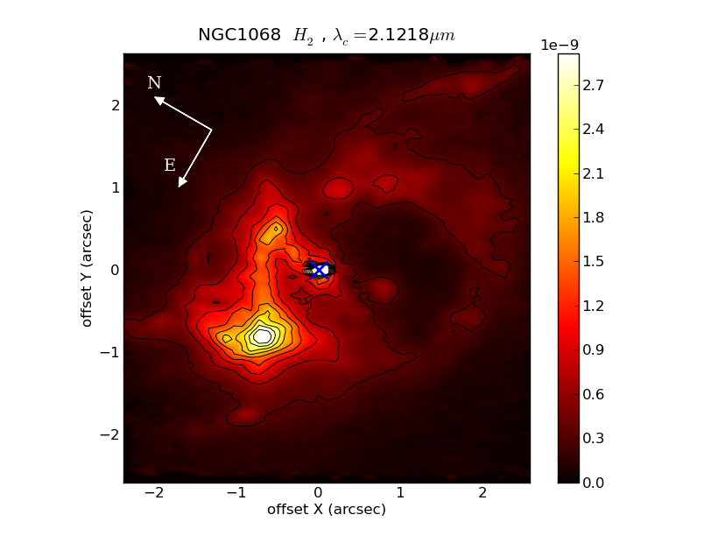
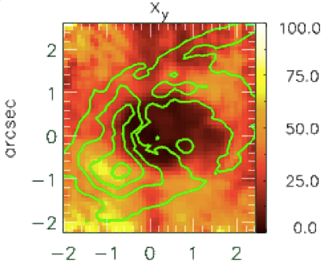
Recent results on the SB/AGN connection
Thaisa Storchi Bergmann
Instituto de Física, UFRGS, Porto Alegre, RS, Brazil

Slide 2
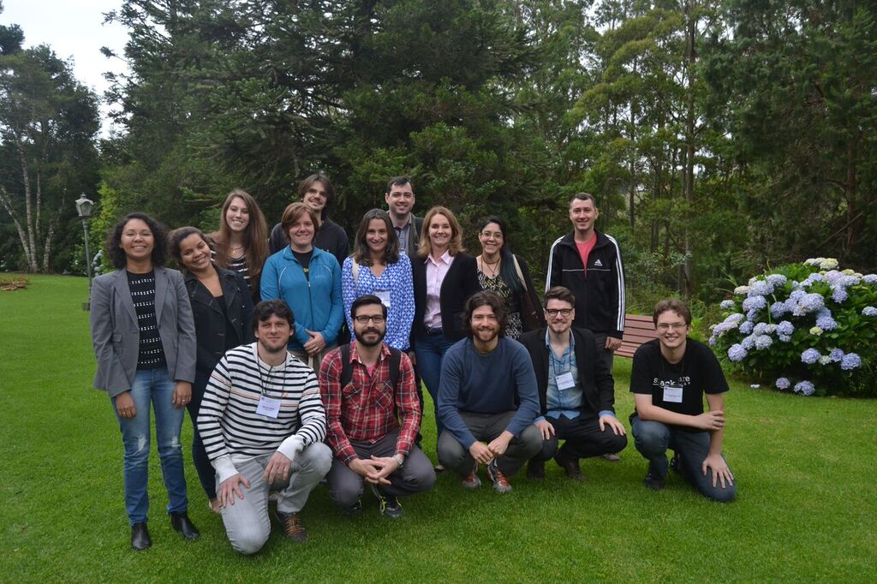
AGNIFS (AGN Integral Field Spectroscopy) collaboration: Feeding and Feedback in nearby AGN
Thaisa Storchi Bergmann
Rogemar A. Riffel
Rogério Riffel
Dinalva A. Sales
Jaderson Schimoia
Daniel Ruschell Dutra
Allan Schnorr Müller
Guilherme Couto
Astor Schönell Jr.
Marlon Diniz
Carine Brum
Hekateline Carpes
Izabel Freitas
Natacha Z. Dametto
Fausto K. B. Barbosa
Bruno Dall’Agnol de Oliveira
Mônica Tergolina
Nicolas D. Mallmann
Janaína Nascimento
Luis Gabriel Dahmer Hahn
Miriani G. Pastoriza
+
Richard Davies (MPE)
Andrew Robinson (RIT)
Luis Colina (CAB-CSIC)
Davide Lena (RIT)
Martin Elvis (CfA)

Slide 3
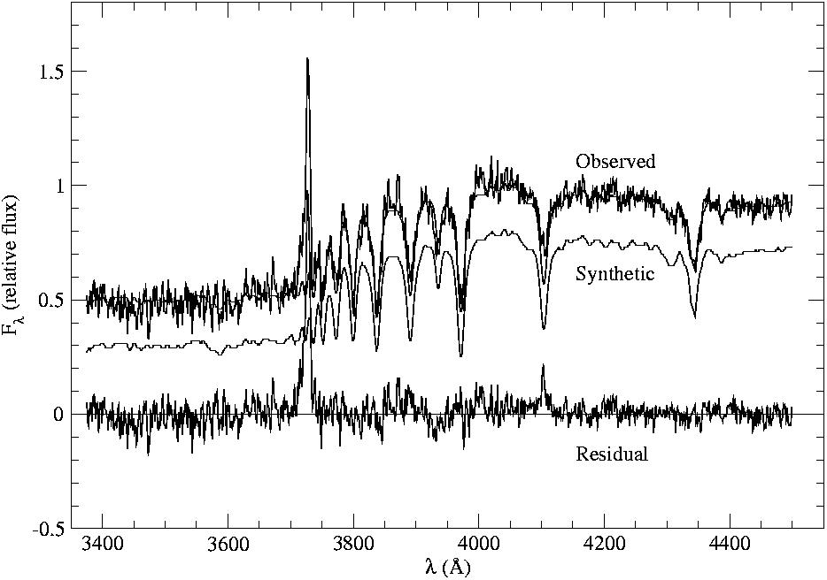
Previous studies integrated spectra (inner 300 pc – 1 kpc)
Terlevich+90-95, Heckman+95-98, Nelson & Whittle 1996, Origlia+90’s, Kauffmann+03 (SDSS-III) for luminous AGN: excess contribution of young to intermediate age stars to the spectra of AGN hosts;
Cid Fernandes +98, Storchi-Bergmann+98,+01, Schmitt+99, Gonzalez-Delgado+01: 50% of Seyfert 2 galaxies have young or intermediate age stars within inner ~500 pc;
Intermediate age stars: high order Blamer lines

Slide 4
Outline
Global: sampling 1-2 kpc scales - AGNs in MaNGA SDSS-IV (Mapping Nearby Galaxies at the Apache Point Observatory): preliminary results on stellar population synthesis
Local: sampling 10-100 pc scales – nearby AGN observed with Gemini IFUs
Relation with molecular gas
Conclusions and evolutionary scenario

Slide 5
Global: MaNGA AGN
MPL-4 (4th Product Launch): 1390 datacubes, 48 AGN
41: Low-luminosity AGN (SDSS-III)
Only 7 “Strong” AGN (Kaufmann+03): L[OIII]>10⁴⁰ erg/s, auxiliary sample (PI Jenny Greene)
LIneA (Laboratório Interinstitucional de e-Astronomia)

Slide 6
Paper I: first 48 AGN + 84 control sample – M, z, C, axial ratio (Rembold+16)
AGN Control Control
AGN Control Control

Slide 7
Paper I: first 48 AGN + 84 controls – matched in M, z, C, axial ratio (Rembold+16)

Slide 8
Paper I: stellar population synthesis of SDSS-III spectra (using Starlight, Cid Fernandes 2005)
0.5-10 x 10⁶yr
25-40 x 10⁶yr
100-290 x 10⁶yr
640-905 x 10⁶yr
1-2.6 x 10⁹yr
4-13 x 10⁹yr

Slide 9
Paper I: stellar population synthesis of SDSS-III spectra (using Starlight, Cid Fernandes 2005)
Low-luminosity AGN: no difference from controls

Slide 10
Paper I: stellar population synthesis of SDSS-III spectra (using Starlight, Cid Fernandes 2005)
Strong AGN: more intermediate age star formation?

Slide 11
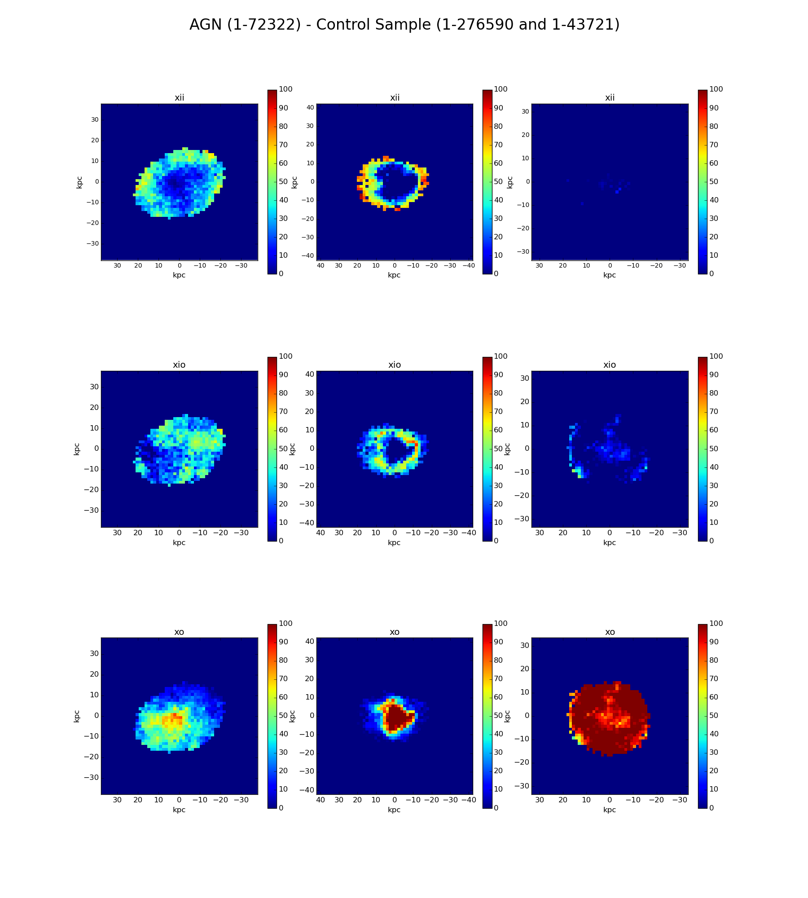
Paper II,preliminary: Resolved stellar population of MaNGA datacubes (Mallman+16)

Slide 12
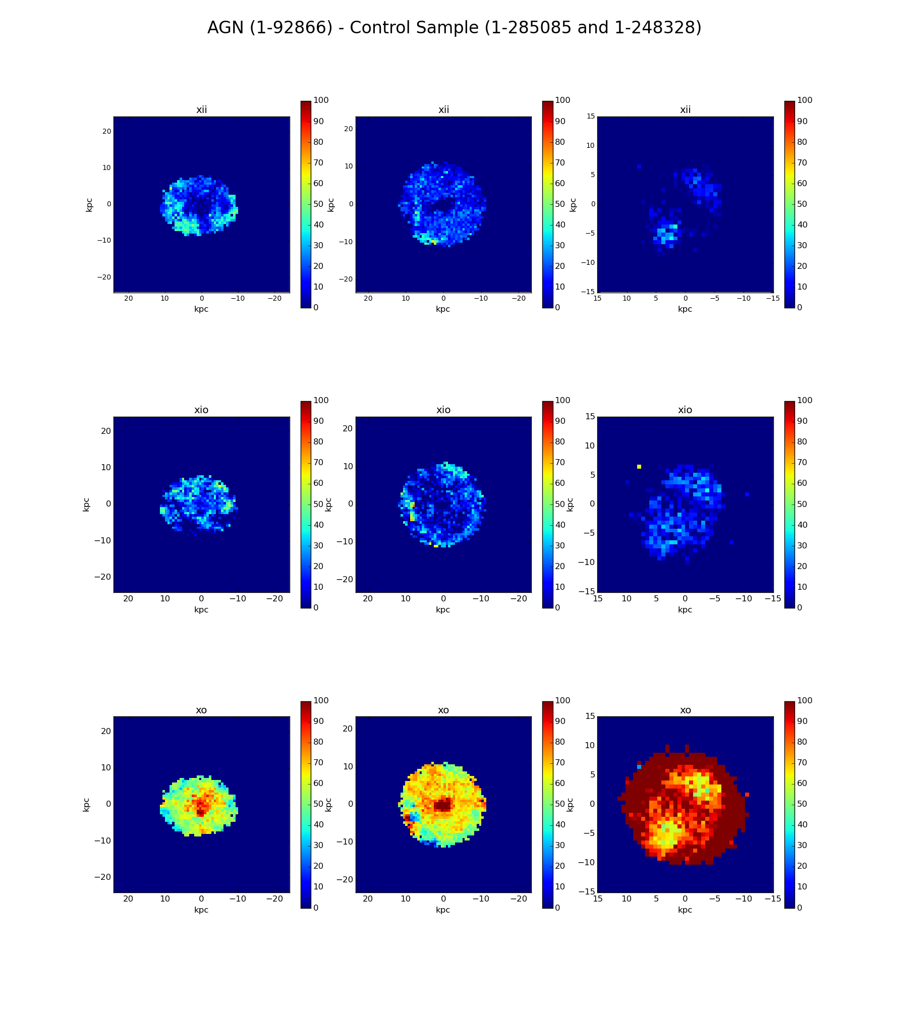
Paper II,preliminary: Resolved stellar population of MaNGA datacubes (Mallman+16)

Slide 13
Paper II,preliminary: Resolved stellar population of MaNGA datacubes (Mallman+16)

Slide 14
Paper II,preliminary: Resolved stellar population of MaNGA datacubes (Mallman+16)

Slide 15
Paper II,preliminary: Resolved stellar population of MaNGA datacubes (Mallman+16)

Slide 16
Paper II,preliminary: Resolved stellar population of MaNGA datacubes (Mallman+16)
Strong AGN: plenty of intermediate age stars

Slide 17
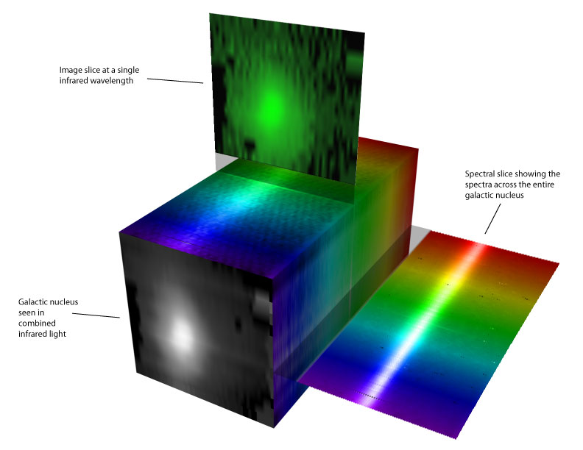
Local: Zooming in with Gemini IFUs
Optical: GMOS IFU
FOV: 3.5”x5” or 5”x7”
Sampling 0.2”
PSF ~ 0.6”
R~2500
Near-IR :NIFS + ALTAIR (adaptative optics)
FOV: 3” x 3”
Sampling: 0.04”×0.1”
PSF ~ 0.1”
R~5500, Z, J, H, K

Slide 18
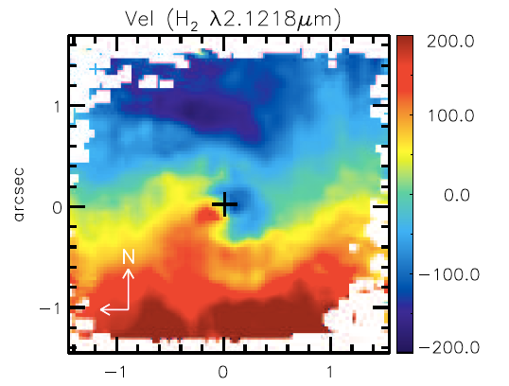
Local: Zooming into the inner kpc:
MaNGA overview paper: Bundy+15: 2”~ 1-2 kpc
NIFS, Diniz+15: 0.1”= 15 pc

Slide 19
Project: Feeding and Feedback on local AGN: inflows, outflows, stellar population
BAT-Swift AGN with L(14−195keV) > 10⁴² erg/s
GMOS-IFU, optical, 22 sources
Near-IR North, Gemini NIFS: sample of 26 AGNs: young stars in 10 analyzed datacubes
Near-IR South, ESO XShooter+SINFONI, PI Rick Davies: sample of 20 most luminous AGN+control sample

Slide 20
NIFS: Sy 2 Mrk1066 (Riffel +10,+11)
0.1”: 24 pc
CO bands at 2.3μm
Low-σ ring at 300 pc:

Slide 21
Stellar population synthesis, Mrk1066
Low-σ ring at 300 pc: intermediate-age (300-700 Myr) stellar population

Slide 22
NIFS, Near-IR: Sy 1, NGC5548 (Schöenell+16)
0.1”=40 pc; ring of interm. age pop.: 200pc

Slide 23
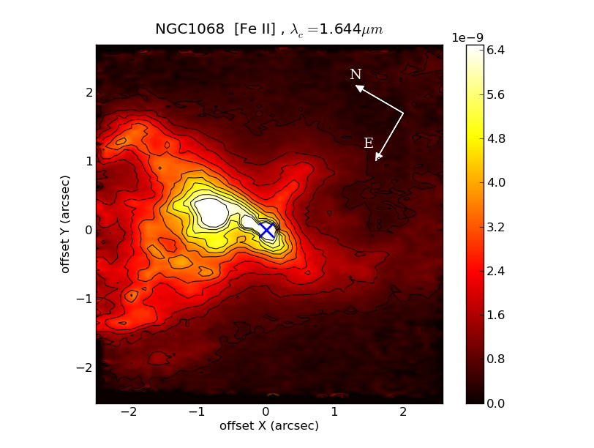
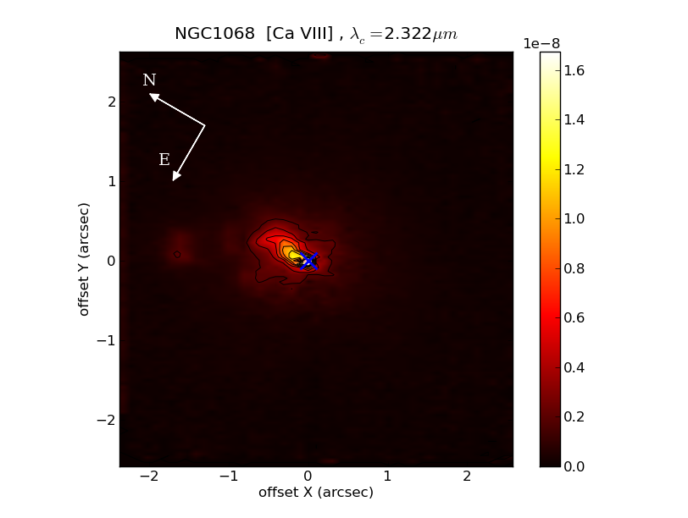
NIFS, near-IR: NGC 1068 (Barbosa+14)
HST [OIII]
Sb, Seyfert 2
500 pc x 500 pc
0.1”= 7 pc
[FeII]: 250 pc from nucleus: broader than conical shape of [OIII];
H₂: 100 pc (radius) off-centered ring
Das et al. 2006

Slide 24
Stellar population + kinematics (Storchi-Bergmann +12)
100 pc ring of young stars correlated with H2 emission
Low-σ ring (~70 pc): correlates with young-to-intermediate age stellar population (300Myr)
Also seen by Davies et al. 2007 in SINFONI data

Slide 25
Near-IR: Sy 2 NGC7582 (Riffel+09)
0.5”: 50 pc
Stellar kinematics from CO bands
Low σ ring at ~ 100 pc

Slide 26
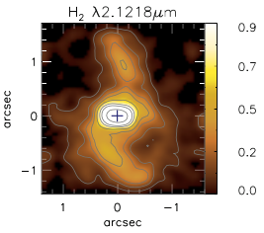
Connection with H2 content and kinematics
H2: low σ rotating disks + inflow in nuclear spirals: cold masses 10⁷-10⁹Min inner 100-400 pc
Ex.: Mrk79, 1”= 450 pc ->
Large surface mass densities (10 gals.): 400-9,000 M pc⁻²: typical of starbursts -> Kennicutt-Schmidt Law (1998) -> SFR ~ 1 M yr ⁻¹ kpc⁻²

Slide 27
Conclusions: SB in AGN hosts
Global: MaNGA AGN 1-2 kpc scales:
Initial 48 AGN + control sample;
Preliminary: excess of young/intermediate age stars in high-lumin. AGN
Local: ~100 pc scales, NIFS:
low-σ* rings at ~100-300 pc from nucleus; ~50% of AGN
young-to-intermediate age stars in AGN within ~300 pc
large molecular gas densities -> starbursts

Slide 28
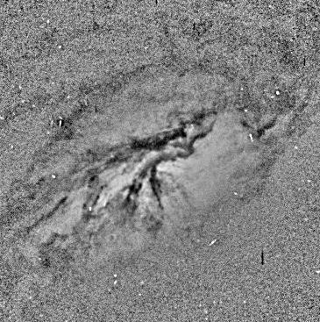
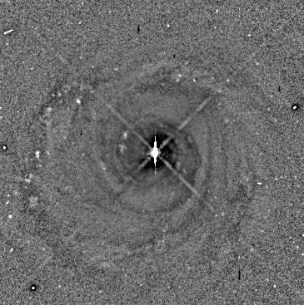
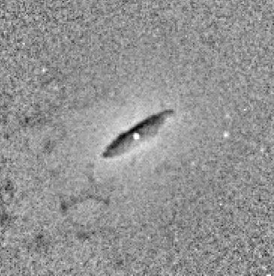
Conclusions: evolutionary scenario
Gas moving in to feed the SMBH form new stars in inner few 100 pc
“Settling sequence” for dust+gas (Lauer+06): chaotic filaments → spiral → compact disk/ring
Next step -> star formation in disk/ring -> co-evolution SMBH (10⁻³ M yr⁻¹⁾ and bulge (1 M yr⁻¹ kpc⁻²) -> consistent with M-sigma relation
→
→
→

Slide 29
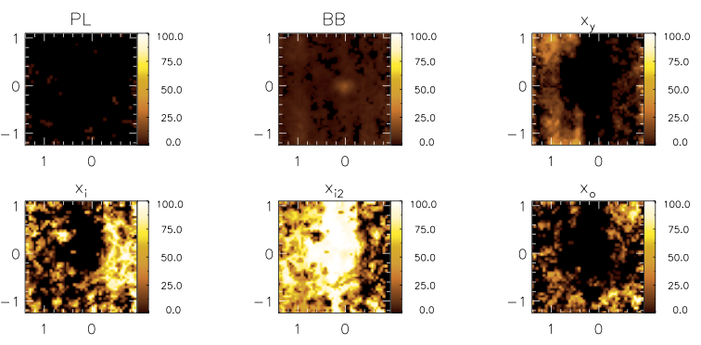
Mrk573, 0.1”=35pc ;NGC5929, 0.1”=20pc

Slide 30
NGC3516, 0.1”=20pc

Slide 31
GMOS-IFU, CaT 8500 A: Low σ* rings
55”
53.5”
NGC4593
0.6”= 100pc
NGC3227
0.6”=50pc
NGC2273
0.6”= 70pc
NGC3516
0.6”=110pc
σ-drops (Marquez+03, Emsellem+04): stars with cold kinematics of gas from which they formed

