Slide 1
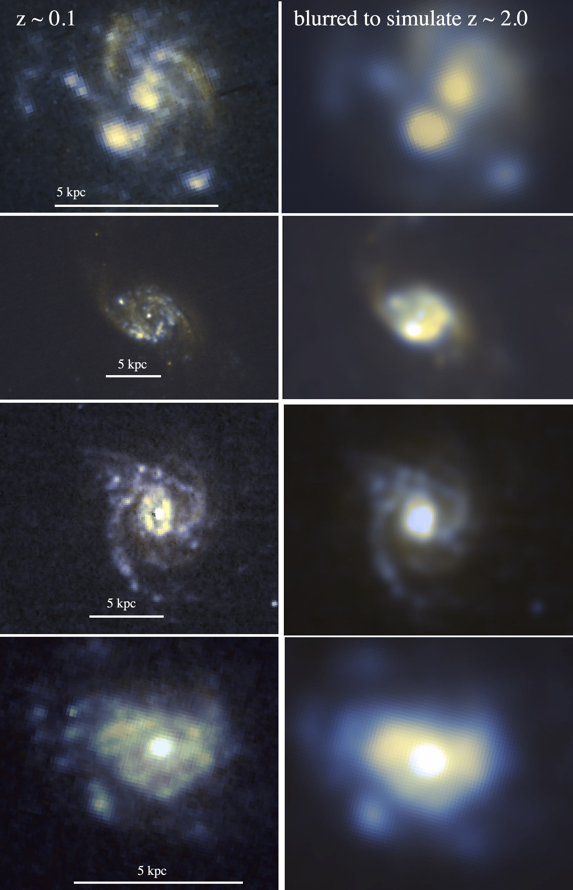
DYNAMO Survey:
An up-close view of turbulent, clumpy galaxies
David B Fisher
Swinburne University of Technology
Karl Glazebrook, Rob Bassett, Andy Green, Heidi White, Ivana Damjanov, Emily Wisnioski,
Erin Mentuch-Cooper, Bob Abraham Peter McGregor,
Paola Oliva-Altimirano, Danail Obreschkow, Alberto Bolatto

Slide 2
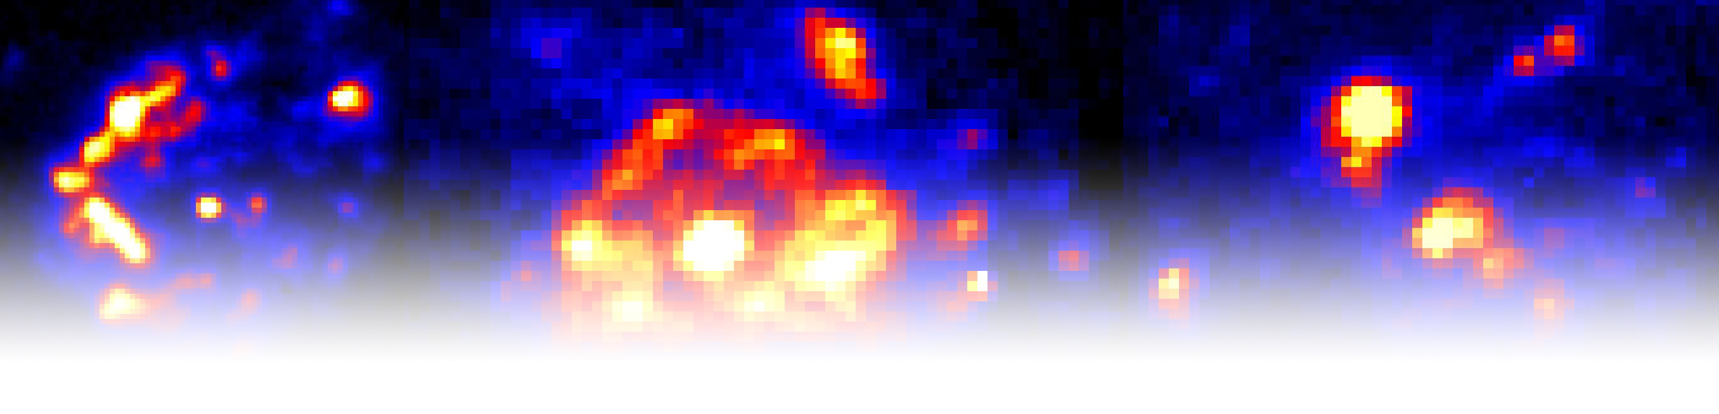
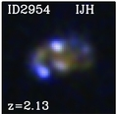
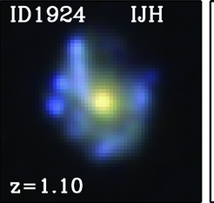
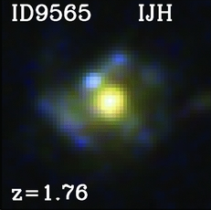
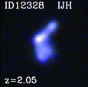
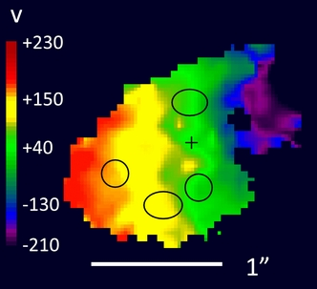
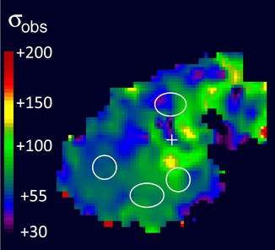
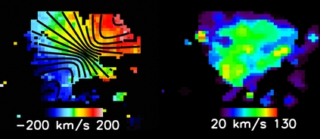
Galaxies at the peak of star formation are VERY clumpy, turbulent disks.
Rotation Dispersion
Stars
Gas
(Hα)
Need to overcome the fact that individual clumps are very difficult to study at this distance.
Genzel et al. 2011, Wisnioski et al. 2012, Swinbank et al 2012, Wuyts et al. 2012

Slide 3
DYNAMO galaxies are similar to z≈1 main-sequence galaxies
DYnamics of Newly Assembled Massive Objects
~100 galaxies with IFS Hα data froms WiFES/2.3-m and SPIRAL/AAT
Similar Properties:
High gas velocity dispersion
High SFR and SFR/M
Gas Richf_{gas}≅15-35%
“Clumpy” gas morphology
Survey paper: Green et al (2014):

Slide 4
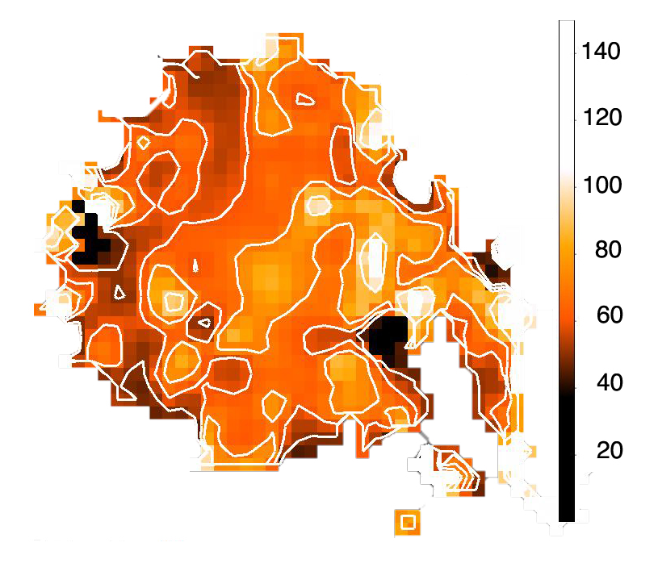
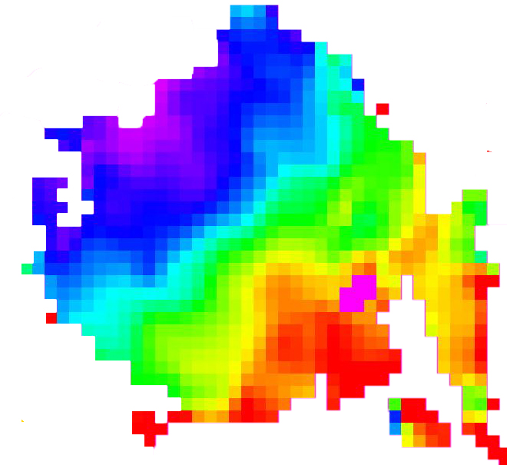
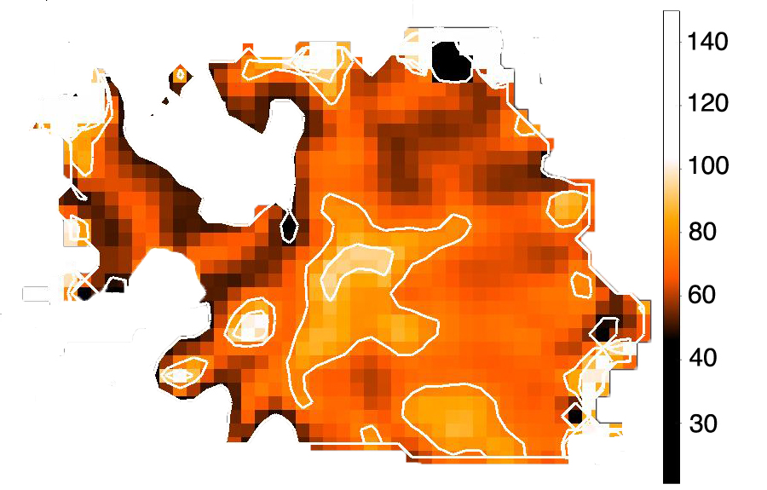
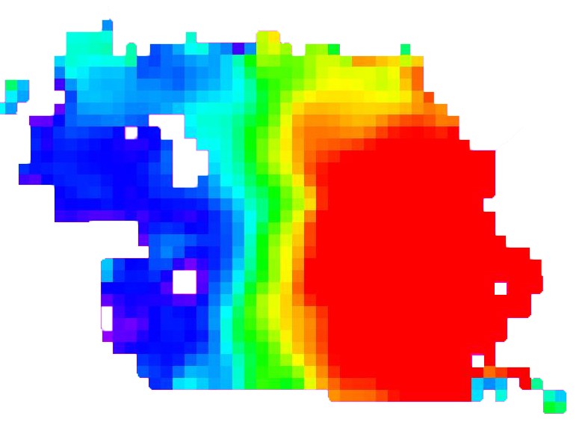
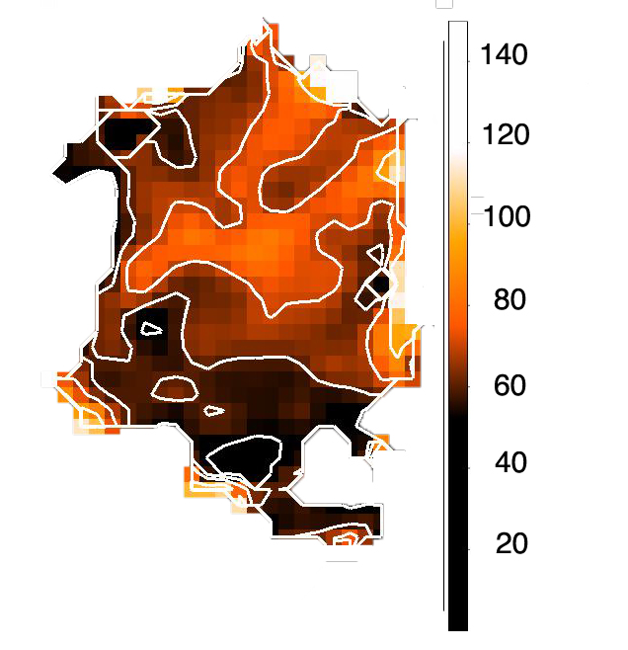
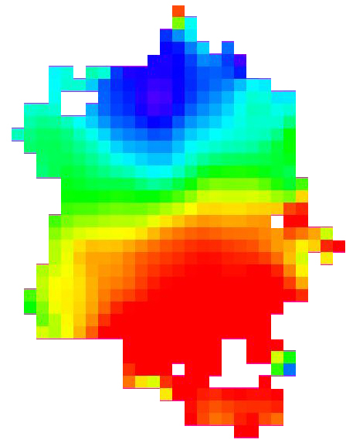
DYNAMO Galaxies Resemble Turbulent Disks
Keck OSIRIS Pa α
Dispersion Rotation Stellar Surface Brightness
SFR≈ 40 Myr⁻¹
SFR≈ 22 Myr⁻¹
SFR≈ 18 Myr⁻¹
Paola Oliva-Altimarano

Slide 5
DYNAMO galaxies are very gas rich
f_{gas} = Molecular gas fraction
Fisher et al. 2014

Slide 6
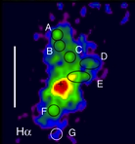
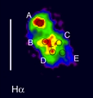
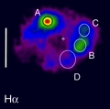
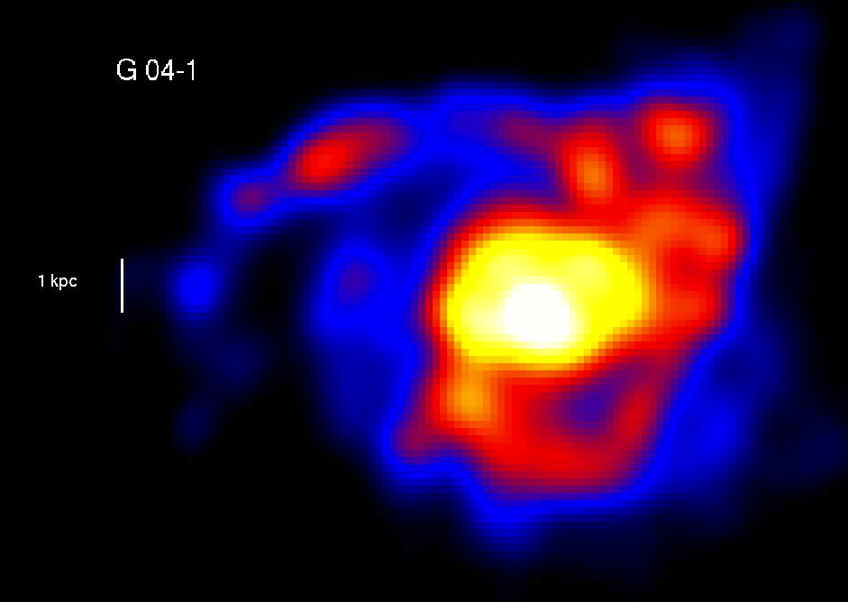
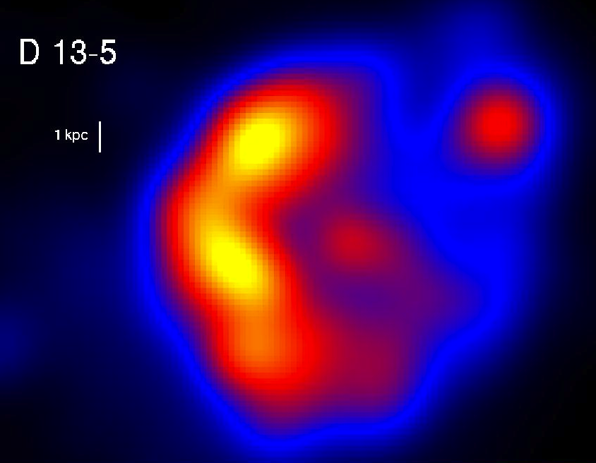
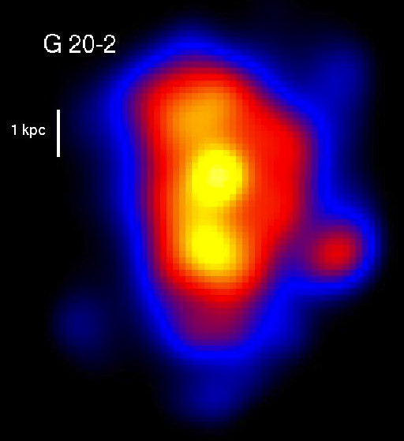
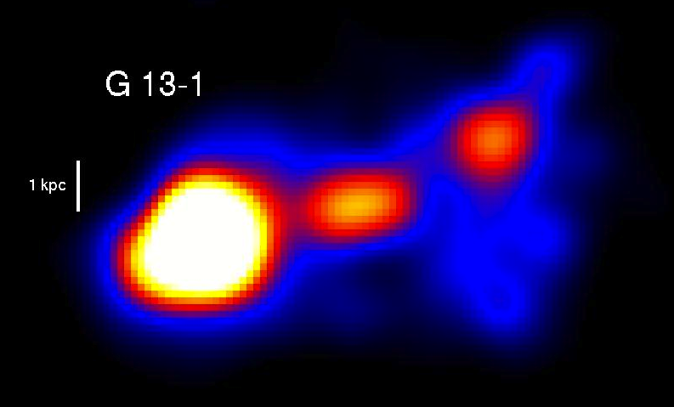
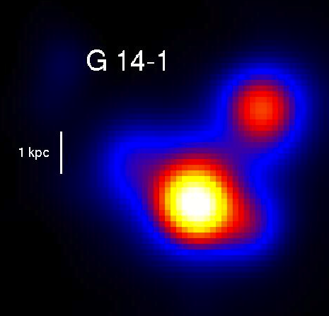
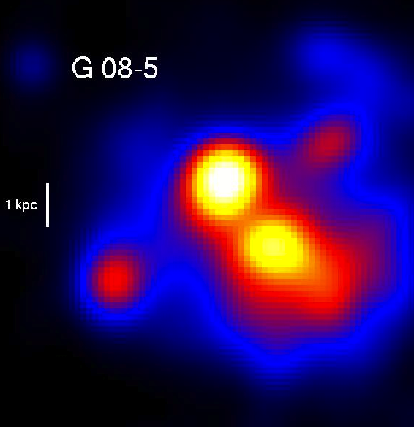
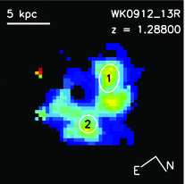
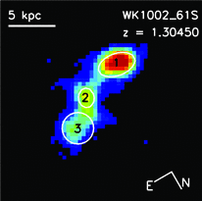
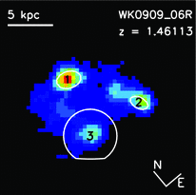
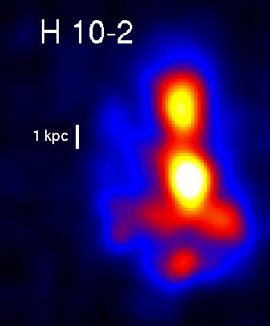
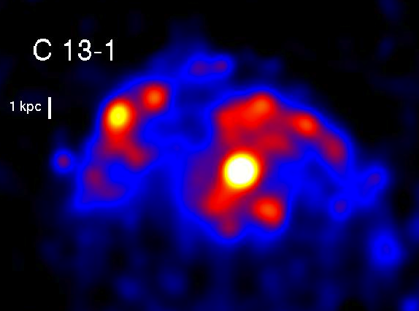
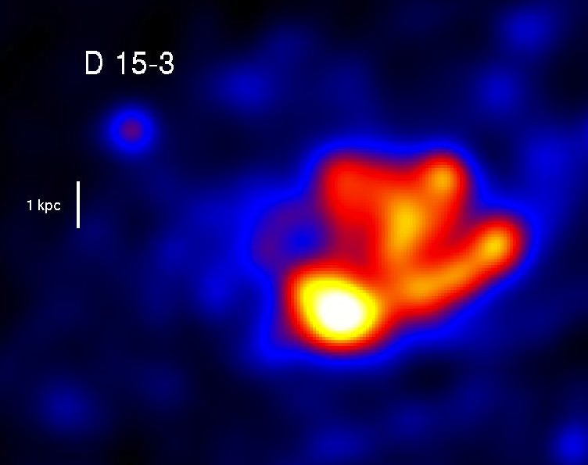
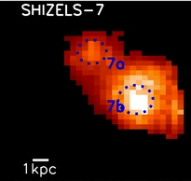
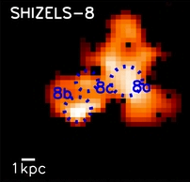
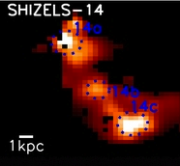
DYNAMO Galaxies Look Like High-z Clumpy Galaxies
Genzel et al. (2011)
DYNAMO Blurred to z=2
Wisnioski et al. (2012)
Swinbank et al. (2012)
Fisher et al 2016 (refereed)

Slide 7
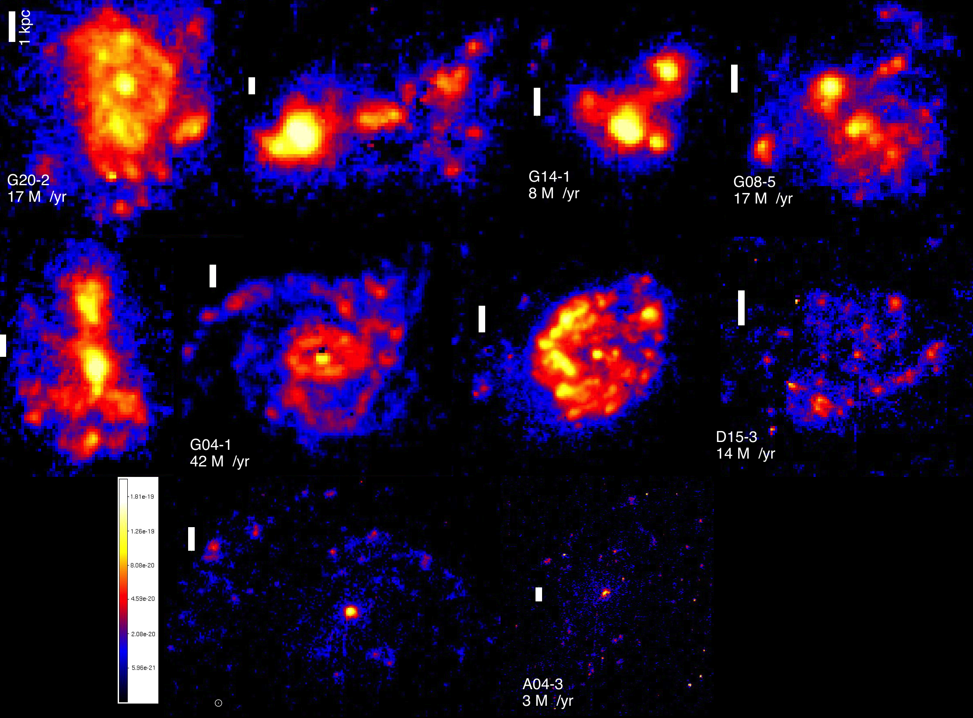

Slide 8
DYNAMO clumps are big and bright, consistent with high-z clumps.
Similar to clumps in lensed galaxies.
DYNAMO:
Fisher et al (in prep)
Unlensed high-z:
Genzel et al. 2011 Wisnioski et al. 2012
Swinbank et al. 2012
Lensed high-z:
Jones et al. 2010
Livermore et al. 2012
Fisher et al 2016 (refereed)

Slide 9
DYNAMO clumps are big and bright, consistent with high-z clumps.
Sizes are the same if beam sizes are the same!
Smaller than unlensed clump sizes.
DYNAMO:
Fisher et al (in prep)
Unlensed high-z:
Genzel et al. 2011 Wisnioski et al. 2012
Swinbank et al. 2012
Lensed high-z:
Jones et al. 2010
Livermore et al. 2012
Fisher et al 2016 (refereed)

Slide 10
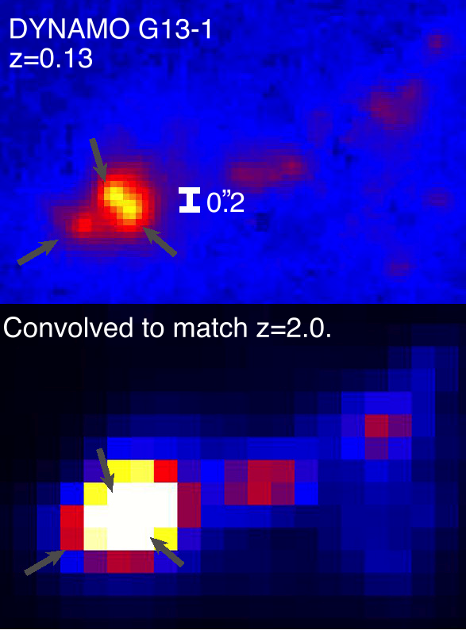
The largest clumps at z=2 resolution are associated with sets of clumps.
Fisher et al 2016 (refereed)
The largest blurred clumps always associated with larger numbers of clumps in the full-resolution maps.

Slide 11
Strong, linear correlations between clump sizes and σ/V and f_{gas}
Sizes from HST,
Kinematics from Gemini/GMOS
Gas masses from PdBI
Fisher et al. in submission

Slide 12
DYNAMO clumps agree with direct predictions from unstable disk model.
Fisher et al. in submission

Slide 13
Angular momentum is lower in turbulent disks
There is a known correlation between j-M-B/T.
Clumpy disks are low-j outliers, but if you consider total clump mass to be future “bulge” mass then they are consistent.
Obreschkow et al. 2015

Slide 14
DYNAMO: Turbulent, Clumpy disks in the nearby Universe
DYNAMO Galaxies are…
- Very similar to turbulent disks
- DYNAMO galaxies are clumpy in Hα similar to high-z galaxies
DYNAMO galaxies are gas rich
Star forming clump sizes in DYNAMO are 100-500 pc
Angular momentum of DYNAMO disks is lower than typical low-z disks
The violent disk instability model is very consistent with our results.
We’re getting more data all the time, stay tuned for more results…

