Slide 1
Molecular Gas in 3D: From Global Dynamics to SMBHs
Martin Bureau, Oxford University
SAURON + Atlas^{3D} CO
(Katey Alatalo, Estelle Bayet, Leo Blitz, Francoise Combes, Alison Crocker,
Timothy Davis, Lisa Young)
Tully-Fisher Relation
(Timothy Davis, Alfie Tiley, Selcuk Topal, Kazufumi Torii)
WISDOM Team
(Timothy Davis, Kyoko Onishi, Leo Blitz, Satoru Iguchi,
Michele Cappellari, Marc Sarzi)
Plans: Introduction: Molecular gas, E/S0 content, kinematic tracer
Tully-Fisher relation: E/S0, local benchmark, high-z
SMBHs: Pilot observations, WISDOM, GMC populations
Conclusions: Tully-Fisher, SMBHs

Slide 2
Molecular Gas in 3D: From Global Dynamics to SMBHs
Martin Bureau, Oxford University
SAURON + Atlas^{3D} CO
(Katey Alatalo, Estelle Bayet, Leo Blitz, Francoise Combes, Alison Crocker,
Timothy Davis, Lisa Young)
Tully-Fisher Relation
(Timothy Davis, Alfie Tiley, Selcuk Topal, Kazufumi Torii)
WISDOM Team
(Timothy Davis, Kyoko Onishi, Leo Blitz, Satoru Iguchi,
Michele Cappellari, Marc Sarzi)
Plans: Introduction: Molecular gas, E/S0 content, kinematic tracer
Tully-Fisher relation: E/S0, local benchmark, high-z
SMBHs: Pilot observations, WISDOM, GMC populations
Conclusions: Tully-Fisher, SMBHs

Slide 3
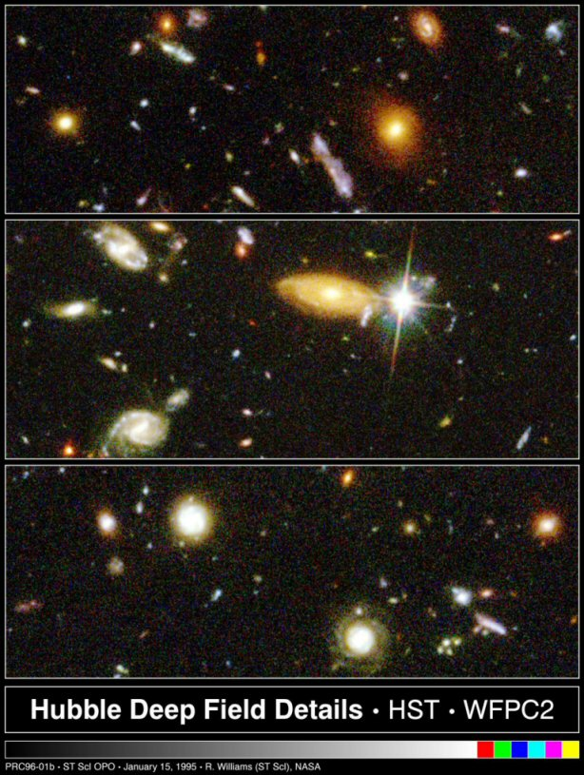
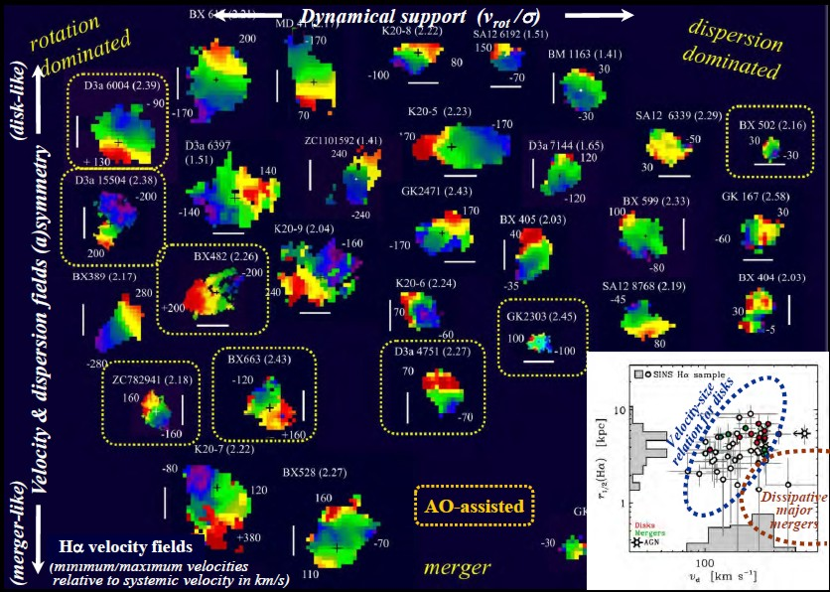
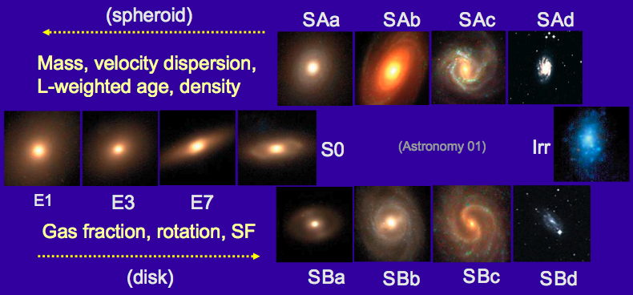
Molecular Gas
Goals:
Mass assembly history
(gas, stars, dark matter)
Chemical enrichment history
(SFH, age, metallicity)
Methods:
Dynamics
(kinematics/mass tracer)
Star Formation
(fuel/SFE, line diagnostics)
“Stellar” populations
(cloud statistics)
⇒ Very complete tracer
(HST HDF)
(SINS)

Slide 4
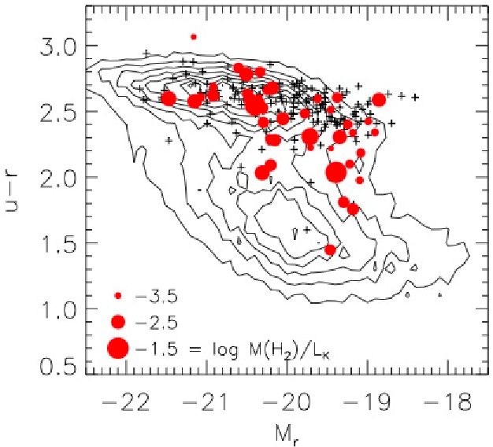
CO in ETGs: Single-dish
(Combes, Young & Bureau 07; Young et al. 11,14)
Optical CMD + CO
IRAM 30m Survey:
CO(1-0,2-1), 23/12” FWHM
260 Atlas^{3D} E/SOs
Sensitivity: 3 mK (30 km s⁻¹)
3 x 10⁷ M⊙
Results:
22% detection rate
M_{H2} = 10^{7.1-9.3} M⊙
CO(2-1)/CO(1-0) ≈ 1 – 2
⇒ Independent structure, dynamics, environment, … but not SF
(Consistent with COLDGASS threshold, Saintonge et al. 11, 12; see also Crocker et al. 11)

Slide 5
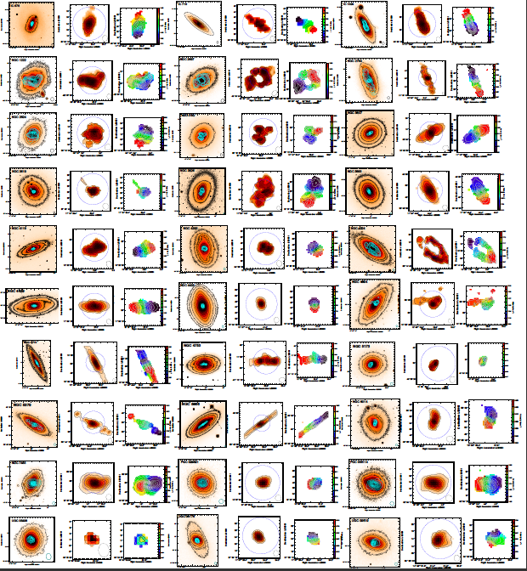
CO in ETGs: Interferometry
(Alatalo et al. 2013; Davis et al. 2013)
Atlas^{3D} (CARMA):
> 40 objects so far
(CARMA, PdBI, BIMA)
Centrally-concentrated H₂ (physical size)
Diverse morphologies
(disks, rings, bars, …)
Kinematic misalignments
(origin, evolution)
⇒ Regular rotation
(Tully-Fisher, SMBHs)

Slide 6
Molecular Gas in 3D: From Global Dynamics to SMBHs
Martin Bureau, Oxford University
SAURON + Atlas^{3D} CO
(Katey Alatalo, Estelle Bayet, Leo Blitz, Francoise Combes, Alison Crocker,
Timothy Davis, Lisa Young)
Tully-Fisher Relation
(Timothy Davis, Alfie Tiley, Selcuk Topal, Kazufumi Torii)
WISDOM Team
(Timothy Davis, Kyoko Onishi, Leo Blitz, Satoru Iguchi,
Michele Cappellari, Marc Sarzi)
Plans: Introduction: Molecular gas, E/S0 content, kinematic tracer
Tully-Fisher relation: E/S0, local benchmark, high-z
SMBHs: Pilot observations, WISDOM, GMC populations
Conclusions: Tully-Fisher, SMBHs

Slide 7
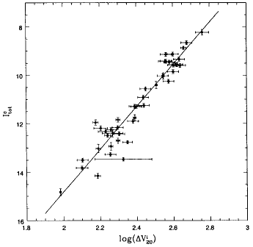
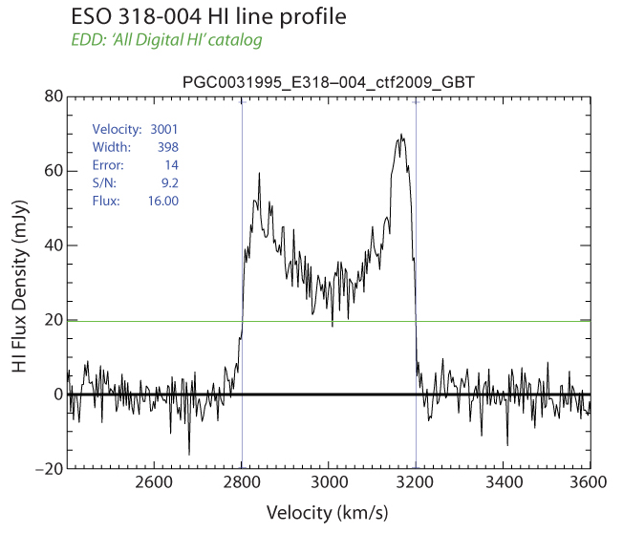
Tully-Fisher: Definition
Scaling:
We have: G M / R² = V² / R
We define: M/L, Σ = M / πR²
⇒ We get: L α V⁴ (M/L)⁻¹ Σ⁻¹
“Hidden” parameters:
Stellar populations
(age, metallicity, non-Solar abundance ratio, SFH, IMF, …)
Dark matter
Size scale
…
(Gas-rich) disk galaxies
Lum.
(Bureau et al. 96)
V/sin i
Definition:
Luminosity (baryonic mass) vs. rotational velocity (total mass)
⇒ Luminous vs. dark matter
Uses:
⇒ M/L evolution with z (and type)
(slope, zero-point and scatter)

Slide 8
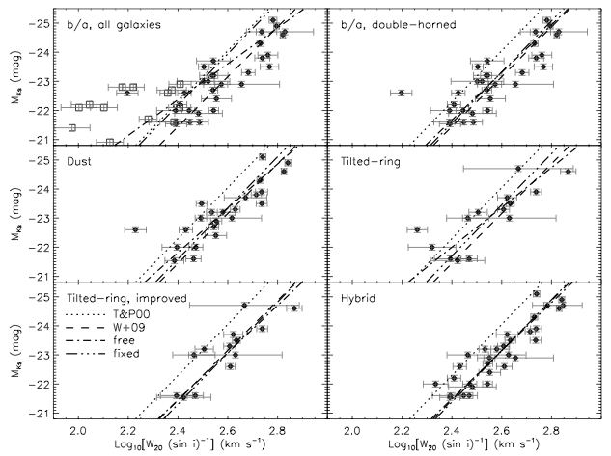
CO TFR: ETG results
(Davis et al. 11)
CO Tully-Fisher:
Many (potential) pitfalls
Many better than expected
Many simple workarounds
Slope and zero-point
robustly recovered
Standard intrinsic scatter
⇒ Stellar / Jeans T-F
easily recovered
⇒ No or minimum efforts !
⇒ Great prospect to probe
M/L(z) with LMT+ALMA…
CO Tully-Fisher relations:
M_{K}
Log (W₂₀ / sin i)

Slide 9
CO TFR: Local benchmark
(Torii et al. 2016)
NANTEN2:
Existing work:
Studies and objects limited
Large single dishes or interferometry
⇒ Non-optimal datasets
⇒ Hard to compare with future high-z work
Ongoing work:
NANTEN2 (4m)
COLD-GASS (30m; SDSS)
EGNoG (CARMA; z ≈ 0.1-0.3)
Literature
M_{KS}
Log (W₂₀ / sin i)

Slide 10
CO TFR: Local benchmark
(Tiley et al. 2016)
COLD-GASS:
Existing work:
Studies and objects limited
Large single dishes or interferometry
⇒ Non-optimal datasets
⇒ Hard to compare with future high-z work
Ongoing work:
NANTEN2 (4m)
COLD-GASS (30m; SDSS)
EGNoG (CARMA; z ≈ 0.1-0.3)
Literature
WISE_1
Log (W₂₀ / sin i)

Slide 11
CO TFR: Local benchmark
(Topal et al. 2016)
EGNoG:
Existing work:
Studies and objects limited
Large single dishes or interferometry
⇒ Non-optimal datasets
⇒ Hard to compare with future high-z work
Ongoing work:
NANTEN2 (4m)
COLD-GASS (30m; SDSS)
EGNoG (CARMA; z ≈ 0.1-0.3)
Literature
M_{KS}
Log (W₂₀ / sin i)

Slide 12
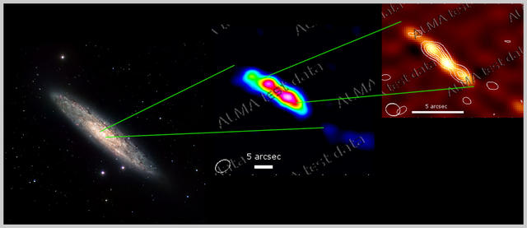
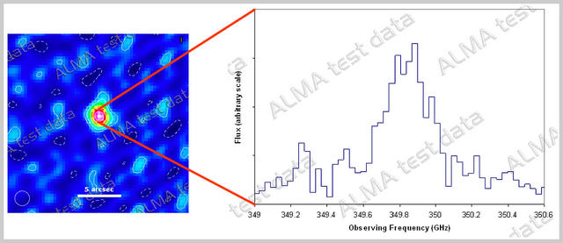
CO TFR: Intermediate z
ALMA:
CO(1-0): Band 3: z = 0.0 – 0.4
Band 2: z = 0.3 – 0.7
Band 1: z = 1.6 – 3.7
CO(2-1): Band 6: z = 0.0 – 0.1
Band 5: z = 0.1 – 0.4
Band 4: z = 0.4 – 0.8
Band 3: z = 1.0 – 1.7
Band 2: z = 1.6 – 2.4
Band 1: z = 4.1 – 6.4
⇒ Great TFR machine
(spatially-resolved or not)
⇒ Need better understanding
of CO(2-1)
ALMA:
Spiral at z = 0.0, optical, CO(2-1), cont. + CO(6-5)
(ESO)
QSO at z = 4.4, CII 158 μm (unresolved)
(ESO)

Slide 13
Molecular Gas in 3D: From Global Dynamics to SMBHs
Martin Bureau, Oxford University
SAURON + Atlas^{3D} CO
(Katey Alatalo, Estelle Bayet, Leo Blitz, Francoise Combes, Alison Crocker,
Timothy Davis, Lisa Young)
Tully-Fisher Relation
(Timothy Davis, Alfie Tiley, Selcuk Topal, Kazufumi Torii)
WISDOM Team
(Timothy Davis, Kyoko Onishi, Leo Blitz, Satoru Iguchi,
Michele Cappellari, Marc Sarzi)
Plans: Introduction: Molecular gas, E/S0 content, kinematic tracer
Tully-Fisher relation: E/S0, local benchmark, high-z
SMBHs: Pilot observations, WISDOM, GMC populations
Conclusions: Tully-Fisher, SMBHs

Slide 14
M•- σ★ Relation: Status
M•- σ★:
Weaknesses:
Still relatively few measurements
Handful of methods
Each method has own weaknesses and systematics
Methods ⬅➔ targets highly correlated
⇒ Highly biased sample
(compact cores)
⇒ Different systematics across relation
(σ★, mass, Hubble type, …)
⇒ Need for unique method (all types),
conceptually simple (no systematics),
easily scalable (rapid)
(McConnell & Ma 13)

Slide 15
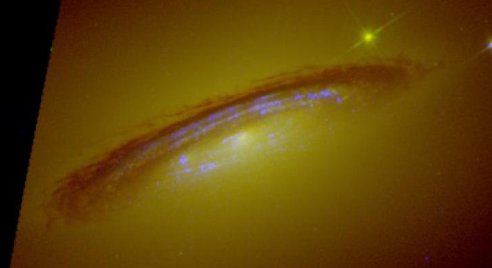
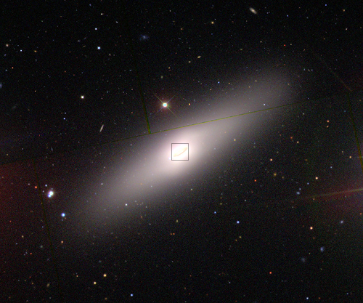
CO: NGC 4526 SMBH mass
(Davis et al. 2013)
HST WFC3 NUV-optical data:
SDSS colour image:
(Kaviraj et al.)
(SDSS)

Slide 16
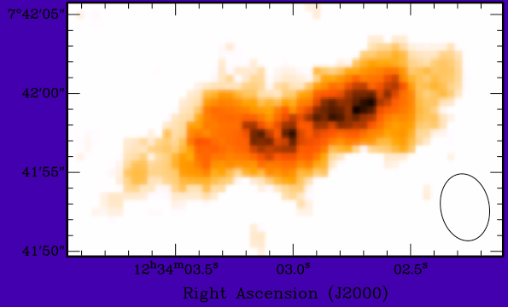
CO: NGC 4526 SMBH mass
(Davis et al. 2013)
HST WFC3 NUV-optical data:
SDSS colour image:
(Kaviraj et al.)
(SDSS)
BIMA low-res (4.5”) data:

Slide 17
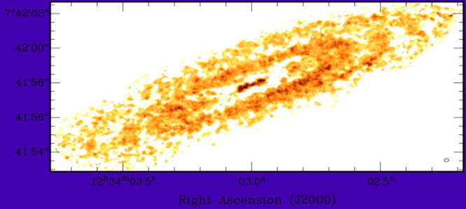
CO: NGC 4526 SMBH mass
(Davis et al. 2013)
CARMA high-res (0.25” = 20 pc) data:
NGC4526:
High resolution (0.25”) CARMA CO(2-1) data
Regular (central) disk kinematics
Free M/L* and M•
⇒ Strong constraints on M•
(M• = 4.1 x 10⁸ M)
(consistent with M• - σ★)
⇒ Great prospects across Hubble sequence with ALMA…
BIMA low-res (4.5”) data:

Slide 18
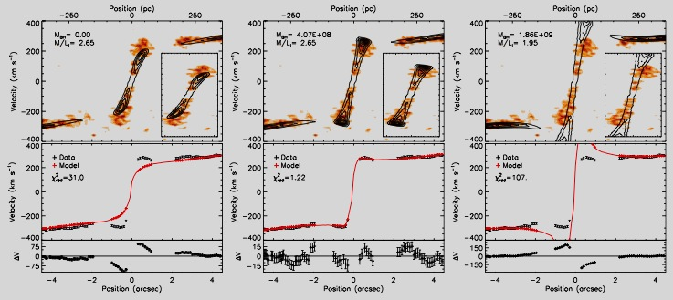
CO: NGC 4526 SMBH mass
(Davis et al. 2013)
Model PVD and major-axis trace:
Velocity
Position

Slide 19
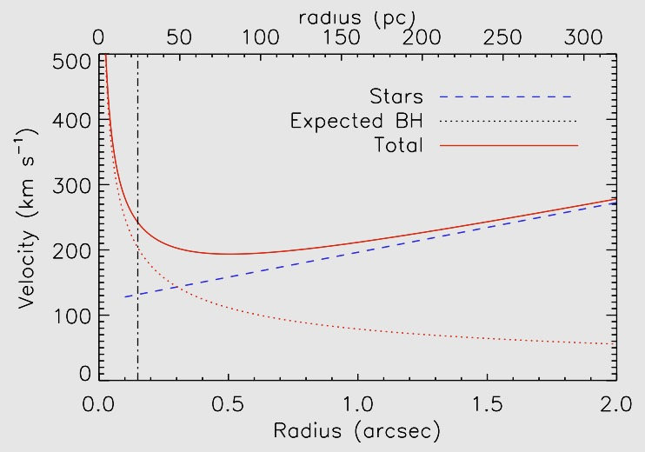
CO: NGC 3665 SMBH mass
(Onishi et al. 2016)
CARMA:
CO(2-1)
B+C array: 0.6” x 0.6”
SMBH:
M• ≈ 5.5 x 10⁸ M
(consistent with M•- σ★)
CO disk roughly perpendicular to jet
Modelling ongoing…
Model predictions:
Velocity
Radius

Slide 20
CO: NGC 3665 SMBH mass
(Onishi et al. 2016)
CARMA:
CO(2-1)
B+C array: 0.6” x 0.6”
SMBH:
M• ≈ 5.5 x 10⁸ M
(consistent with M•- σ★)
CO disk roughly perpendicular to jet
Modelling ongoing…
CARMA CO PVD:

Slide 21
CO: NGC 3665 SMBH mass
(Onishi et al. 2016)

Slide 22
ALMA Cycle 2
HST images + CO:
CO velocity:
CO velocity:
PVD observed:

Slide 23
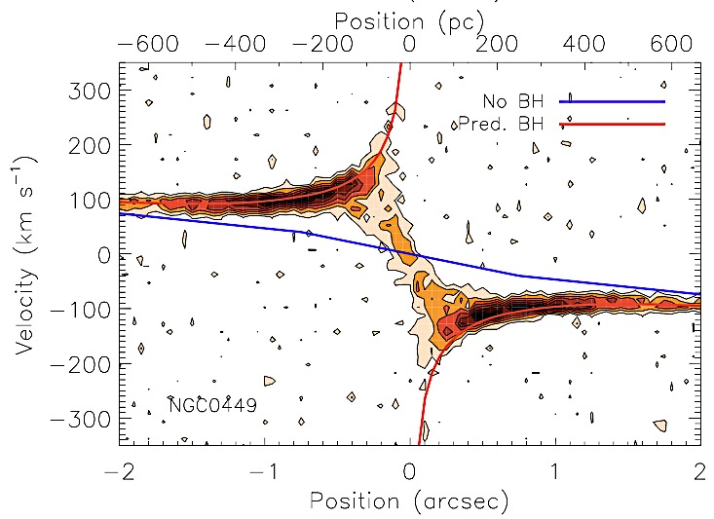
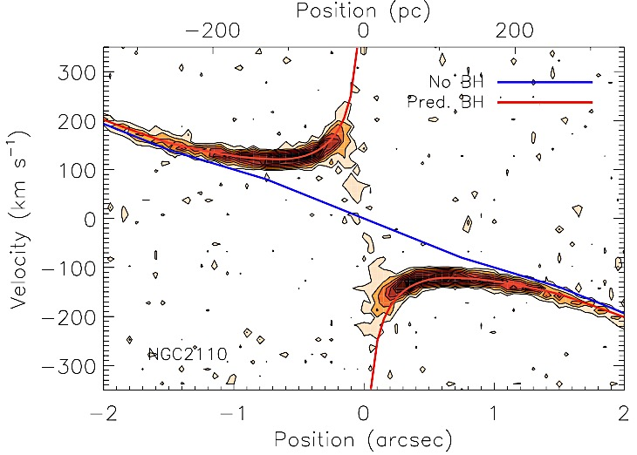
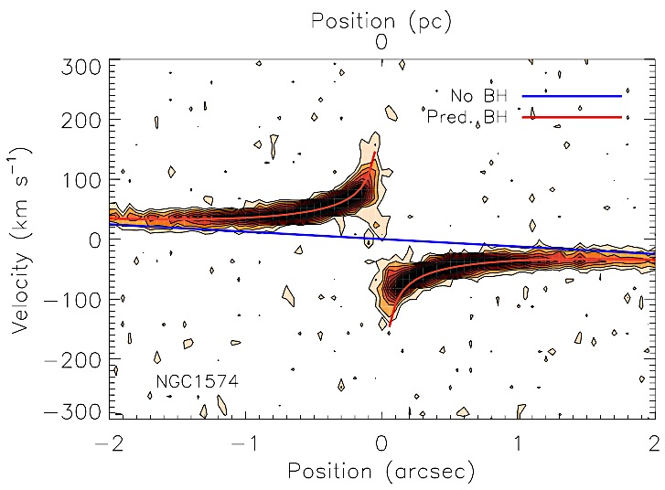
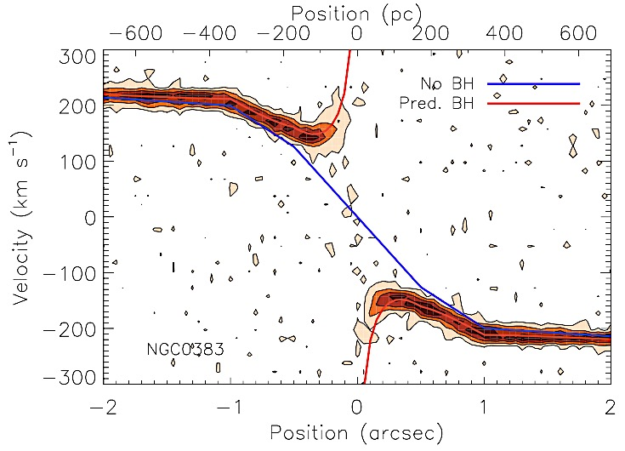
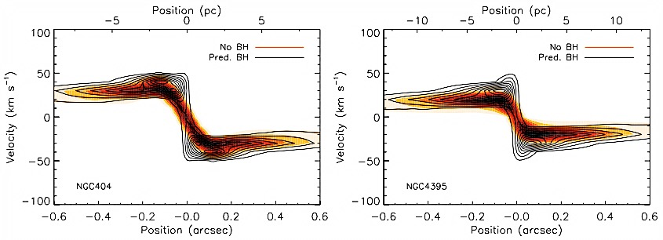
ALMA Cycle 3
Massive:
Normal:
Dwarfs:

Slide 24
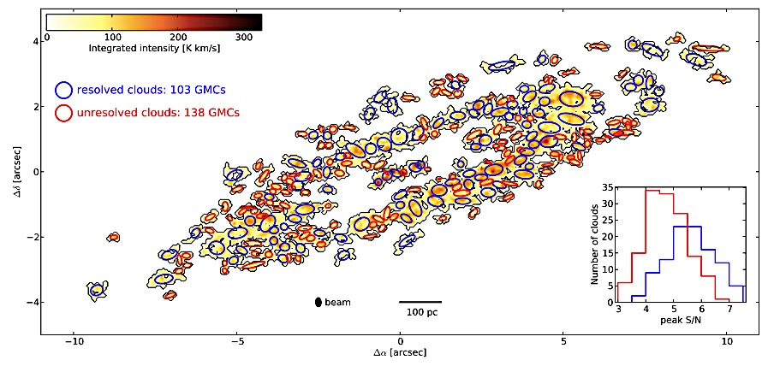
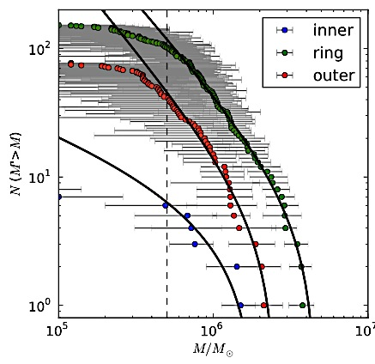
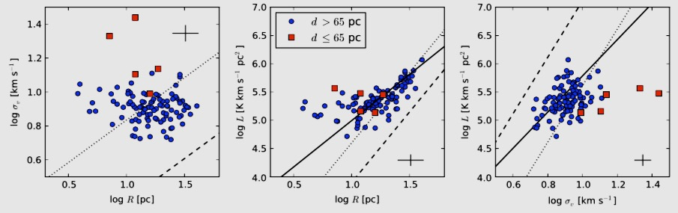
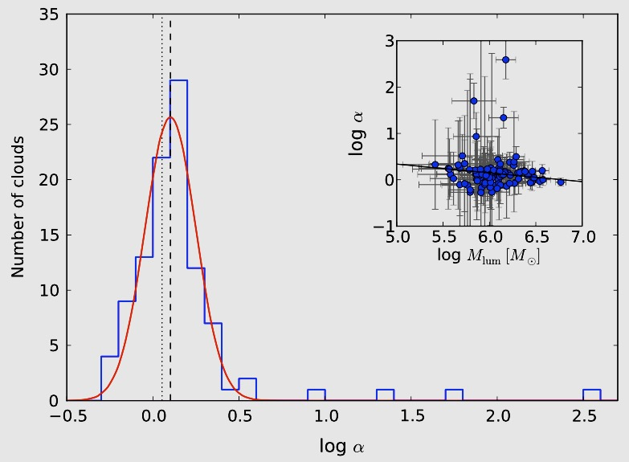
SMBHs: GMC studies (free!)
(Utomo et al. 15)
Cloud identification:
MDFs:
Spatially-resolved
GMC populations:
Cloud statistics / MDFs
Larson relations
Support / timescales
Shear / rotation
KS law / star formation
…
⇒ Milky Way-like studies in external galaxies
⇒ Comparison to other galaxies (expanded parameter space)
Larson relations:
Support:
Dynamics:

Slide 25
Molecular Gas in 3D: From Global Dynamics to SMBHs
Martin Bureau, Oxford University
SAURON + Atlas^{3D} CO
(Katey Alatalo, Estelle Bayet, Leo Blitz, Francoise Combes, Alison Crocker,
Timothy Davis, Lisa Young)
Tully-Fisher Relation
(Timothy Davis, Alfie Tiley, Selcuk Topal, Kazufumi Torii)
WISDOM Team
(Timothy Davis, Kyoko Onishi, Leo Blitz, Satoru Iguchi,
Michele Cappellari, Marc Sarzi)
Plans: Introduction: Molecular gas, E/S0 content, kinematic tracer
Tully-Fisher relation: E/S0, local benchmark, high-z
SMBHs: Pilot observations, WISDOM, GMC populations
Conclusions: Tully-Fisher, SMBHs

Slide 26
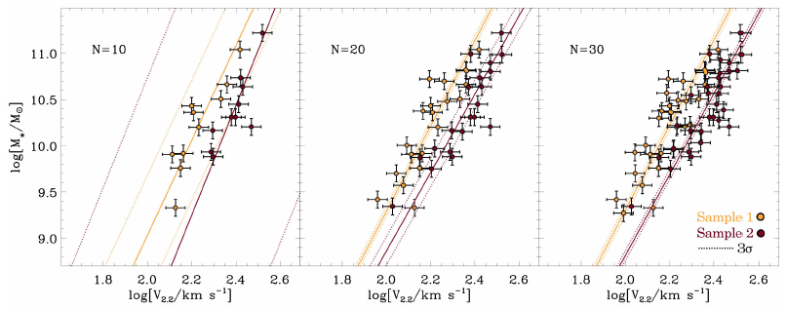
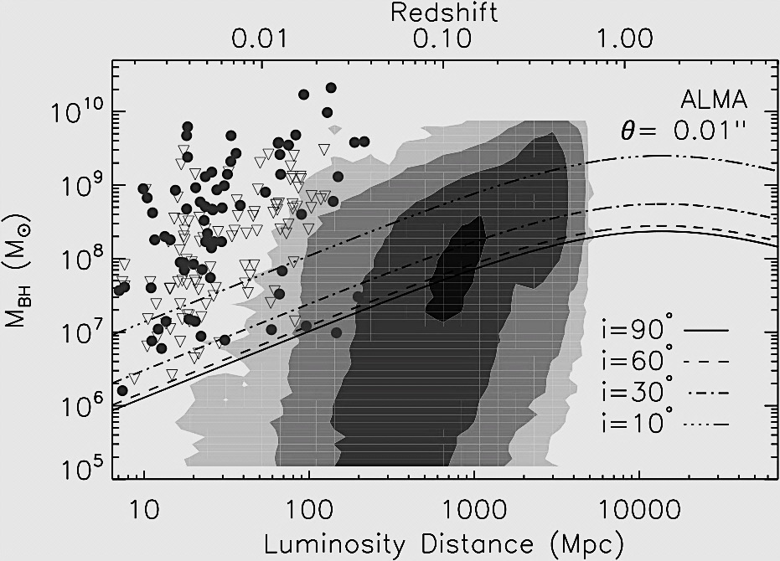
Conclusions
TFR:
Tully-Fisher Relation:
Applicable across Hubble sequence
Conceptually simple
Rapid, 100s measurements trivial
⇒ Method ripe for large-scale exploitation
⇒ Revolution in studies of TFR(z)
SMBHs:
Applicable across Hubble sequence
Conceptually simple
Rapid, 100s measurements trivial
⇒ Method ripe for large-scale exploitation
⇒ Revolution in studies of M• - σ★ relation
1000 galaxies !
(Miller et al. 12)
SMBH statistics:
1000 BHs !
(Davis 14)

