Slide 1
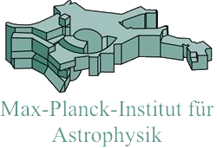
Dynamical structure and formation history of early-type galaxies
Thorsten Naab
MPA, Garching
The interplay between local and global processes in galaxies
Cozumel, April 13th

Slide 2
The complex cosmological assembly histories
see Oser et al. 2012, Hirschmann et al. 2013
There are clear theoretical predictions for the dynamical effect of in-situ star formation or accretion (e.g. Naab et al. 2014)
More massive galaxies have higher fraction of ex-situ stars at z < 1 (e.g. Guo & White 2008, Moster et al. 2013)
Metal cooling and stellar feedback increases the in-situ fraction and changes merger history
Feedback from black holes reduces the in-situ fractions (Hirschmann et al. 2012)
ETG dynamics is regulated by the interplay of feedback processes and environment
ex-situ
in-situ
The two phase formation of ETGs (Oser et al 2010)

Slide 3
Detailed analysis of complex galaxy assembly
Typical observed kinematic features also in simulated galaxies
Gas dissipation and star formation increases rotation (A)
Major mergers can increase (B,D) or decrease (C,E) rotation
Many minor mergers decrease rotation (F)
Naab et al., 2014

Slide 4
Assembly class and rotation
edge-on projection
Six characteristic assembly classes with distinct features; late dissipation – younger stellar ages (class A,B)
All simulated galaxies have realistic λ_{R}-profiles; gas dissipation (A/B) promotes rotation
Notes:
Number density of 2x10^-4

Slide 5
Higher-order moments of the LOSVD
Class A & B show strong correlation – steep leading wings in the LOSVD (see Krajnovic et al. 2011)
Class D with weak correlation but fast rotation (typically not observed)
Class C, E & F with no correlation
Notes:
Number density of 2x10^-4

Slide 6
Orbital content of zoom simulations: the stellar backbone
Röttgers, Naab & Oser 2014

Slide 7
Influence of gas on the stellar component
Galaxies with a dissipational history can rotate fast
Galaxies are more axi- symmetric
Galaxies have LOSVDs with steep leading wings
…caused by a dominance of tube orbits
… similar to binary merger experiments (Naab, Jesseit & Burkert 2006, Hofmann et al. 2009)
Röttgers et al. 2014

Slide 8
Tomography of a counter-rotating core
Röttgers et al. 2014

Slide 9
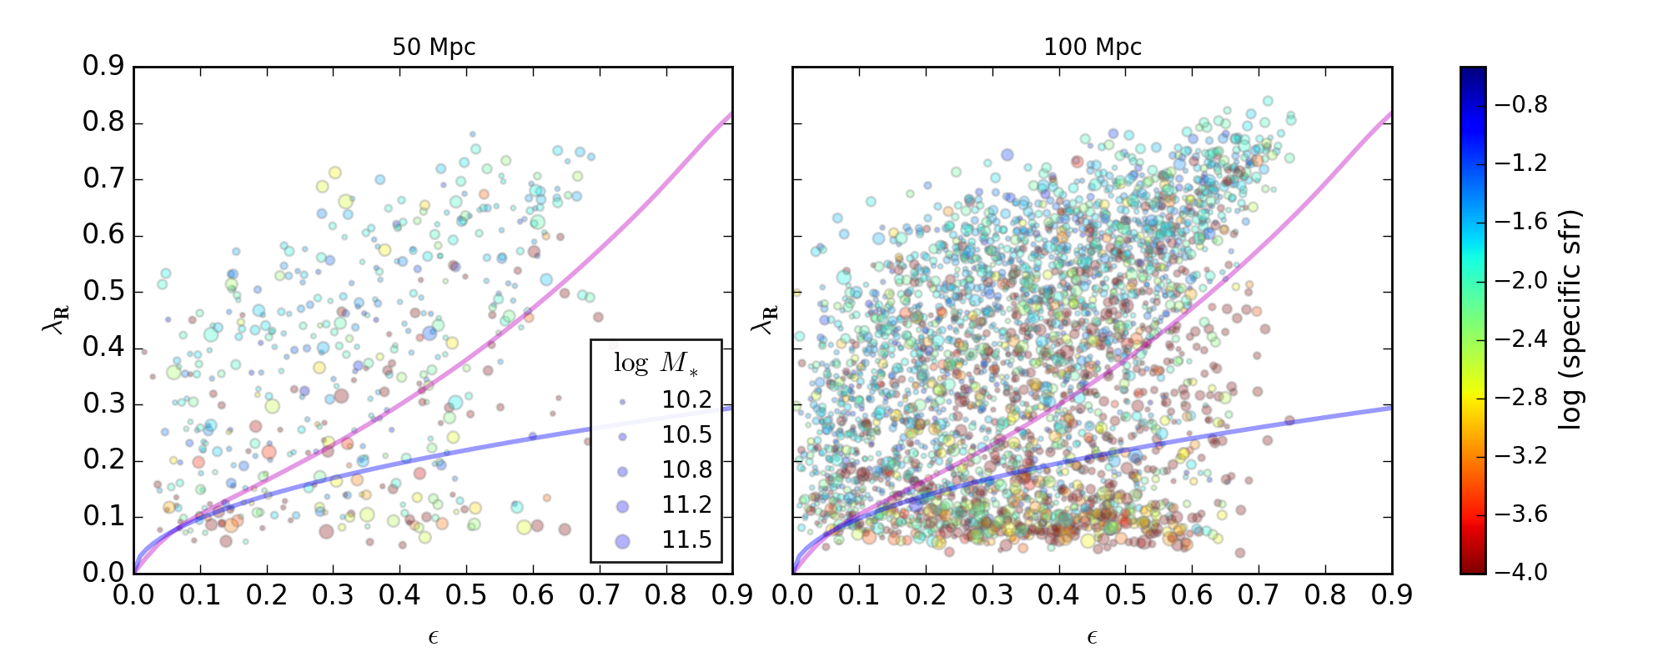
Eagle galaxies: rotation
Star forming galaxies rotate faster than quiescent galaxies
Naab et al. in prep
Notes:
Turbulent viscosity generated by inhomogeneities and random motions
Then simulations started with models of disks……..

Slide 10
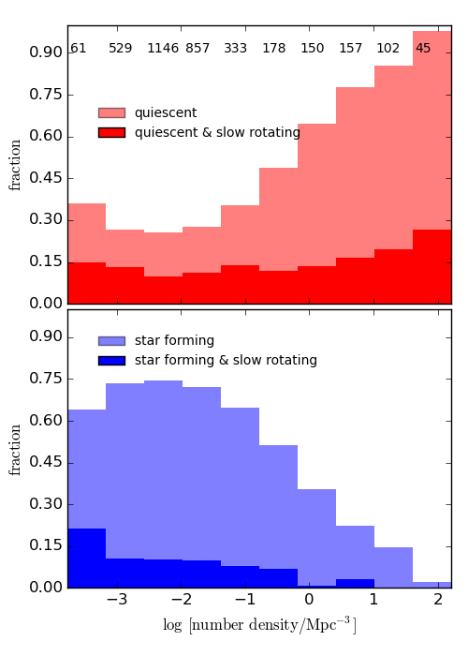
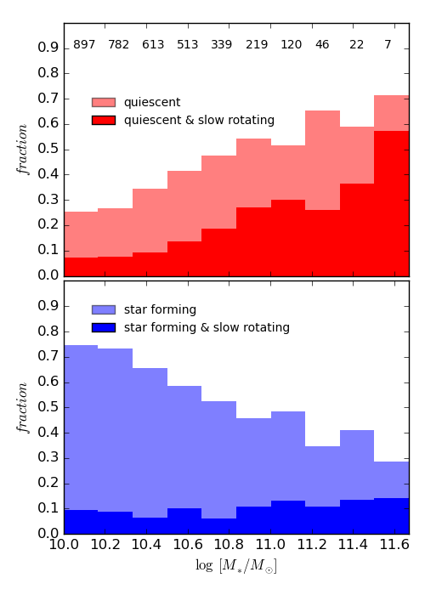
Eagle galaxies: mass or environment?
Mass and environment determine star formation properties
Angular momentum decreases with mass
Notes:
Turbulent viscosity generated by inhomogeneities and random motions
Then simulations started with models of disks……..

Slide 11
AGN feedback in cosmological zoom-simulations
Dubois et al. 2013
AGN feedback reduces in-situ star formation (e.g. Hirschmann et al. 2012)
Reduced stellar mass in better agreement with abundance matching estimates (as in all AGN models)
Transformation of rotating systems in dispersion dominated systems (Dubois et al. 2013, Martizzi et al. 2014)
Martizzi et al. 2014

Slide 12
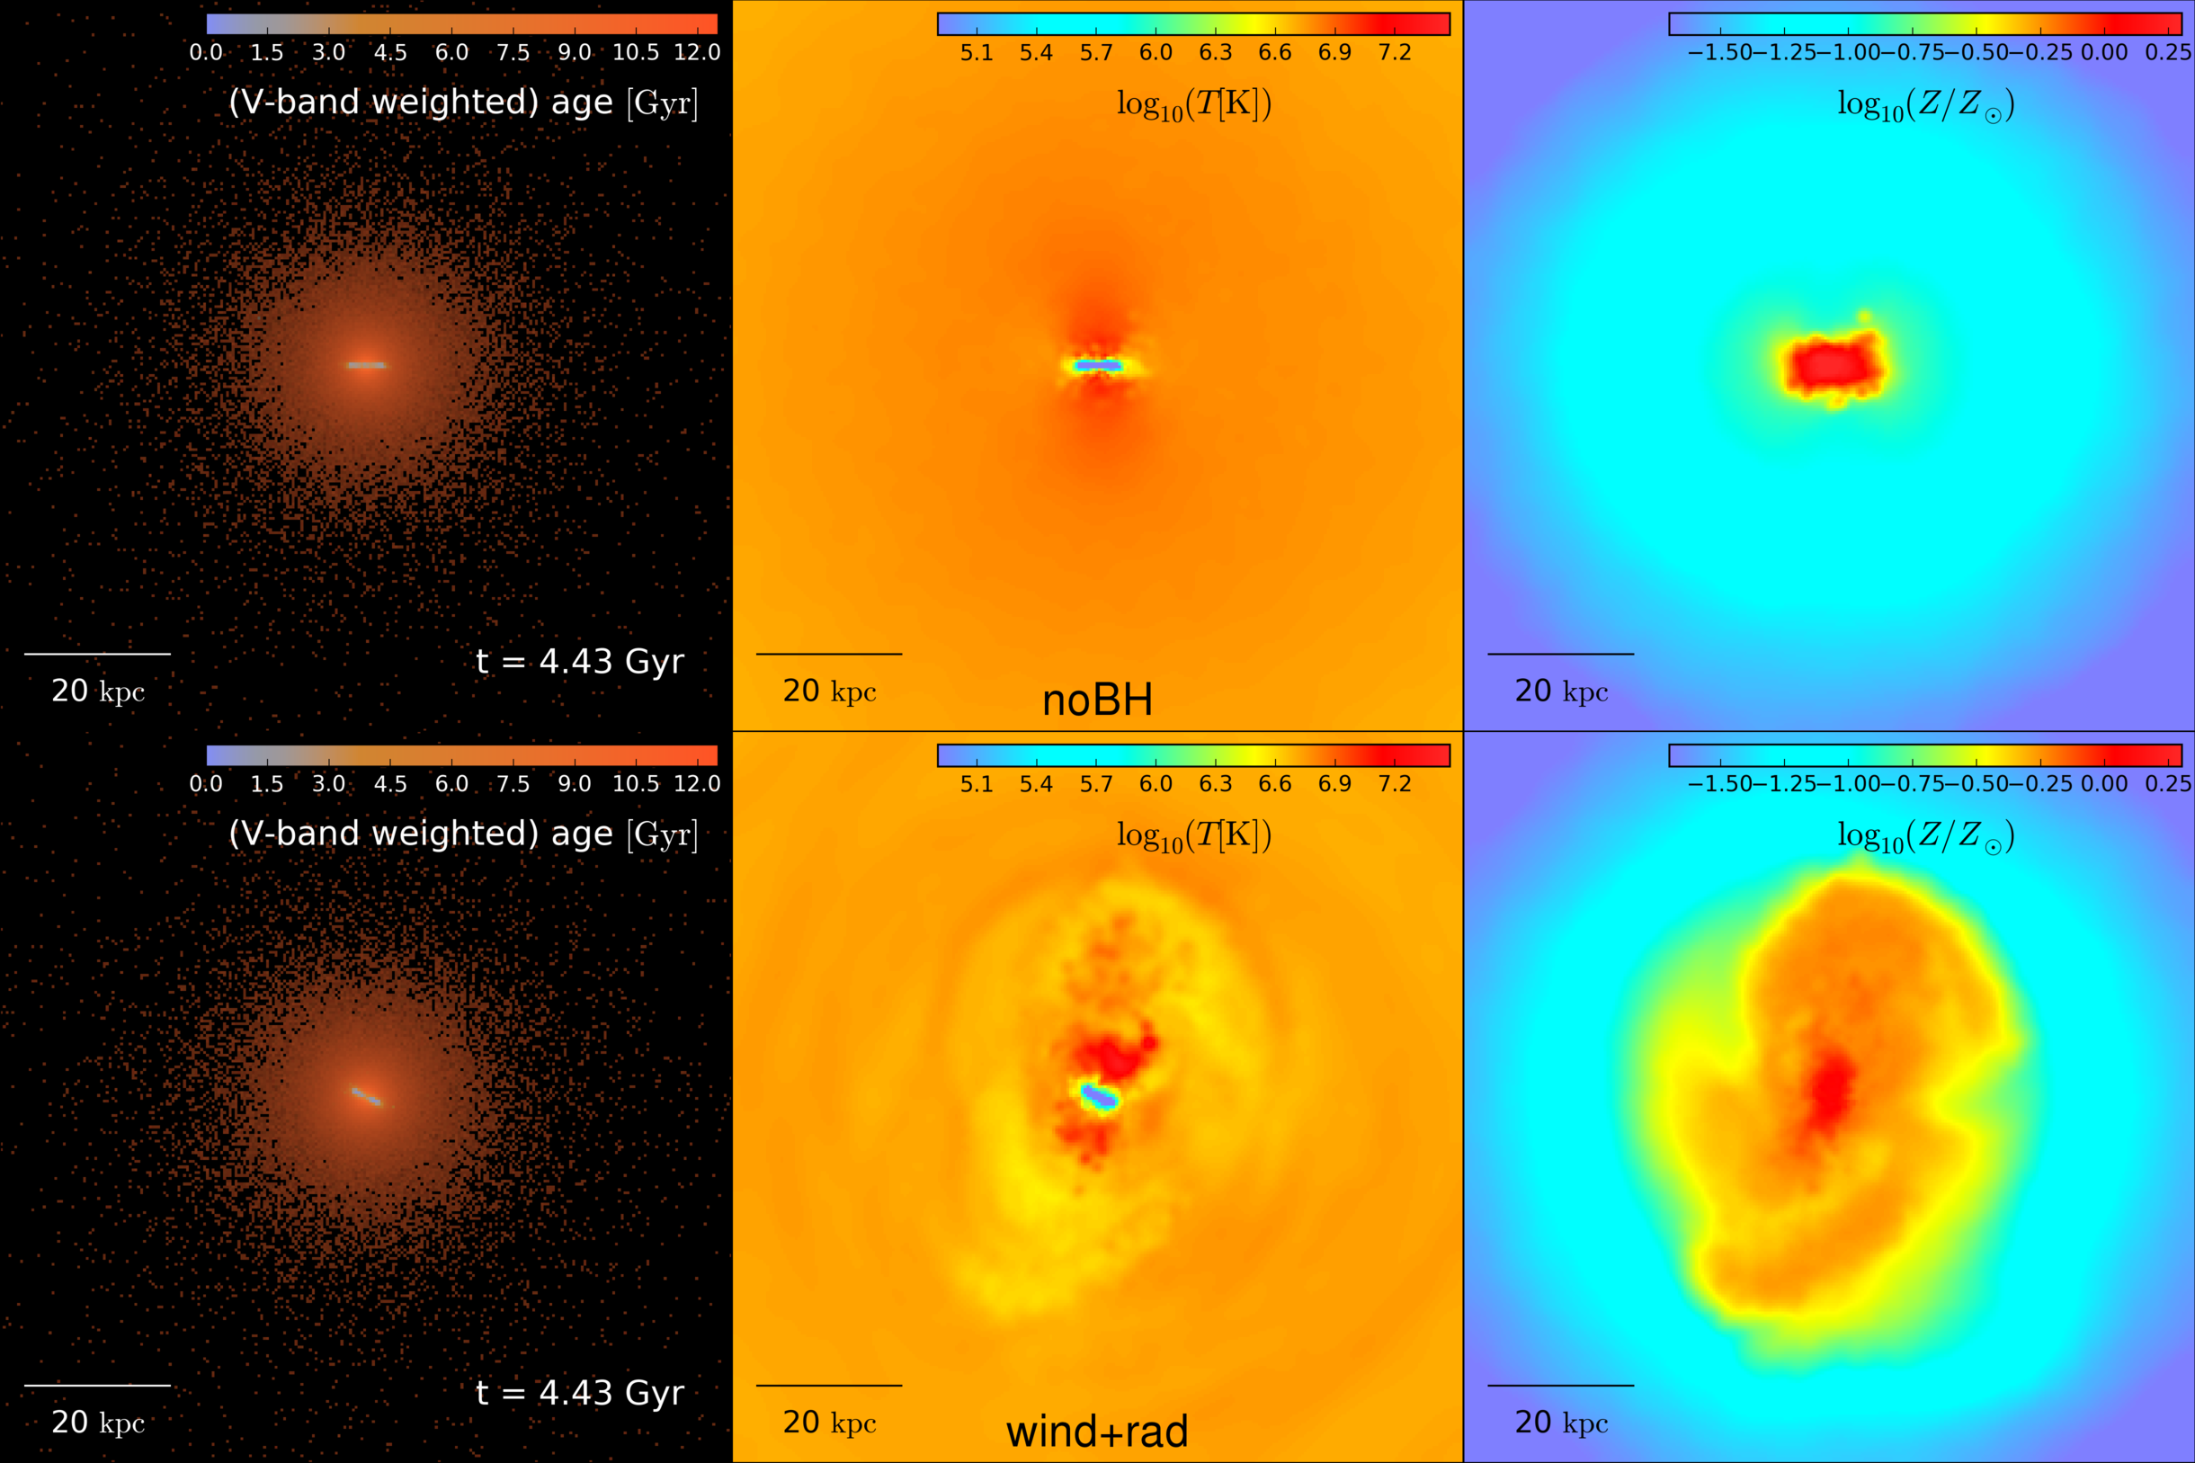
The dynamical impact of AGN feedback
Eisenreich et al., in prep.

Slide 13
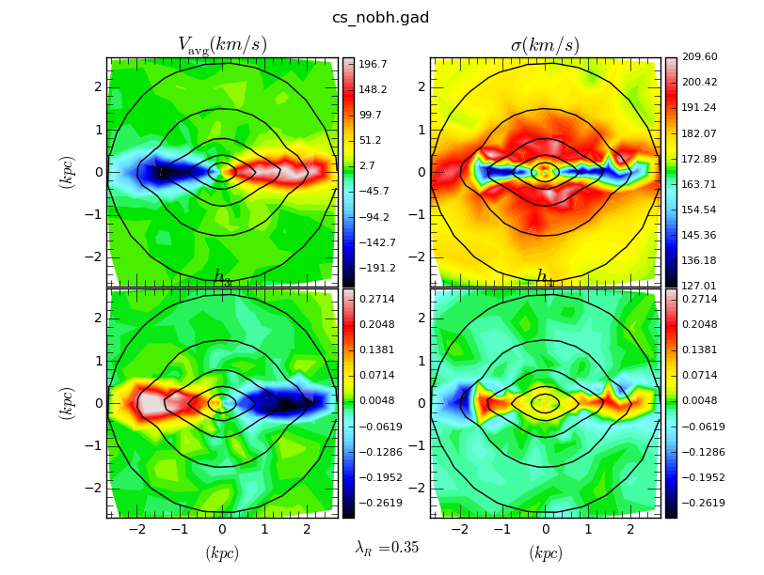
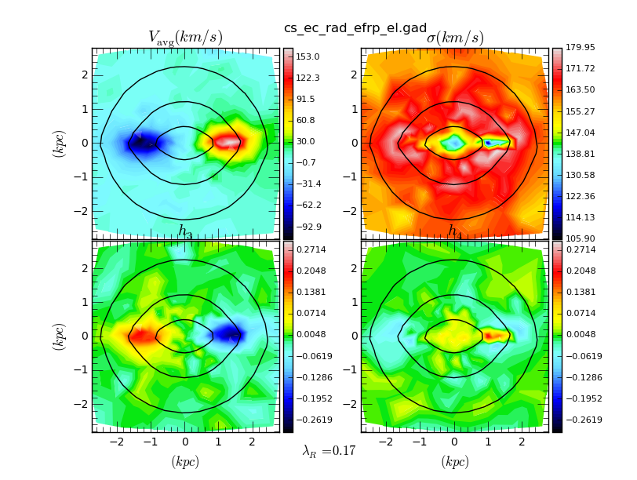
The dynamical impact of AGN feedback
no AGN
AGN
simultaneous reduction of rotation
and sSFR
Eisenreich, Frigo et al., in prep.

Slide 14
The impact of AGN feedback on ETG dynamics
Cosmological zoom simulations with Choi et al. (2015) AGN feedback model - AGN strongly impact dynamics
Frigo et al., in prep.
Notes:
Turbulent viscosity generated by inhomogeneities and random motions
Then simulations started with models of disks……..

Slide 15
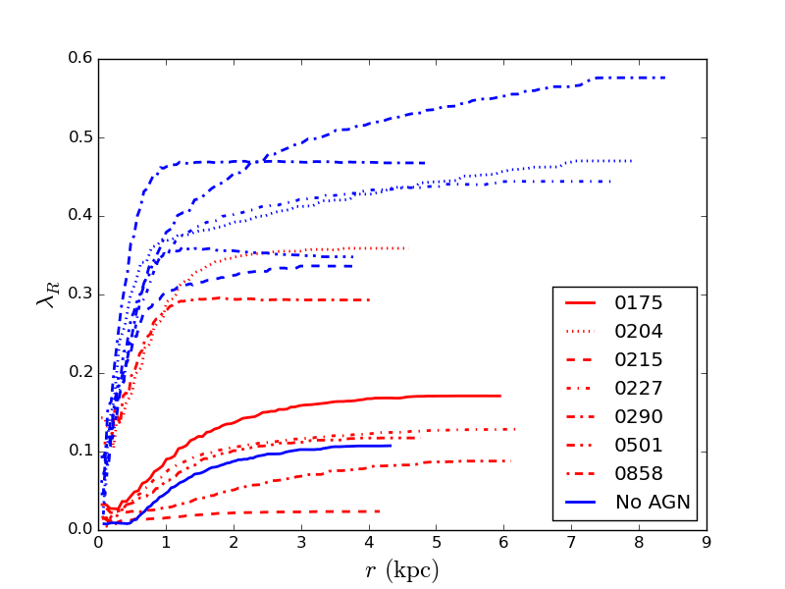
The impact of AGN feedback on ETG dynamics
Mass and environment determine star formation properties
Angular momentum decreases with mass
Notes:
Turbulent viscosity generated by inhomogeneities and random motions
Then simulations started with models of disks……..

Slide 16
The impact of AGN feedback on ETG dynamics
AGN feedback reduces the in-situ component dramatically – and star formation
Choi et al., in prep.
Notes:
Turbulent viscosity generated by inhomogeneities and random motions
Then simulations started with models of disks……..

Slide 17
The impact of AGN feedback on ETG dynamics
AGN feedback reduces the in-situ component dramatically – and star formation
Choi et al., in prep.
Notes:
Turbulent viscosity generated by inhomogeneities and random motions
Then simulations started with models of disks……..

Slide 18
Conclusions
Two-dimensional kinematic features of simulated galaxies can be directly linked to characteristic formation histories
The stellar orbital backbone helps to explain observed kinematic features like asymmetries in the LOSVD
Studies can naturally be extended to stellar population properties: colors, ages, metallicities
The combination of 2D-kinematics, population properties and orbit analysis offers a unique test-bed for formation models of massive early-type galaxies
Notes:
Turbulent viscosity generated by inhomogeneities and random motions
Then simulations started with models of disks……..

Slide 19
Rotation and stellar population age
edge-on projection
Slow rotators form from gas-rich and gas poor major mergers and minor mergers only (C, E, F)
Fast rotators from dissipative major and minor mergers and gas-poor major merger (A, B, D)
Notes:
Number density of 2x10^-4

Slide 20
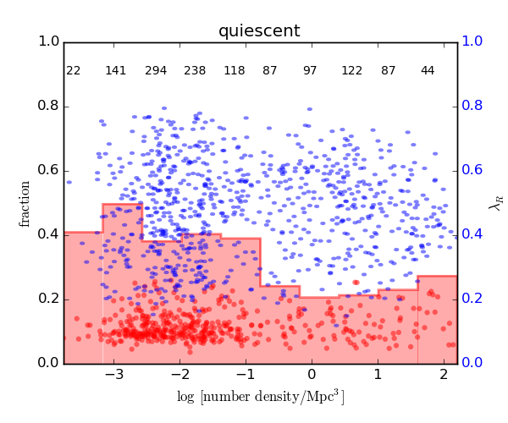
Eagle galaxies: environment
Hmmmm……..
Notes:
Turbulent viscosity generated by inhomogeneities and random motions
Then simulations started with models of disks……..

Slide 21
The future…
With high resolution cosmological simulations it is/will be possible to connect formation histories and physical processes like AGN and stellar feedback to present day kinematic and population features
Feedback processes will leave signposts detectable in 3D data – this will help to put constraints even for massive galaxies that are way past their main star formation epoch
There is also gas (see e.g. Serra et al. 2014)
… will be bright with existing and upcoming IFU surveys (CALIFA, SAMI, MaNGA, MUSE, VIRUS, MASSIVEx…)
Notes:
Turbulent viscosity generated by inhomogeneities and random motions
Then simulations started with models of disks……..

Slide 22
High-quality maps from cosmological simulations
Naab et al. 2014 with ATLAS^{3D}-team

Slide 23
Orbital content of zoom simulations: the stellar backbone
Detailed orbital analysis of the stellar component from cosmological zoom simulations allow a detailed analysis of line-of-sight kinematic features – i.e. direct correspondence of tube orbits and rotation in the kinematic maps
Röttgers, Naab & Oser 2014

Slide 24
Eagle galaxies
Notes:
Turbulent viscosity generated by inhomogeneities and random motions
Then simulations started with models of disks……..

Slide 25
Detailed analysis of galaxy assembly
projection effects
Emsellem et al. 2011
Projections fill almost the full parameter space of observed galaxies
Slow rotators project at almost constant - low – angular momentum
Dearth of simulated galaxies with no rotation an artifact
Naab + ATLAS team, 2014

Slide 26
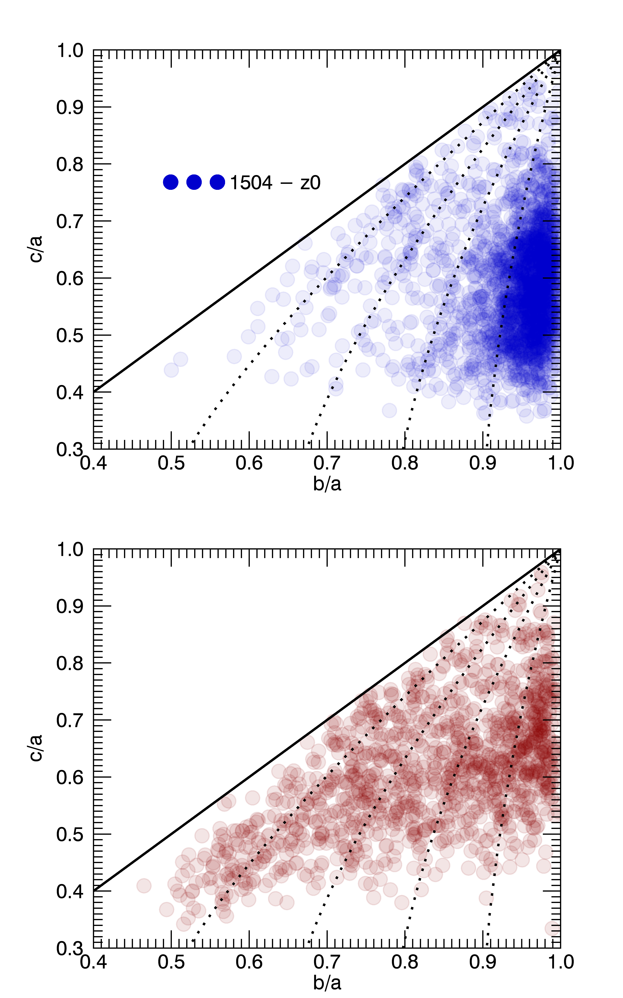
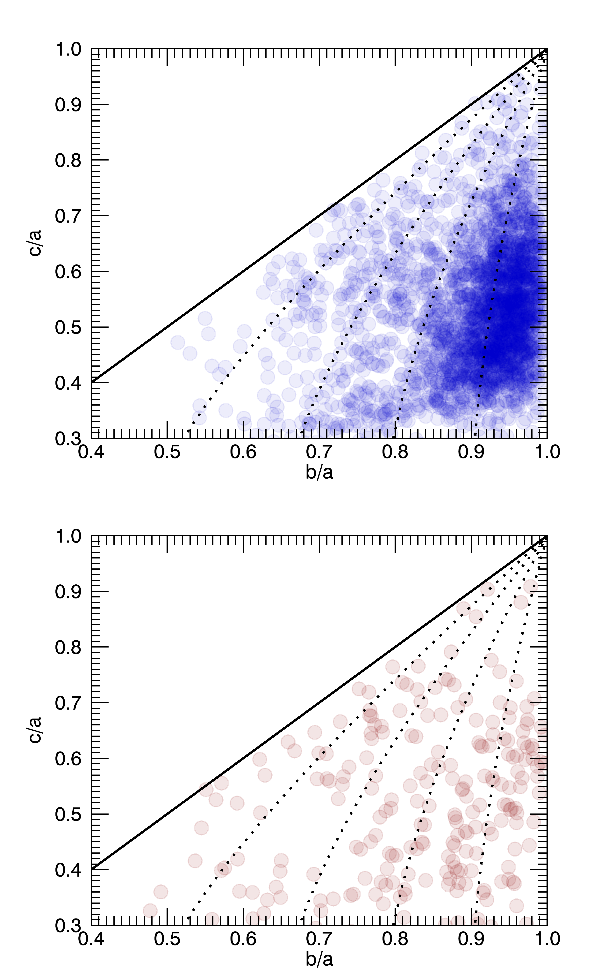
Eagle galaxies
Notes:
Turbulent viscosity generated by inhomogeneities and random motions
Then simulations started with models of disks……..

Slide 27
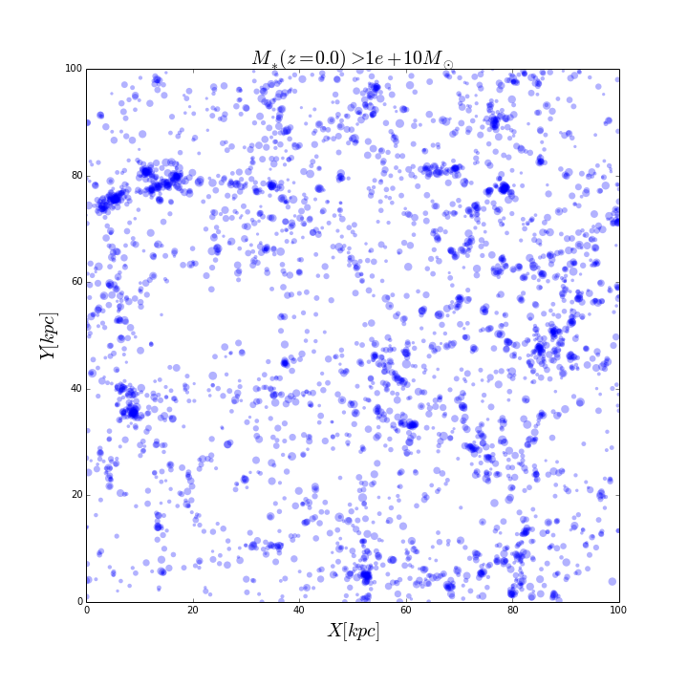
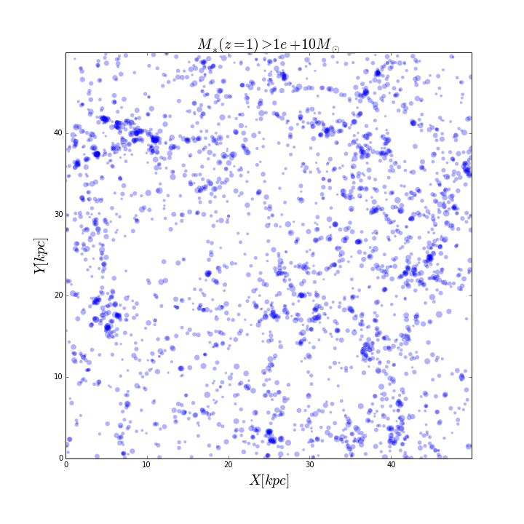
Eagle galaxies
Notes:
Turbulent viscosity generated by inhomogeneities and random motions
Then simulations started with models of disks……..

Slide 28
ATLAS^{3D} - sample
Galaxies mostly populate the red-sequence and cover field and cluster environments
ATLAS^{3D} I: Cappellari, Emsellem, Krajnovic, Mc Dermid et al. 2011
Notes:
SDSS DR7 postage stamps and INT red-green-blue composite images, plot side equals 10re, sorted according to rotation, jet in 4486, interaction in 1222, 3414, 5557, counter rotating disks in 4550, 3796, 4528

Slide 29
How do galaxies get their rotation properties?
ATLAS^{3D} III: Emsellem et al. 2011
Notes:
HST Goods South as part of Candles

Slide 30
Preliminary kinematic analysis of “Eagle” galaxies
Simulated cosmological volume of 200³ Mpc³ following galaxy formation at slightly lower resolution than the zoom simulation with ‘realistic’ galaxy properties (Schaye et al. 2015)
Selected all galaxies with stellar masses above 10¹⁰ (3554 at z=0, 2990 at z=1) for the large 200 Mpcbox.
Construct stellar velocity fields (shapes, sizes) for all galaxies in edge-on (or random) projection and compute λ_{R}
Divide into star forming and non-star forming galaxies based on sSFR < 0.01/Gyr
Naab, Oser et al. 2015
Notes:
Turbulent viscosity generated by inhomogeneities and random motions
Then simulations started with models of disks……..

Slide 31
Eagle early-type slow rotators
Notes:
Turbulent viscosity generated by inhomogeneities and random motions
Then simulations started with models of disks……..

Slide 32
Eagle fast rotators
Notes:
Turbulent viscosity generated by inhomogeneities and random motions
Then simulations started with models of disks……..

Slide 33
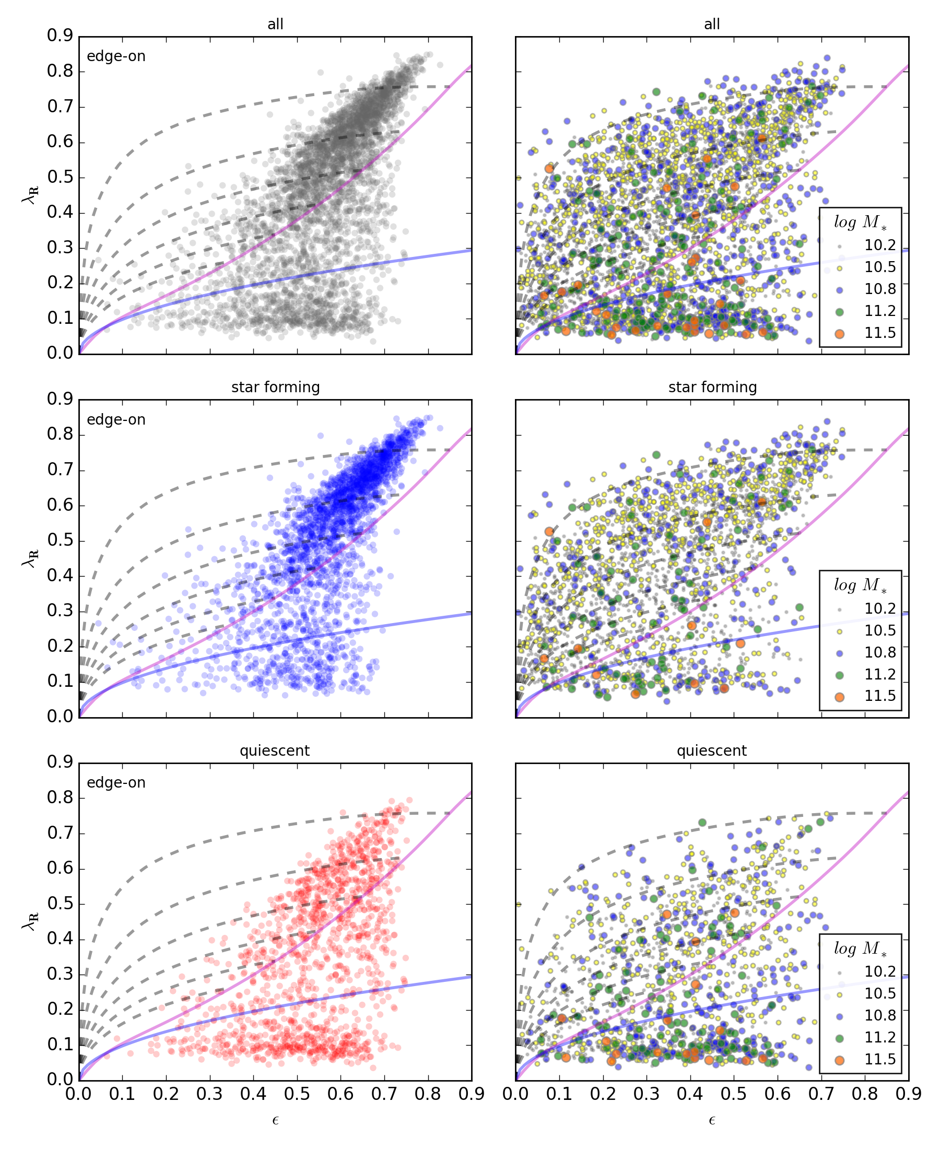
Eagle galaxies
Galaxies cover observed parameter space
Star forming galaxies rotate faster than quiescent galaxies
Overabundant population of elongated slow rotators?
Notes:
Turbulent viscosity generated by inhomogeneities and random motions
Then simulations started with models of disks……..

Slide 34
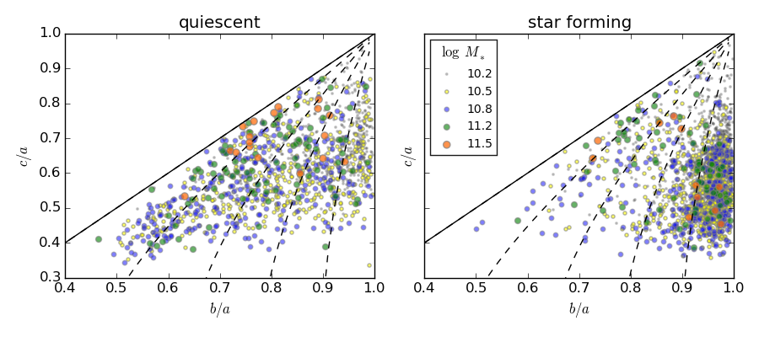
Eagle galaxies: shapes
Star forming galaxies are oblate, quiescent galaxies cover all shapes
Notes:
Turbulent viscosity generated by inhomogeneities and random motions
Then simulations started with models of disks……..

Slide 35
Science with modern observational data
Integral field spectroscopy of 48 elliptical and lenticular galaxies (Bacon et al. 2001, de Zeeuw et al. 2002, Emsellem et al. 2004, Cappellari et al. 2006)
Wealth of kinematic features like KDCs, KT, two- sigma dispersion profiles
Measure of the angular momentum of a galaxy: λ_{R} (Emsellem et al. 2004)
Early-type galaxies are fast rotators (λ_{R}>0.1) or slow rotators (λ_{R}<0.1)
Notes:
Luminosity weighted measure of the specific line-of-sight angular momentum

Slide 36
Kinematics in ATLAS^{3D} and CALIFA
ATLAS^{3D} (Emsellem et al. 2011)
Early-type galaxies
CALIFA (Falcon-Barroso et al. 2014)
Early-type & late type galaxies
Fast rotating early-type galaxies and spirals have similar rotation properties

