Slide 1
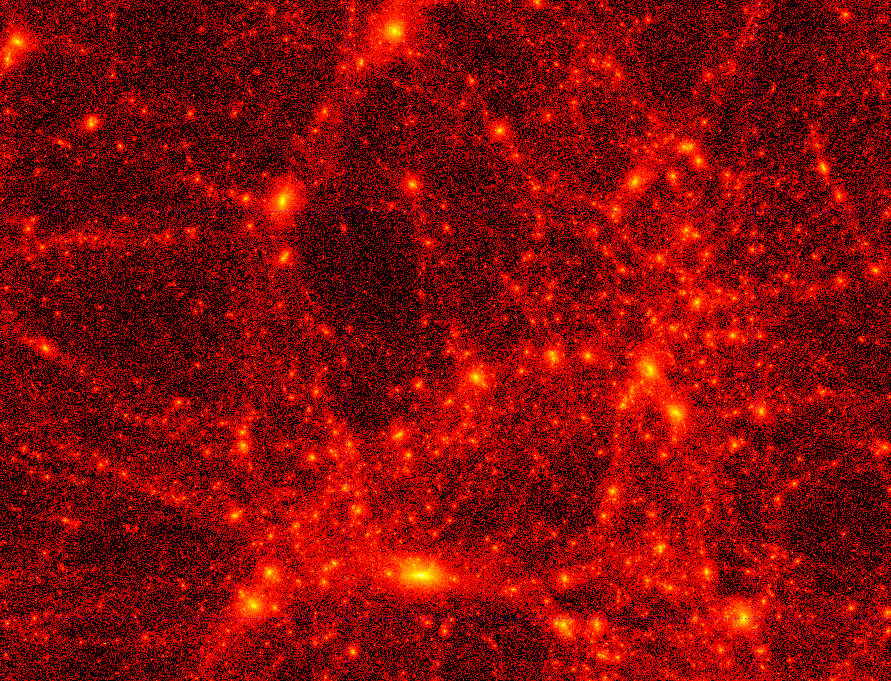



Evolving galaxies semi-analytically with local processes
Adam R. H. Stevens
Swinburne University of Technology
Melbourne, Australia
Notes:
Nearly the end of day 4, so I know we’re all feeling like…

Slide 2


Slide 3
Evolving galaxies semi-analytically with local processes
Adam R. H. Stevens
Swinburne University of Technology
Melbourne, Australia
with Darren J. Croton & Simon J. Mutch
Notes:
Started the conference with a discussion on the value of analytics. I agree.
To do astrophysics analytically but properly really requires a SAM in order to have a cosmologically consistent picture.
20-sec description of SAMs

Slide 4
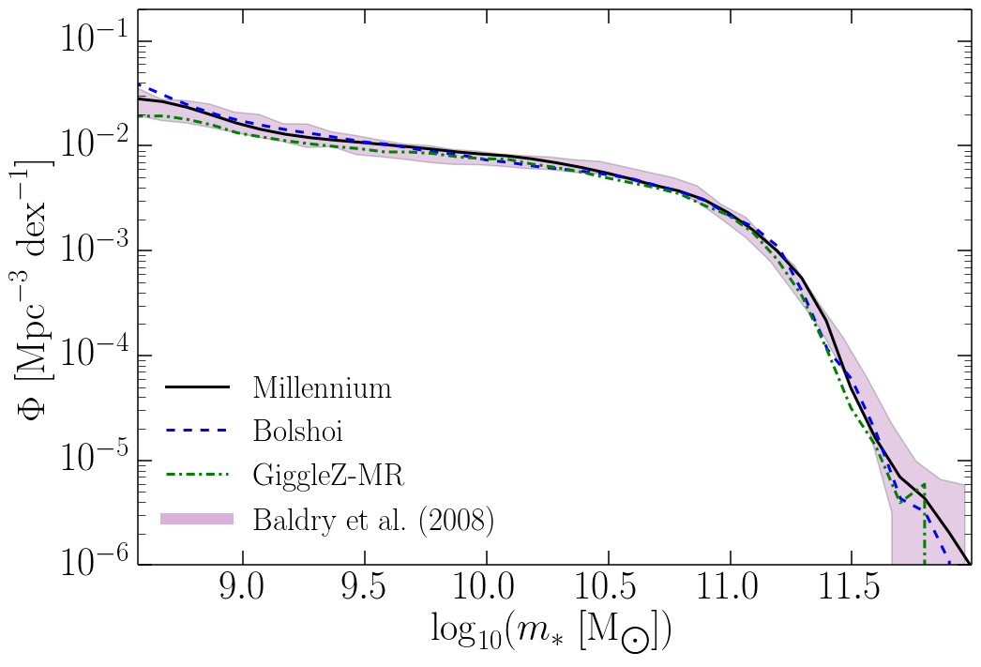
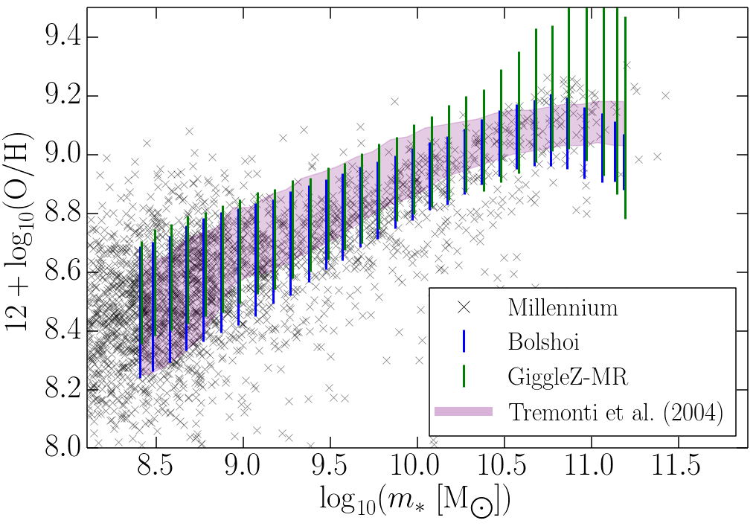
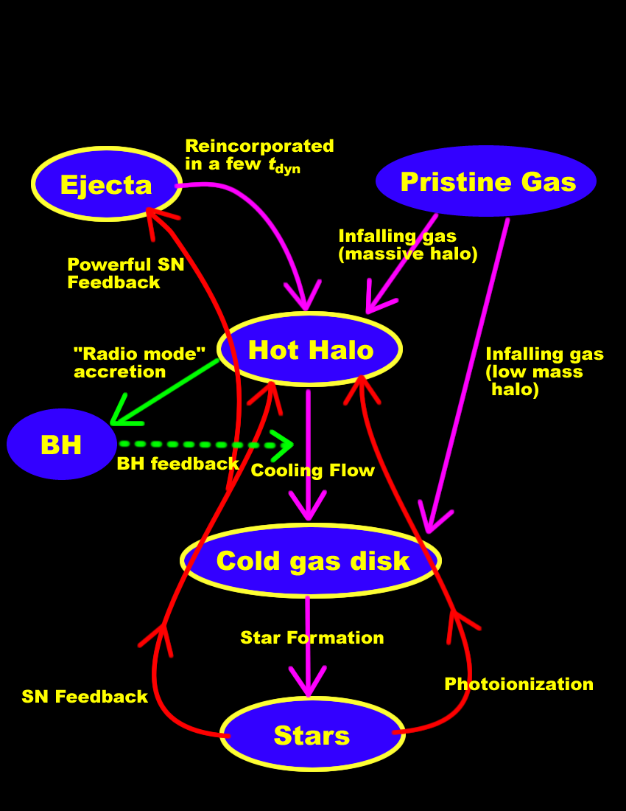
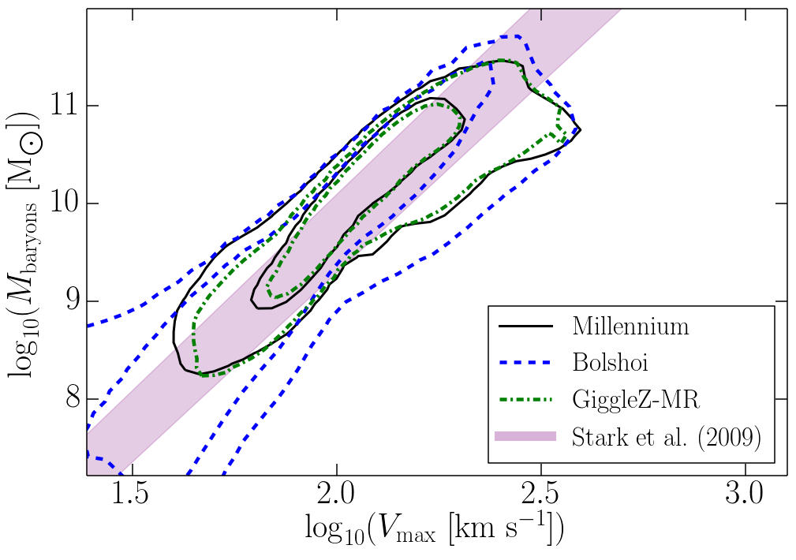
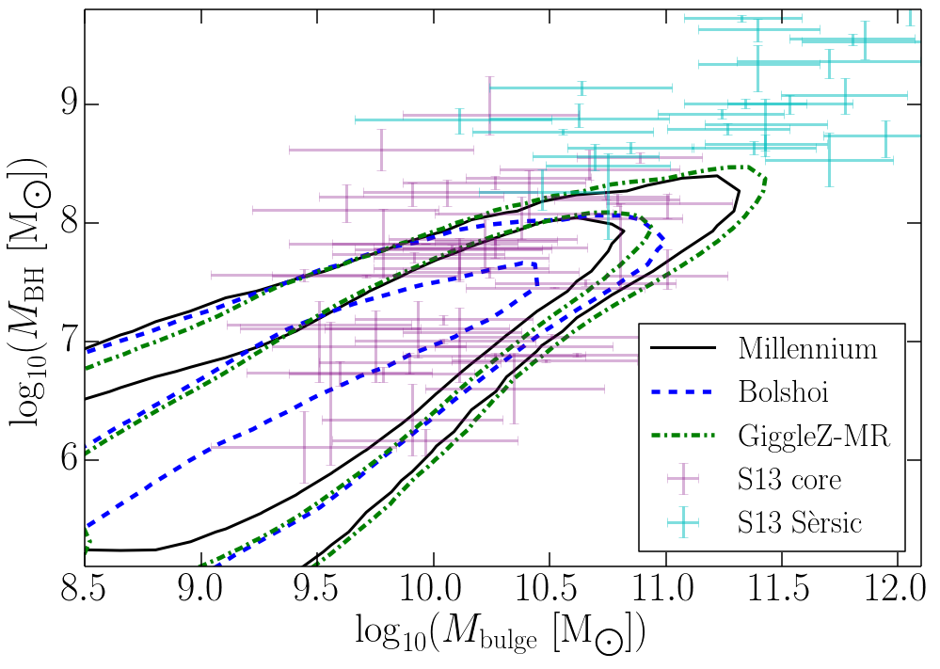
SAGE – Semi-Analytic Galaxy Evolution
(Croton, Stevens et al., 2016)
github.com/darrencroton/sage
tao.asvo.org.au
Stellar mass function
Mass—metallicity
Global model of
galaxy evolution
Baryonic
Tully—Fisher
Black hole—bulge
Notes:
Classical SAMs describe galaxy evolution as a global process, constrained by global properties
Plug SAGE
Modular SAM that runs well on multiple simulations with a single parameter set
Publicly available on GitHub, Catalogues available on TAO

Slide 5
Hydro
Modern SAM
Classical SAM
Local
Global
Legitimately fundamental properties:
Specific angular momentum
Mass
Fundamental properties:
Specific angular momentum
Mass
Notes:
SAMs and hydrosims typically at opposite ends of the global—local spectrum. Modern SAMs need to be more centrist especially when surveys of comparison have local information
Ideally should be able to use fundamental physical quantities as the independent variables to describe galaxy evolution
These are mass and specific angular momentum
“Fundamental” often a grossly misused term in this community -- should come from conservation laws of physics

Slide 6
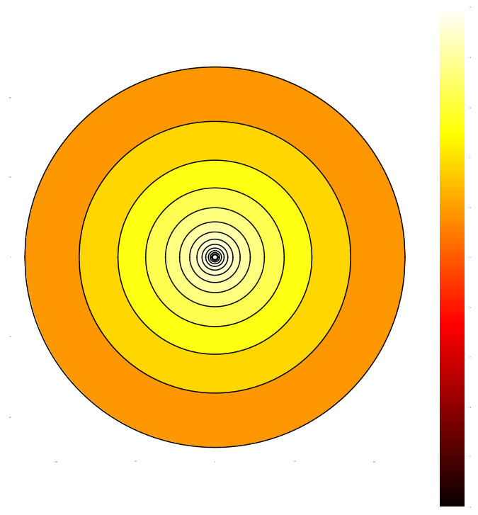
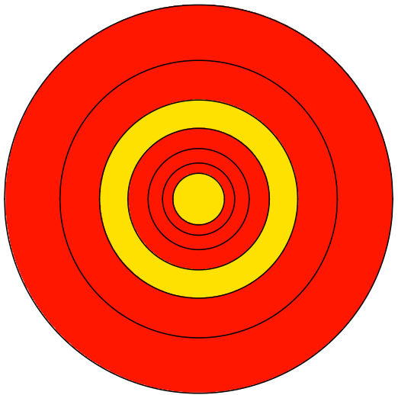
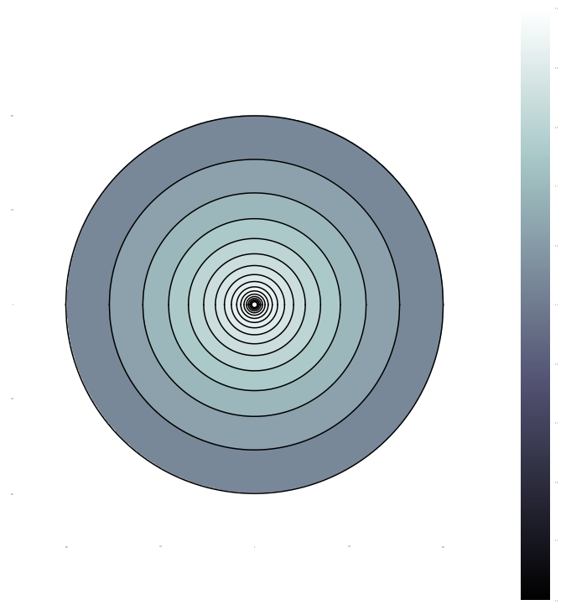
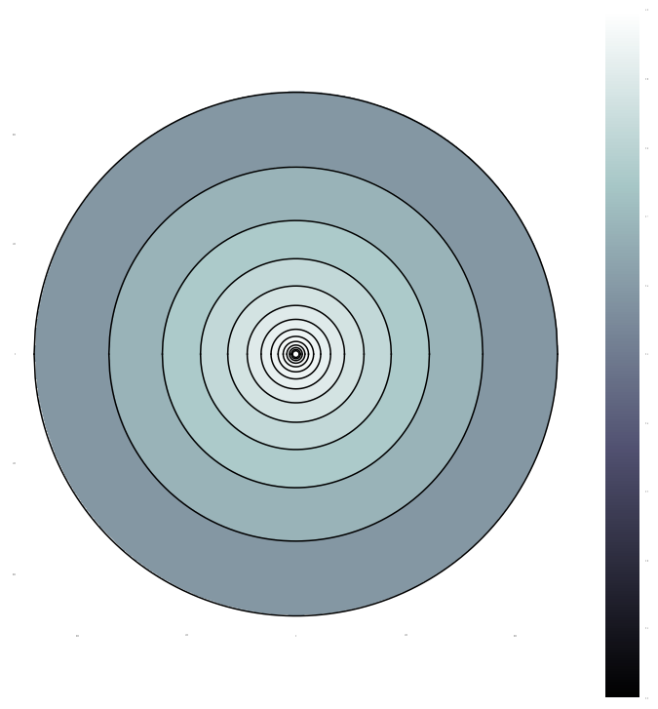
Introducing Dark SAGE
(Stevens et al., super duper close to submission)
Local(ish) model of galaxy evolution
unstable
stable
time
time
bulge (black hole)
Disc annuli
Cooling (star formation)
Gas precession
Disc instabilities
(Minor) mergers
Also including:
- Gas phase breakdown
- Ram-pressure stripping
- Merger starbursts
- BH feeding and feedback
etc…
Notes:
I’ve developed a heavily modified version of SAGE aimed at resolving disc structure.
I don’t believe in contriving acronyms
Discs are considered in annuli of fixed specific angular momentum
Both the angular-momentum structure and vector directions are evolved naturally
Galaxy processes evolved in these annuli
Local angular momentum and mass (surface density) drives the evolution, so we’re sticking to the fundamental

Slide 7
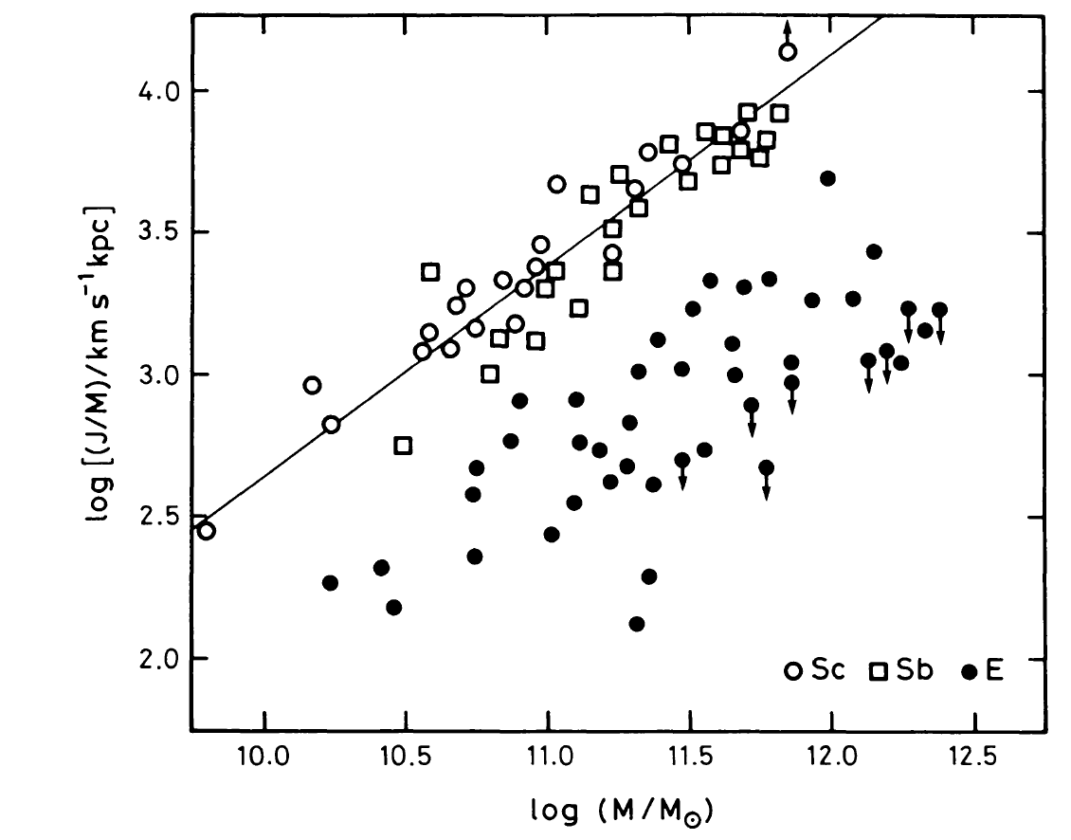
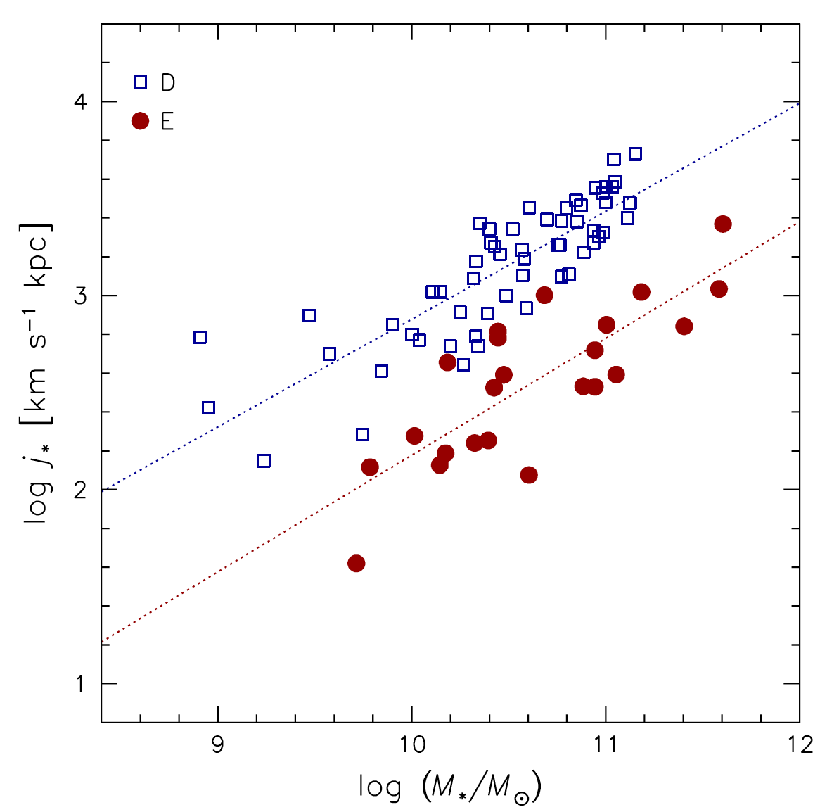
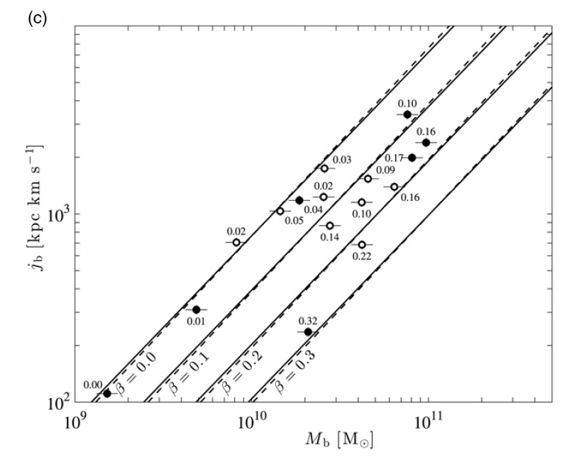
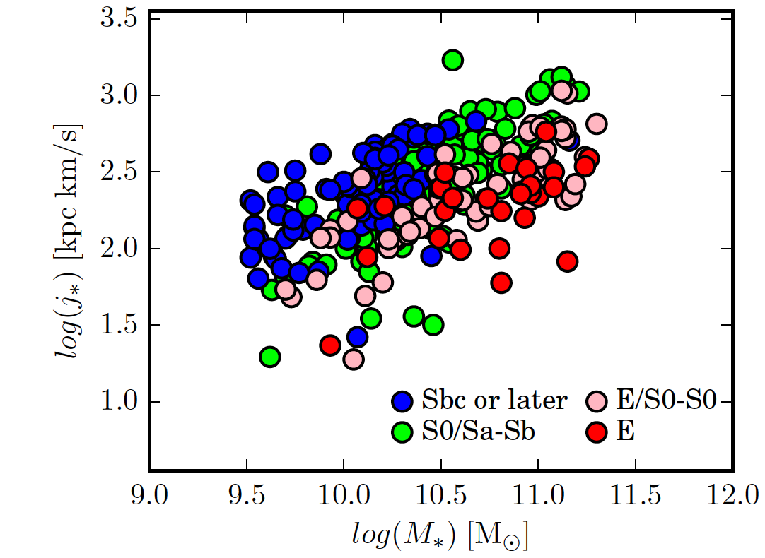
Mass—spin relation of spiral galaxies
Stellar mass
Fall (1983)
Fall & Romanowsky (2013)
Stellar specific
angular momentum
Obreschkow &
Glazebrook (2014)
Cortese et al. (2016)
Notes:
Interesting thing about those fundamental properties, is they’re globally linked
Have had mentions of this from many talks already
What can a model that deals with these properties locally say about them globally?

Slide 8
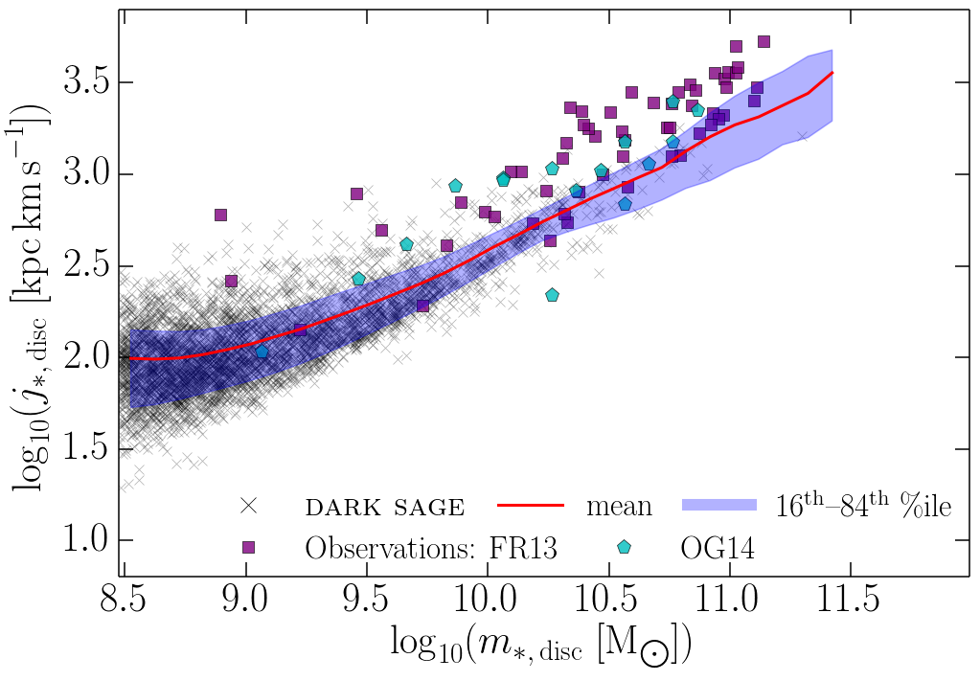
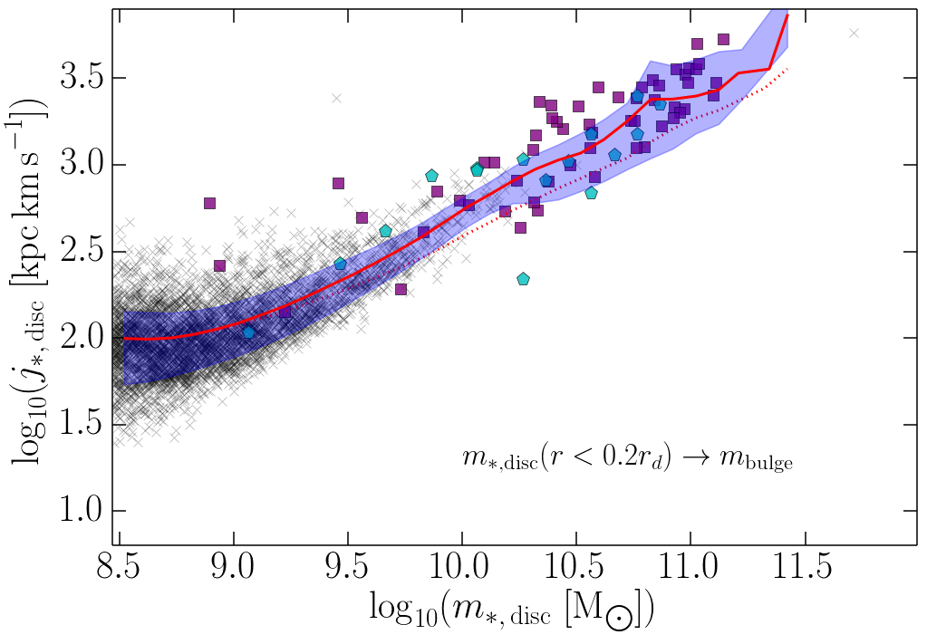
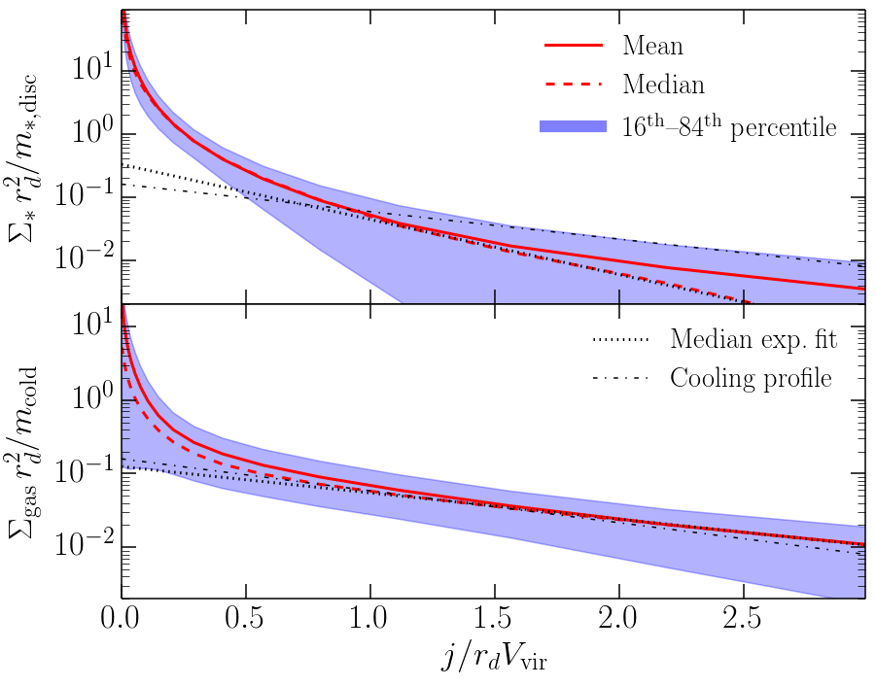
Mass—spin relation of spiral galaxies
After accounting for pseudobulge
contribution to the disc
“Pseudobulge”
Notes:
Prediction appears to be below the observational data, meaning there’s too much low-j material in the discs
In inspecting the disc profiles we find this is indeed the case, where discs are cuspy.
If I were an observer, I’d call the cusp a “pseudobulge”. Which is another way of saying we lie to ourselves about discs being exponential.
To compare to observations fairly, that contribution has to be removed, as this classically “isn’t part of a disc”
Side note, the observed galaxies are acknowledged to have pseudobulges as well.
Classically, pseudobulges thought to form as a result of a disc stabilizing itself, so there’s a hint this is an important process for the m-j relation

Slide 9
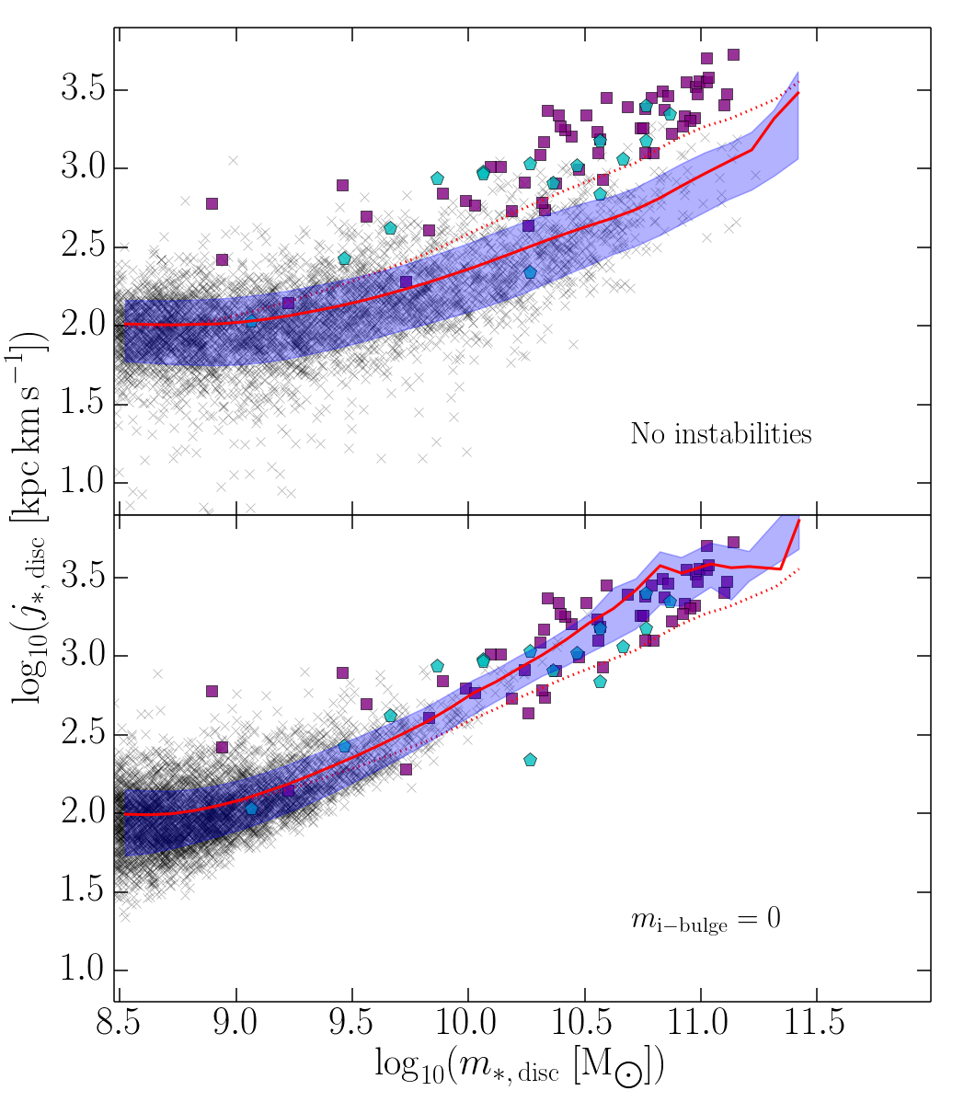
Mass—spin relation of spiral galaxies
Instabilities left unresolved
Totally stable discs
Notes:
Can show the importance of disc instabilities by removing their resolution from the model.
Discs that are allowed to be unstable typically lack specific angular momentum
There is always a population of galaxies that are stable throughout their entire life-time and they match the data perfectly.

Slide 10
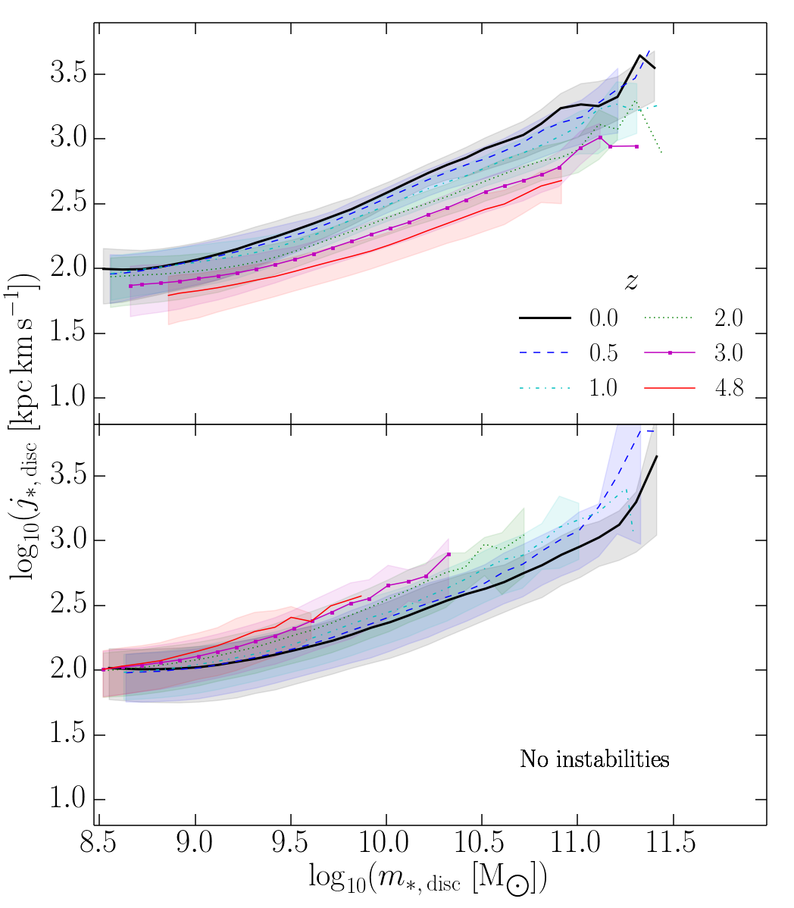
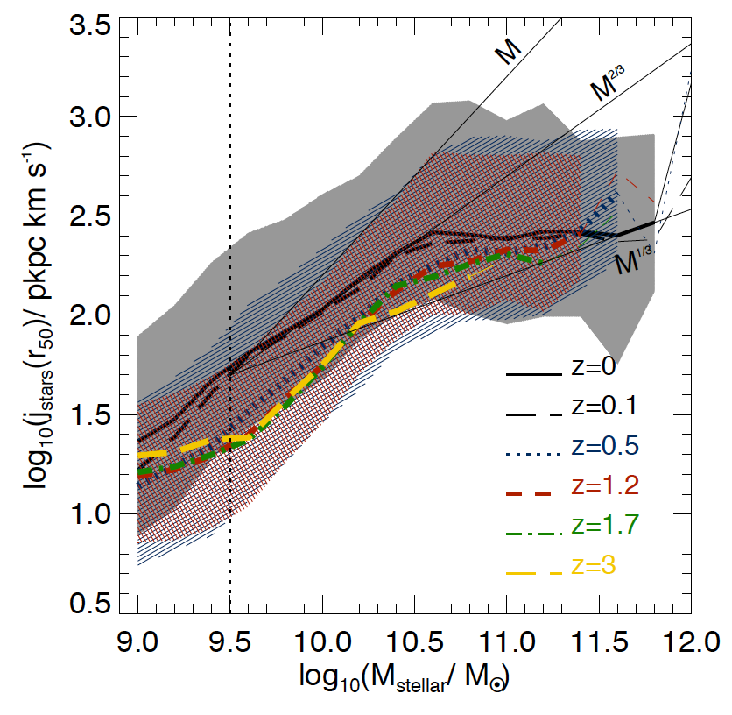
Evolution of the mass—spin relation of spiral galaxies
Instabilities left unresolved
EAGLE
(Lagos et al., in prep.)
Dark SAGE
(Stevens et al., in prep.)
Notes:
Alfie’s stuff shows TF evolution, suggesting rotation rate increasing at higher z. Balanced by decreasing size.

Slide 11
Adam Stevens
astevens@swin.edu.au
Take-home messages
- The best theory of galaxy evolution is one that can be explained in terms of legitimately fundamental properties
- Toomre disc instabilities regulate the mass—specific angular momentum relation of galaxies
- SAGE codebase publicly available – github.com/darrencroton/sage
Notes:
Who needs a job? This guy.

Slide 12
B-b-b-bonus round!!!!!!

Slide 13
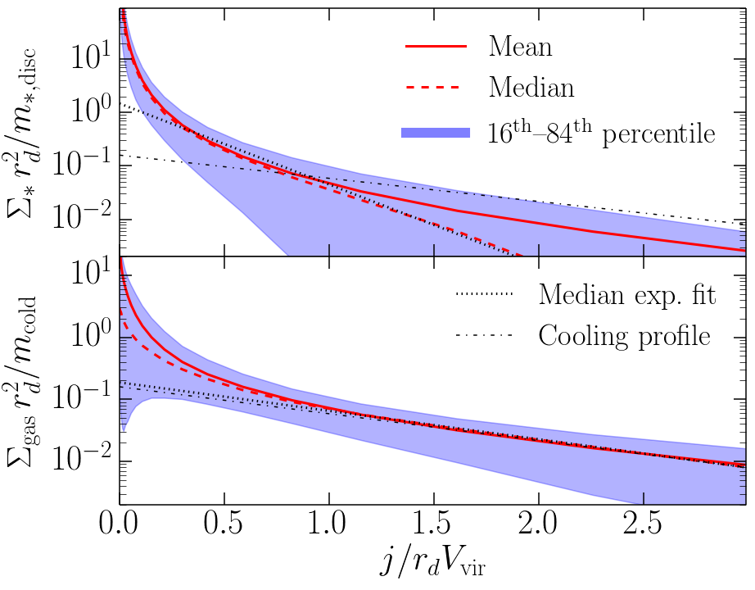
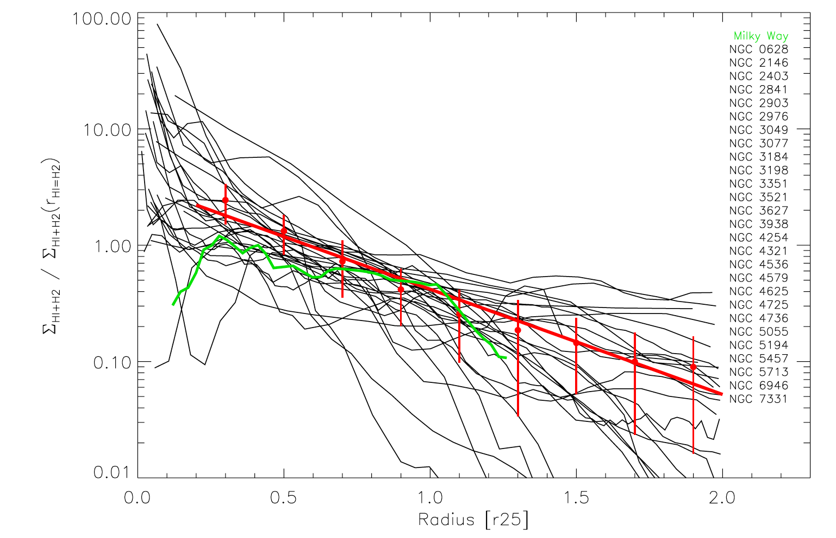
Stars
Surface density of discs alone
for Dark SAGE MW-like galaxies
Gas
or r/r_{d}
Bigiel & Blitz (2012)
Observations for gas
Radius [r25]

Slide 14
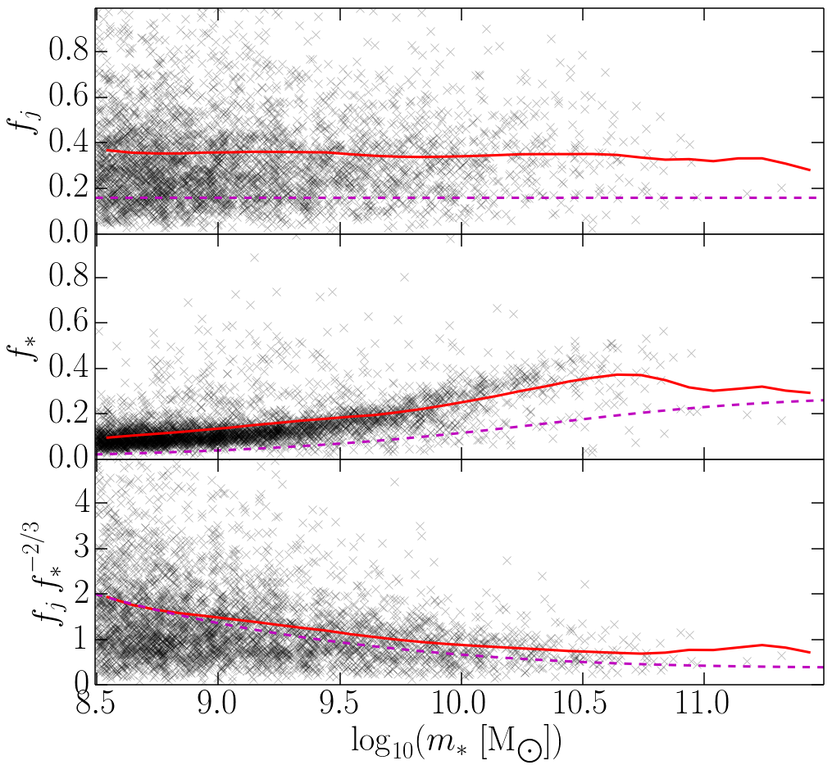
Ratio of specific angular momentum of stars to halo

Slide 15
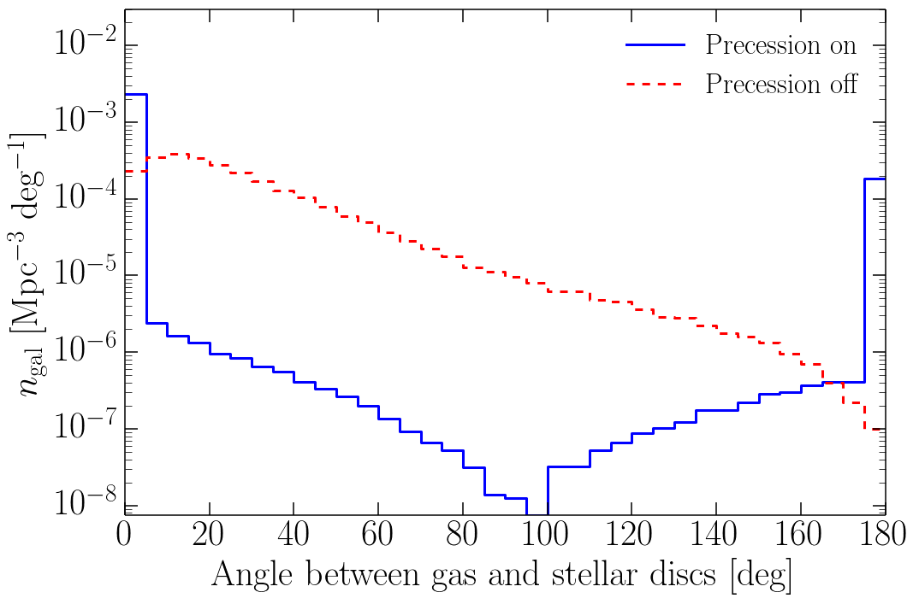
B/T < 0.5
M* > 10^{8.5} M
7%

Slide 16
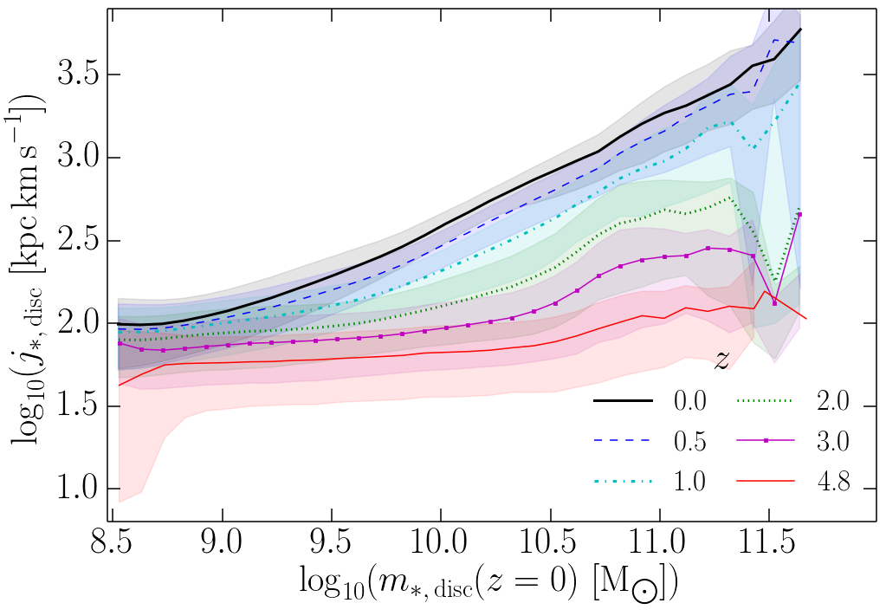
Evolution of the mass—spin relation of spiral galaxies

Slide 17
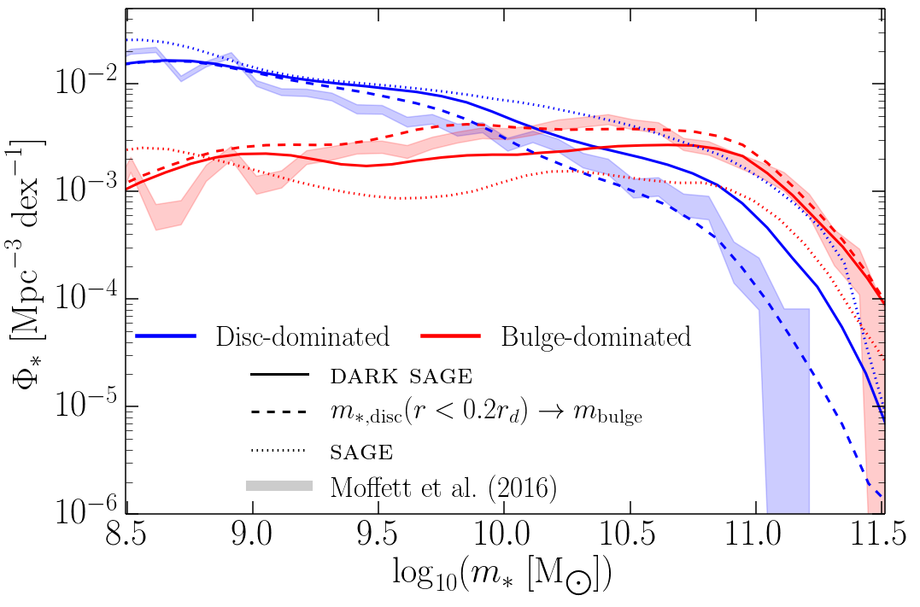
Morphologically decomposed stellar mass functions

