Slide 1
Photoionization models of the CALIFA regions.
C. Morisset, G. Delgado-Inglada, S. Sanchez
Instituto de Astronomia, UNAM, Mexico
+ CALIFA team
Paper submitted to A&A
Cozumel, April 14, ’16 v1.5

Slide 2
CALIFA for dummies
Calar Alto Legacy Integral Field spectroscopy Area survey
~ 600 galaxies observed with the PMAS/PPAK IFU spectrophotometer mounted on the Calar Alto 3.5m telescope.
R ~1650, lambda in [3700-7000AA]
~ 20000 giant HII regions defined by HIIEXPLORER (Sánchez et al. 2012)

Slide 3
Photoionization models
P-space
SED
shape (softness: T*, age)
intensity
Gas
density
abundances
O/H
N/O
etc…
Distance source-gas
Morphologie (O or //)
O-space
Halpha, Hbeta
[NII]6584
[OII]3727
[OIII]5007
No [OIII]4363 nor [NII]5755
Model

Slide 4
Photoionization models
P-space
SED
shape (softness: T*, age)
intensity
Gas
density U=Q/r^2.n
abundances
O/H
N/O
etc…
Distance source-gas
Morphologie (O or //)
O-space
Halpha, Hbeta
[NII]6584
[OII]3727
[OIII]5007
No [OIII]4363 nor [NII]5755
Model

Slide 5
Photoionization models
P-space
SED
shape (softness: T*, age) -> FIT3D
intensity
Gas
density log(U)
abundances
O/H -> O3N2, Stel. pop
N/O
etc…
Distance source-gas
Morphologie (O or //)
O-space
Halpha/ Hbeta: EB-V
[NII]/Ha
[OII]/Hb
[OIII]/Hb
Model

Slide 6
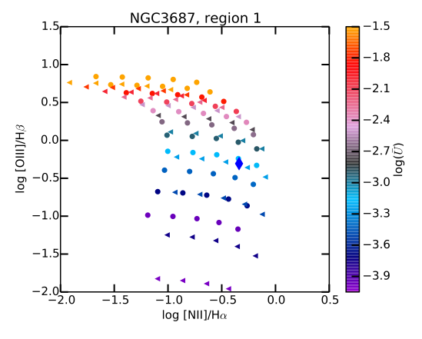
log(U) and N/O grids
For each region (> 9000): 11 values of log(U), 5 values of N/O, 2 morphologies (O or //) and 2 values for O/H -> 220 models with adapted SED and O/H. -> Determination of log(U) and N/O.
A total or ~2 millions models are run for the meta-grid (that's why O/H is not free!)
ad-hoc models with adequate log(U) and N/O are re-run and stored in 3MdB.
[OII]/Hb used to filter the final set of models used for the following plots.

Slide 7
Eq. widths
OB stars
HOLMES
Halpha Eq. width disagree between models and observations:
obs < mod ----> leaking (~80%)
mod < obs ----> missing ionizing photons (pb...)

Slide 8
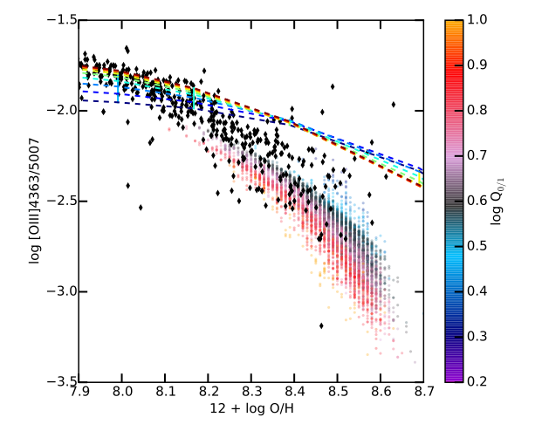
[OIII] 4363/5007: observations reproduced!
OB stars
Our ad-hoc models
observations
MAPPINGS models
HOLMES

Slide 9
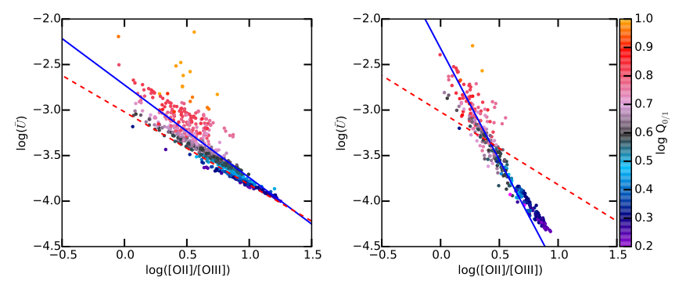
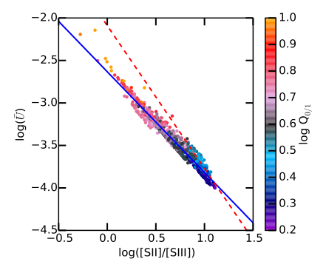
Determining U
OB stars
Diaz+00
This work
HOLMES
O
Morphology
U is not easily determined from observations.
[OII]/[OIII] depends on the morphology
[SII]/[SIII] more acurate
Diaz+91
This work

Slide 10
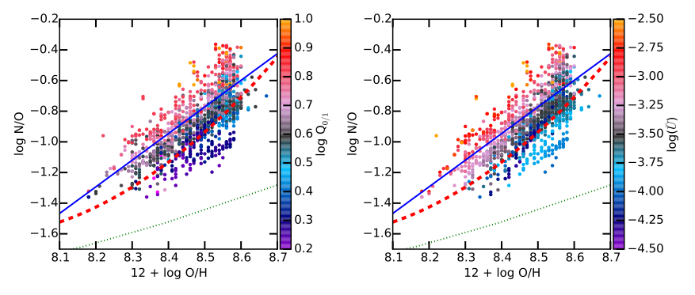
N/O vs. O/H
Pilyugin+13
Dopita+12
This work
OB stars
HOLMES
N/O vs. O/H: our results are closer to the ones from Pilyugin et al. than to Dopita et al.

Slide 11
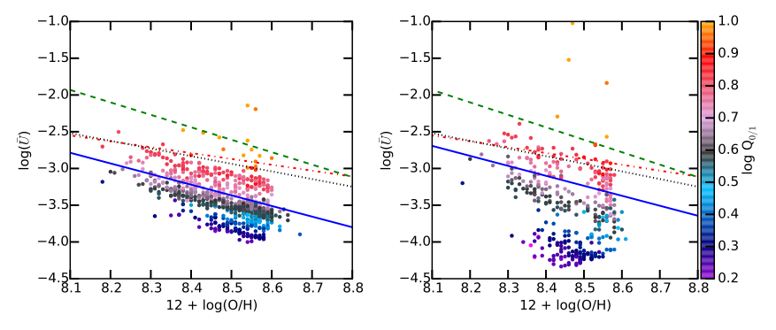
Log(U) vs. O/H
Dopita+86
Dopita+06
Perez-Montero+14
This work
OB stars
HOLMES
O
Morphology
Since Dopita & Evans 1986 we suspect a relation between U and O/H.
We determine a new fit, depending on the region morphology and the SED softness.

Slide 12
Models on 3MdB
All the 20,793 ad-hoc models are available on 3MdB (Mexican Million Models database, Morisset et al. 2015), a mySQL database of photoionization models.
input parameters, and a lot of outputs :
intensities for more than 150 emission lines (IR & UV included)
ionic fractions
ionic temperatures
https://sites.google.com/site/mexicanmillionmodels

Slide 13
Future work
Use the DR3 data
Run a 3D grid changing O/H, N/O and log(U): this implies much more models (one more free parameter). To define models fitting simultaneously the 3 line ratios [NII]/Ha, [OII]/Hb and [OIII]/Hb (maybe 4 if we also fit [SII]/Hb, relaxing S/H) we will use kind of genetic algorithms.

