Slide 1
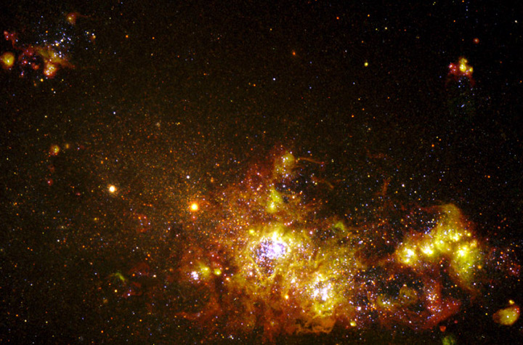
Starbursts and Galaxy evolution:
Results from COSMOS survey
Casiana Muñoz-Tuñón
cmt@iac.es
Instituto de Astrofísica de Canarias (IAC)
Rodrigo Hinojosa Goñi (Chile)
Jairo Méndez-Abreu (St. Andrews-UK)

Slide 2
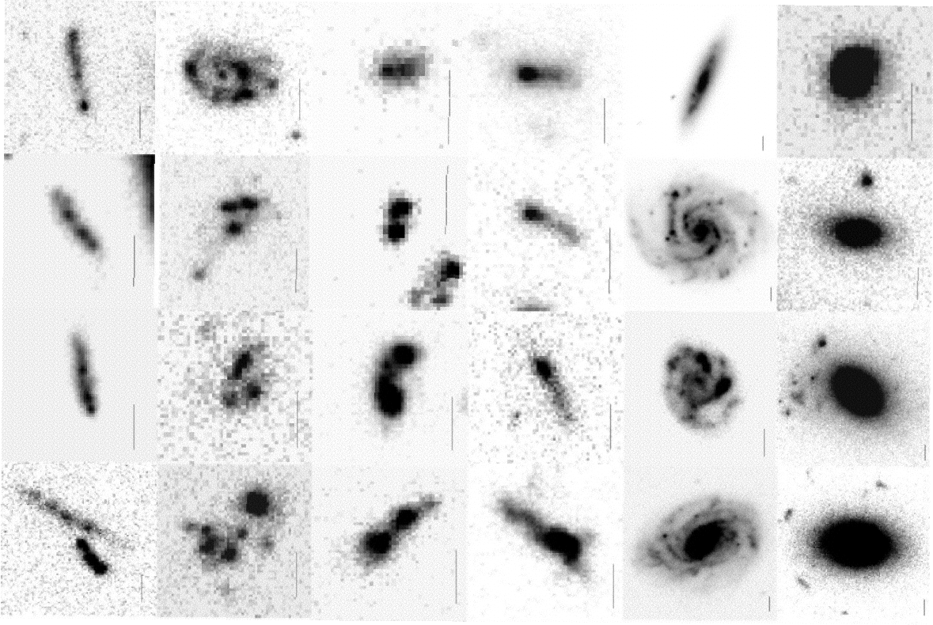
Morphologies in the UHDF
Elmegreen et al. 2005, ApJ, 361, 85

Slide 3
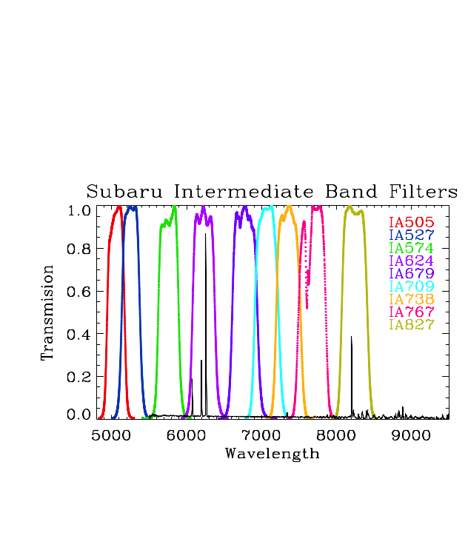
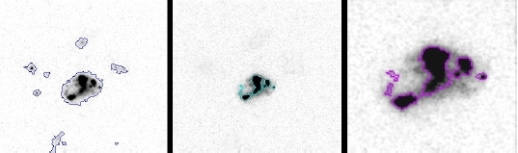
COSMOS
Search for starburst galaxies
Systems with EW in Hα / OIII >80 A. (Cairós et al., 2007, 2009).
0>z>0.5
COSMOS BB catalogue (Capak et al, 2007,ApJS, 172, 99.
ZCOSMOS (Lilly et al., 2007, ApJS, 172, 70.
SUBARU.
HST images
Equatorial field
Limiting magnitud I 26 mag/arcsec ^2

Slide 4
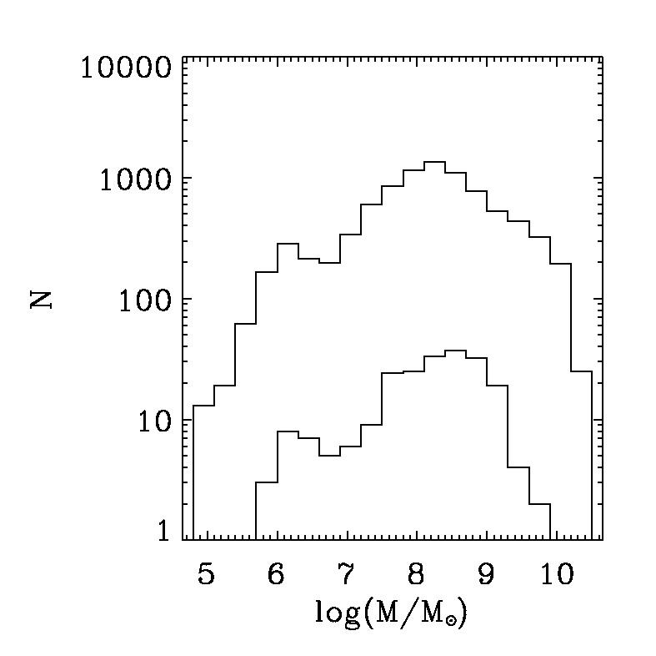
Mass of starbursts (220) and quiescent (300.000) Galaxies

Slide 5
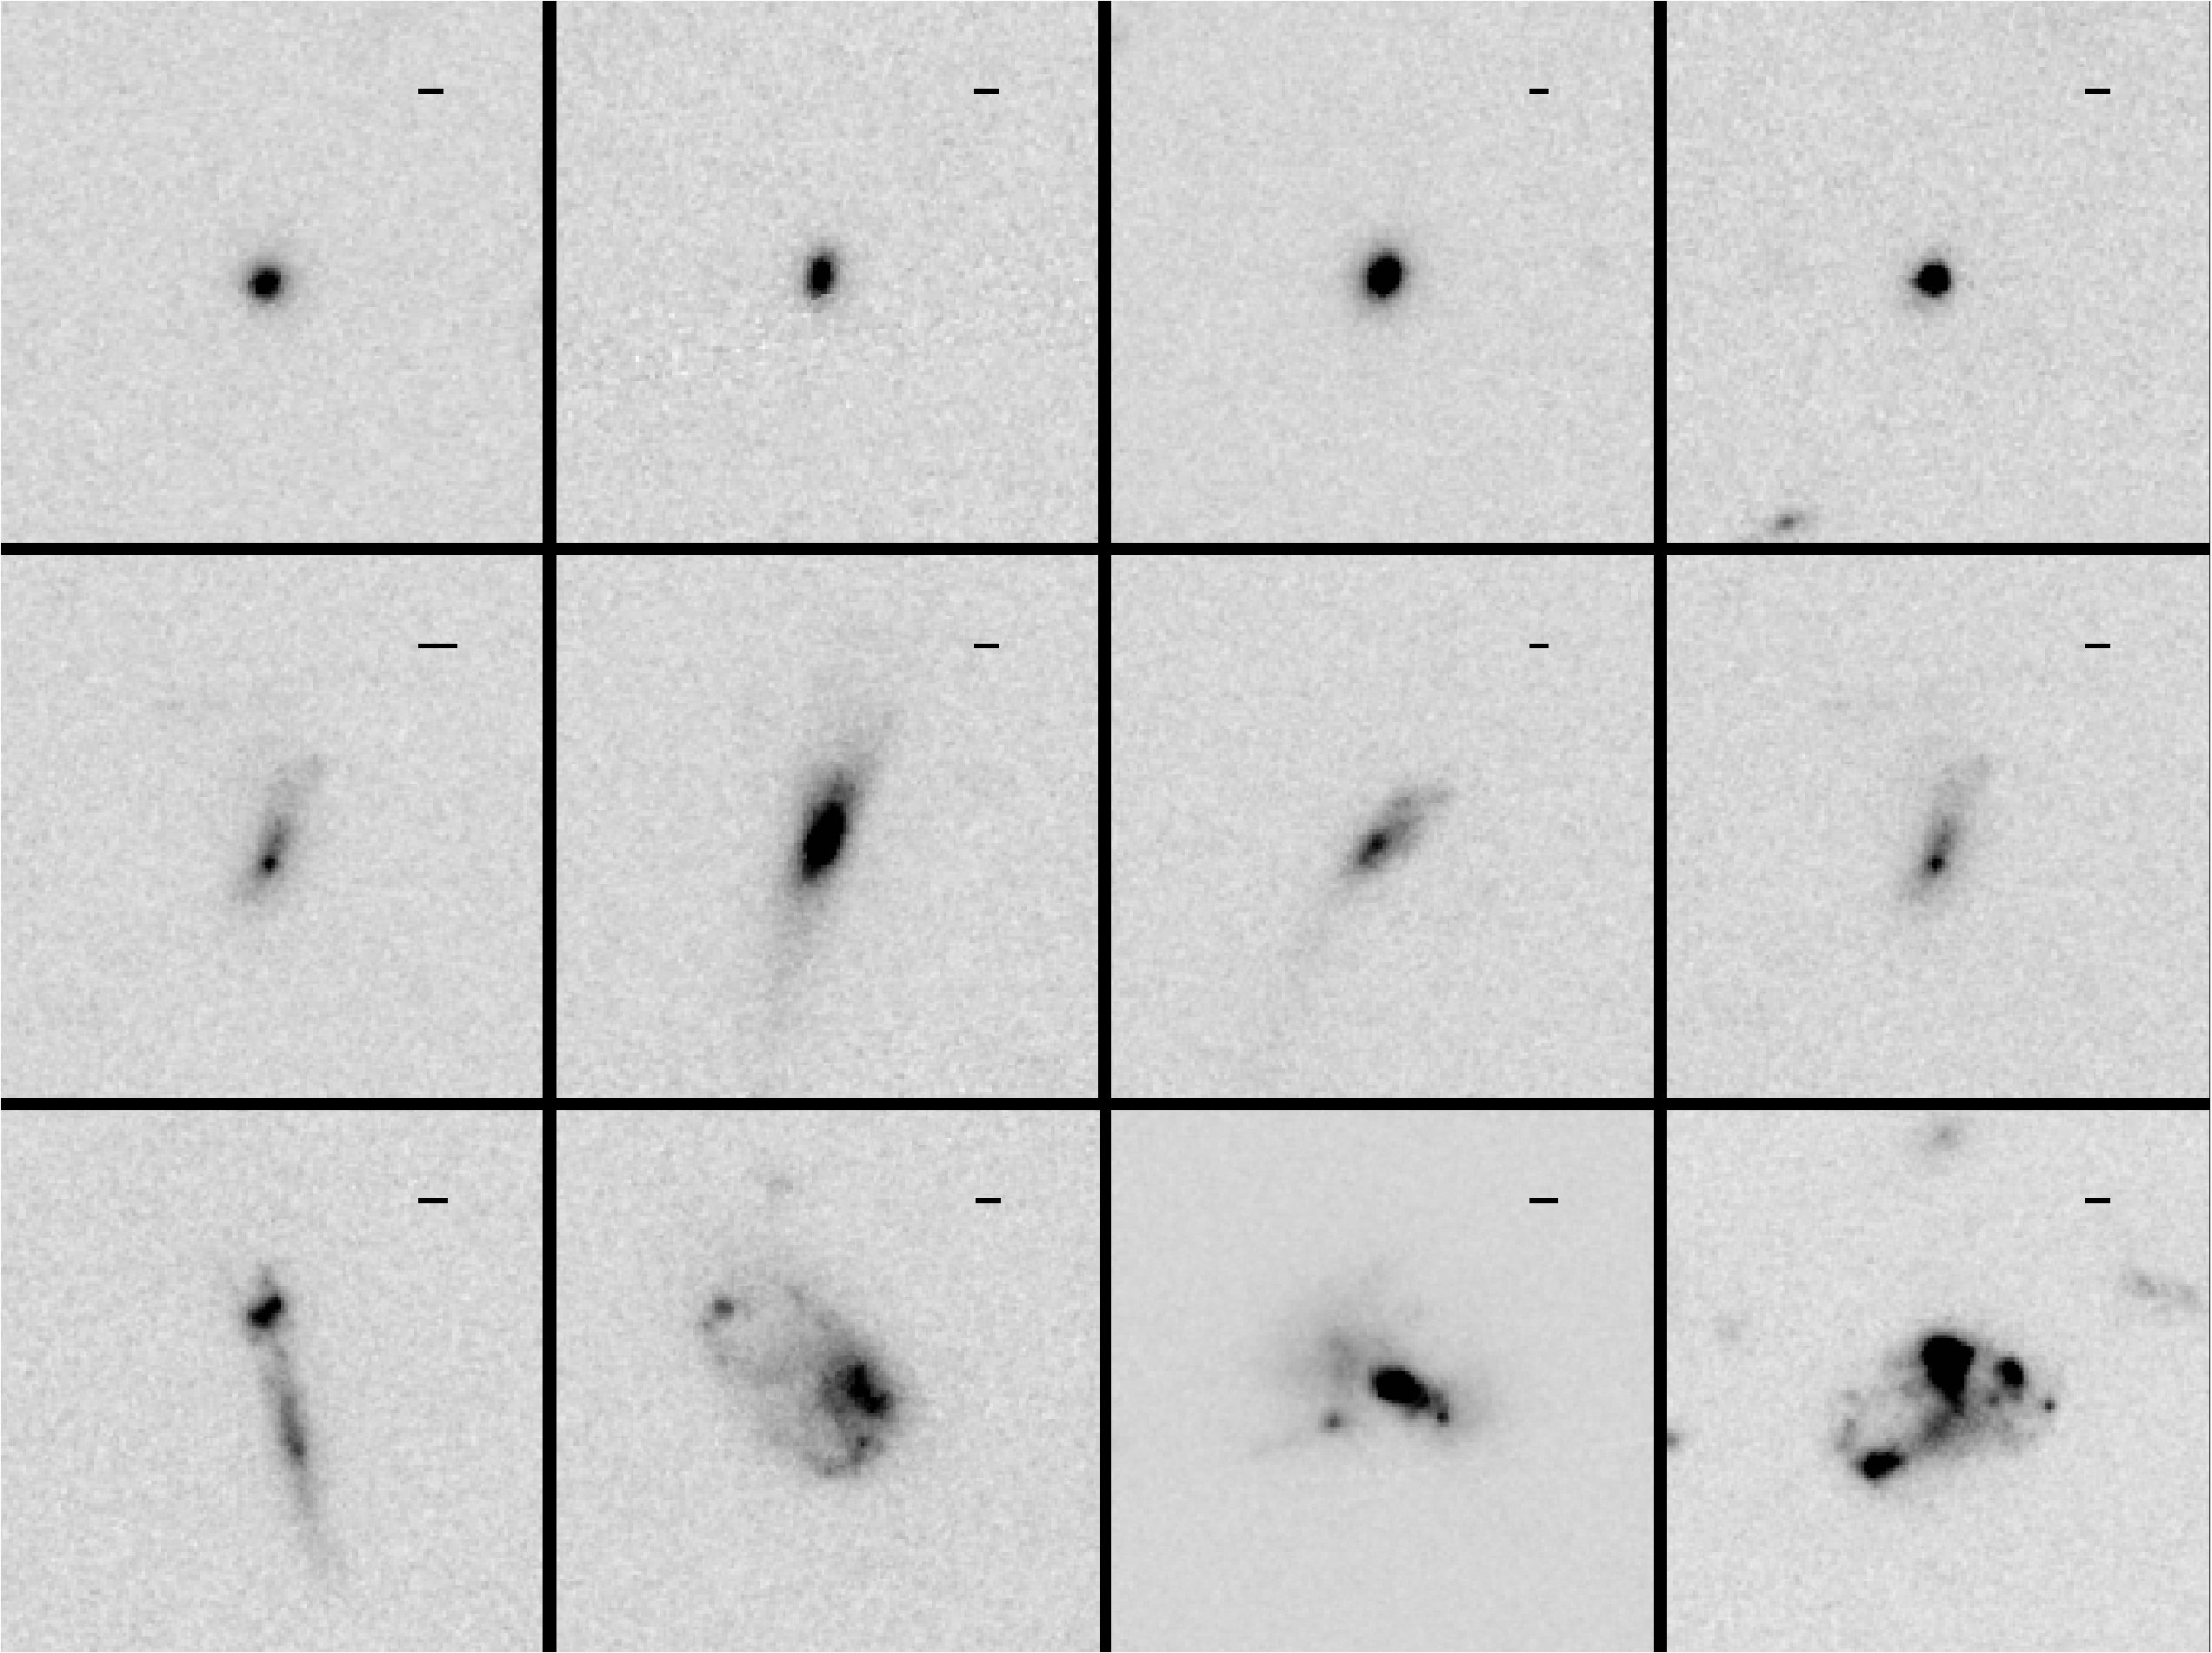
Three classes

Slide 6
Galaxy classes and their Clumps

Slide 7
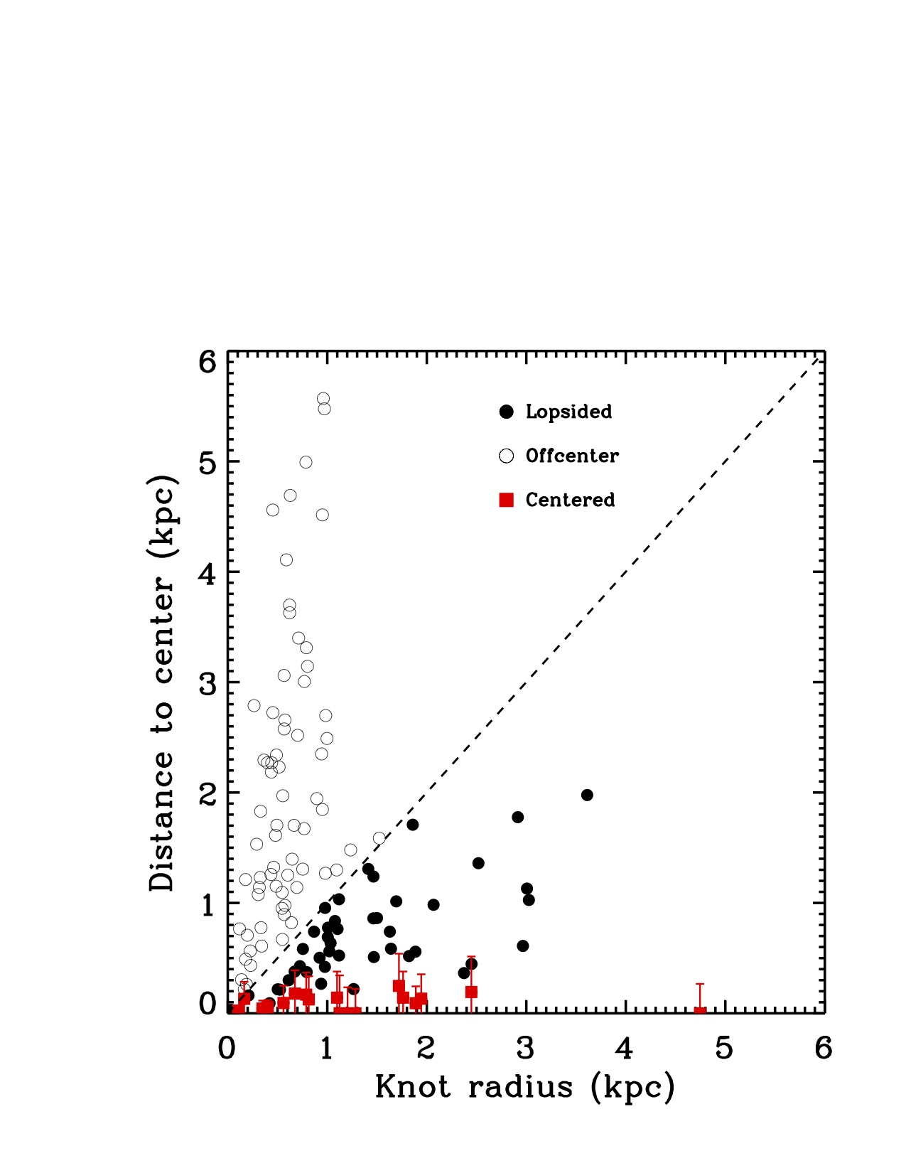
The Knots at their location
Centered and off-centered

Slide 9
See Amorin, R., Muñoz-Tuñón, C. et al., A&A 467, 541–558 (2007)
“Two-dimensional fits of the stellar hosts in BCD galaxies”
Hinojosa-Goñi etal. 2016 in preparation.

Slide 10
The clumpies (Sknot+diff. and Mknot) (133/220 ≈ 60%) are disks

Slide 11
220 Starbursts Galaxies in COSMOS @ z<0.5.
<Mass> =10 ^8.2 Msun.
Similar mass distribution as the quiescent galaxies
Catalogue of the SF knots (HST)//
Three classes: Sknot, (Sknot+diff and Mknot) “clumpy”
60% Starbursts Galaxies in COSMOS are clumpy
Galaxies about 10 times more massive than the knots.
The more massive knots bigger and in the centre of their host galaxy.
The knots are “similar” (Surface SFR, Surface Mass)
The host galaxy Sersic index of the clumpies is <1>.
Clumpy Starburst are turbulent disk-like Dwarf galaxies evenly starbursting.
Hinojosa Goñi, R., Muñoz-Tuñón C. & Méndez Abreu,J. A&A, 2016
http://arxiv.org/abs/1604.01698
Notes:
Snot may be just too low SB to the extended emission been identified..

Slide 12
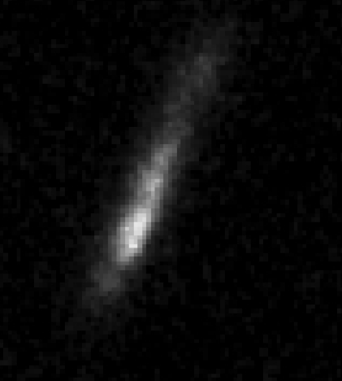
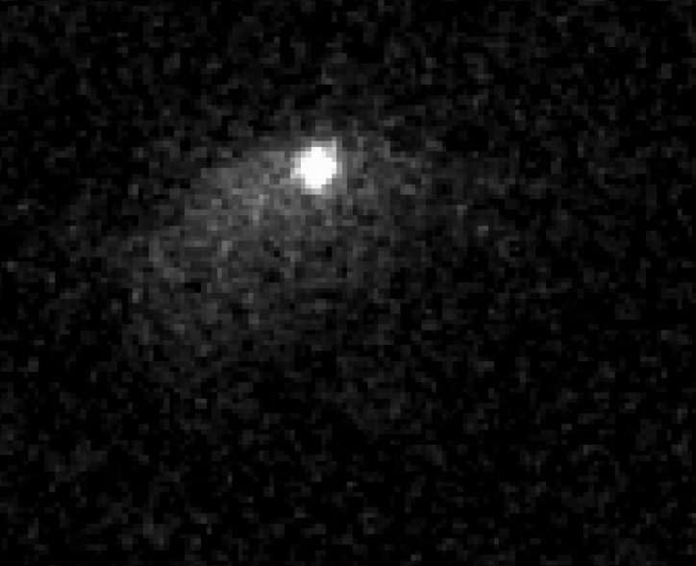
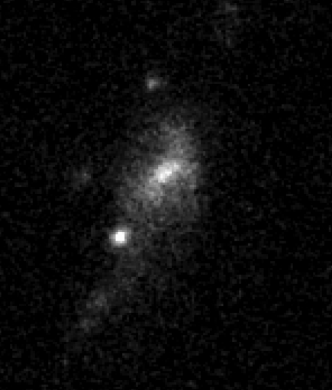
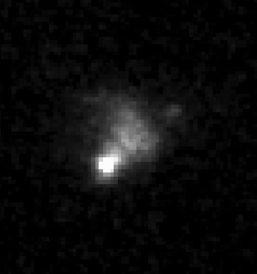
What triggers SF in these turbulent low-mass galaxy discs??

Slide 13
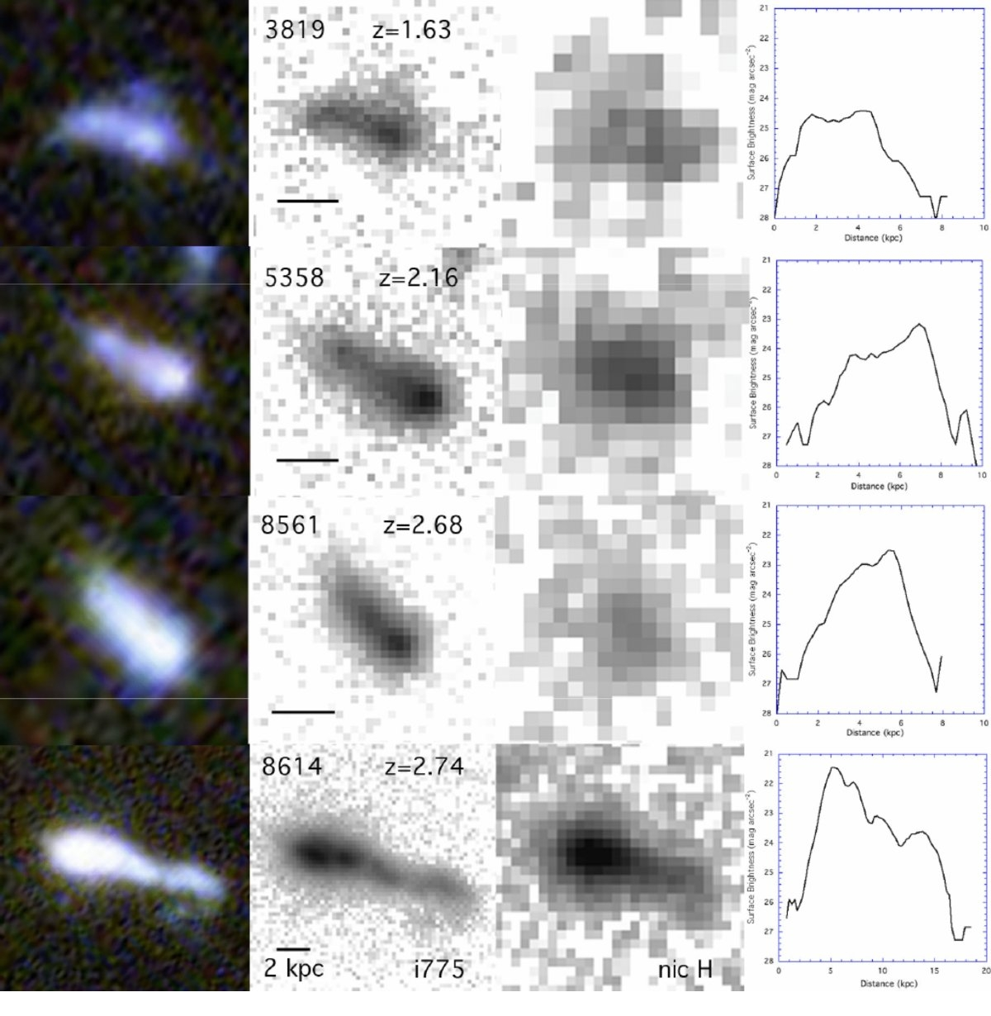
Figure 1 from Tadpole Galaxies in the Hubble Ultra Deep Field B G. Elmegreen and D.M. Elmegreen 2010 ApJ 722 1895.
Notes:
Luminosity profiles.
Exponential like- Disc characteristics
SF in primeval discs (lop-sided)

Slide 14
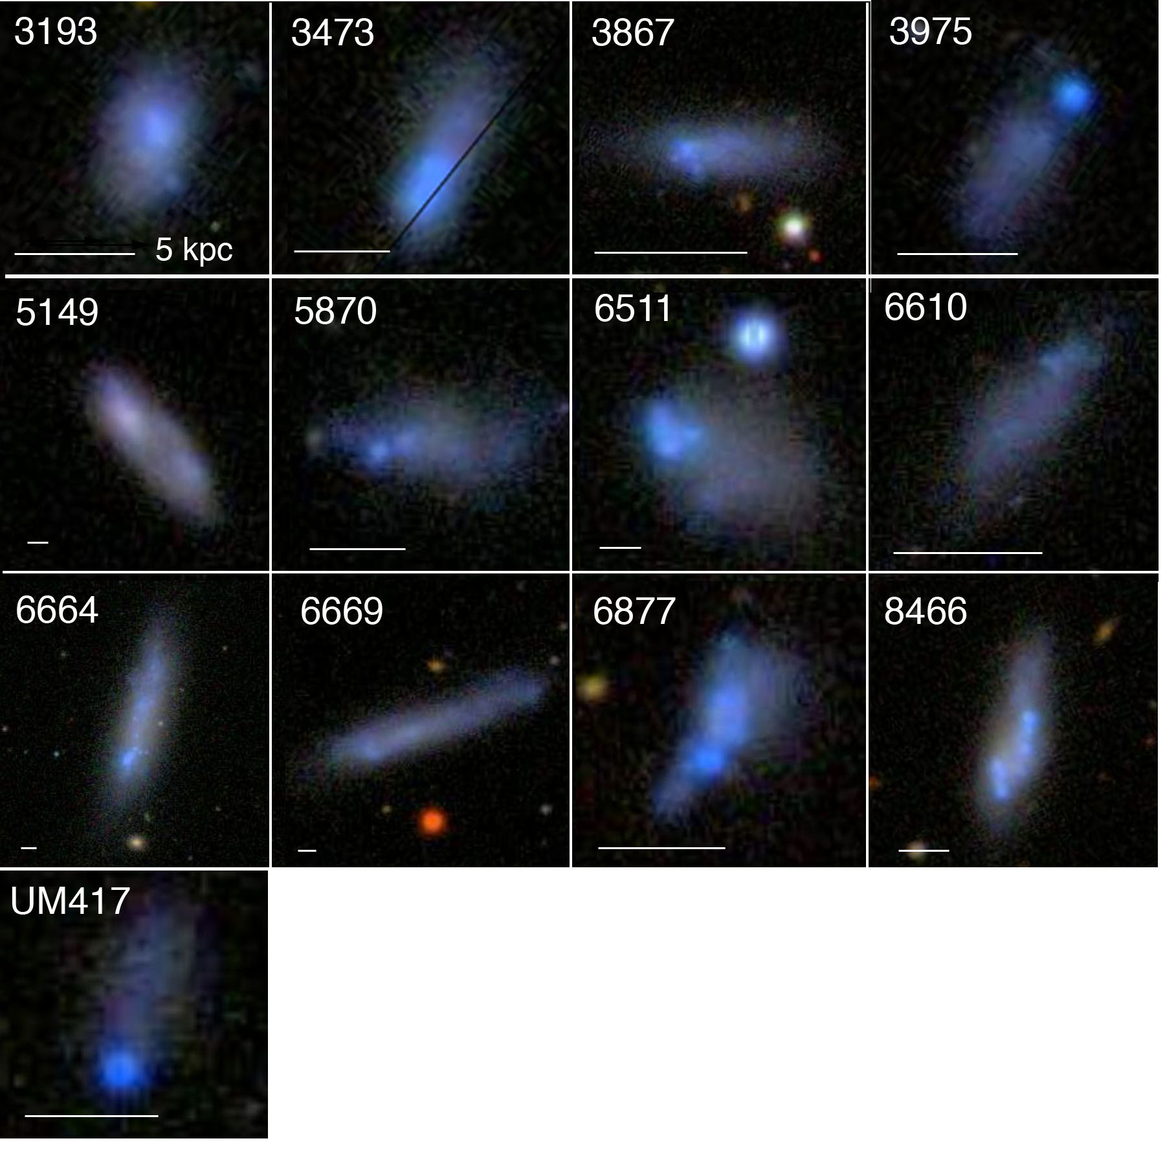
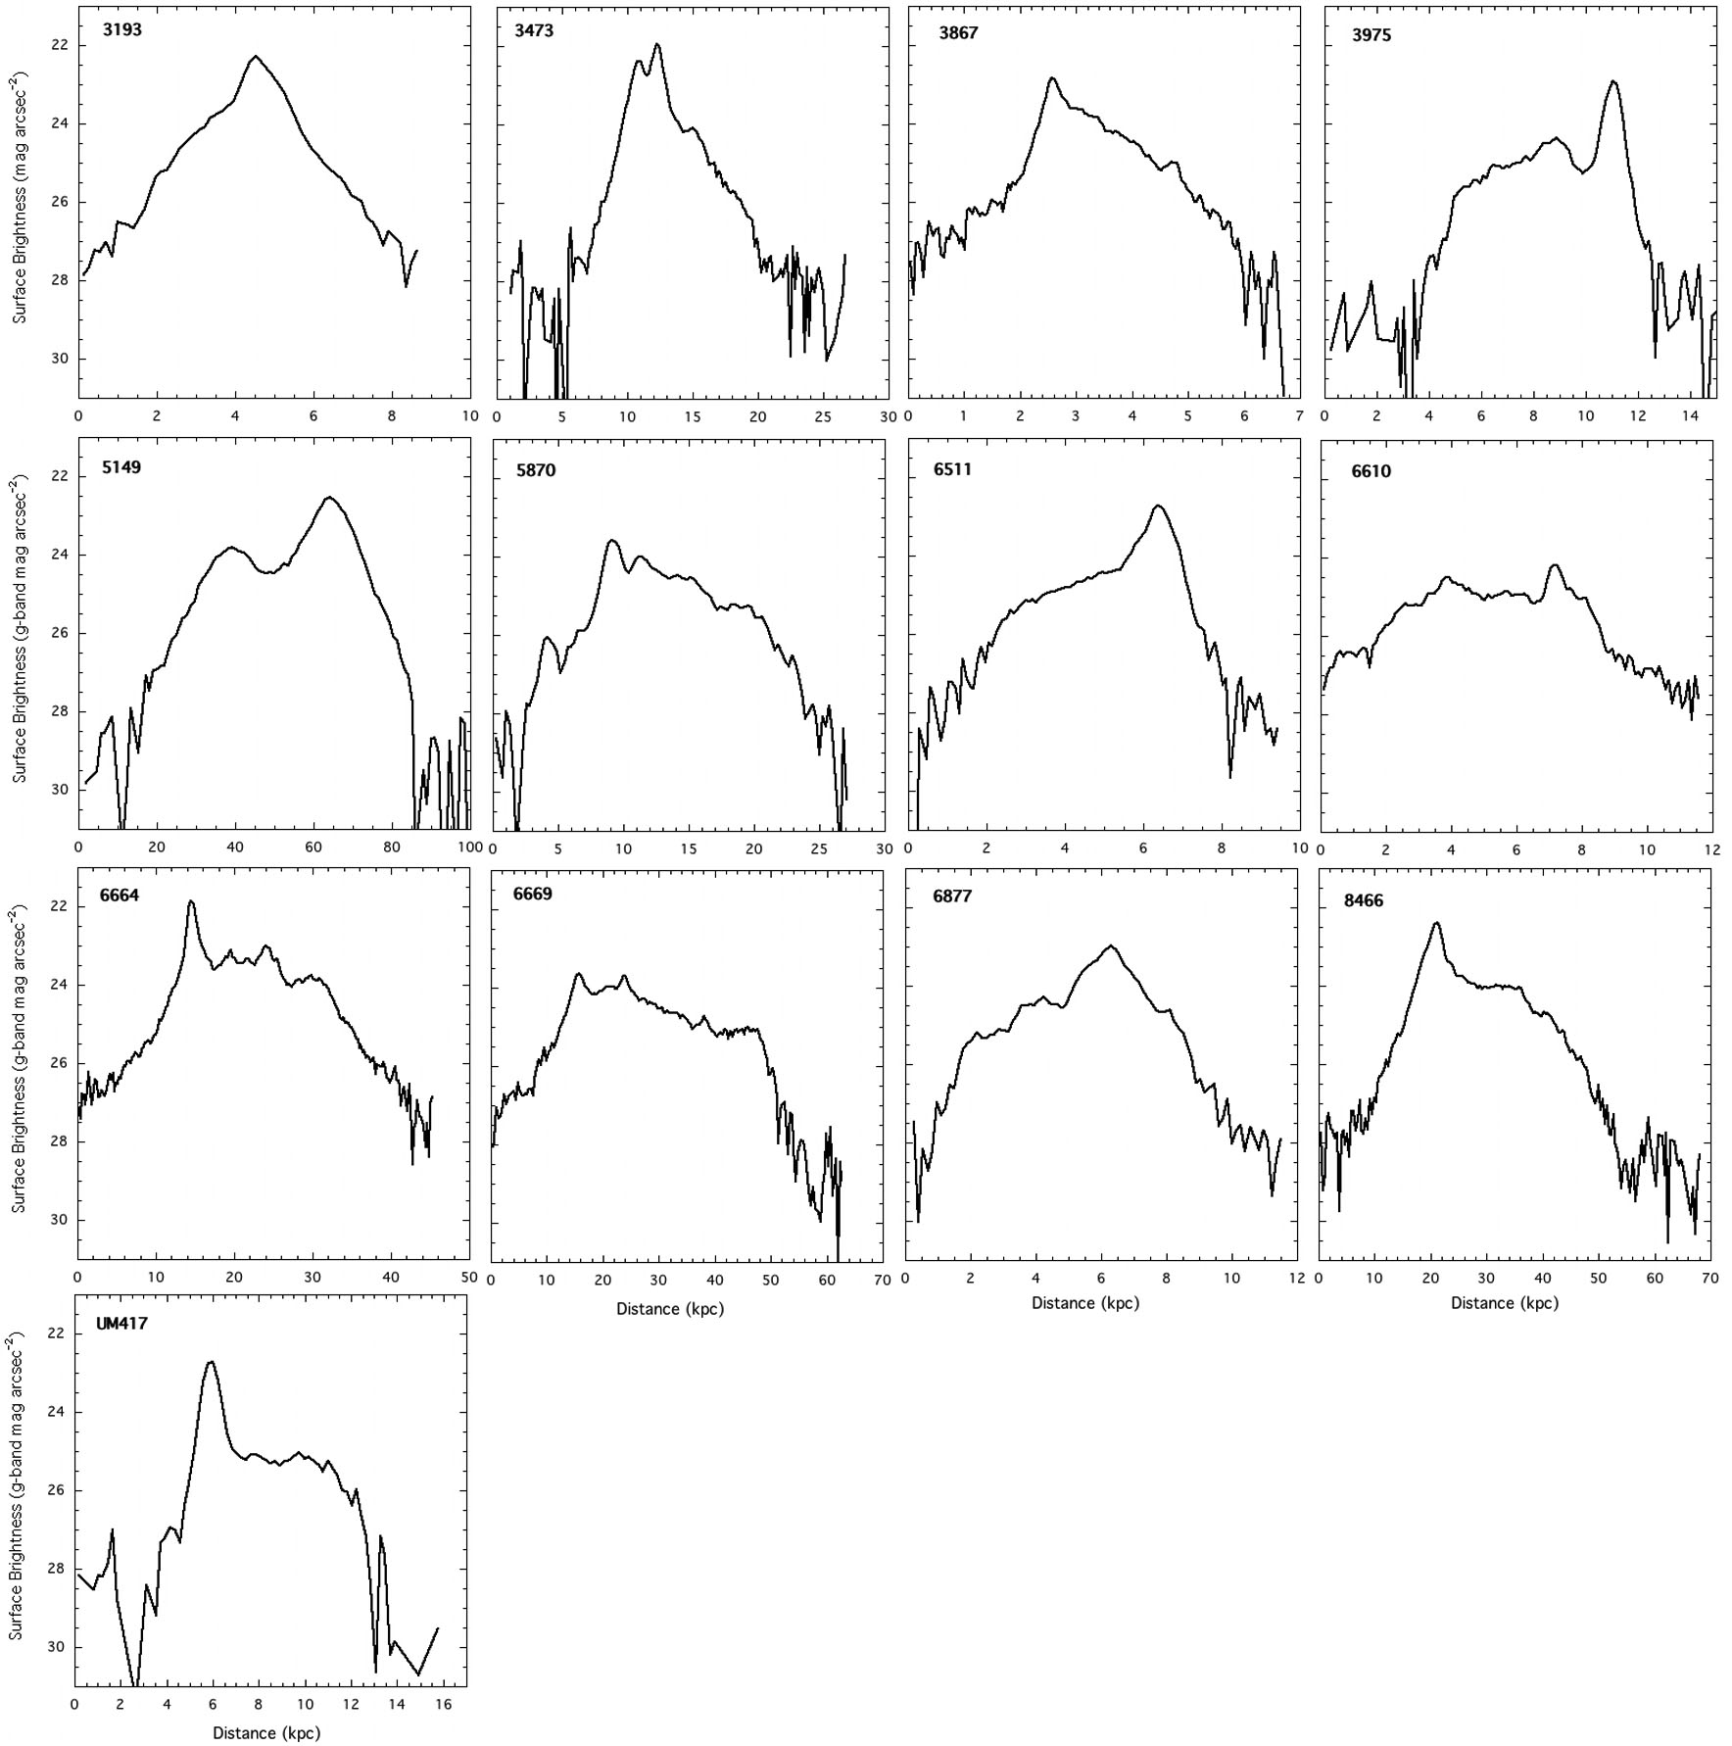
Elmegreen, D. etal.,
2012, Ap.J., 750, 95.
DISKS with lop sided star formation
Notes:
Galaxies selected from the UM and KISO archive of bright UV galaxies.
Sloan and H-UDF

Slide 15
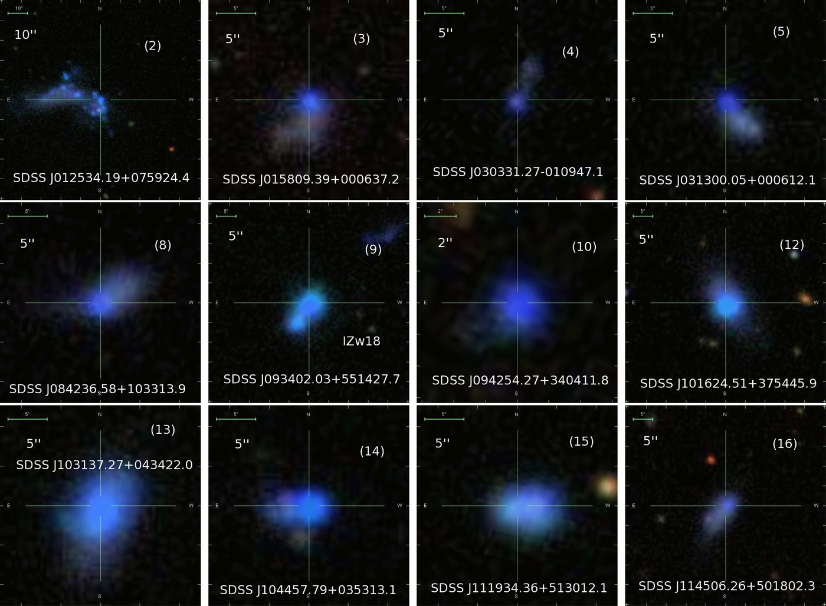
Morales-Luis et al. 2011 ApJ 743 77.; see also Papaderos et al, 2008.
Notes:
Low metallicity galaxies selected from the spectra are tadpole (cometary) like (80%)

Slide 16
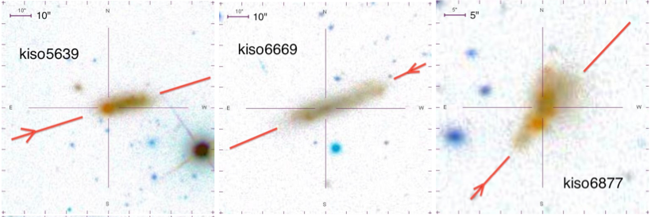
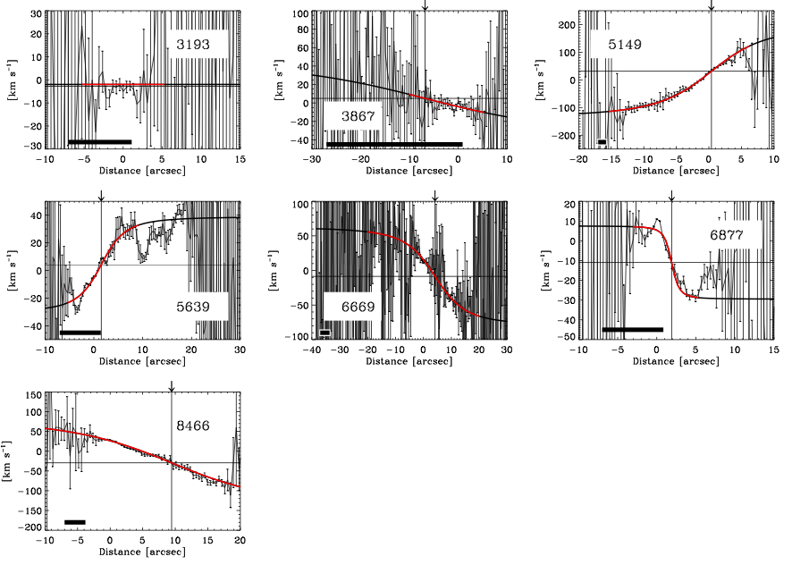
IDS@INT and ALFOS@NOT Hа (R~10000)
5(6) rotate.
Metallicity drops at the head of the comet.
Sanchez Almeida, J. Muñoz-Tuñón etal. 2013, Ap.J., 767, 74.
Notes:
Firm probe of what we proposed using luminosity profiles

Slide 17
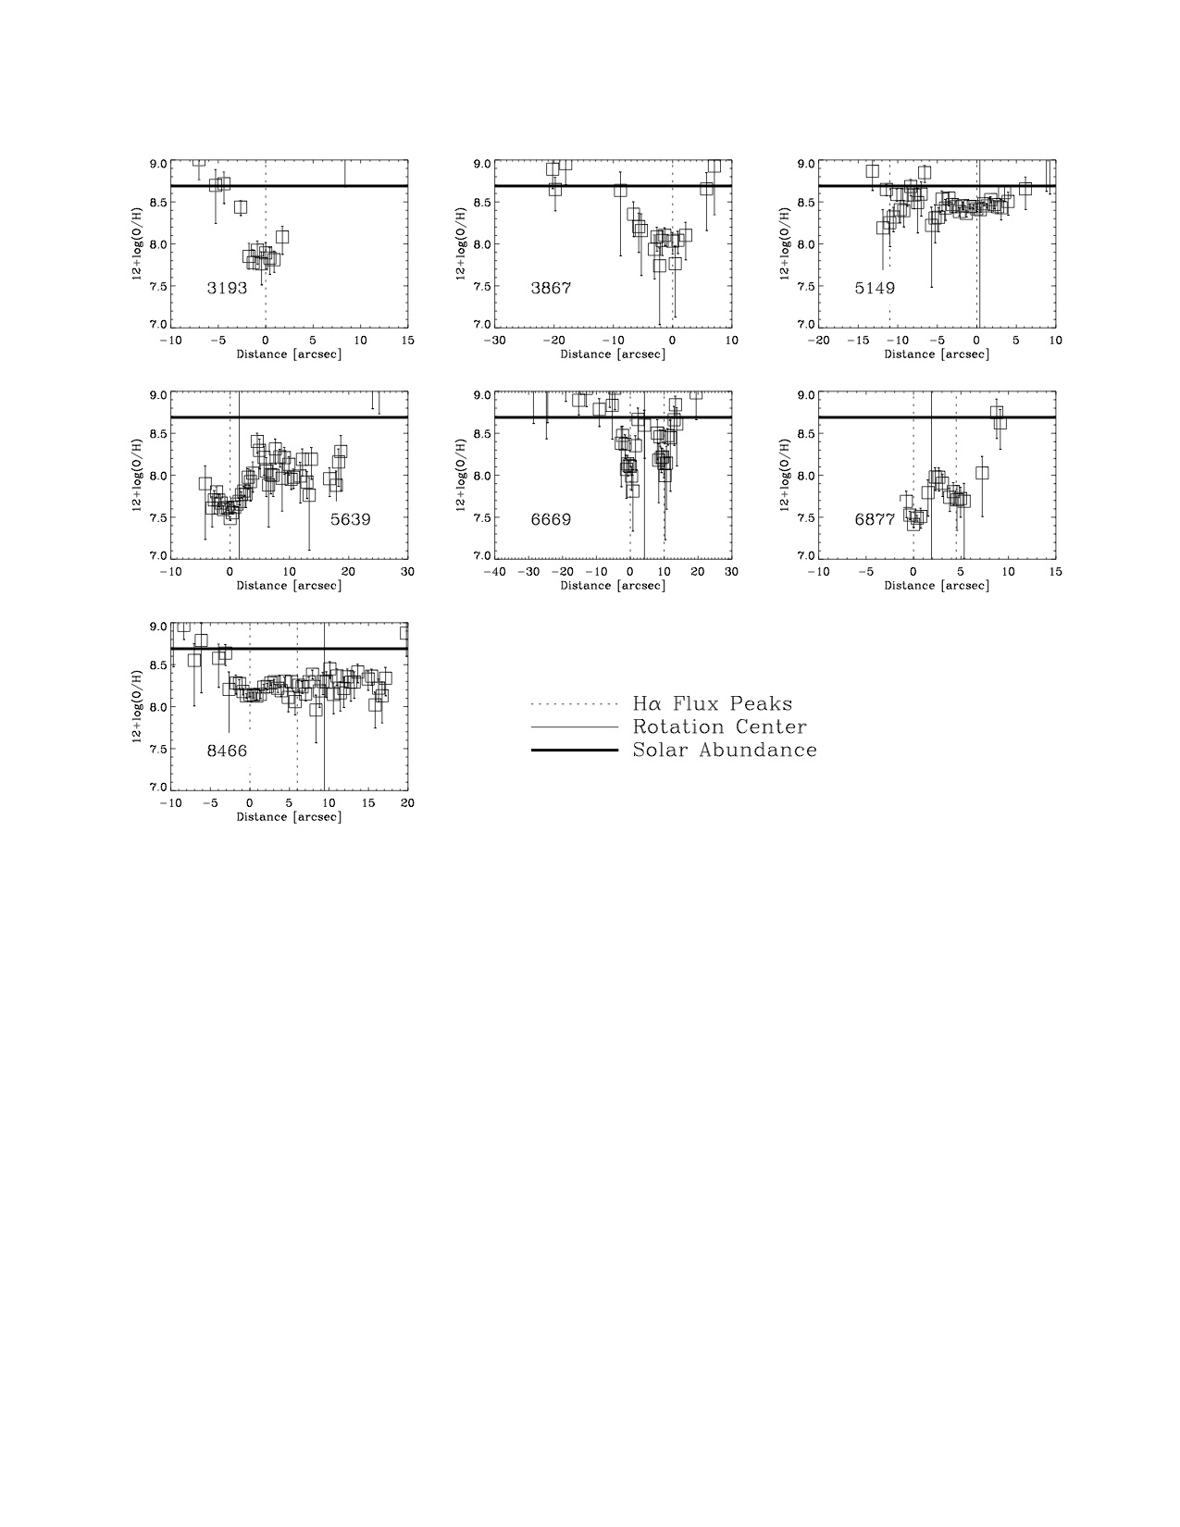
Metallicity (Oxygen abundance)
- O/H based on [NII]6583/Hα
Notes:
They are metal poor but the holes in metallicity coincide with the head.

Slide 18
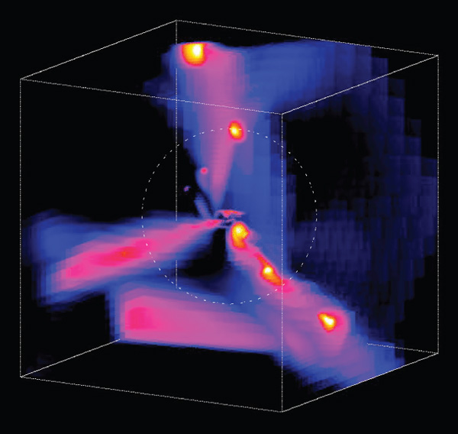
COLD FLOW scenario
Streams of pristine gas in three dimensions from numerical simulations
A Dekel et al. Nature 457, 451-454 (2009) doi:10.1038/nature07648
Notes:
TRIGGERING the starburst by the cosmic web.
Box side length 320 Kpc.
Three radial streams appear in all simulations of massive haloes at high z.
The dotted circle marks the halo virial radius.
Mass of the clumps inside about 1/10 that of the central galaxy- that is it 10^10 Msun clumps.
This is cold gas infall.
Here we have
“cold flow accretion”- so the flow interacts with the dark matter halo , cold down and gets into the galaxy body- hundred kpc scales.

Slide 19
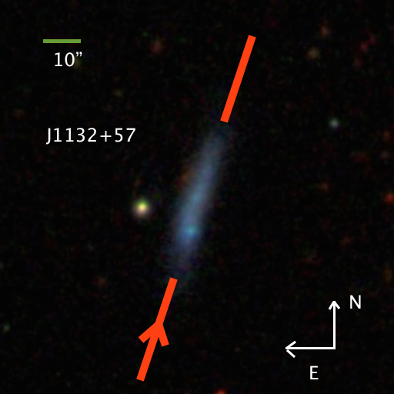
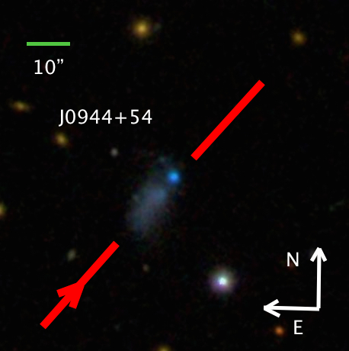
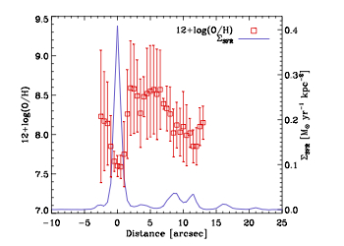
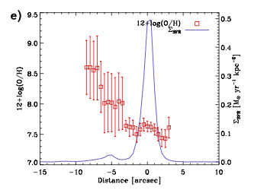

Slide 20
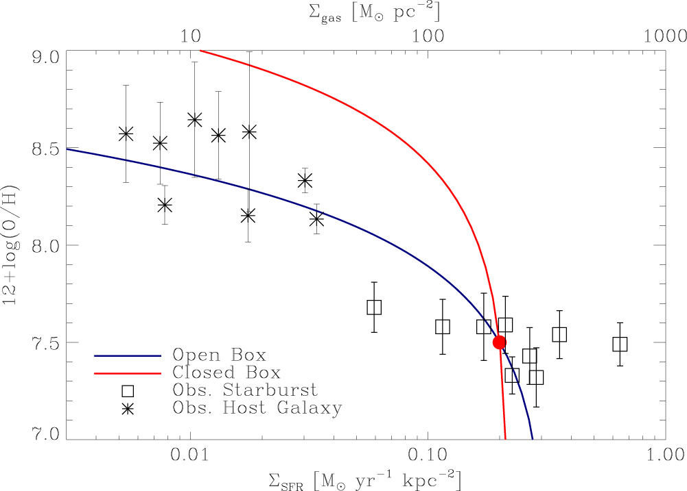
Sanchez Almeida, Elmegreen, Muñoz-Tuñón & Elmegreen. 2014, A&AR . 22,71.
Sanchez Almeida, Morales Luís, Muñoz-Tuñón etal. 2014, Ap.J. 783,45.
Sanchez Almeida, Elmegreen, Muñoz-Tuñón etal. 2015, Ap.J. 810L, 110.
Ceverino, D., Sanchez Almeida, Muñoz-Tuñón, Dekel etal.. 2016, MNRAS, 457, 2605.

Slide 21
Summary (from XMPs) and some speculation…
Extremely metal poor have clumpy morphology
Local ones rotate with the head displaced from the rotation center.
Metallicity drops at the head (largest SFR)
60% starburst in COSMOS are clumpy// some of the cometary and all of them disks-like with SF most likely resulting from violent disks instabilities.
They are candidates to be discs “rejuvenated” by SF driven by new gas from the IGM.
All the results suggest that XMP are disks in early stages of assembling with its star-formation sustained by accretion of external metal poor gas.

Slide 22

Small is Beautiful
And
Dwarf starburst can be the traps to catch
the cold flow accretion still in action in
the nearby Universe

Slide 23
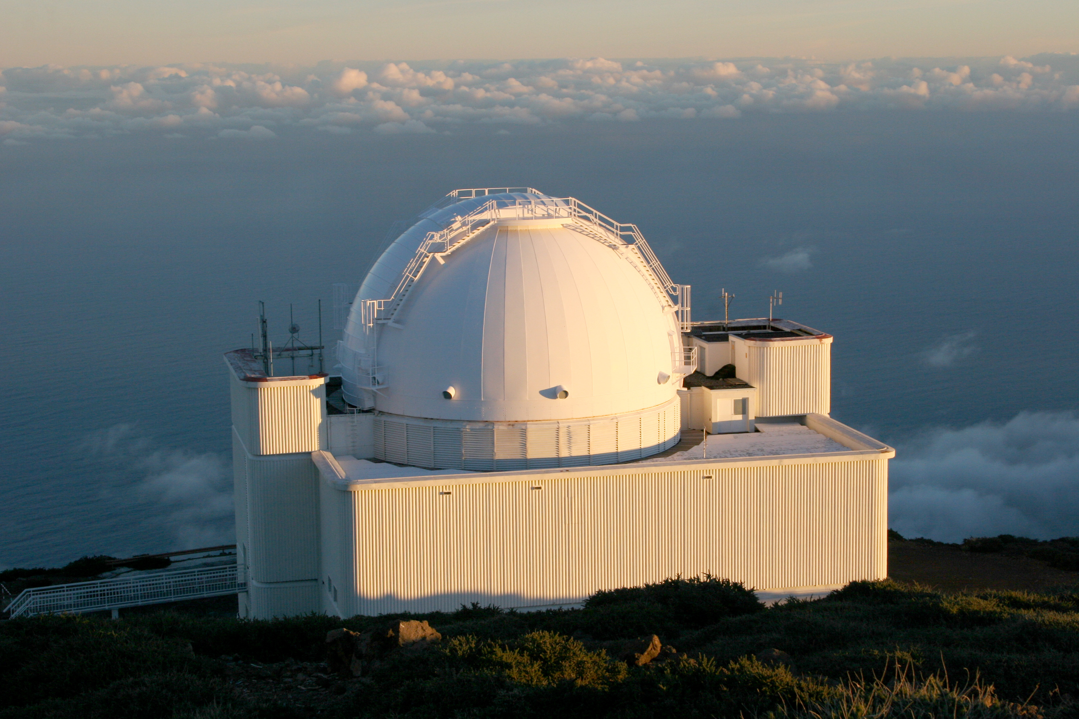
Thanks to all of you and also to...
Jorge Sánchez Alméida (IAC)
Mercedes Filho (IAC-Porto)
Debra Elmegreen & Bruce Elmegreen.(NY)
Estallidos´s team.

