Slide 1

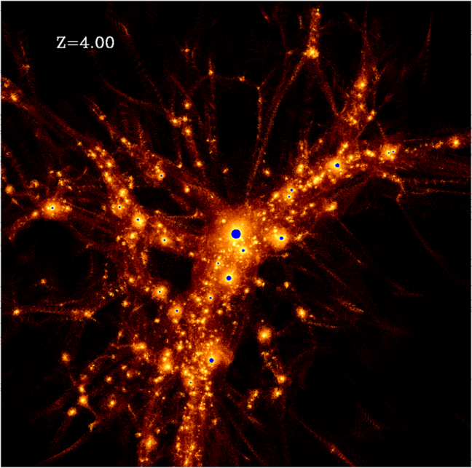
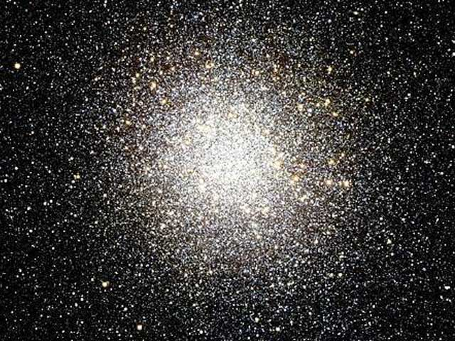
Towards Realistic Modeling of Massive Star Clusters
Oleg Gnedin
(University of Michigan)
graduate student Hui Li

Slide 2
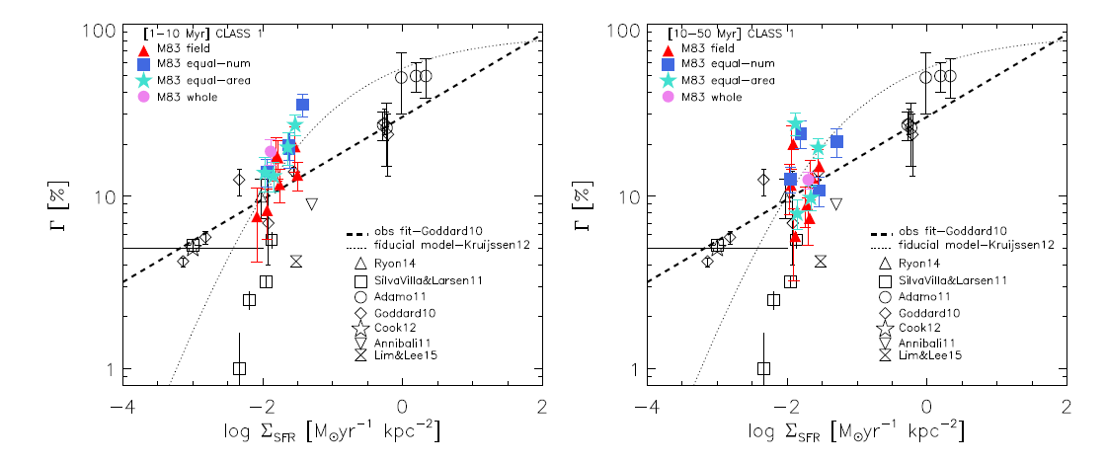
Star clusters are dominant components of active star formation: they connect small-scale SF (local) and global processes in galaxies
Adamo et al. 2015
Fraction of all young stars contained in massive star clusters increases with the intensity of star formation, up to 50-60%

Slide 3
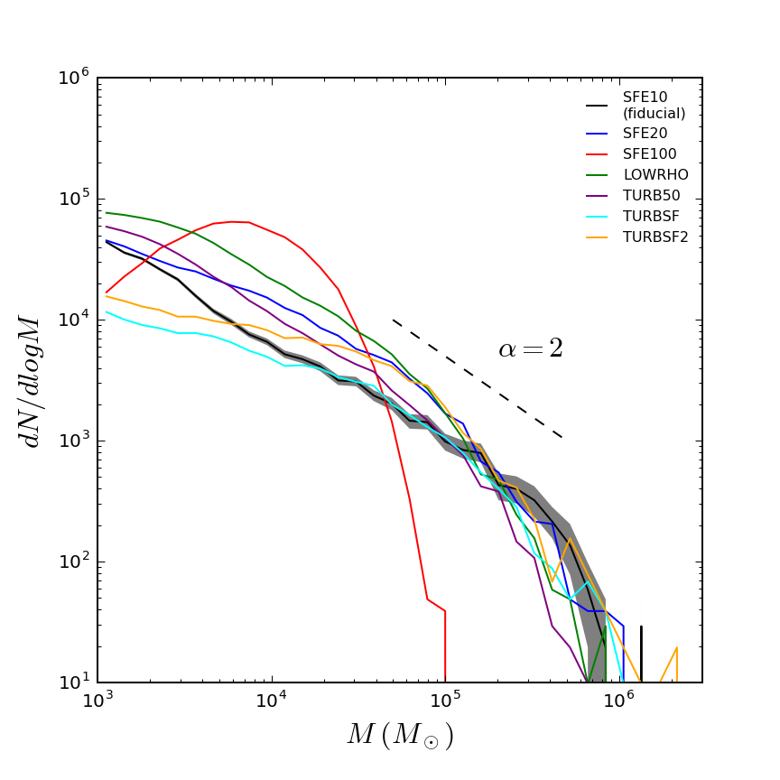
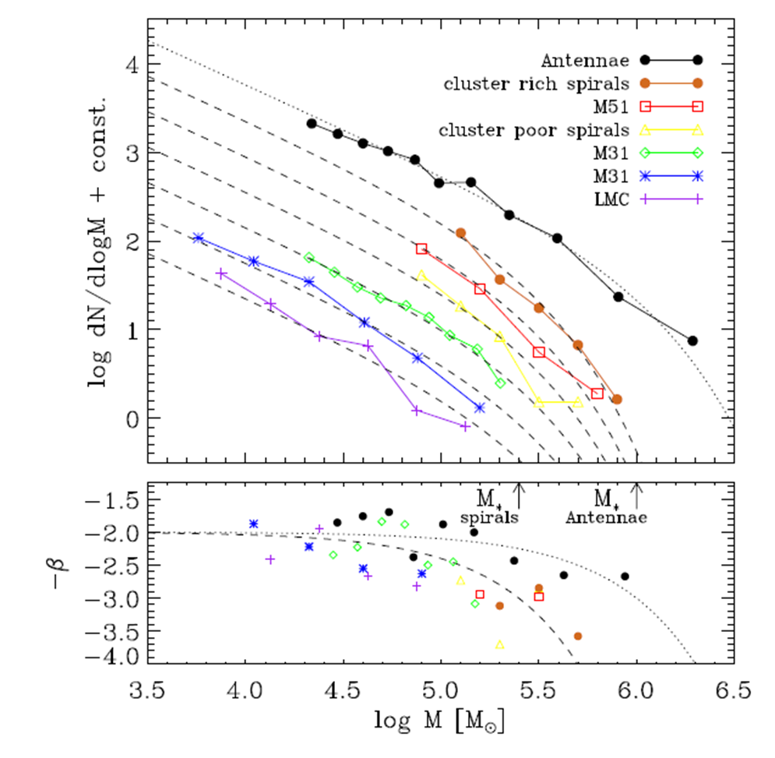

Initial Mass Function of young clusters is almost invariant
cutoff mass
α
z ≈ 5
Cosmological simulation of a Milky Way sized-galaxy (Li & OG 2016):
MF is a power law as observed for young star clusters
Unless star formation is too disruptive (i.e., 100% SFE)
slope α ≈ 2
it’s a number, not a free cluster

Slide 4
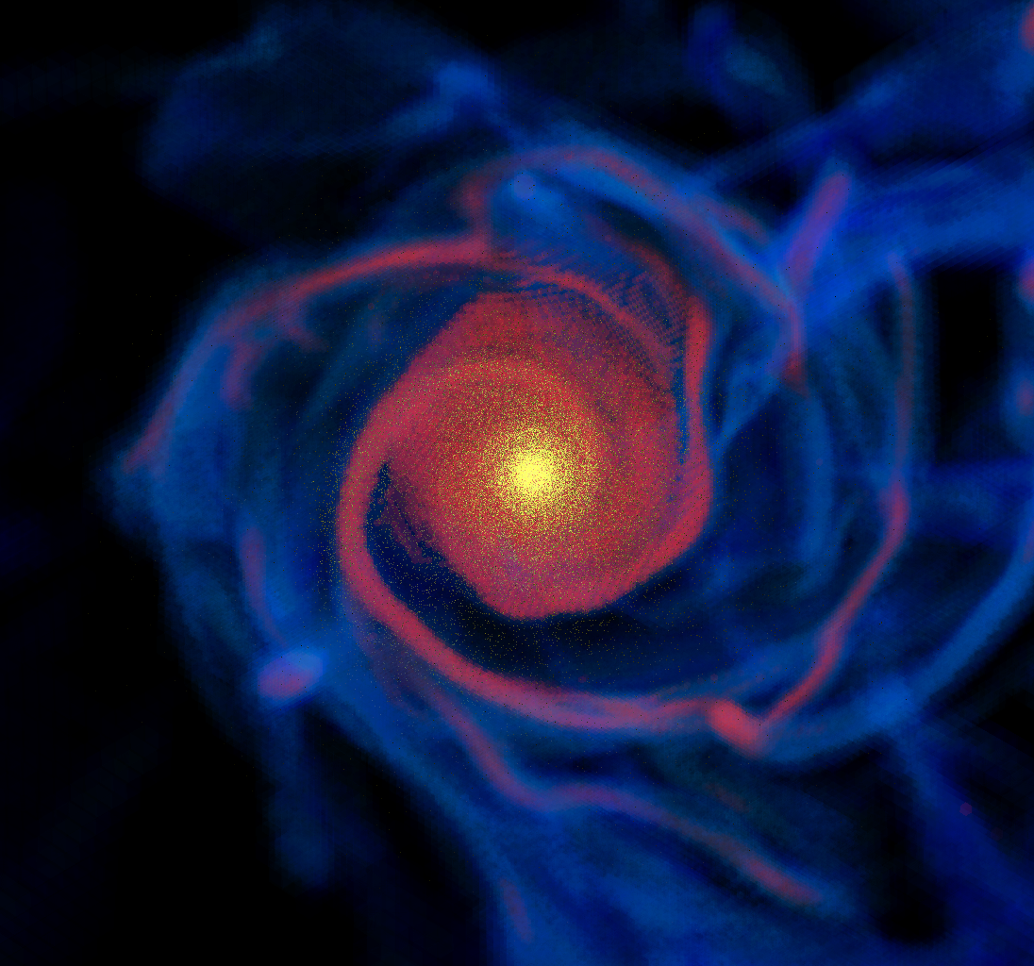
Cosmological simulations with run-time treatment of H₂ chemistry, stellar feedback, radiative transfer, and subgrid-scale turbulence
z=3:
stars
H₂ gas
HI gas
Adaptive Mesh Refinement ART code
star formation in molecular gas, supernovae feedback and metal enrichment, stellar mass loss
radiative cooling and heating: Compton, UV background, with density and metallicity dependent rates
3D radiative transfer
H2 formation on dust grains/destruction by UV, with self-shielding and shielding by dust (N. Gnedin & Kravtsov 2011)
Novel treatment of subgrid-scale turbulence (Semenov et al. 2016)
Zemp et al. (2012)
Ionization by cosmic and local
interstellar UV flux
atomic and
molecular chemistry
dust
chemistry

Slide 5
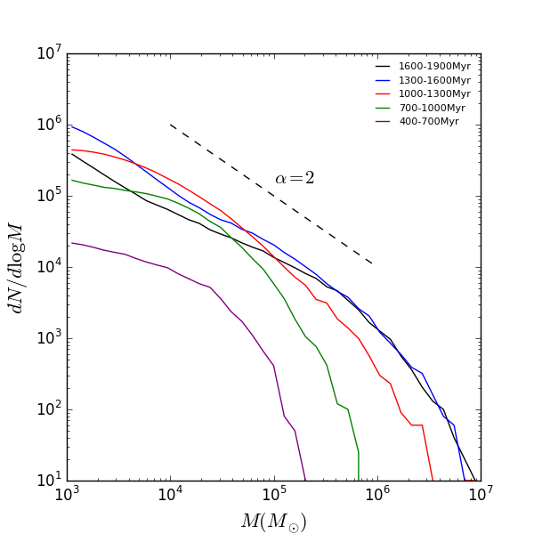
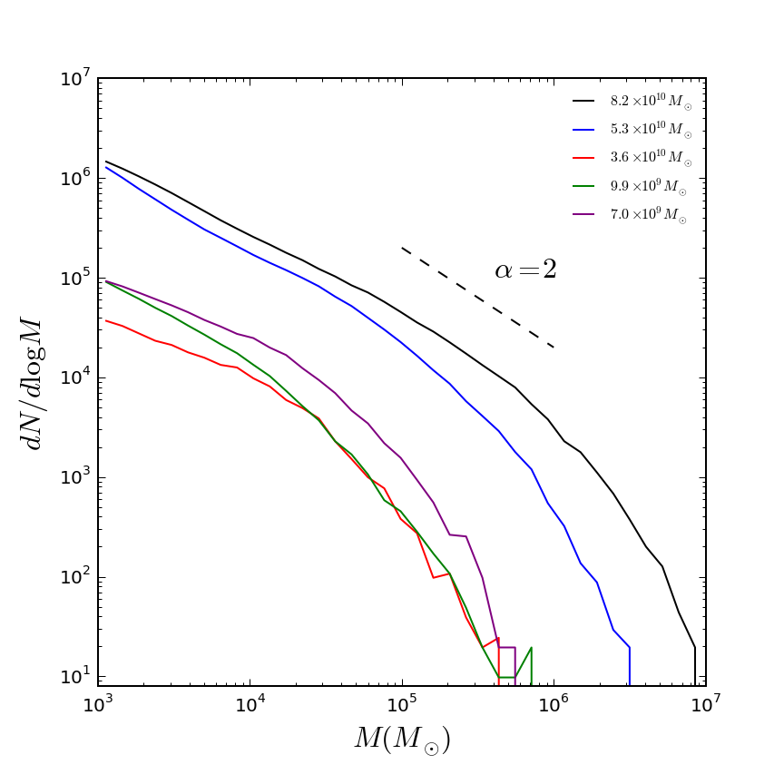
In the simulations, cluster mass function remains a stable power-law
Different epochs within the same central galaxy
Different galaxies at the same epoch (z ≈ 3.3)

Slide 6
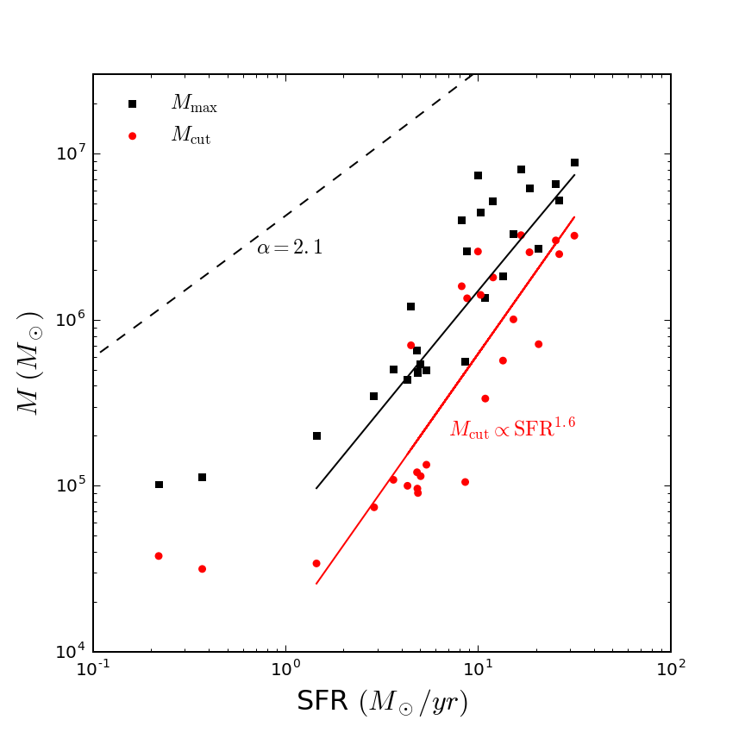
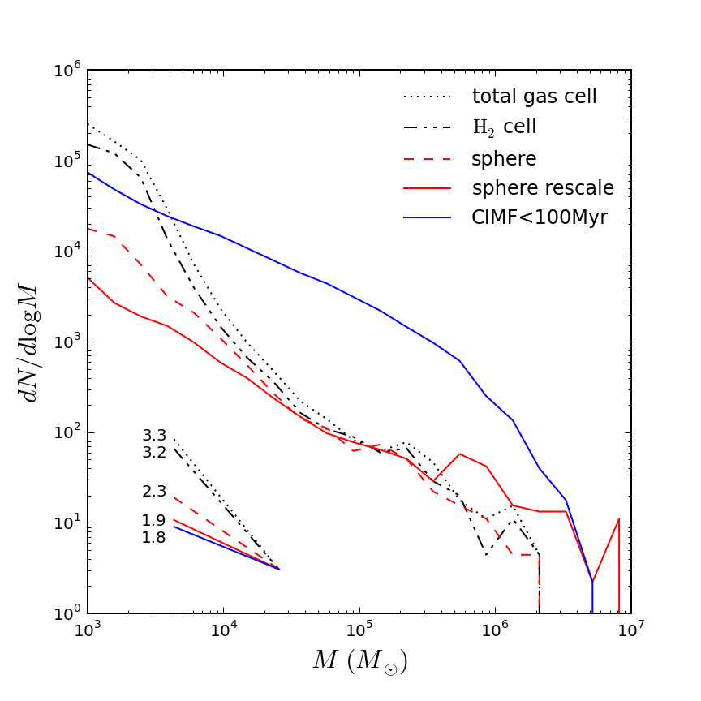
Origin of the shape of cluster mass function
10⁷
expected M_{max} for power-law MF
10⁵
M_{max} for Schechter MF with M_{cut} ∝ SFR^{1.6}
10⁶
10⁷
Maximum cluster mass is consistent with that expected for a Schechter function with truncation mass scaling as SFR^{1.6}
Power-law MF emerges from the gradual suppression of SFR of a cluster by feedback of its own young stars

Slide 7
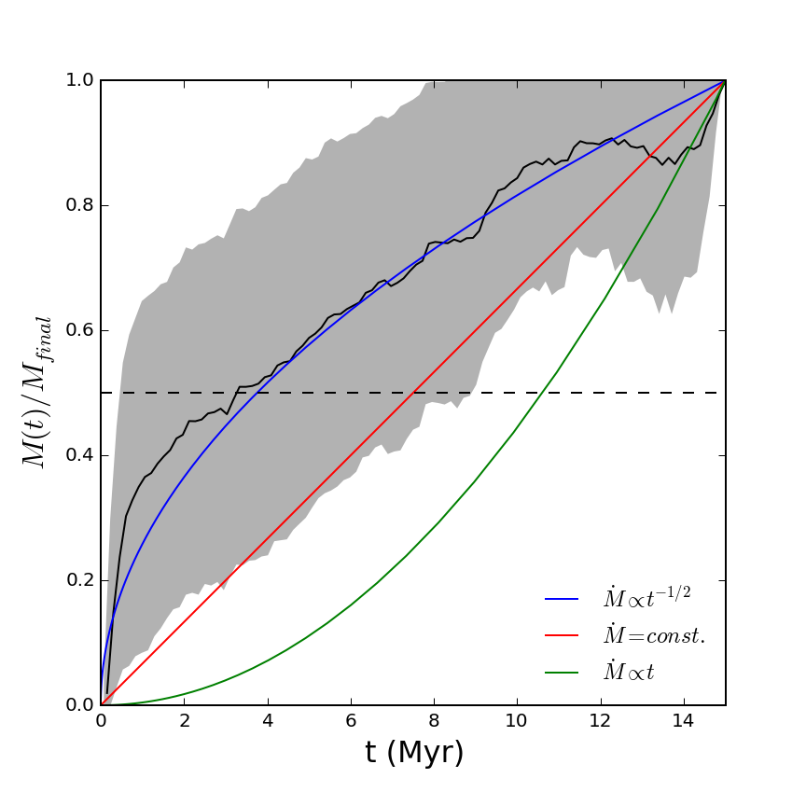
Formation rate of a cluster particle is slowed by feedback of its own young stars

Slide 8
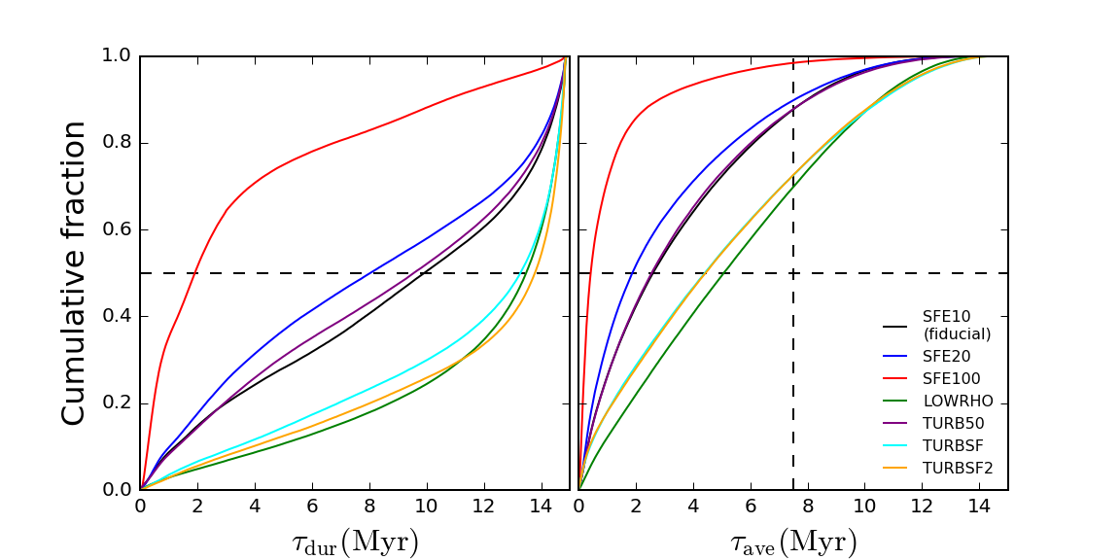
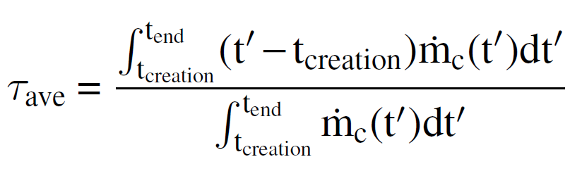
Feedback of own stars terminates star formation within a few Myr and sets the final cluster mass
ρ > 10³ cm⁻³
ε_{ff} = 10-100%
also:
> 10 cm⁻³
ε_{ff} from SGS turbulence model (Semenov et al. 2016)
spatial resolution 5 pc at z=5
typical timestep 10³ yr – resolved cluster growth
clusters grow from gas mass inside fixed-sized sphere of 10 pc (typical GMC core/clump)

Slide 9
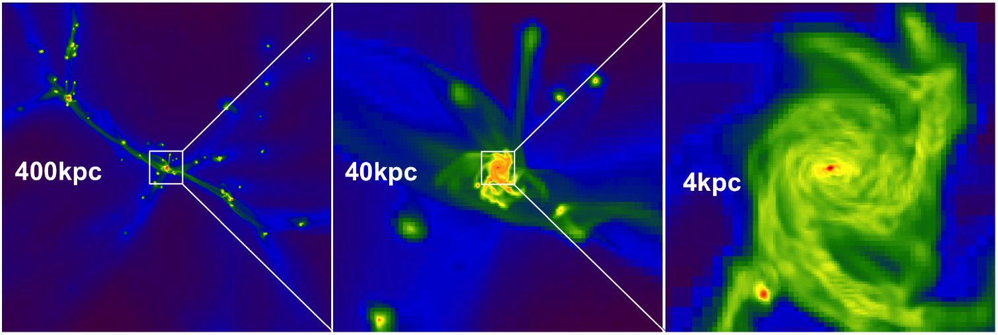
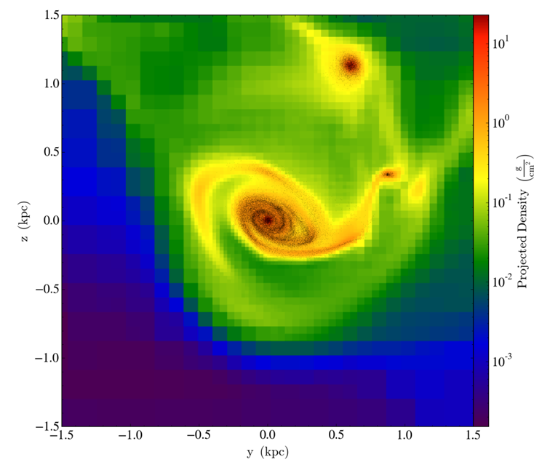
Massive clusters form within galaxy disks, but the disks are perturbed by frequent mergers and accretion of satellites
z ≈ 3.3
z ≈ 4

Slide 10
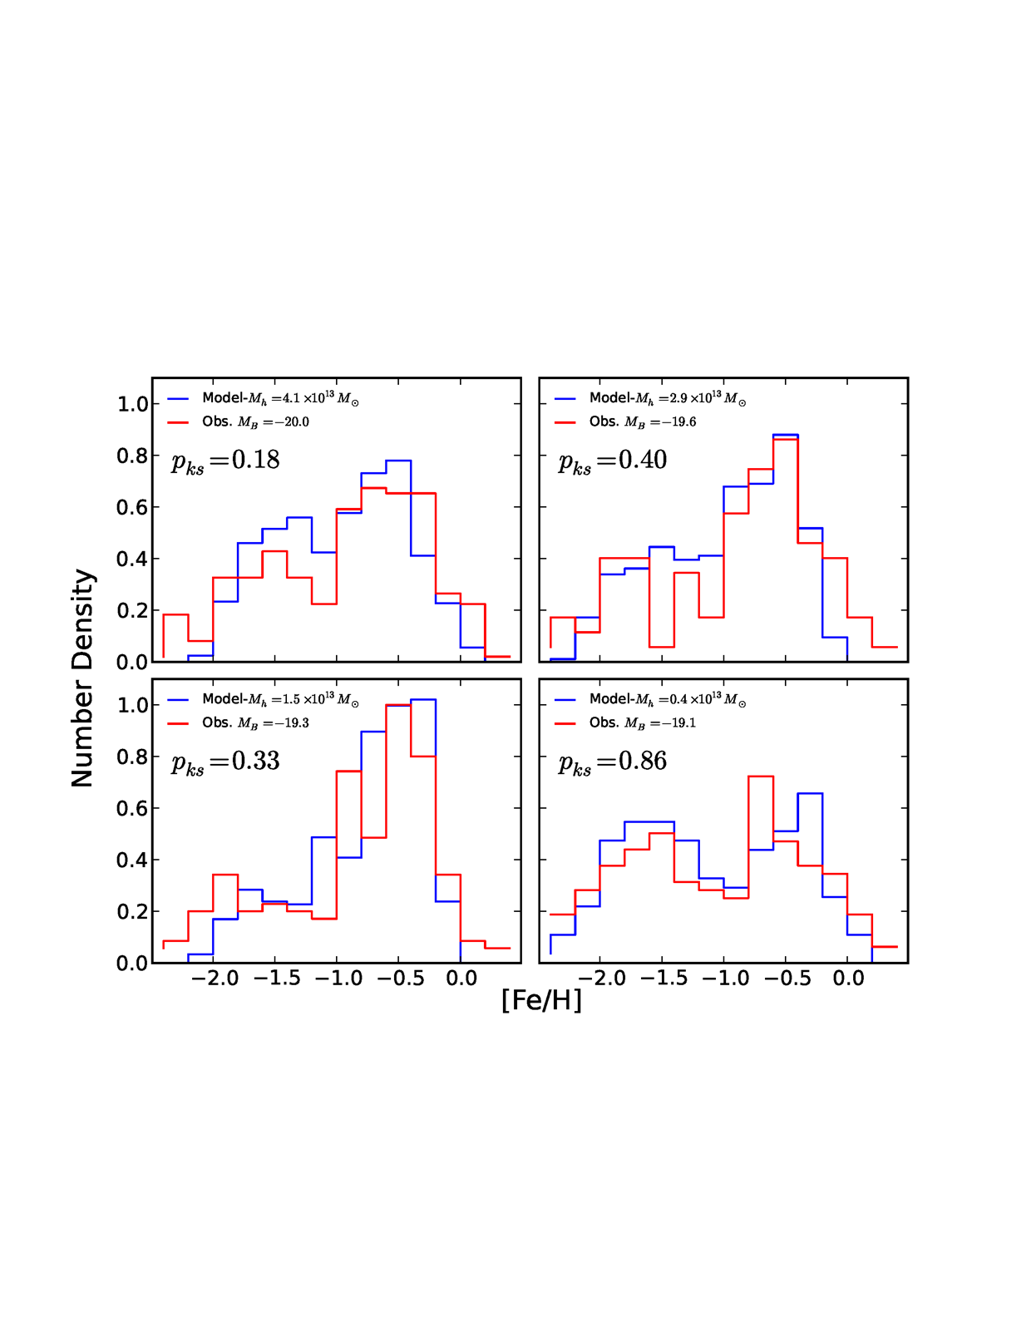
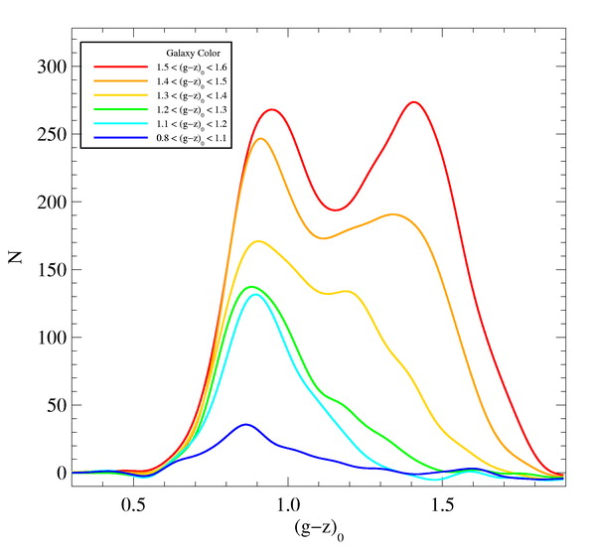
Analytical models based on simulations match GC mass and metallicity distributions in MW and in ellipticals in Virgo cluster
blue
red
[Fe/H]≈−0.5
[Fe/H]≈−1.5
Peng et al. 2006 – HST Virgo Cluster Survey
Muratov & OG 2010
Li & OG 2014
Color/metallicity distribution of GCs in most galaxies is multimodal
Each metallicity group tells us about different episodes of cluster formation
GC formation is triggered by gas-rich mergers,
metallicity assigned from observed M*-Z relation for host galaxies

Slide 11
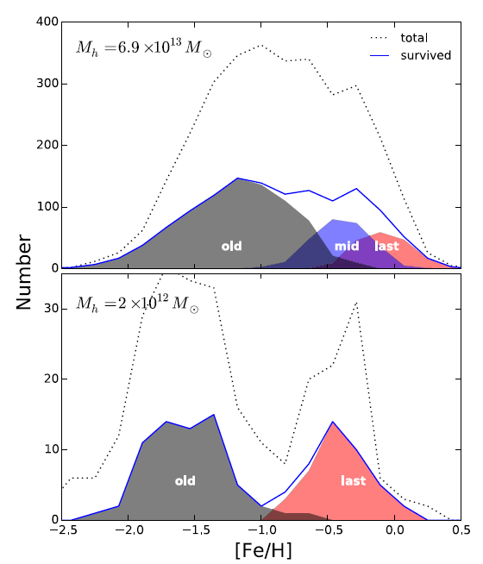
Build-up of the globular cluster system from gas-rich mergers and accretion of galaxies: begin with cosmological simulations of halo formation supplement halos with cold gas mass based on observations use M_{GC} - M_{gas} relation from hydro simulations metallicity from observed M* - Z relation for host galaxies, include evolution with time
Li & OG 2014

Slide 12
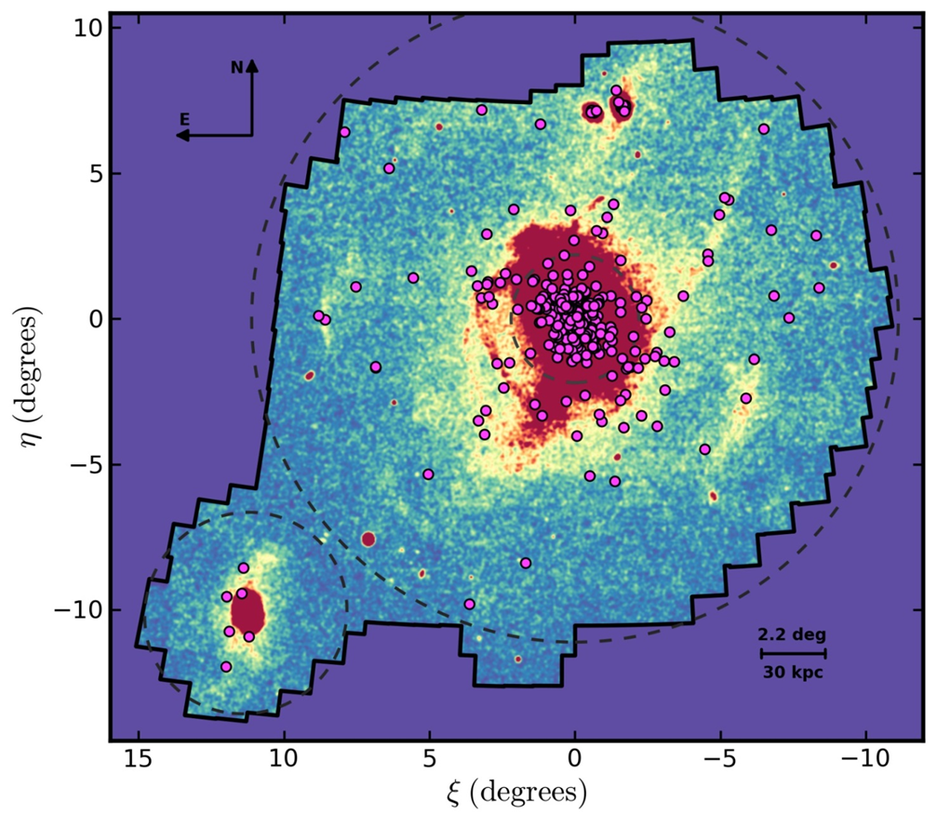
Formation of massive star clusters may be triggered/enhanced by major mergers of gas-rich galaxies
Star clusters form in giant molecular clouds (GMC)
Higher density of globular clusters requires higher external pressure on GMC
Interstellar medium is over-pressured during galaxy mergers
Extreme masses of proto-globular GMC require very gas-rich galaxies
In addition, accreted satellites bring their populations of GCs
outer GCs in M31 are associated with tidal streams (D. Mackey)

Slide 13
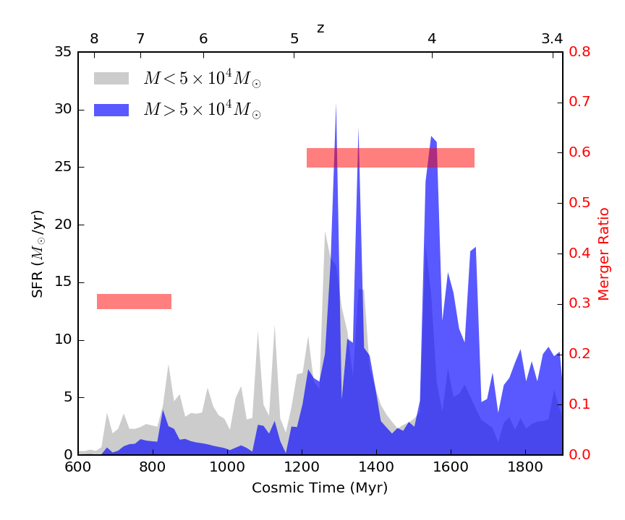
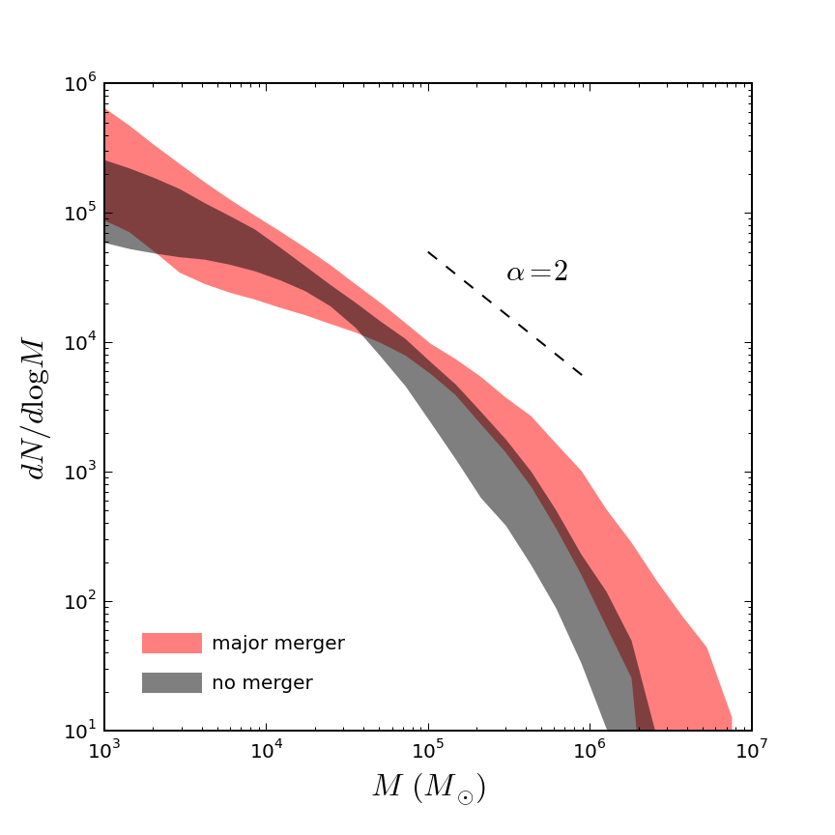
Gas-rich mergers of massive galaxies trigger cluster formation
Li & OG 2016
no merger
major merger
Cluster MF is more strongly truncated between mergers

Slide 14
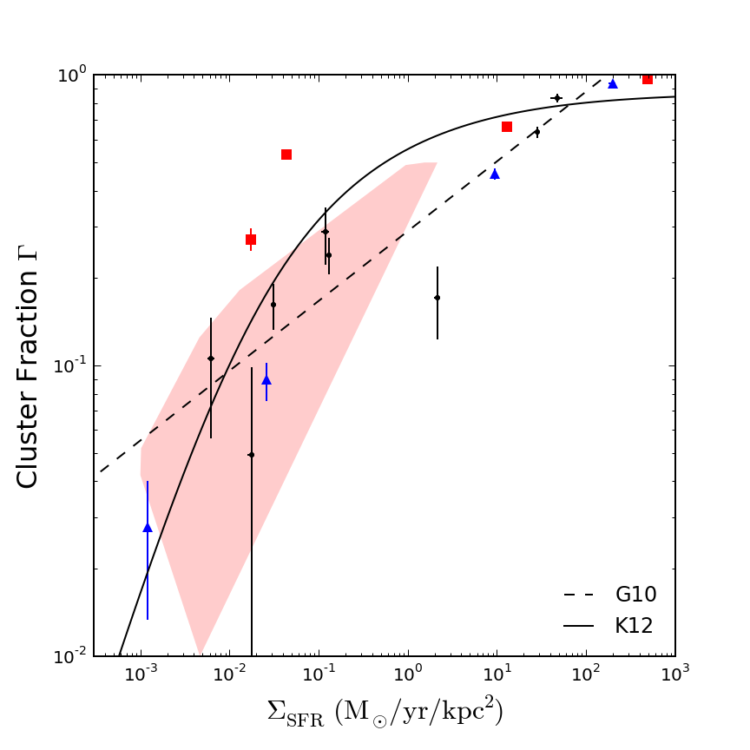
Cluster formation efficiency
fraction of total mass of young stars contained in star clusters more massive than 10⁴ M
observations
--- central galaxy
--- first satellite
--- other satellites
z = 3.3

Slide 15
Summary
Mass function of young star clusters is a truncated power law, both in observations and galaxy formation simulations
Truncation mass and maximum cluster mass scale with SFR
Mergers of gas-rich galaxies may trigger/enhance formation rate of massive star clusters (M > 10⁵ M)
Globular clusters could be used to trace major episodes of mass assembly of their host galaxies

