Slide 1
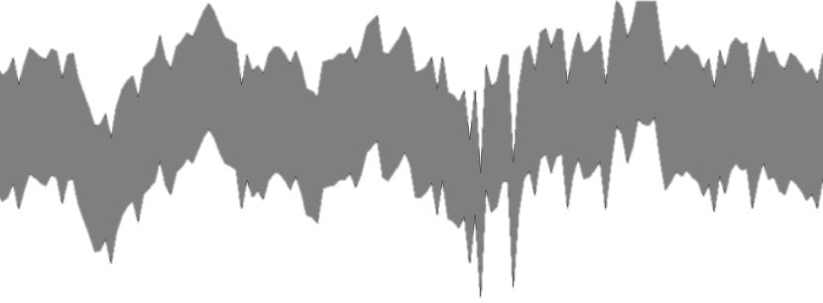
Synergies between resolved star and integrated light studies of galaxies
mind the gap:
Nell Byler
University of Washington
In collaboration with:
Julianne Dalcanton, Ben Williams, Dan Weisz, Ben Johnson, Charlie Conroy

Slide 2
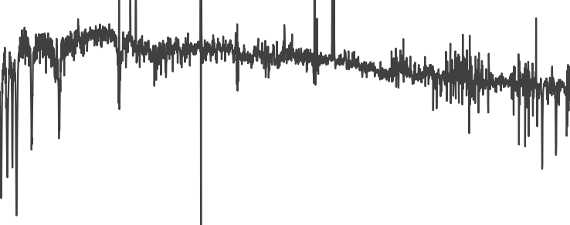
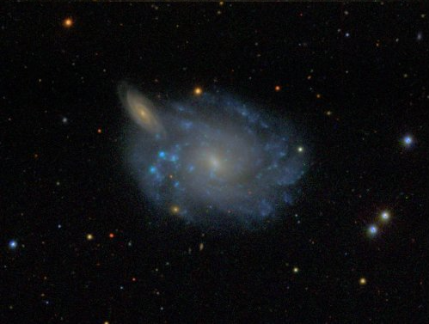
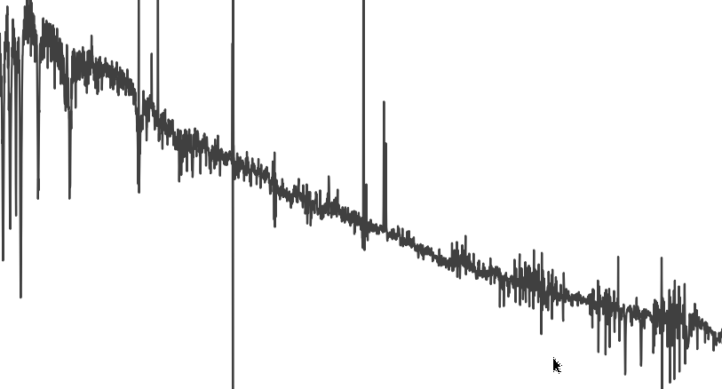
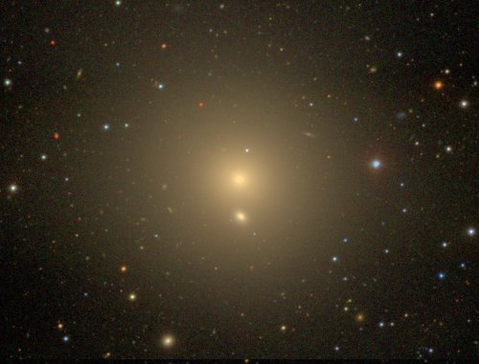
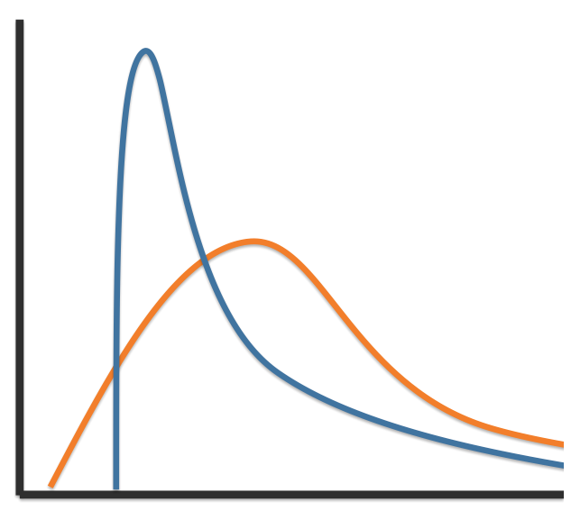
Population Synthesis: Light → Astrophysics
SF
SSP
SFH
SFR
Time
Notes:
Getting physical parameters from galaxies relies on SPS models – broadly applied at low and high z, photometric and spectroscopic SEDs.
Fundamental unit to build a galaxy is the SSP – add them in some combination ascribed to a SFH – rising, falling, bursty.
Physical intuition to understand how parameters effect emergent populations.

Slide 3
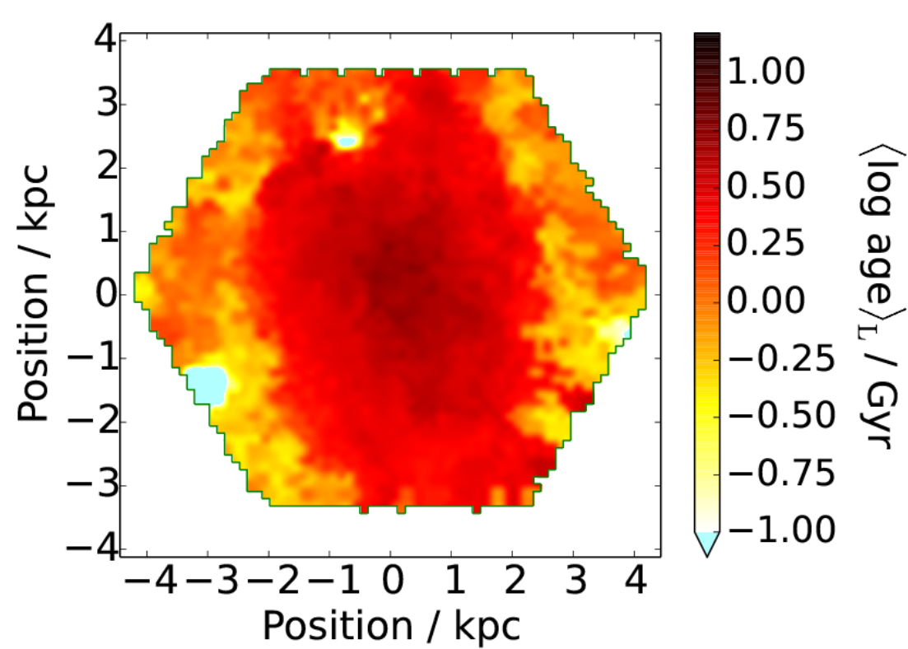
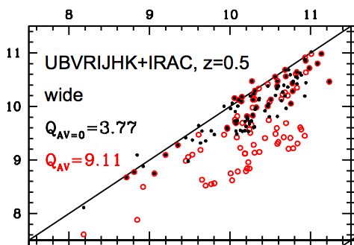
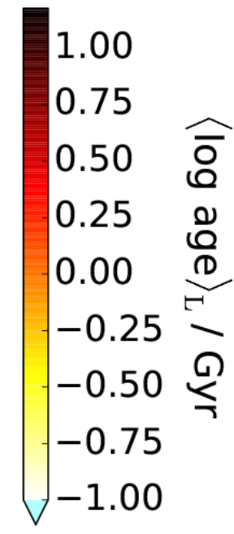
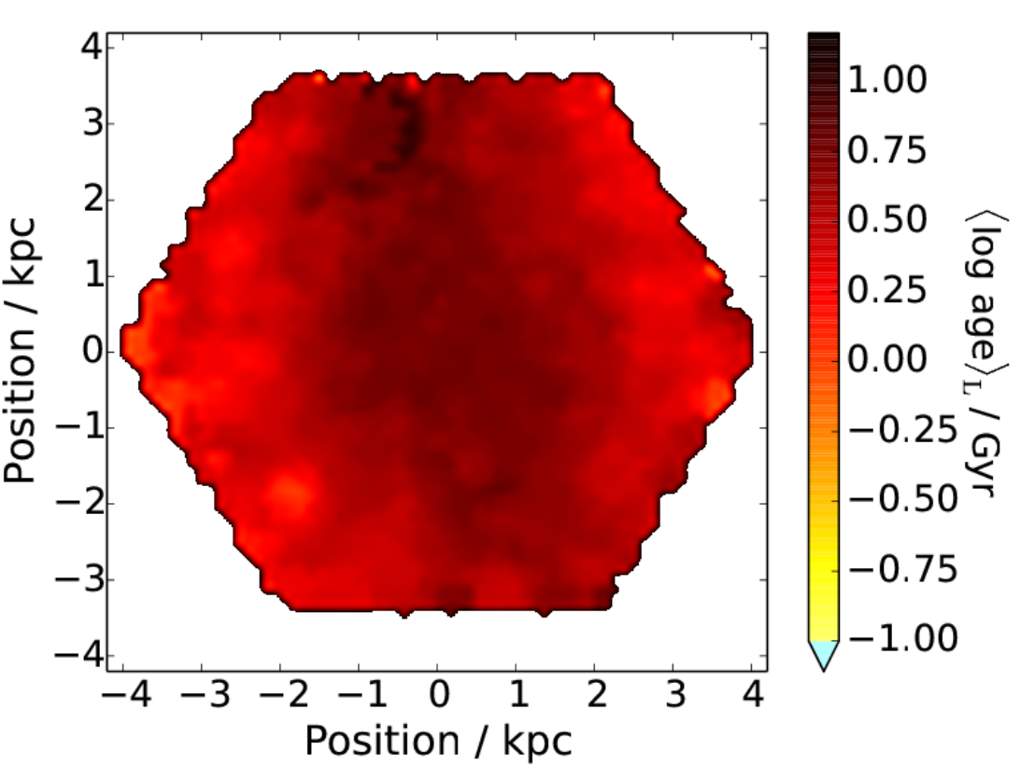
SFH choice biases derived parameters
M/L, <age>, stellar mass, SFR
~ 2 Gyr
Firefly
Mass (fitted)
~ 4 Gyr
Mass (input)
Pforr et al. (2012)
PPXF
Wilkinson et al. (2015)
Notes:
Degeneracies between age/met/dust for integrated light – forced to adopt simple function for SFH.
Young pops dominate the light – adopted SFH has direct effect on measured mass/light , mean stellar ages, star formation rates
Has been a lot of good, hard work on checking self-consistency of models and their sensitivity to things like stellar evolution and imf and sample – really need independent constraint
Non-uniqueness of SPS model fits: Stellar age maps for MaNGA galaxy derived with two different SPS codes (L firefly) (R PPXF) – same spectral library but age is systematically higher with ppxf by 0.2-0.4dex. wilkinson 2015: fig 19

Slide 4
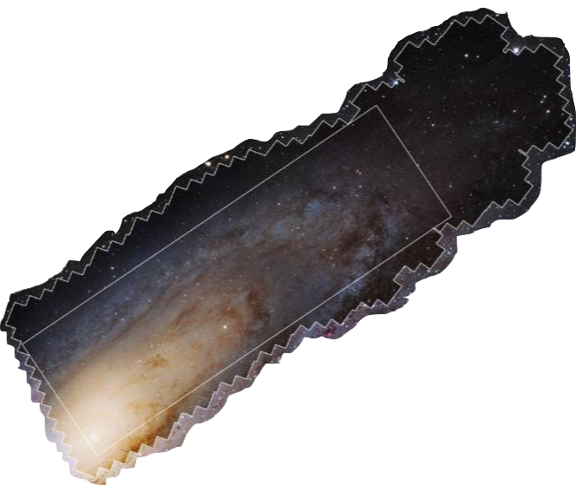
IFU Surveys: New Regime
Variations within individual galaxies of order systematic uncertainties
2” fiber at
z ~ 0.5
~1 kpc at
z = 0.04
Changing scale of application
Irregular dust geometry
Star formation:
Temporal stochasticity, spatial clustering
Notes:
Spatial coverage of optical fiber on M31 at redshift typical for SDSS III galaxies, same coverage for typical MaNGA galaxy
Comparing properties of galaxy population as whole probably fairly robust
Fitting trends within individual galaxies – variation is on order systematic error
Sub-kpc scale – smooth slowly varying SFH breaks down

Slide 5
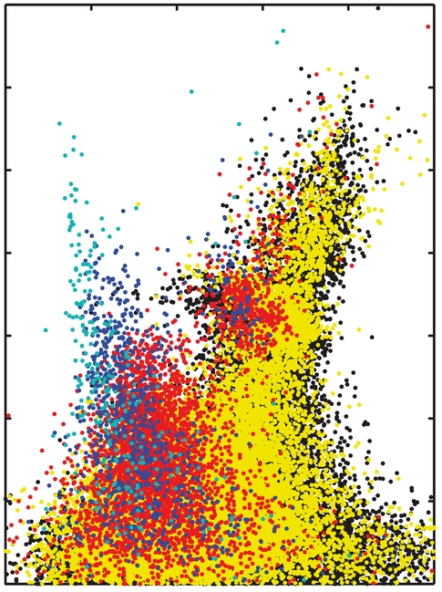
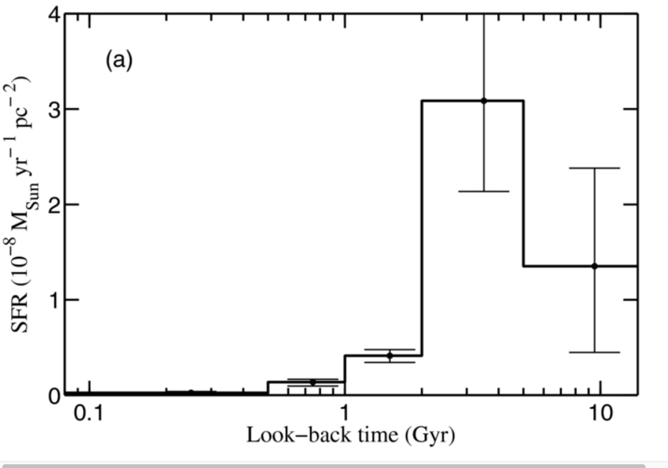
Resolved Stars:
“gold standard” SFHs
Direct access to stars of all ages
Mag ( F814W )
SFR ( M☉ / yr )
Lookback Time (Gyr)
< 5 Myr
0.5-1 Gyr
1-2 Gyr
2-5 Gyr
Color ( F606W - F814W )
Monachesi et al (2014)
Notes:
Resolved stars are the ground truth – far more absolute and temporal precision in SFHs
Can get grasp at ancient populations, stochastic sampling, which can be challanging from spectra alone.

Slide 6
Empirical Calibration: HST + MaNGA
Compare
resolved stars and
integrated light for
matched area
NGC 4163
Notes:
Independent constraint would be nice, but at least this is not just testing for self consistentcy – way for all codes to hold themselves standard
Only handful of galaxies can do this currently
NGC 4163: Burst of SF in last half Gyr; Wide range of recent ages present, strong spatial variation. Low extinction – clean test of SFH recovery

Slide 7
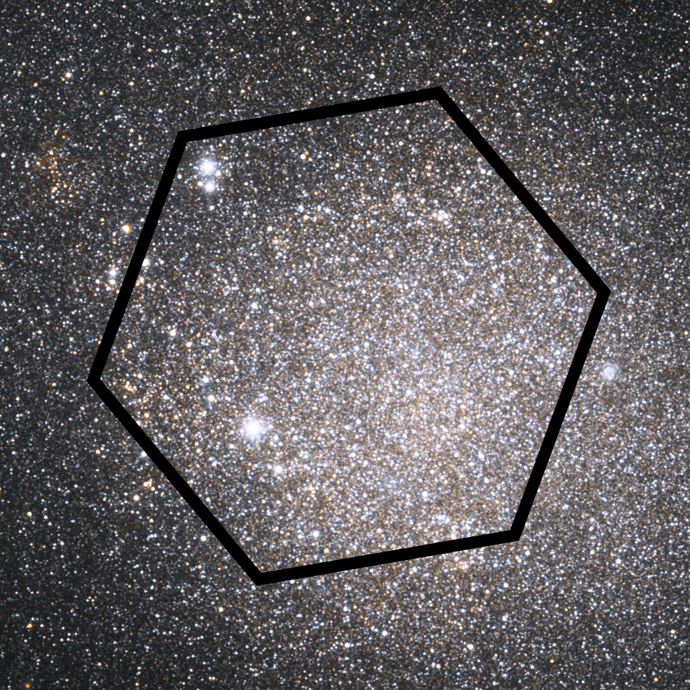
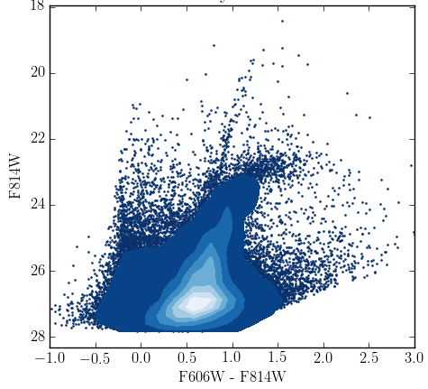
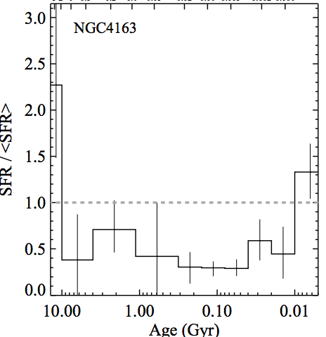
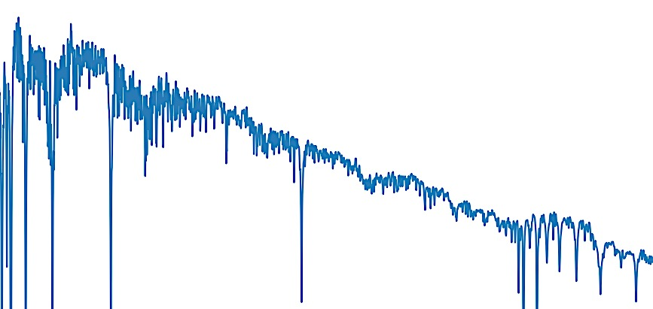
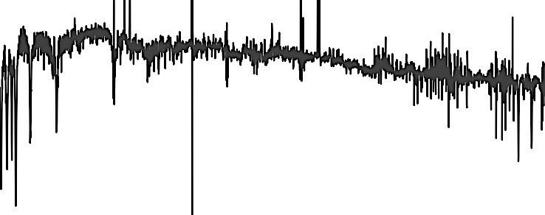
Aperture-Matched Comparison of Light
Resolved Stars
Integrated Light
Sum MaNGA spectra
over matched area
Precise SFH determination
Observed
SFH-reconstructed
Directly measure contribution of stars to total light
Notes:
Can say for the first time where biases occur and how much debiation

Slide 8
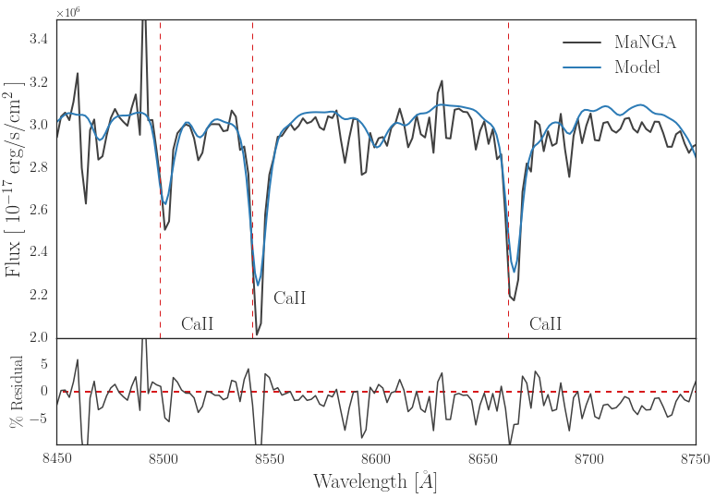
Aperture-Matched Comparison
Notes:
Overall good agreement between methods – still some finessing to do.

Slide 9
Assess sensitivity of mass-weighted properties
Cumulative SF
50% Mass
<10% Light
L☉ / Å
Wavelength [ Å ]
Notes:
M/L accurate to 0.3 dex level, but dominated by systematics.
We can use this calibration to assess how things like model priors, the choice of model templates, when dust model is applied, etc introduce bias, degeneracies.
Mass-weighted vs light weighted properties – we can begin to say something about *how* they are sensitive to assumed model SFH, where priors or model grid limits get you.
Important for osmic build up of mass in universe!

Slide 10
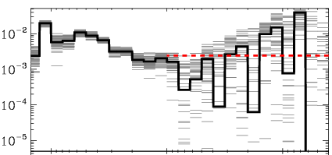
Empirical calibration: Test your code here!
SFR
Lookback Time
Notes:
We’ve done a really excellent job building intuition with SPS models, and assessing how parameters effect the emergent spectrum, how self consistent methods are etc. The combination of HST and MaNGA will provide the first calibration of systematic bias – and can provide a way of assessing a code’s ability to reproduce the ground truth SFH from a spectrum. A grand experiment where all codes test on this and determine what works well and where.

