Slide 1
The Baryon Cycle on FIRE
Tracing Cosmic Inflows, Galactic Outflows, and
Gas Recycling in Realistic Environments
Daniel Anglés-Alcázar
CIERA Postdoctoral Fellow
Center for Interdisciplinary Exploration and Research in Astrophysics
Northwestern University, USA
With: C-A Faucher-Giguère, P. Hopkins, D. Keres, N. Murray, E. Quataert
The interplay between local and global processes in galaxies
Cozumel, México, April 12th, 2016

Slide 2
The Baryon Cycle in Galaxy Evolution
…Martin+2005, Erb 2008, Weiner+2009, Steidel+2010, Kornei+2012, Genzel+2011, Dekel+09, Oppenheimer+10, Davé+11,12, Lilly+13, Anglés-Alcázar+14, Shen+14, Muratov+15, Christensen+15,…
Fresh gas accretion
Wind recycling
Wind loss

Slide 3
The Baryon Cycle in Galaxy Evolution
…Martin+2005, Erb 2008, Weiner+2009, Steidel+2010, Kornei+2012, Genzel+2011, Dekel+09, Oppenheimer+10, Davé+11,12, Lilly+13, Anglés-Alcázar+14, Shen+14, Muratov+15, Christensen+15,…
Non-externally processed
Galaxy mergers:
Gas + stars
Fresh gas accretion
Wind recycling
Wind loss
Externally processed

Slide 4
The Baryon Cycle in Galaxy Evolution
…Martin+2005, Erb 2008, Weiner+2009, Steidel+2010, Kornei+2012, Genzel+2011, Dekel+09, Oppenheimer+10, Davé+11,12, Lilly+13, Anglés-Alcázar+14, Shen+14, Muratov+15, Christensen+15,…
Non-externally processed
Galaxy mergers:
Gas + stars
Fresh gas accretion
Intergalactic transfer:
Wind transfer
Stripping
Wind recycling
Wind loss
Externally processed

Slide 5

FIRE simulations
Connecting local and global processes in galaxies
M_{STAR} – M_{HALO} relation: Hopkins+14
High resolution cosmological zoom simulations
with mass, momentum, energy, and metal feedback
from stellar population synthesis models
Mass–Metallicity relation: Ma+15
HI in z=2 CGM: Faucher-Giguère+15
Powerful outflows: Muratov+15

Slide 6
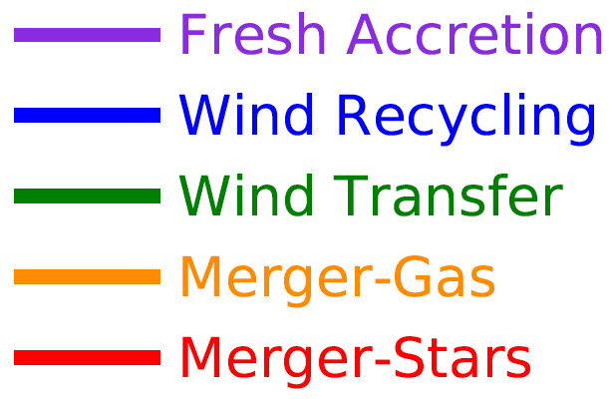
Origin of stellar content of galaxies
Total stellar mass
log M_{HALO} (z=0) = 12
→ Fresh gas accretion dominates first but wind recycling takes over
→ Stars + gas from galaxy merger at z=2, but wind transfer dominates

Slide 7
Origin of stellar content of galaxies
Fraction of stellar mass
log M_{HALO} (z=0) = 12
→ Fresh gas accretion dominates first but wind recycling takes over
→ Stars + gas from galaxy merger at z=2, but wind transfer dominates

Slide 8
Fraction of z = 0 M_{STAR}
From dwarfs to elliptical galaxies
Externally
processed
Non-externally
processed
z = 0
Increasing halo mass: log M_{HALO} = 10 → 13

Slide 9
Trends with halo mass
Cumulative mass-loading factor
Mass-loading factor larger for low mass galaxies (Muratov+15)

Slide 10
Trends with halo mass
Cumulative mass-loading factor
Fraction of gas accretion rate
Mass-loading factor larger for low mass galaxies (Muratov+15)
Wind recycling more important in low mass galaxies

Slide 11
Trends with halo mass
Cumulative mass-loading factor
Fraction of gas accretion rate
Fraction of gas accretion rate
Mass-loading factor larger for low mass galaxies (Muratov+15)
Wind recycling more important in low mass galaxies
Wind transfer increases with halo mass

Slide 12
Tracking # of recycling times
non-externally processed gas
Never
ejected
Cumulative stellar mass
log M_{HALO} (z=0) = 13, 12, 11, 10
# of recycling times
Gas is recycled more in lower mass halos prior to forming stars
50% of mass recycled more than [ 1, 2, 3, 6 ] times in log M_{HALO} = [ 13, 12, 11, 10 ]

Slide 13
Metallicity implications
→ Track number of times ejected gas cycles through the galaxy
non-externally processed gas
log M_{HALO} (z=0) = 13, 12, 11, 10
z = 0
→ Gas increasingly enriched as it cycles through the galaxy

Slide 14
The Baryon Cycle in MW-mass galaxies
% stellar mass at z=0 averaging 3 MW-mass galaxies
Non-externally processed
50%
25%
Galaxy mergers:
Gas + stars
40%
Fresh gas accretion
75%
Intergalactic transfer:
Wind transfer
Stripping
Wind recycling
60%
50%
Wind loss
Externally processed
Gas mass loss equivalent to z=0 stellar mass

Slide 15
Tracing baryons in the FIRE simulations
On-going particle tracking analysis of FIRE zoom-in simulations to quantify the cycling of baryons in galaxy evolution
Recycling of galactic winds represents a significant contribution to galaxy growth, but also the transfer of gas between galaxies via winds!
Currently exploring the implications of fresh accretion, gas recycling, wind transfer, and mergers for chemical evolution and structural properties of galaxies
Develop observational diagnostics of the baryon cycle
Anglés-Alcázar et al. in preparation

Slide 17
The baryon cycle in simulations
Momentum-driven winds
no winds
removing wind
recycling
z = 0
Oppenheimer et al. (2010)
→Galactic winds required to match GSMF and wind recycling contributes a lot!

Slide 18
The baryon cycle in simulations
SINS galaxies (Förster Schreiber+09)
)
winds
no winds
z = 2
Anglés-Alcázar et al. (2014)
→Galactic winds required to match structural/kinematic properties of z=2 disks

Slide 19
Tracing stars back to the original gas source
Gas: ISM
Mergers
Stars
Externally processed
Gas: wind transfer
Intergalactic transfer
Stellar content of Galaxy at z = 0
Stars: stripping
Gas: wind recycling
Non-externally processed
Gas: fresh accretion

Slide 20
Tracing stars back to the original gas source
% mass from each mode for
log M_{HALO} = [ 13, 12, 11 ]
Gas: ISM
[ 41, 70, 60 ]
Mergers
[ 68, 24, 23 ]
[ 59, 30, 40 ]
[ 49, 45, 28 ]
Stars
Externally processed
Gas: wind transfer
[ 32, 76, 77 ]
[ 98, 98, 96 ]
Intergalactic transfer
[ 2, 2, 4 ]
Stellar content of Galaxy at z = 0
Stars: stripping
Gas: wind recycling
Globally:
[ 35, 56, 78 ]
[ 47, 62, 81 ]
Non-externally processed
[ 51, 55, 72 ]
[ 53, 38, 19 ]
Gas: fresh accretion

