Slide 1
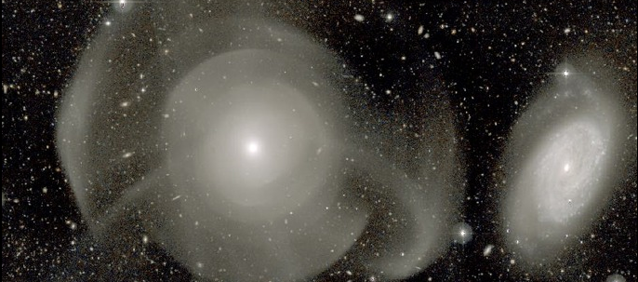


Spatially resolved stellar populations from Atlas3D, and the impact on the IMF
Image: Duc +Atlas3D 2011
Richard McDermid
Macquarie University / Australian Astronomical Observatory

Slide 2
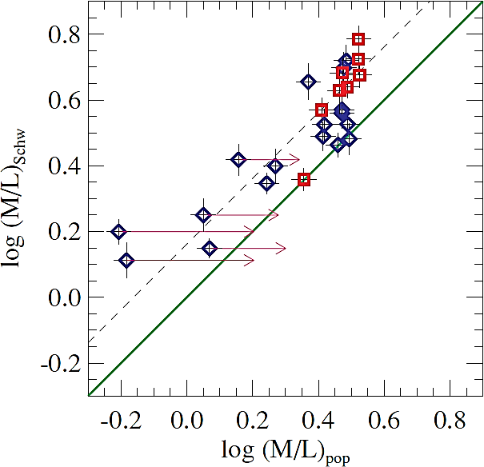
Mass excess in early-type galaxies
Cappellari+06
‘pile up’ at
high (M/L)_{pop}
Salpeter
Chabrier
M/L consistent with varying IMF, but varying dark matter not ruled out
Effect of young stars
1SSP 2SSP
Stellar Dynamical Models
Stellar Population Models

Slide 3
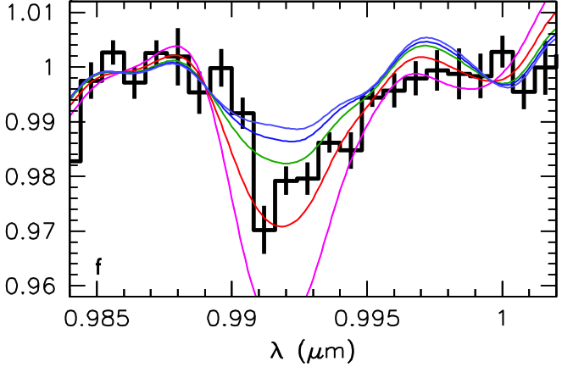
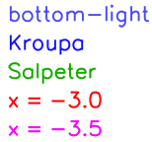
Mass excess in early-type galaxies
van Dokkum & Conroy 2010
FeH

Slide 4
Mass excess in early-type galaxies
Conroy & van Dokkum 2012

Slide 5
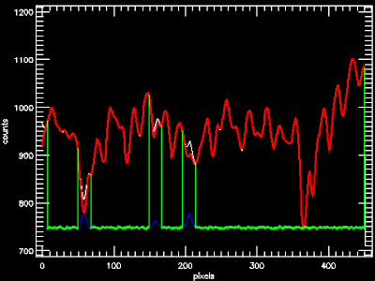
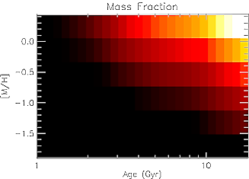
Stellar Population (M/L)_{Salp}
Mass Fraction
[Z/H]
Age (Gyr)
Fit to SAURON spectrum Regularized star formation history

Slide 6
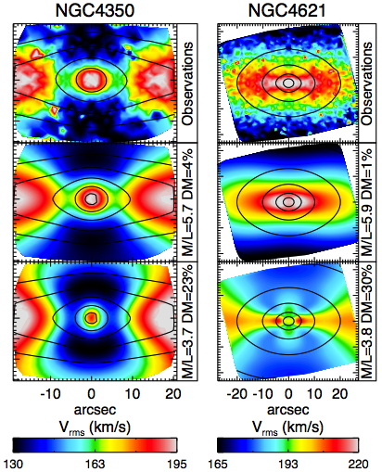
Stellar Dynamical (M/L)_{stars}
MGE
JAM
Scott+13
Cappellari+13

Slide 7
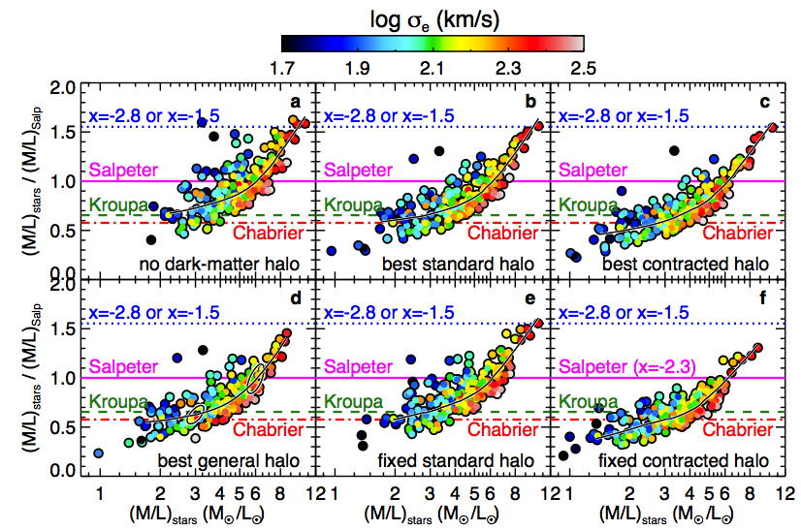
Variation of the IMF across 260 ETGs
Cappellari, McDermid, et al.2012
α_{dyn}
α_{dyn}= (M/L)_{stars} / (M/L)_{Salp}

Slide 8
IMF Variation with Line Strengths
Locally-weighted average values
McDermid+14
Models = Schiavon 2007

Slide 9
Global IMF Variation with SSP Age
McDermid+14
Gradient
Correlation and Significance
α_{dyn}

Slide 10
Global IMF Variation with SSP Metallicity
McDermid+14
Gradient
Correlation and Significance
α_{dyn}

Slide 11
Global IMF Variation with SSP [α/Fe]
McDermid+14
Gradient
Correlation and Significance
α_{dyn}

Slide 12
Comparison Dynamical vs. Spectroscopic IMF
McDermid+14
α_{dyn}
= Conroy & van Dokkum 2012b

Slide 13
IMF Variation with σ
Cappellari+13
r = 0.36
p = 5.7e−08
α_{dyn}

Slide 14
Comparison IMF Variation with σ
Spiniello+14
Spectroscopic
- Lensing
- Dynamics
Posacki +15
Cappellari+13

Slide 15
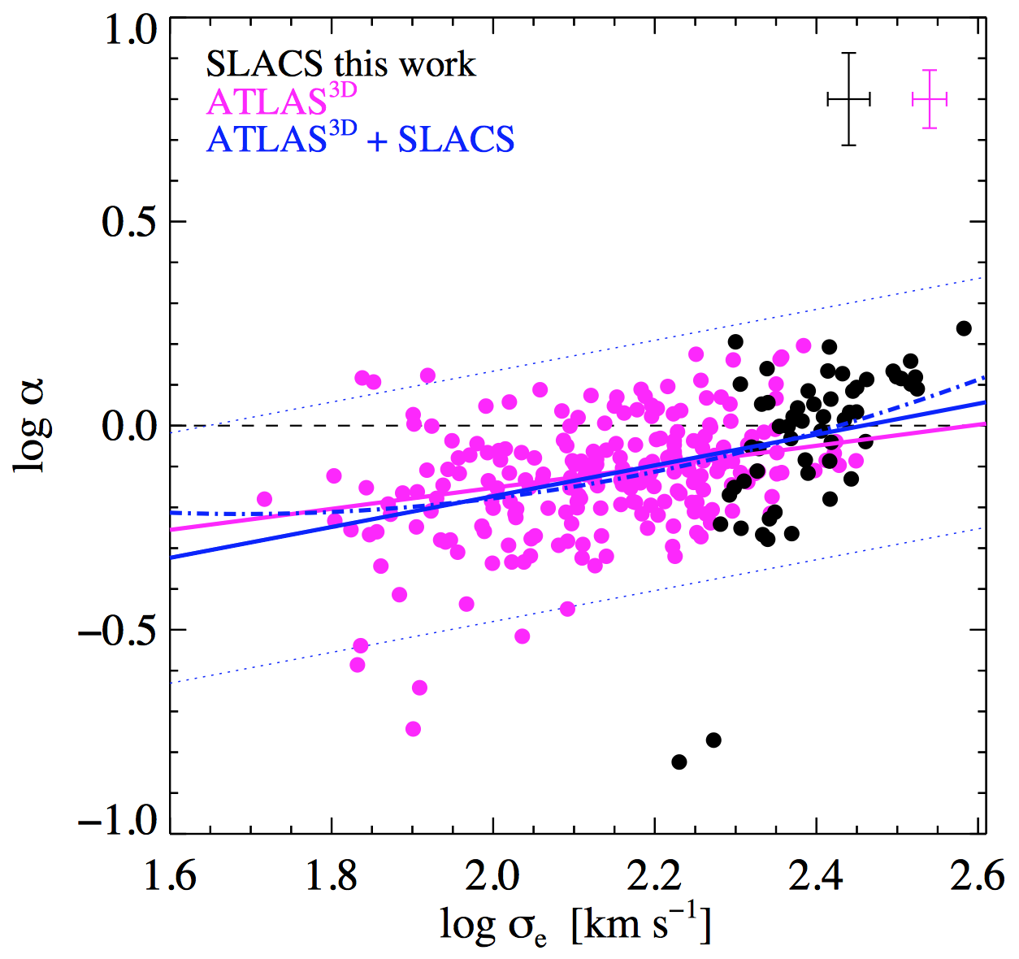
Comparison IMF Variation with σ
Posacki+14
Lensing Only
α_{dyn}

Slide 16


Inconsistent Individual Galaxy IMFs?
Reference Stellar Population M/L?
Dynamical versus population total M/L?
Galaxy-by-galaxy IMF normalization?
(See Mariya Lyubenova’s talk)
Smith 2014

Slide 17
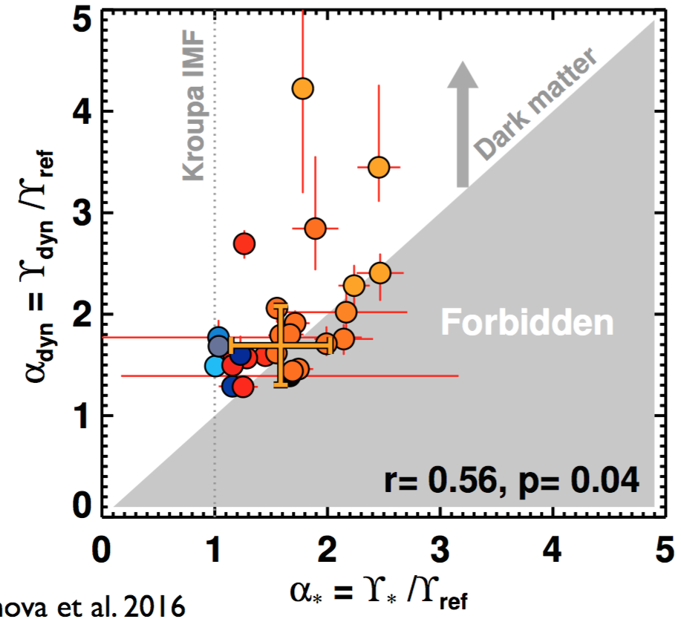
Inconsistent Individual Galaxy IMFs?
Reference Stellar Population M/L?
Dynamical versus population total M/L?
Galaxy-by-galaxy IMF normalization?
(See Mariya Lyubenova’s talk)
Smith 2014
Lyubenova et al. 2016

Slide 18
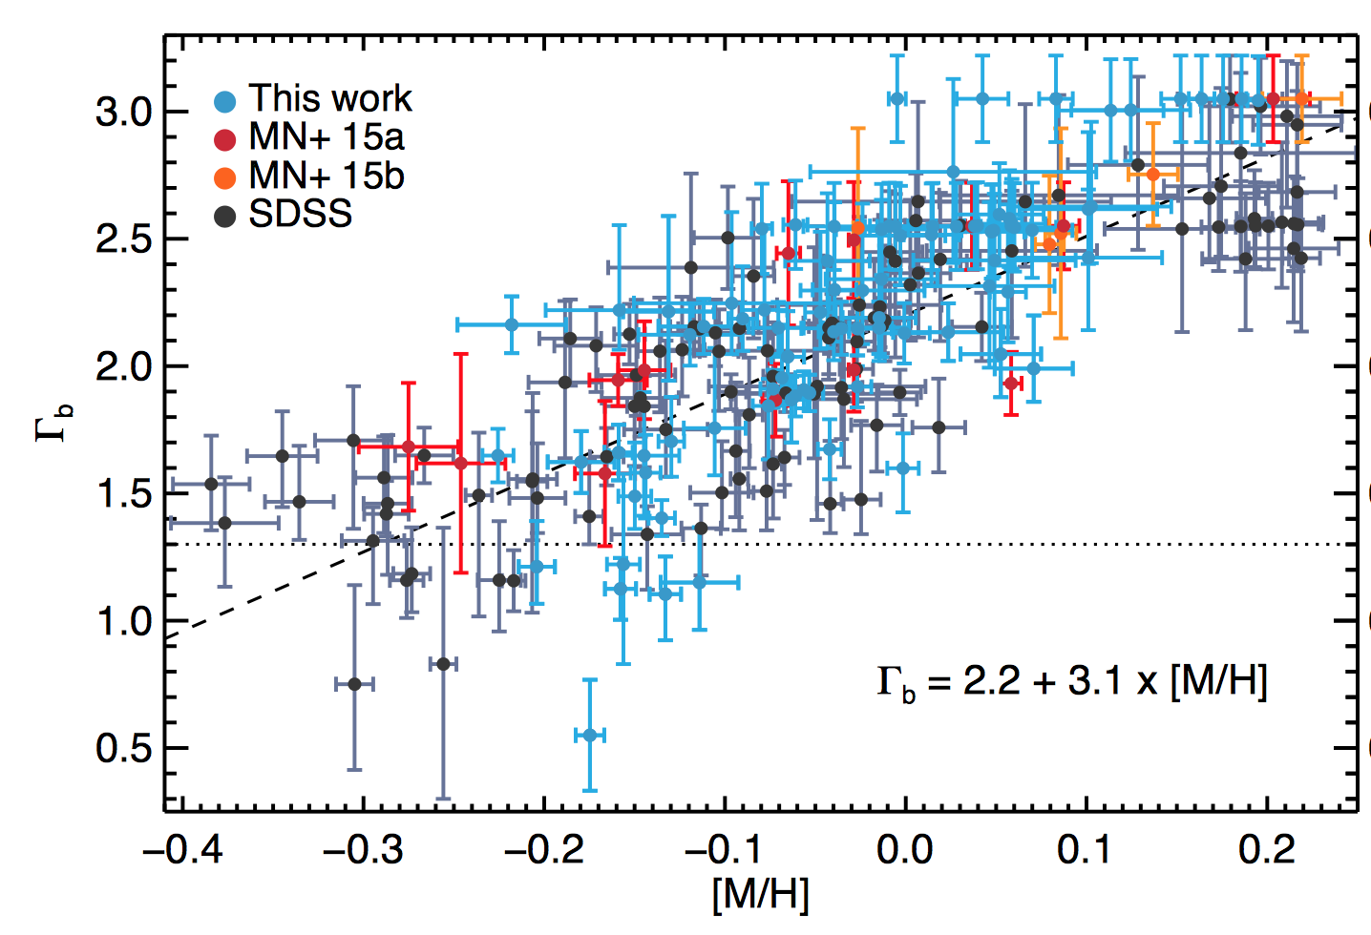
Inconsistent IMF Variation with [Ζ/Η]?
McDermid+14
Martín-Navarro +15
(=IMF Slope)
Kroupa
Global and Local IMF - [Z/H]
Stellar Population Analysis Only
Global IMF – [Z/H]
Dynamics and Stellar Pops

Slide 19
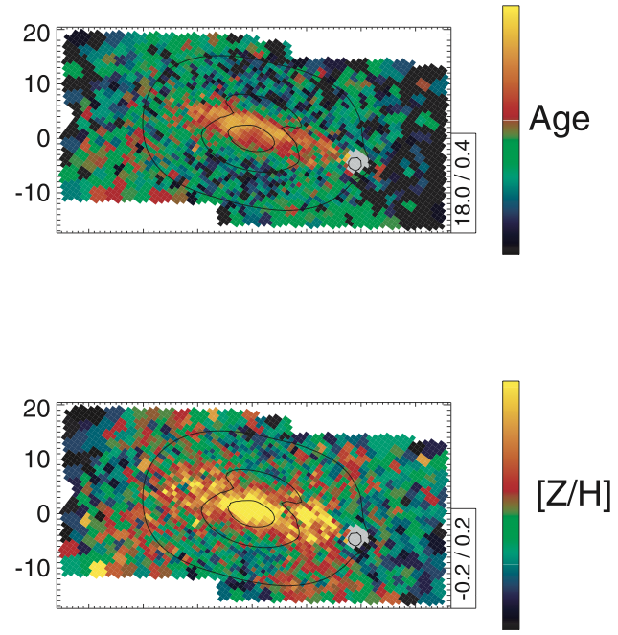
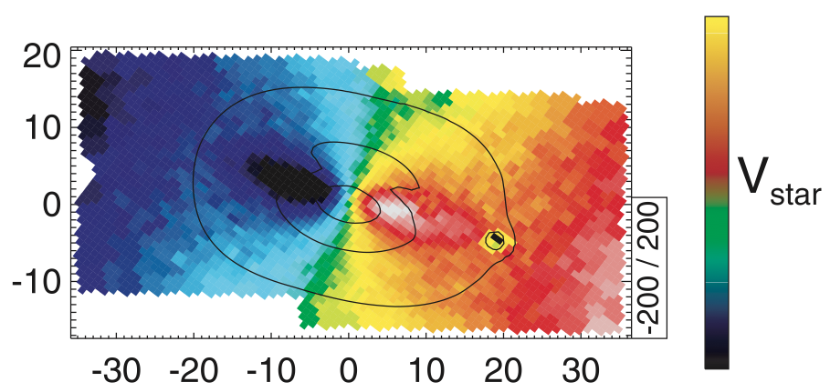
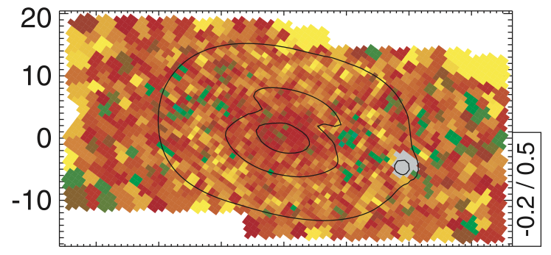
Spatially-Resolved Populations
NGC4526 / SAURON: Kuntschner et al. 2010
Age
Young
Metallicity
Old
[α/Fe]
Stellar Velocity
arcsec
arcsec

Slide 20
Accounting for (M/L)_{Salp} Variations
Incorporate the M/L changes into the MGE of the dynamical model
➔ self-consistent dynamical modelling

Slide 21
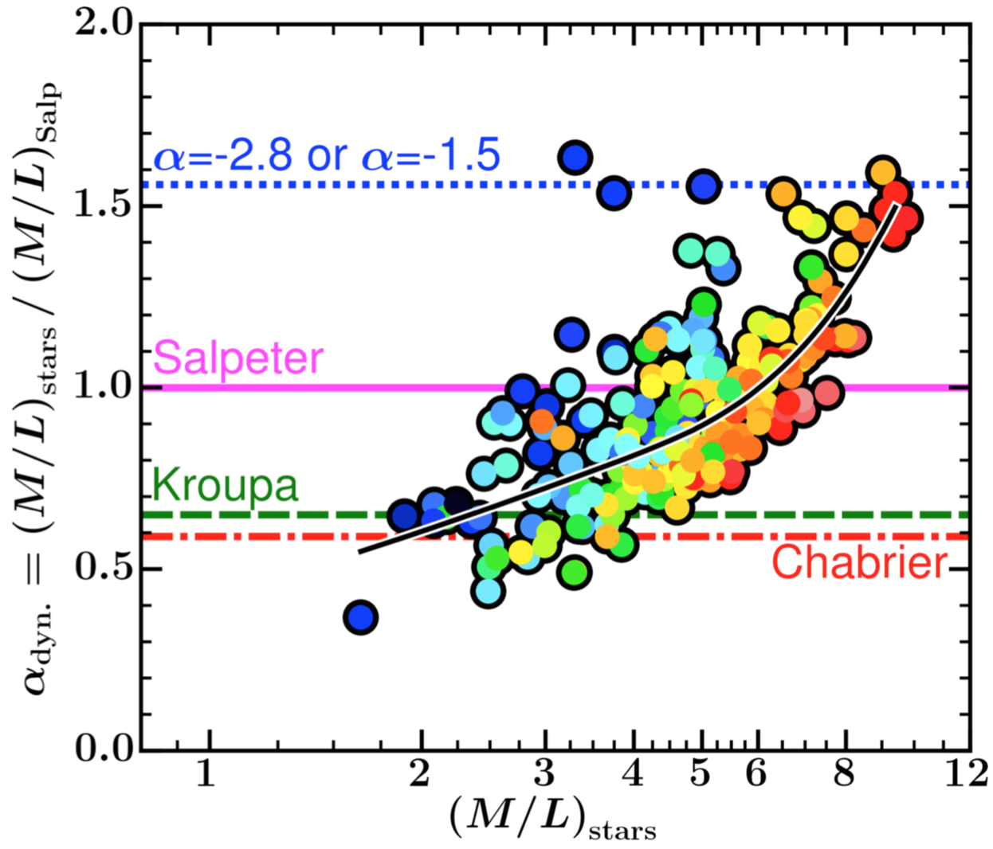
Assuming Constant (M/L)_{Salp}
α_{dyn}
Credit: Adriano Poci,
Macquarie Masters Student

Slide 22
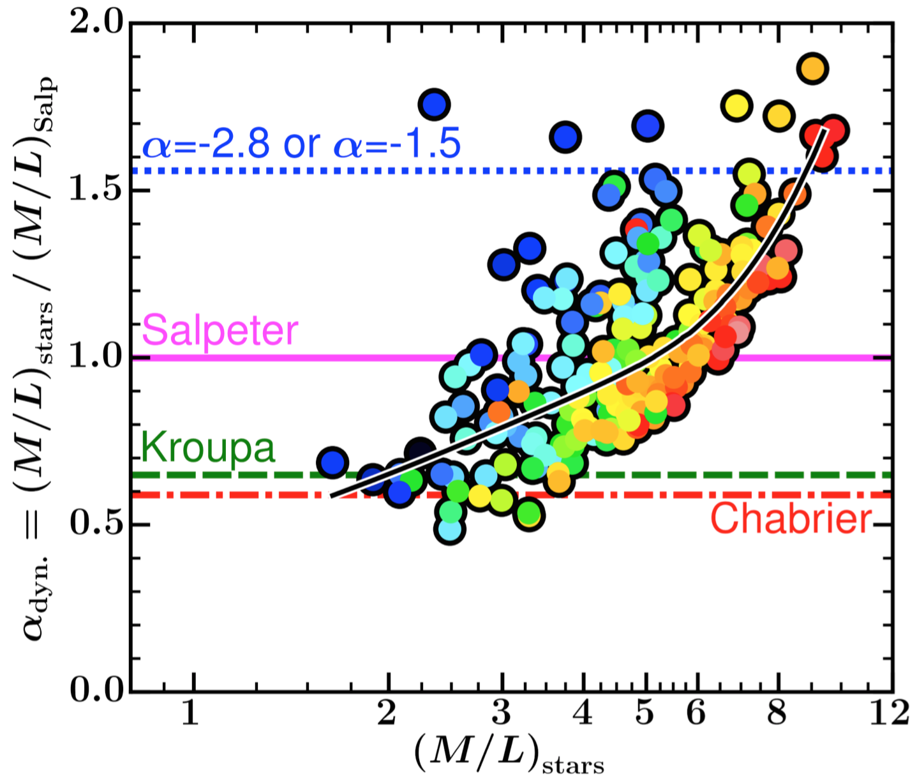
Assuming Radially Varying (M/L)_{Salp}
α_{dyn}
Credit: Adriano Poci,
Macquarie Masters Student

Slide 23
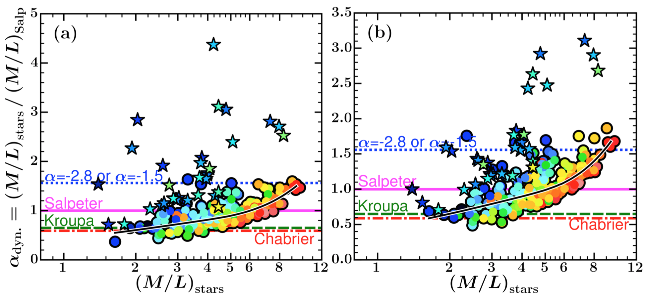
Assuming Radially Varying (M/L)_{Salp}
Credit: Adriano Poci
Constant M/L
Varying M/L
= Strong Age
Gradient
Accounting for radial age/metallicity variations reduces scatter due to strong gradients – important for later types

Slide 24
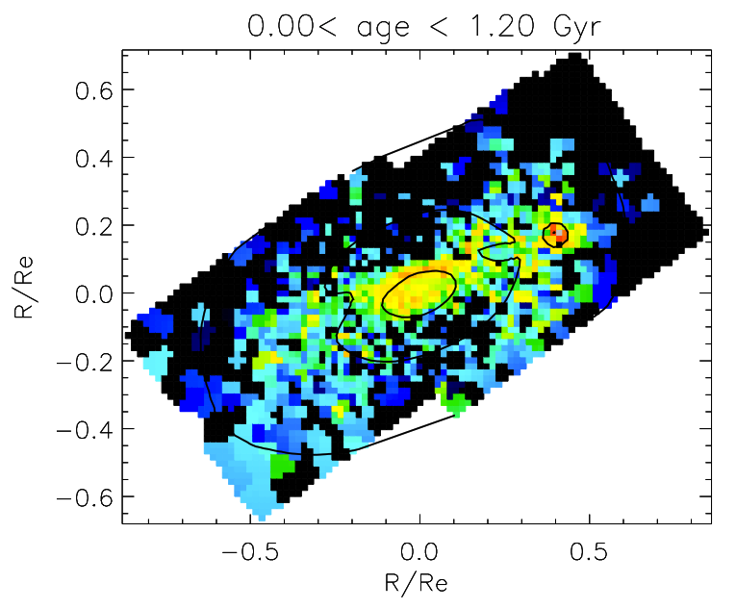
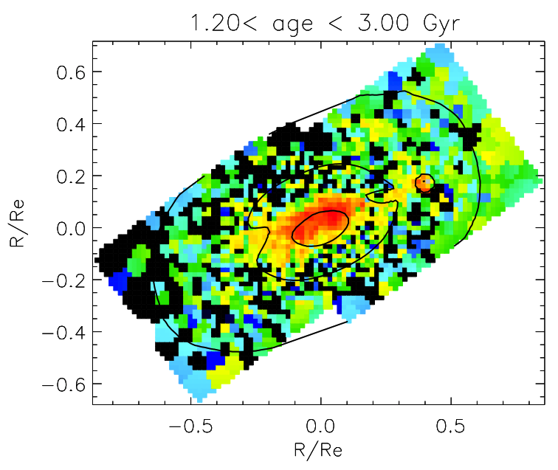
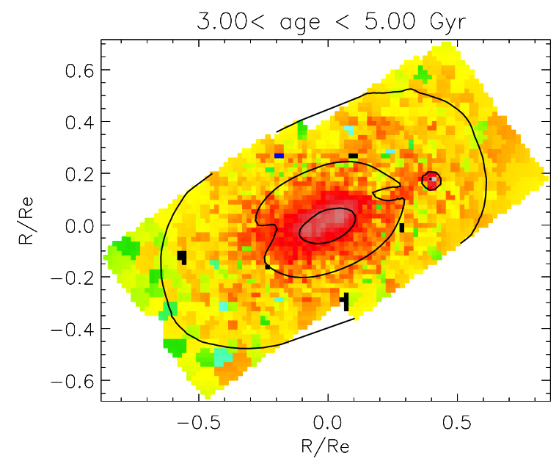
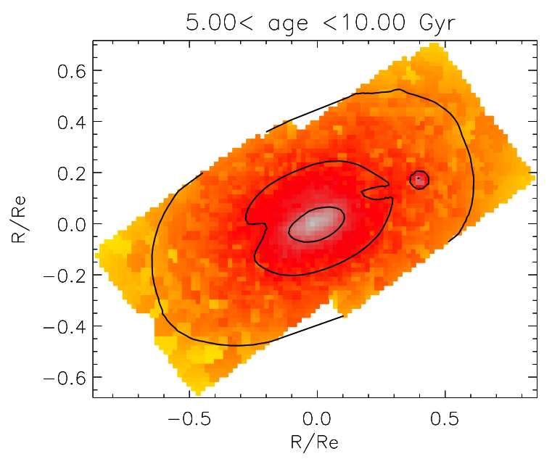
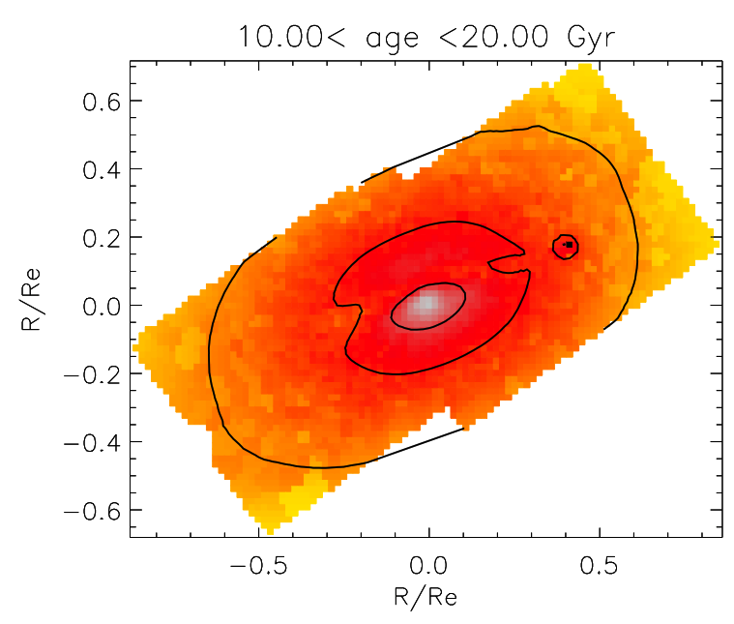
Spatially-Resolved Star Formation History
0.1 < age < 1. 2Gyr
1.2 < age < 3.0 Gyr
3 < age < 5 Gyr
0.01% of Mass
0.6% of Mass
4% of Mass
5 < age < 10 Gyr
age > 10 Gyr
Mass Fraction
31% of Mass
65% of Mass

Slide 25
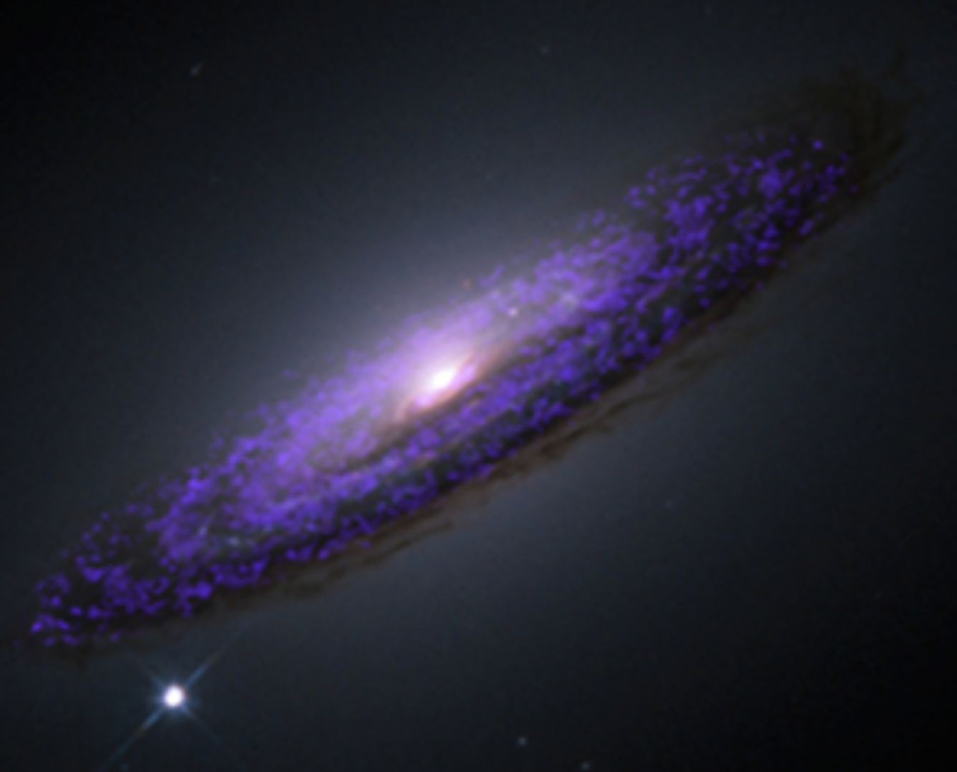
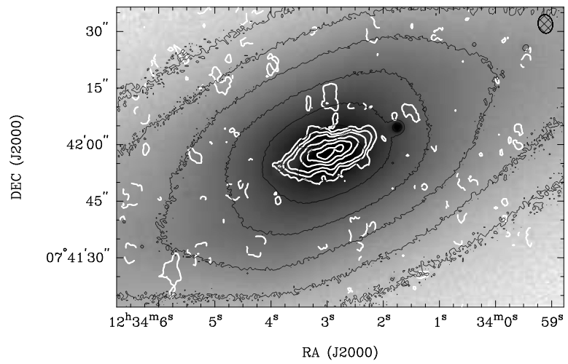
Spatially-resolved picture
Davis et al. 2013
Young et al. 2010

Slide 26
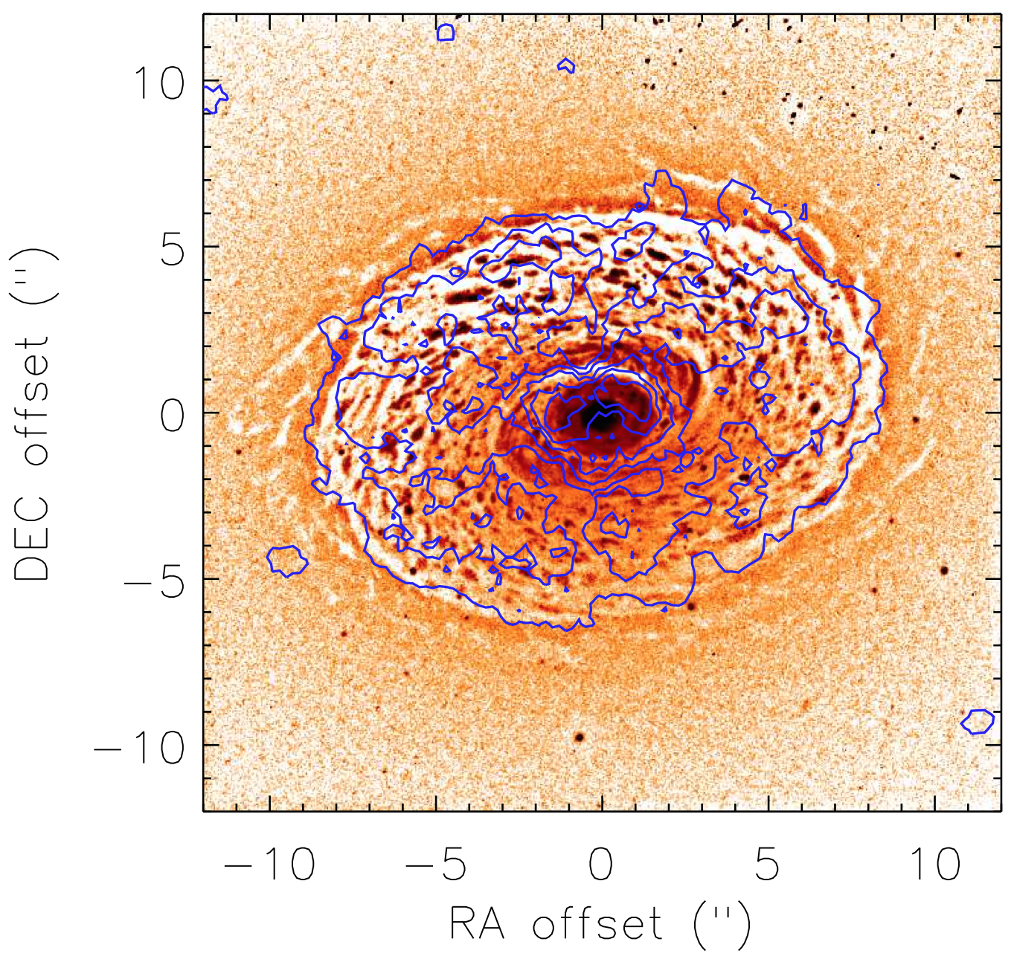
CO Disks in Atlas3D ETGs
NGC4459
HST + CARMA
Davis & McDermid,
2016 submitted

Slide 27
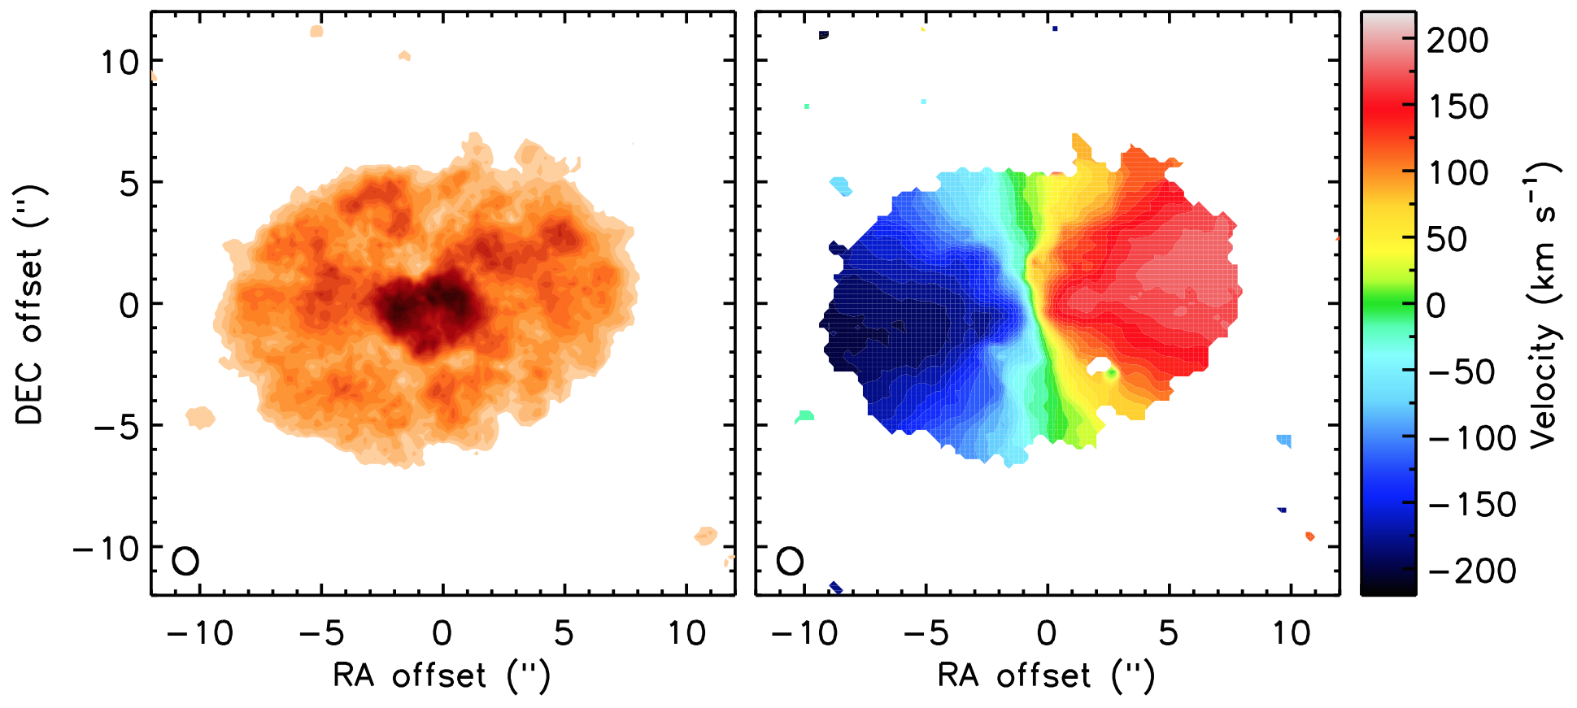
CO Disks in Atlas3D ETGs
NGC4459
Sample of 7 early-type galaxies (ETGs) with well-resolved, regular CO disks
Davis & McDermid, 2016 submitted

Slide 28
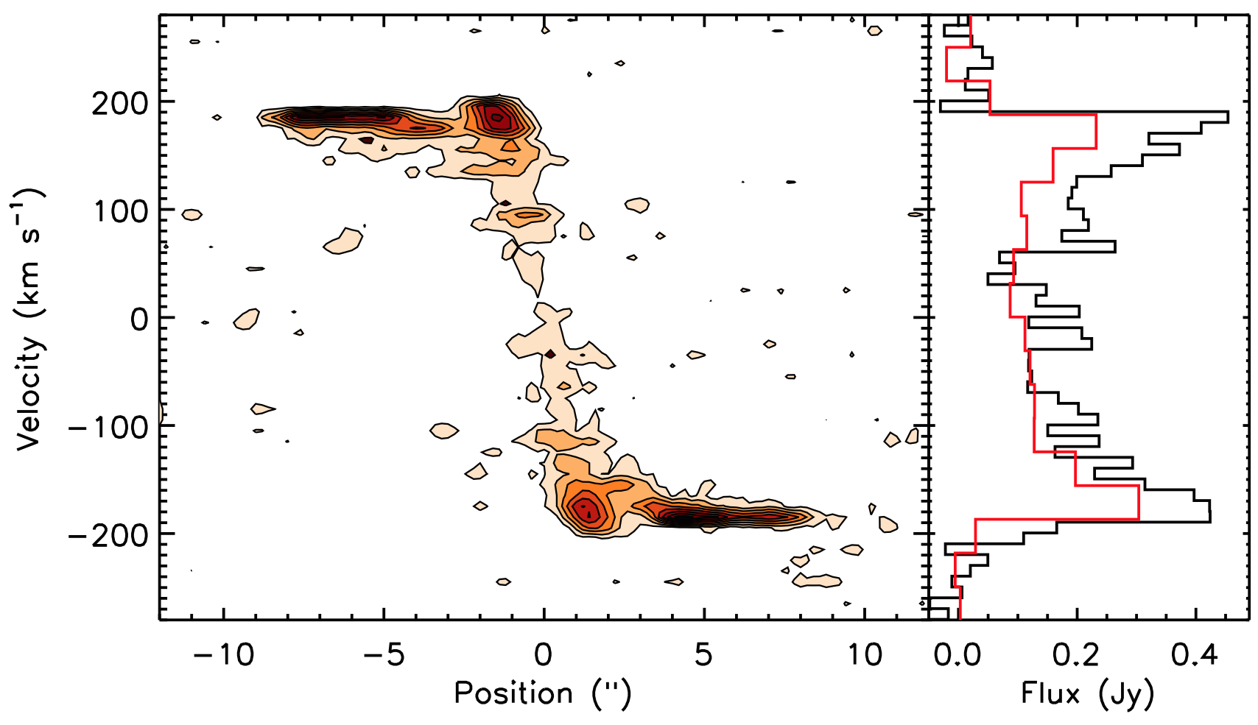
CO Disks in Atlas3D ETGs
NGC4459
CARMA
IRAM Combes+07
Use CO to trace V_{circ}(r) ➔ Enclosed Mass Profile
Compare M(r) with luminosity ➔ M/L Profile
Compare M/L(r) with stellar populations ➔ α_{dyn} Profile
Davis & McDermid, 2016 submitted

Slide 29
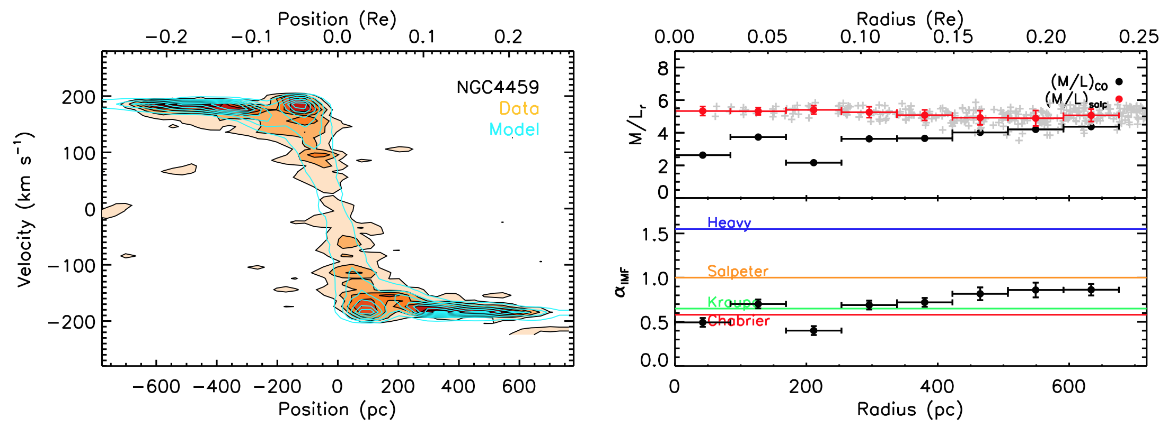
M/L Profile from CO Disk
NGC4459
Data
Model
Model fit directly to CO data cube with KINematic Molecular Simulator (KinMS) of Davis+13
Use MCMC to optimize disk flux, centre, PA, inclination, dispersion, and rotation velocity in radial bins
Davis & McDermid, 2016 submitted

Slide 30
M/L Profile from CO Disk
M/L from Stellar Populations
M/L from CO Gas Disk Model
Ratio of M/Ls = α
Model fit directly to CO data cube with publicly available KINematic Molecular Simulator (KinMS) of Davis+13a
Use MCMC to optimize disk flux, centre, PA, inclination, and rotation velocity in radial bins
Davis & McDermid, 2016 submitted

Slide 31
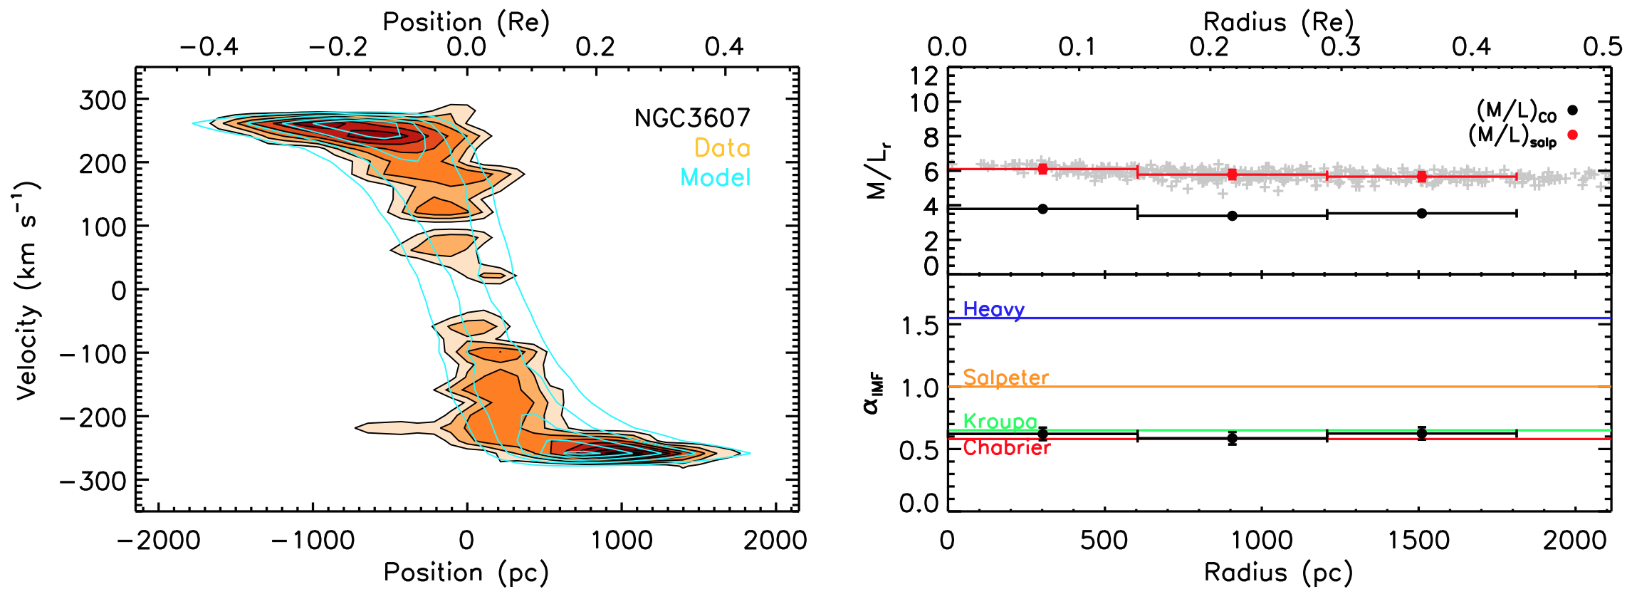
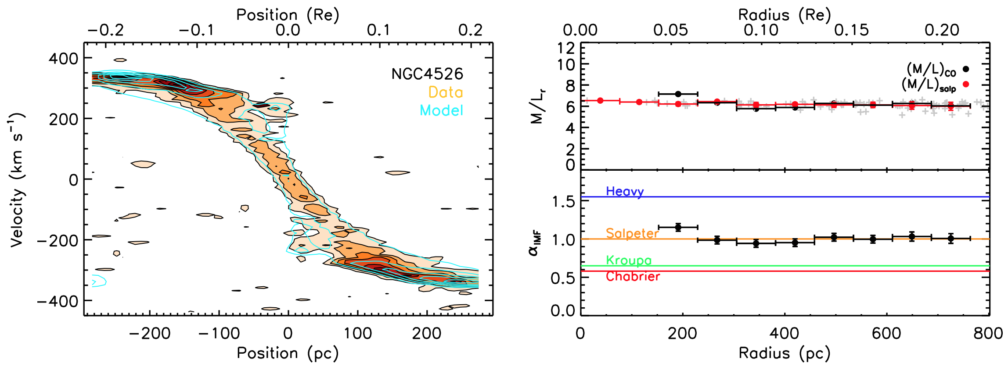
M/L Profile from CO Disk
Davis & McDermid, 2016 submitted

Slide 32
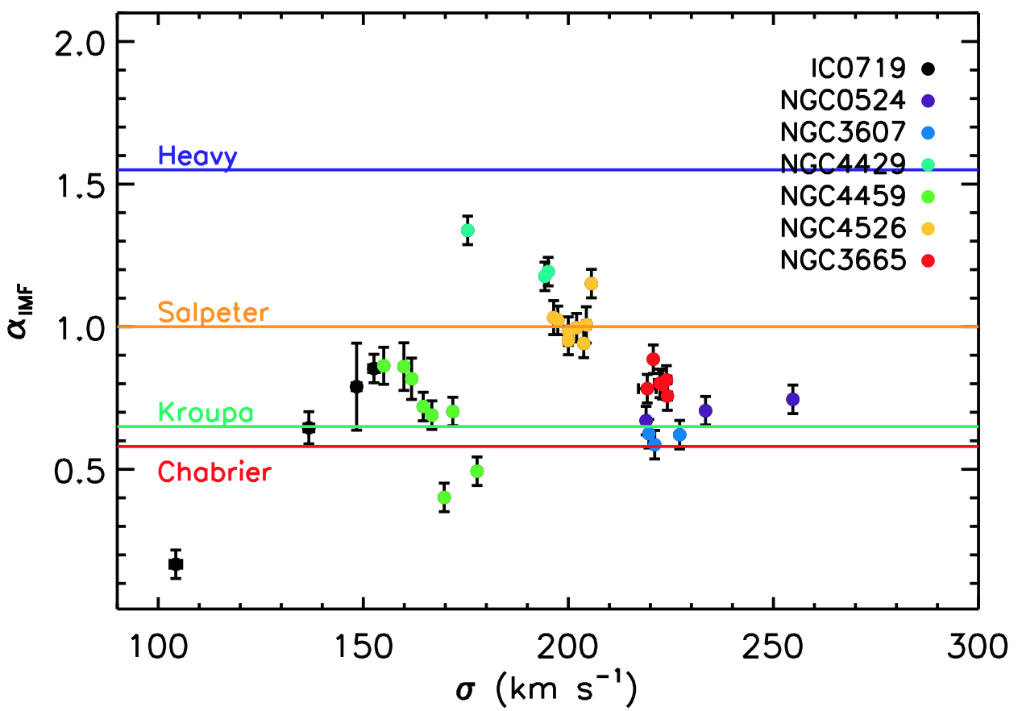
IMF Profile with Local Velocity Dispersion
α_{dyn}
Davis & McDermid, 2016 submitted

Slide 33
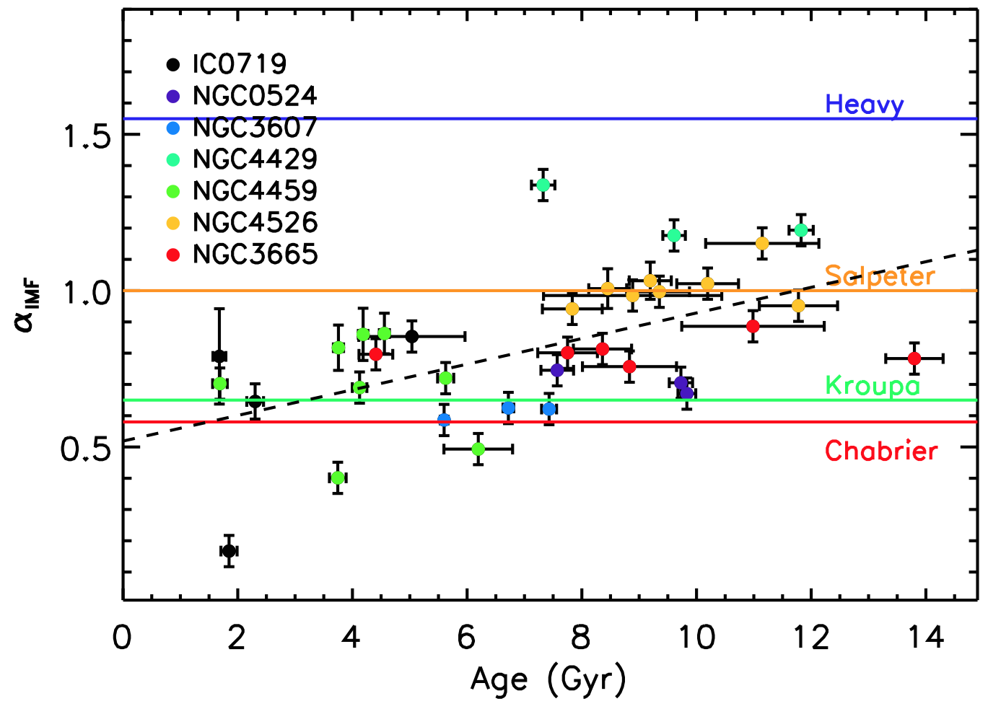
IMF Profile with Local Age
α_{dyn}
Davis & McDermid, 2016 submitted

Slide 34
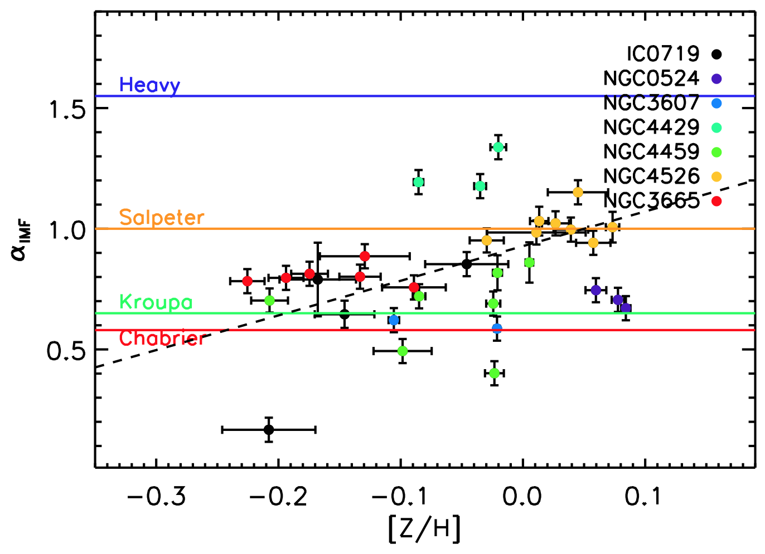
IMF Profile with Local [Z/H]
α_{dyn}
Davis & McDermid, 2016 submitted

Slide 35
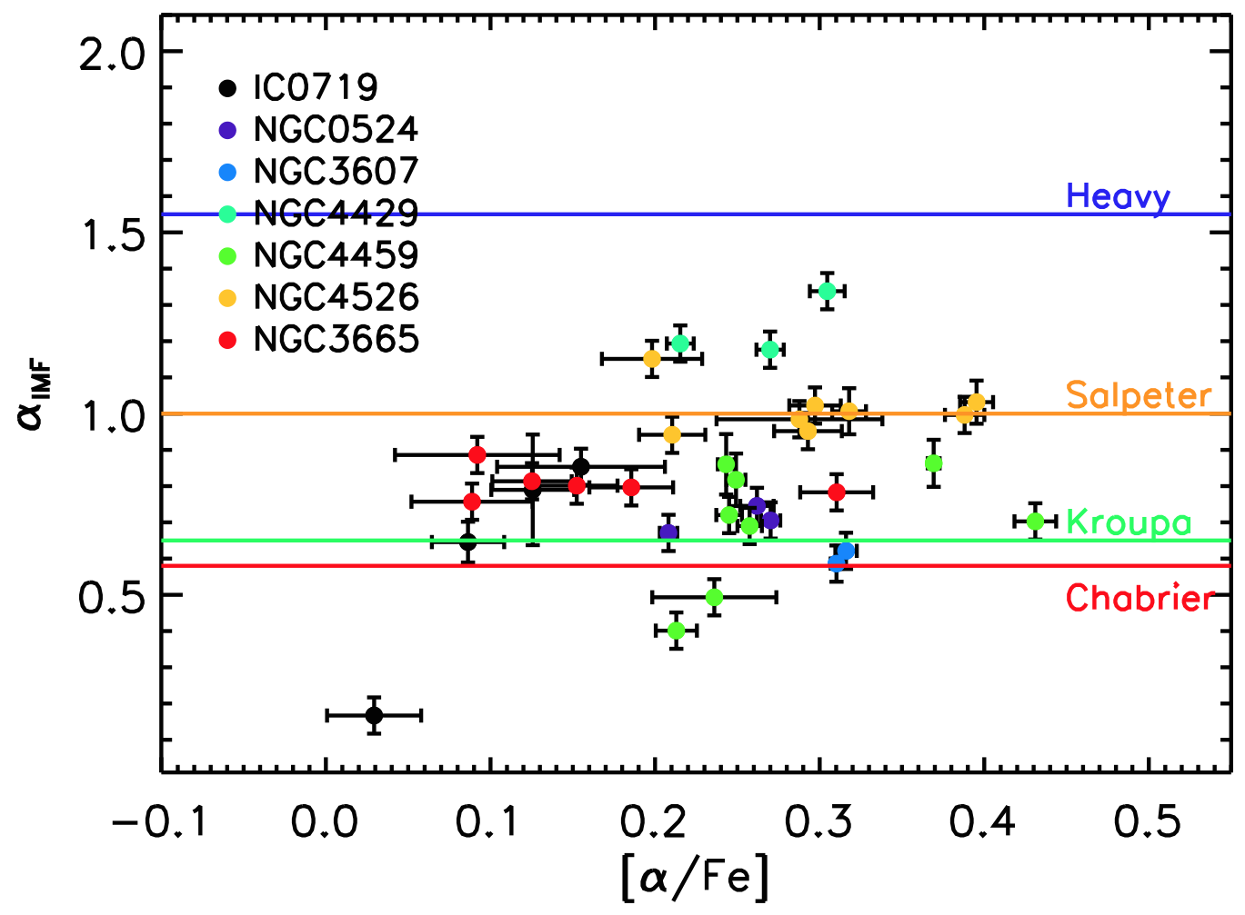
IMF Profile with Local [α/Fe]
α_{dyn}
Davis & McDermid, 2016 submitted

Slide 36
Conclusions
Global trends of dynamically-derived IMF with stellar populations are weak, in contrast to pure spectroscopic studies
Self-consistent stellar dynamical models with spatially varying M/L_{pop} preserve systematic IMF variation, and help reduce biases
CO disks provide local tracer of mass profile, allowing unique spatially resolved dynamical IMF profile determinations
CO-based IMF profiles show trends with spatially-resolved SSP age and metallicity, in partial agreement with spectral studies.
Weak global trends may therefore be driven by different weighting of stellar dynamics (spatial) vs. populations (luminosity)

Slide 38
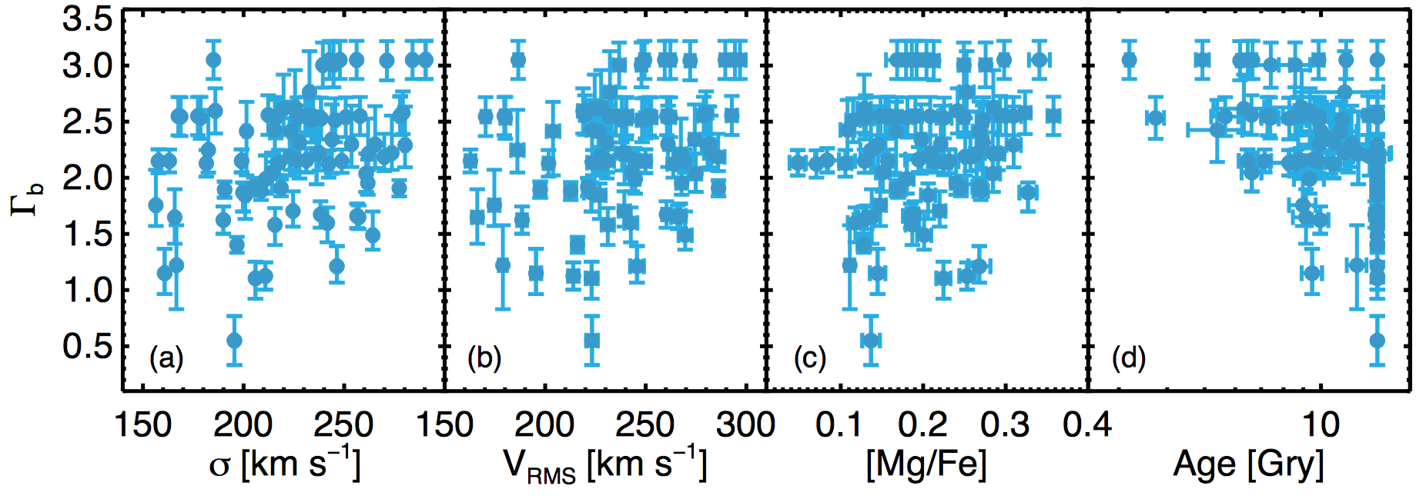
Dynamics vs. Populations: Local Trends
σ
[α/Fe]
Age
Metallicity
Davis & McDermid, 2016
Martín-Navarro +15

Slide 39
IMF Profile with Velocity Dispersion
Global values

Slide 40
IMF Profile with Age

Slide 41
IMF Profile with [Z/H]

Slide 42
IMF Profile with [α/Fe]

Slide 43
Aperture Size
Re / 8
Re / 2
Re
Age
McDermid
et al. (2015)
Metallicity
[α/Fe]
Velocity Dispersion

Slide 44
IMF Variation with Age (σ−dependance removed)
Gradient
Correlation and Significance
arXiv:1501.03927

Slide 45
IMF Variation with [α/Fe] (σ−dependance removed)
Gradient
Correlation and Significance
arXiv:1501.03927

Slide 46
IMF Variation with [Ζ/H] (σ−dependance removed)
Gradient
Correlation and Significance
arXiv:1501.03927

Slide 47
Comparison Dynamical vs. Spectroscopic IMF
McDermid+14
= Conroy & van Dokkum 2012b

Slide 48
IMF Variation with SSP parameters
Locally-weighted average values
McDermid+14

Slide 49
IMF Variation with SSP parameters
Locally-weighted average values
McDermid+14

