Slide 1
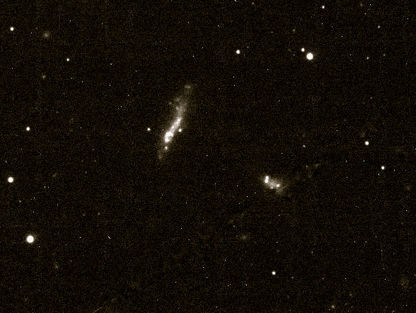
The Role of Dwarf-Dwarf Interactions in Galaxy Assembly
Sabrina Stierwalt
(NRAO, U. of Virginia)
April 15, 2016
WIYN pODI Hα
Notes:
State out front why our current understanding of galaxy mergers is not sufficient – before getting into all that we already do know about mergers (maybe something like what feeds SF and whether or not major mergers are enough)

Slide 2
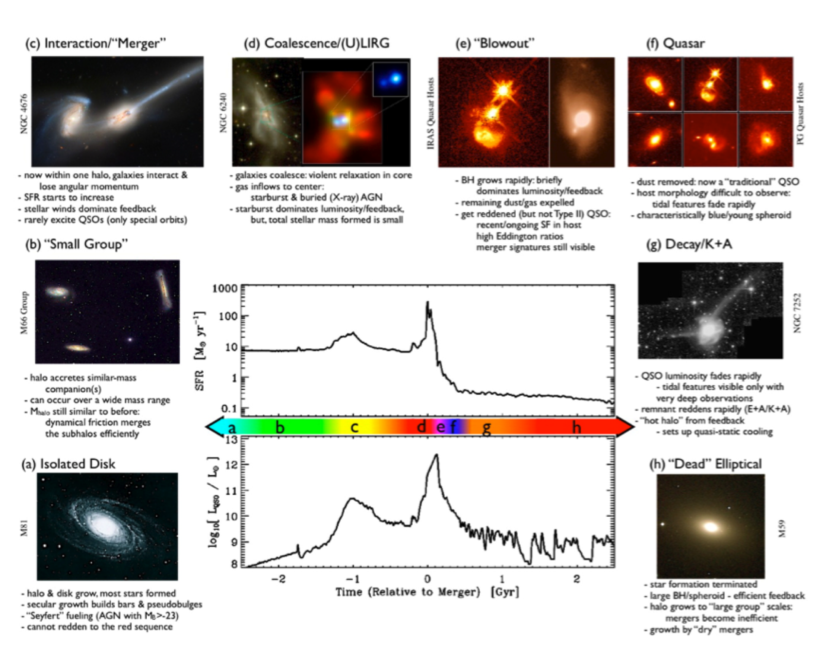
Mergers provide an important mode of galaxy evolution.
Hopkins+08
Sabrina Stierwalt (NRAO)

Slide 3
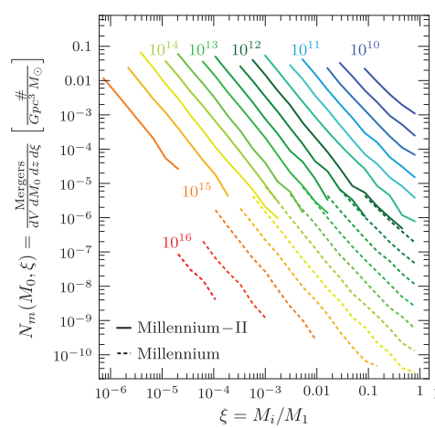
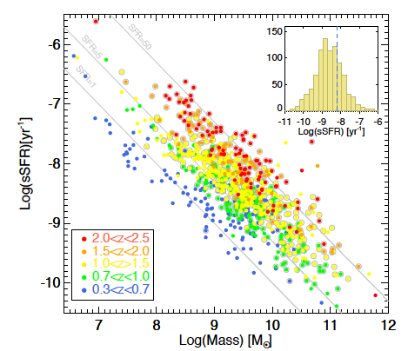
But … most mergers in the universe occur between low mass galaxies.
Theory Observations
Atek+14
Fakhouri+10
Sabrina Stierwalt (NRAO)
Notes:
not only interesting from a dwarf galaxy evolution perspective, but also that they are potentiallly significant contributors to the SF over the universe’s history and they pose an interesting physics problem with their shallow grav wells.
At any given redshift

Slide 4
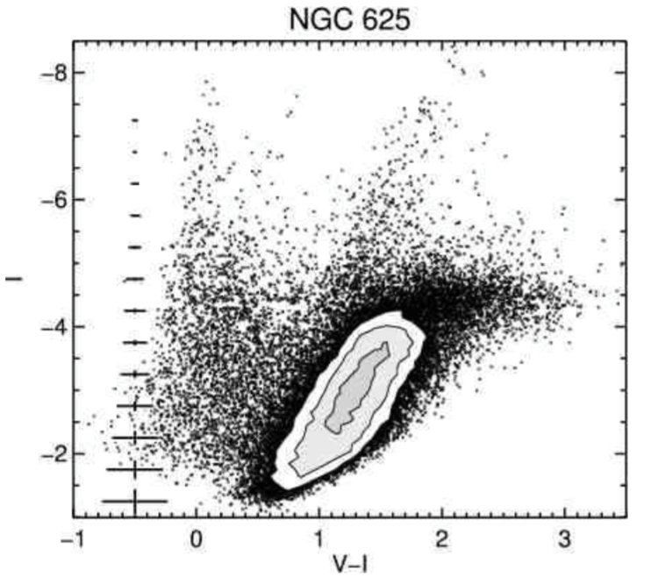
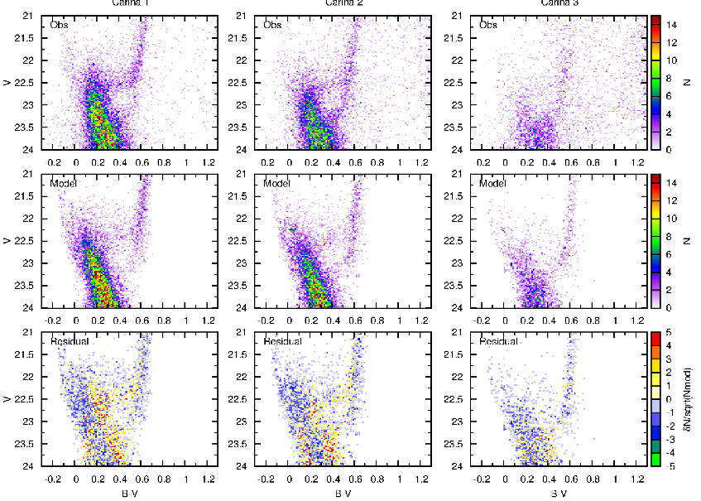
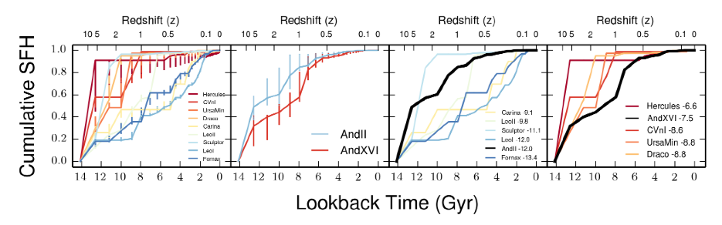
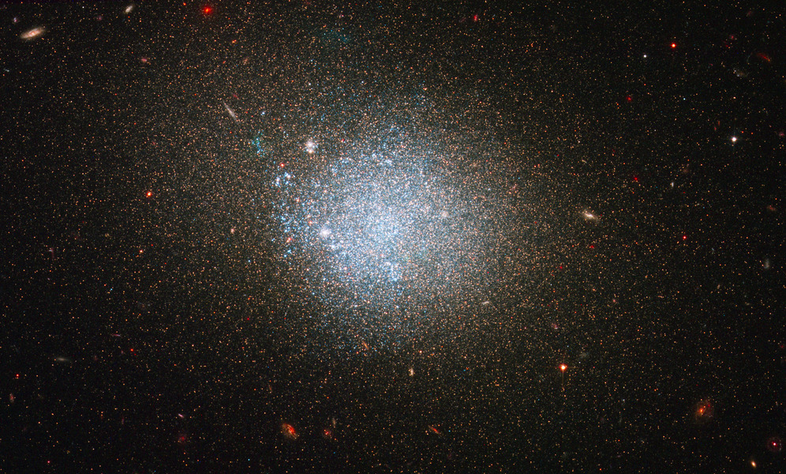
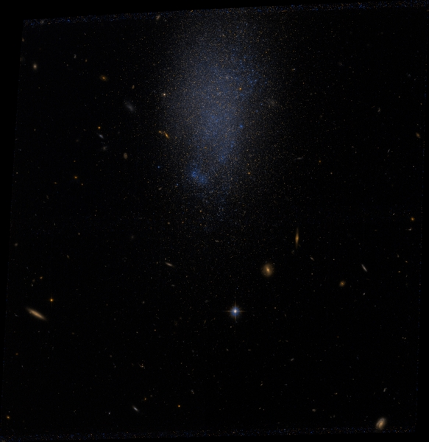
Mergers may explain the complicated star formation histories of dwarfs.
de Boer et al. 2014
Star formation histories are inconsistent with simple models.
McQuinn et al. 2010a
Interactions with other dwarfs may play a role.
ANGST Survey (Dalcanton+09; Weisz+11)
Weisz+14
Sabrina Stierwalt (NRAO)
Notes:
de Boer, Tolstoy et al. 2014 – two star forming episodes in Carina formed from gas of different abundance patterns metallicities which is inconsistent with simple isolated model

Slide 5
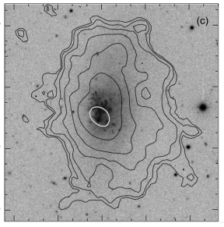
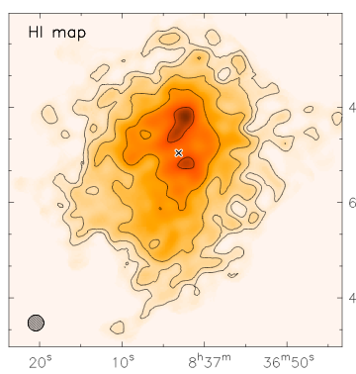
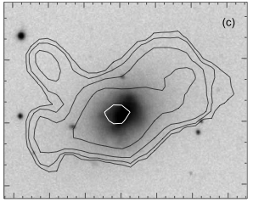
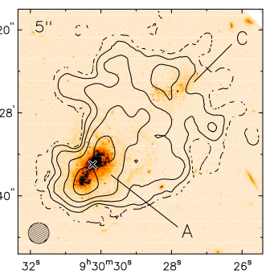
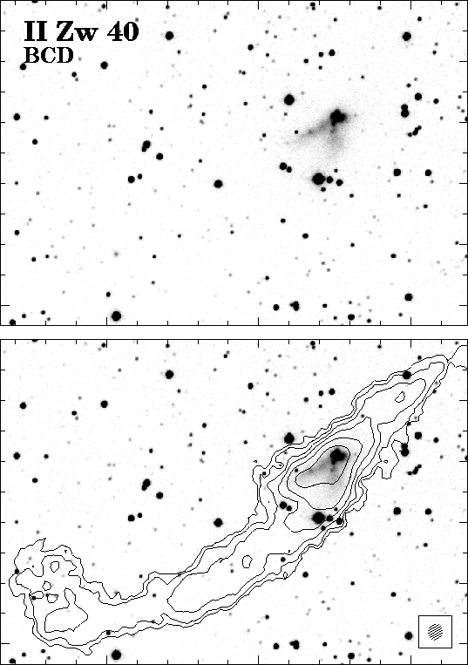
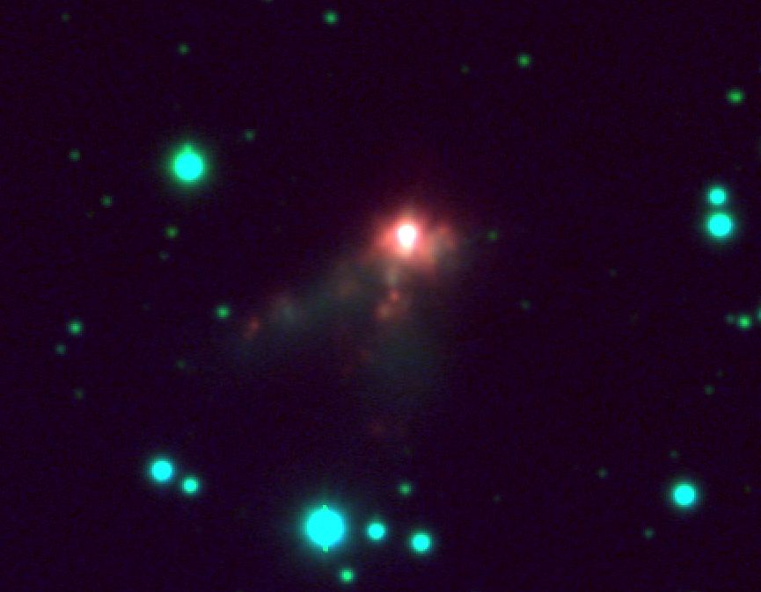
Mergers may explain starbursting dwarfs in the field.
IZw18: Lelli+12a
UGC4483: Lelli+12b
VIIZw403/Haro 2: Thuan, Hibbard & Levrier 04
IIZw40
van Zee, Skillman & Salzer 1998
Gil de Paz et al. 2003
Sabrina Stierwalt (NRAO)

Slide 6
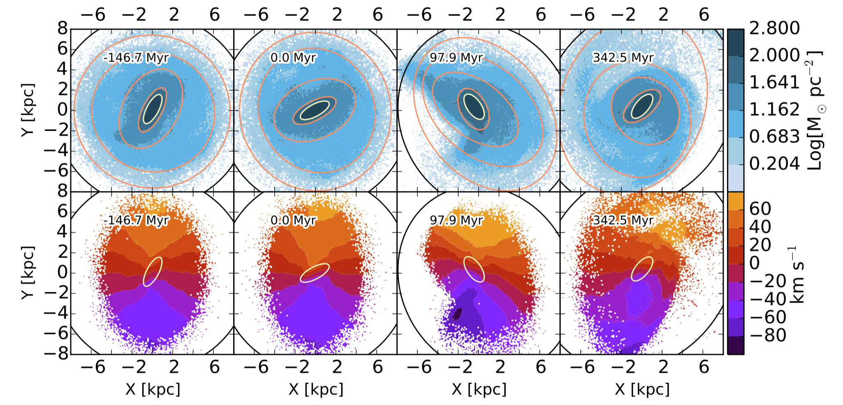
Mergers may explain off-center stellar bars in Magellanic spirals.
Pardy et al. 2016
Notes:
Mag irregulars rarely found around other spirals, N body simulations say it could be a dwarf-dwarf merger that offsets the bar long enough for us to observe them

Slide 7
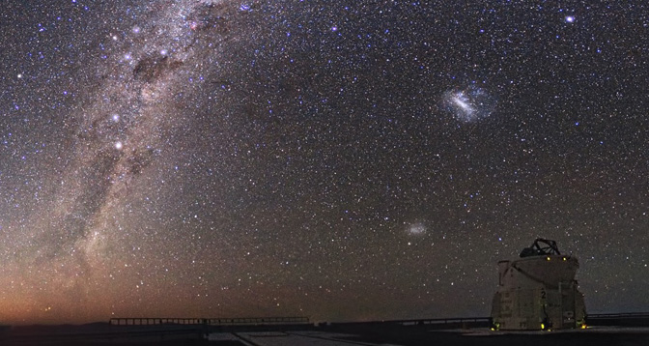
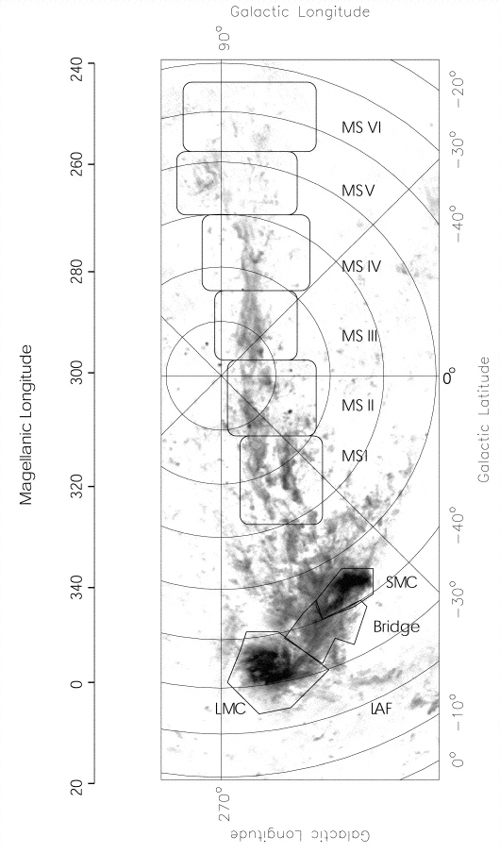
A few examples of likely dwarf-dwarf interactions exist.
BUT no studies have been done on a complete sample of interacting dwarfs.
Putman+02
Sabrina Stierwalt (NRAO)
Notes:
He2-10 is 12 Mpc away (900 km/s) and 7-8 kpc across; pink likely Ha (ionized gas) while blue/orange are broadband optical continuum
N4449 is 3.5 Mpc away; 5 kpc across (about size of LMC); tidal stream is resolved into red giant stars – xxx replace with 4485/90
IIZw40 (harder to argue against as a dwarf-dwarf merger/interaction); 4490,

Slide 8
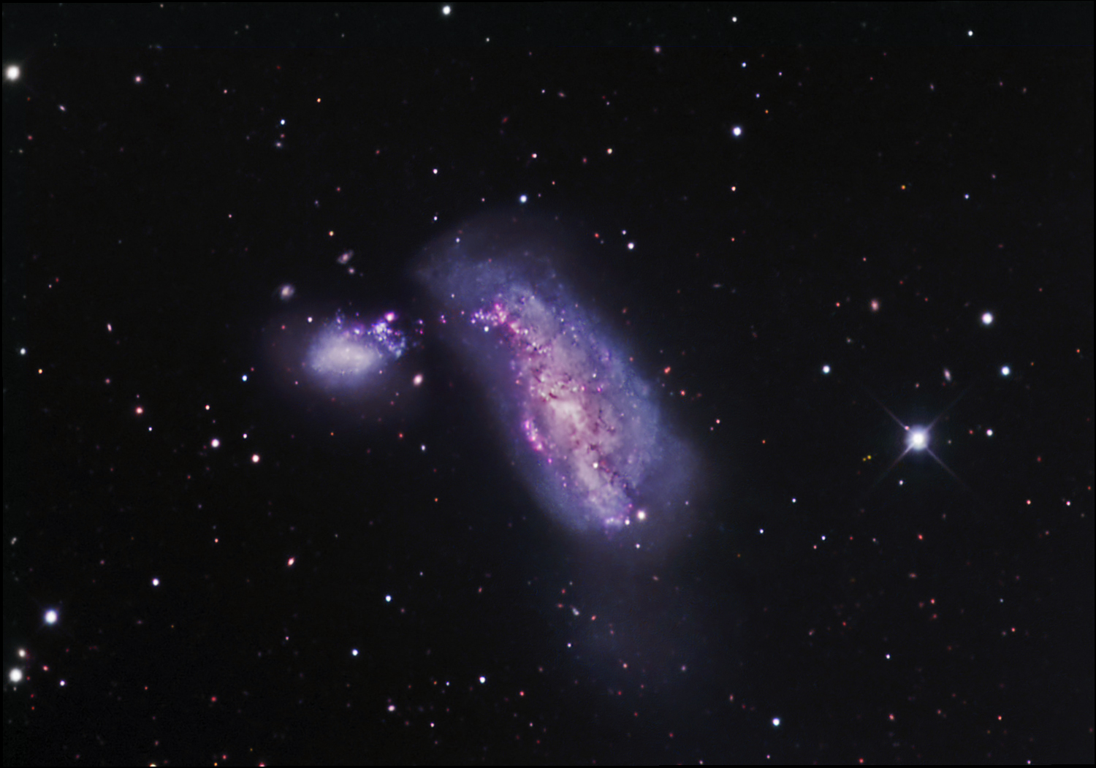
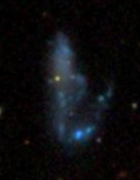
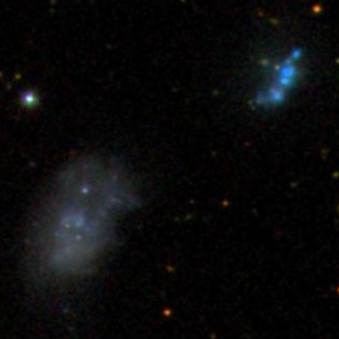
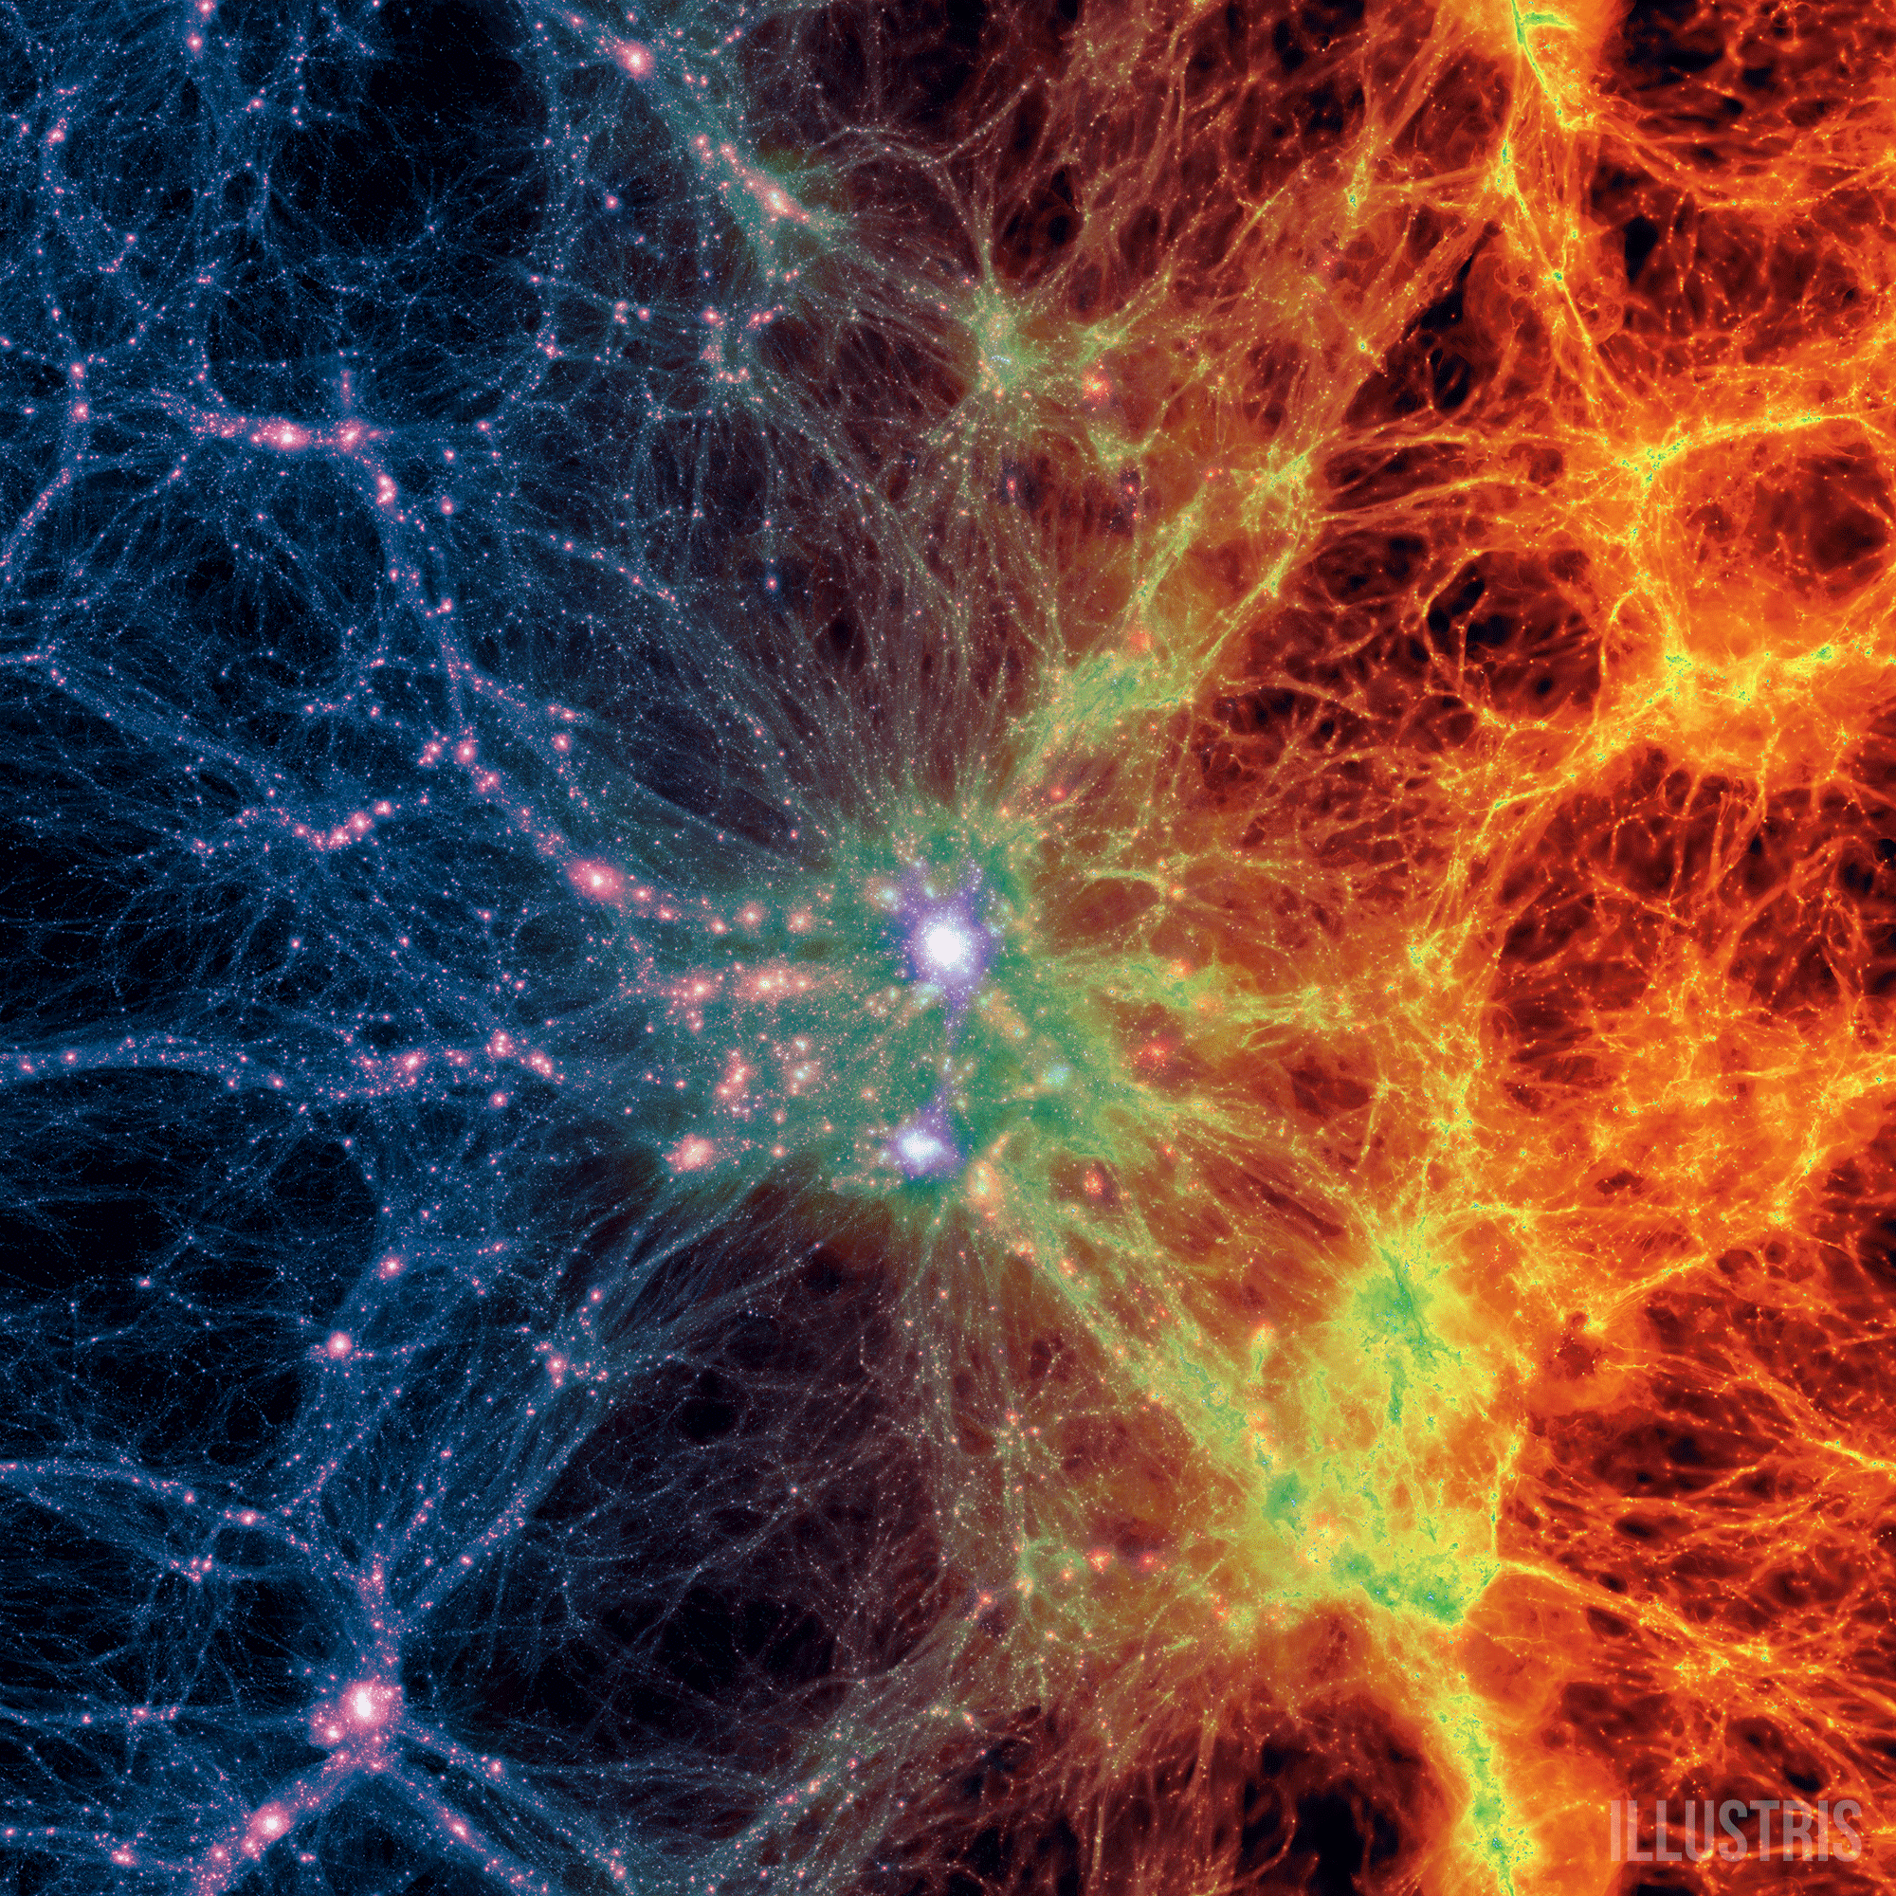
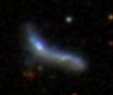
TiNy Titans (TNT) is a systematic study of interacting dwarf galaxies.
Local Volume Sample:
(lead: Mary Putman)
Low-z (z<0.07) Pair Sample:
(lead: Stierwalt)
60 SDSS-selected Dwarf Pairs
10⁷ M_{sun} < M* < 5 x 10⁹ M_{sun}
Projected Separation < 50 kpc
Velocity Separation < 300 km/s
D > 1.5 Mpc from a massive neighbor
Theoretical Program:
(lead: Gurtina Besla)
TiNy Titans: Sabrina Stierwalt, Gurtina Besla, Kelsey Johnson, Nitya Kallivayalil, David Patton, Mary Putman, George Privon
Notes:
Most mergers in the universe happen between dwarf galaxies but we know very little about what we know about massive galaxies can be scaled down to dwarf galaxy interactions and mergers.
Using metrics like SFR, gas fraction, color, etc, how does the dwarf-dwarf merger sequence differ from that for more massive galaxies
Relate observables for this low redshift sample to systems at high redshift when these interactions were more common
The TNT program has 3 main parts. Our Local volume sample is taking an in depth look at archival the small number of known nearby dwarf-dwarf interactions and our theoretical program is looking at things like the frequency of such interactions in cosmological simulations. I want to focus now on the core of TNT which is a large scale multiwavelength observational effort to study a sample of 104 low redshift dwarf pairs. We select our dwarf pairs from SDSS …

Slide 9
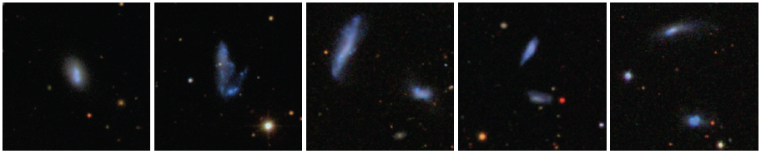
How do galaxy mergers proceed at low masses?
How is star formation and the response of the ISM different in dwarf-dwarf interactions than in interactions between massive galaxies?
More interactions, but fewer mergers?
Supernova feedback (along with outflows and subsequent enrichment of the ISM) more important?
Role of AGN less important?
Different dynamical timescales due to lower masses?
More dynamic processing due to lack of stabilizing bars/arms?
End products still red, quenched systems? (see also Geha+12)
Sabrina Stierwalt (NRAO)
Notes:
In addition to having cosmological importance, I think this is just a cool physics problem as well … Dwarfs are very influenced by their surroundings (external) and internal influences, dynamically unstable due to shallow potential wells
Add radial separations
Point out that none of these questions are limited by resolution or technology – no one has asked them yet!

Slide 10
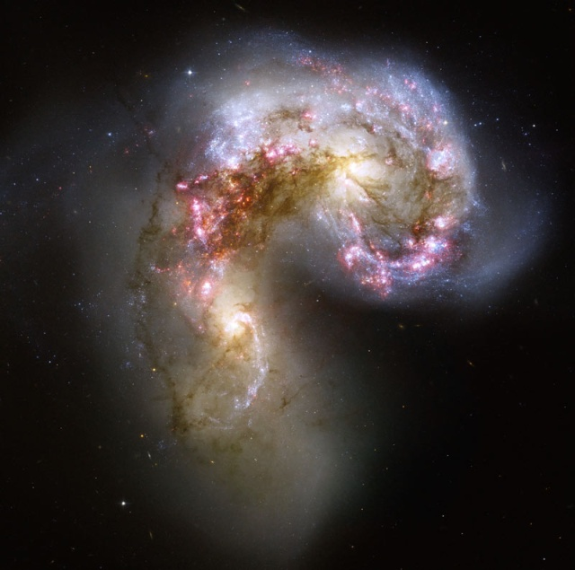
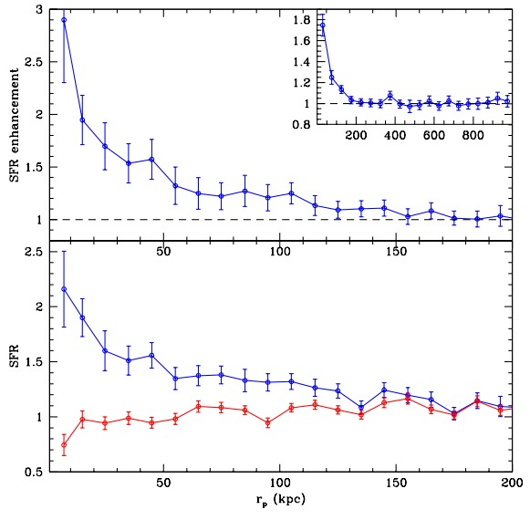
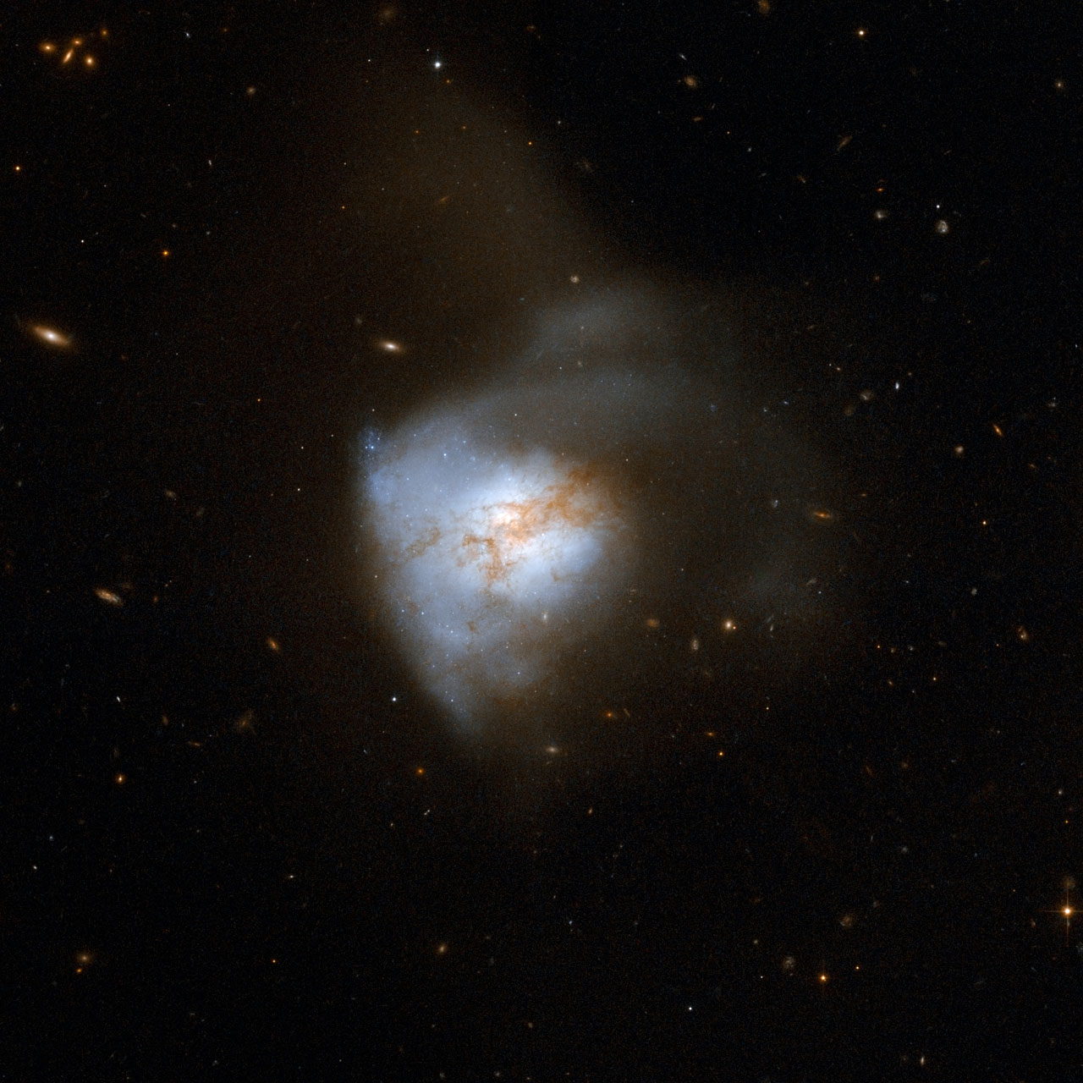
How do galaxy mergers proceed at low masses?
Do we see enhanced SF in these paired/interacting dwarfs compared to single (unpaired) dwarfs?
Paired Massive Galaxies
Patton+13
Sabrina Stierwalt (NRAO)
Notes:
Why do we expect this answer to be different for dwarfs? Keep playing this up – grav potential wells different, tidal response of system – less dynamical torquing, everything driving gas to center of mass is going to be less effective in dwarfs
To get at this question, we redid sdss photometry

Slide 11
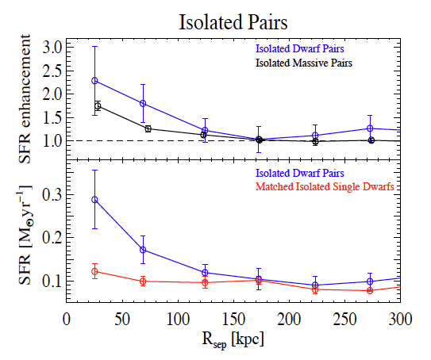
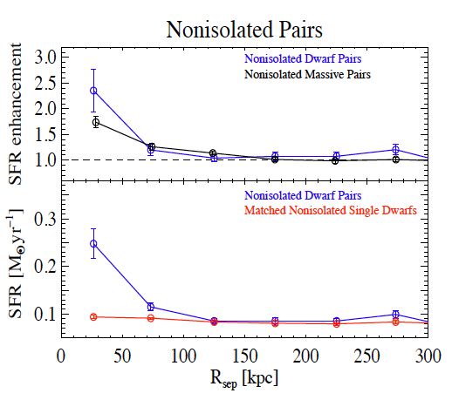
TNT Results: Star formation is enhanced in low mass galaxy interactions.
Isolated Pairs
Isolated Dwarf Pairs
Isolated Massive Pairs
R_{sep} [kpc]
Nonisolated Pairs
Stierwalt et al. 2015
Nonisolated Dwarf Pairs
Nonisolated Massive Pairs
R_{sep} [kpc]
Sabrina Stierwalt (NRAO/UVa)
Notes:
If have time, redo so massive galaxies come in on a click
How do I calculate SFR?
Error bars prob bigger, overplot massive galaxy line: 1.7 at 25 kpc;1.2 at 70 kpc
Shull thinks we need to normalize by virial radius. He also thinks we might be affected by extinction (which would affect starbursts more?)

Slide 12
TNT Results: Star formation is enhanced in low mass galaxy interactions.
Galaxy mass plays an important role in these results.
SFR Enhancement
log (M*/M_{sun})
Stierwalt et al. in prep
Sabrina Stierwalt (NRAO)

Slide 13
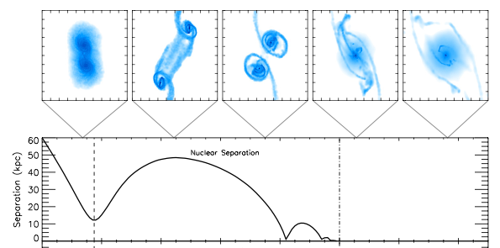
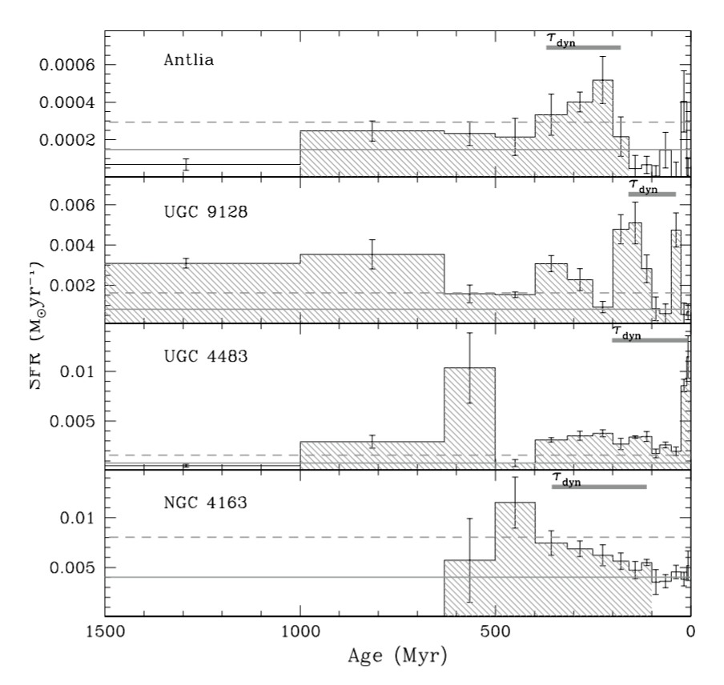
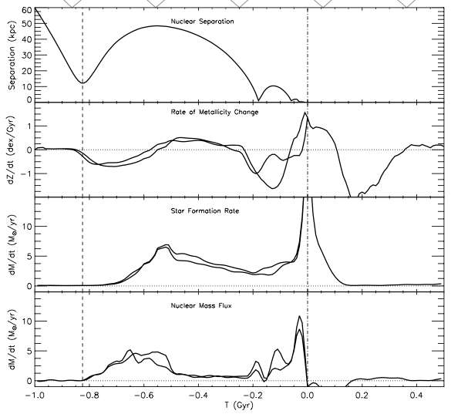
How do galaxy mergers proceed at low masses?
Star formation is enhanced in paired over unpaired dwarfs.
Nuclear Separation
SFR
-1.0 -0.8 -0.6 -0.4 -0.2 0.0 0.2 0.4
τ [Gyr]
McQuinn et al. 2010
Torrey et al. 2012
Sabrina Stierwalt (NRAO)
Notes:
McQuinn et al. 2010b bursts last as long as 450-650 Myr

Slide 14
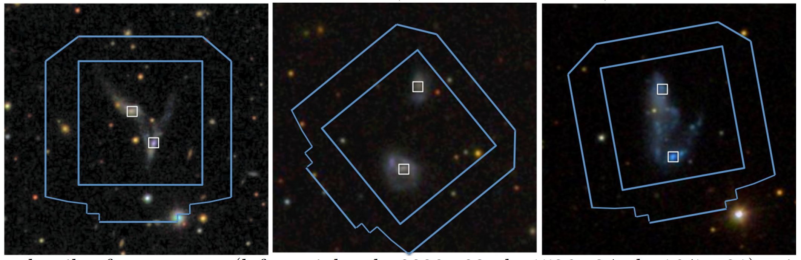
Do dwarf-dwarf interactions show metallicity gradients?
MUSE Observations (Coming soon): Look for metallicity gradients and map the excitation of the ISM
(e.g., Kewley et al. 2006; Rich et al. 2011)
Sabrina Stierwalt (NRAO/UVa)
Notes:
It’s hard not to think of ALMA as something shiny, and new but when TMT comes online, ALMA will be this many years old
TMT will stimulate new longer wavelength science and will reignite interest in ALMA from outside of the radio community.
Full ALMA will see that in the most extended configuration (16km baseline)
bsmart@astro.wisc.edu Brianna

Slide 15
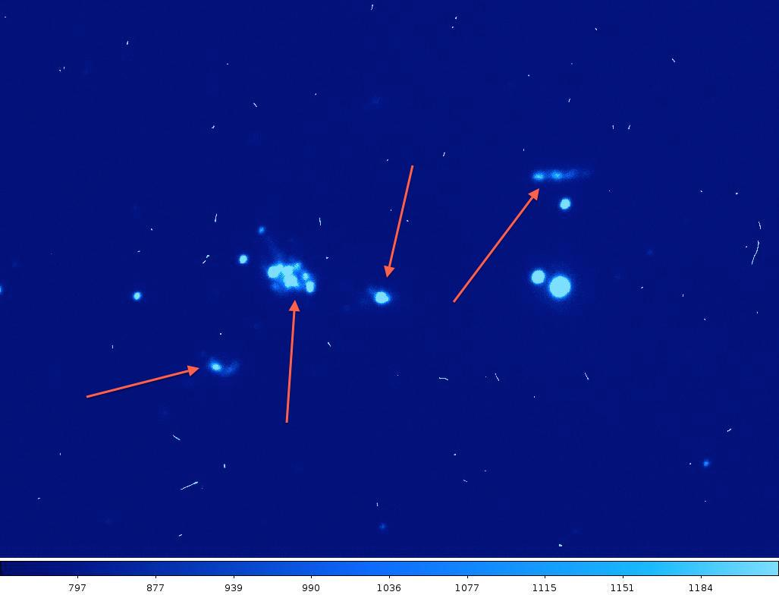
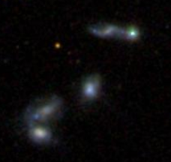
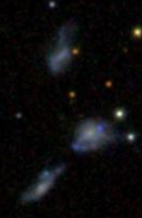
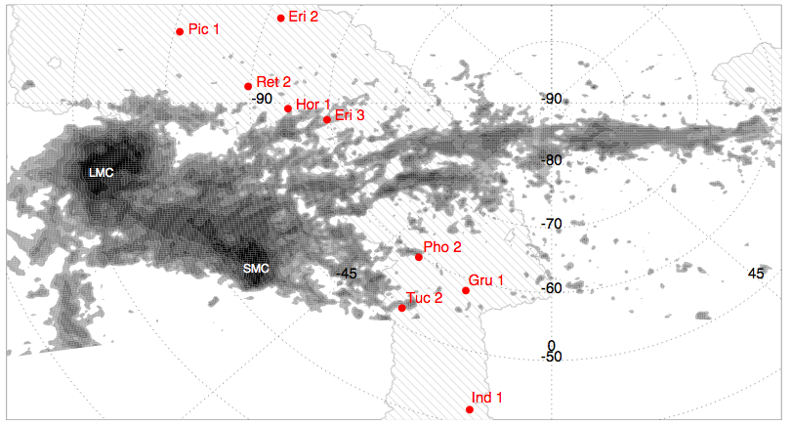
Do compact groups of only dwarfs exist?
Magellan Fabry Perot Tunable Filter
Next Step: VLA observations of the diffuse, extended 21-cm line emission surrounding the groups
Koposov+15
Sabrina Stierwalt (NRAO/UVa)
Notes:
It’s hard not to think of ALMA as something shiny, and new but when TMT comes online, ALMA will be this many years old
TMT will stimulate new longer wavelength science and will reignite interest in ALMA from outside of the radio community.
Full ALMA will see that in the most extended configuration (16km baseline)
bsmart@astro.wisc.edu Brianna

Slide 16
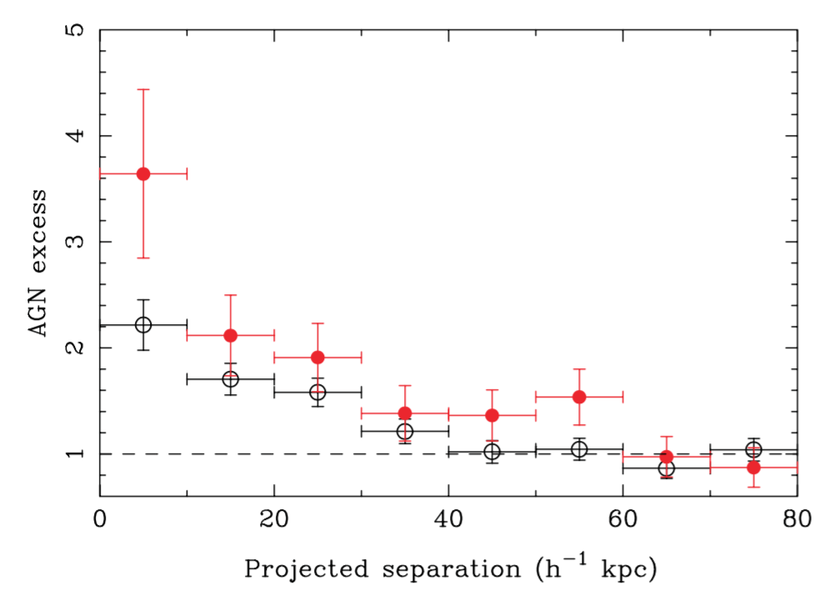
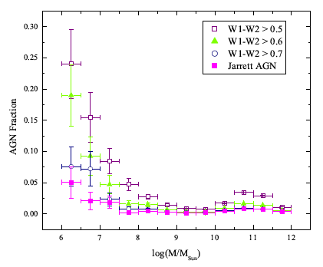
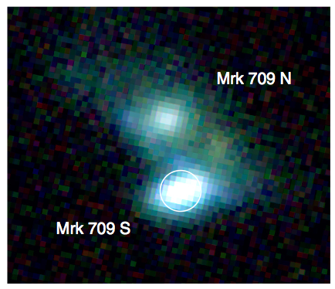
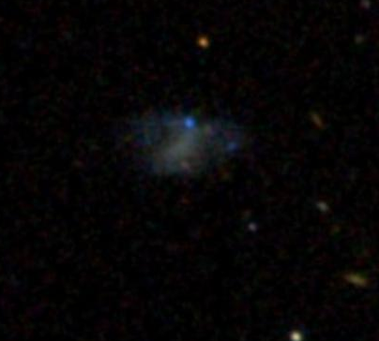
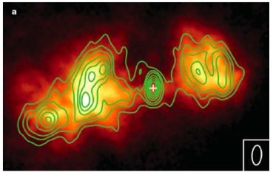
Can dwarf-dwarf interactions trigger an AGN?
Ellison+11
Satyapal+14
Stern et a. 2012
Reines et al. 2011
Secrest et a. 2015
Sabrina Stierwalt (NRAO)
Notes:
He2-10: narrow band HST/NICMOS imaging at 1.87um to trace ionized gas through Paschen alpha emission; contours VLA 8.5 GHz (3.5 cm)
Mrk709: left SDSS image; right SDSS image, Chandra hard X-ray point source (cyan cross) and 95% positional accuracy (cyan circle), VLA 7.4 GHz
Xray and Radio obs more sensitive to BHs with low Eddington ratios
Can set upper limit to Xrays expected from XRBs in SF gals from Mstar and SFR
Radio flux can exceed how ionizing radiation you expect to come from a reasonable number of O stars, can give you spectral index (although not for Mrk 709 since only had 5 and 7.5 GHz so not enough range plus large uncertainties)

Slide 17
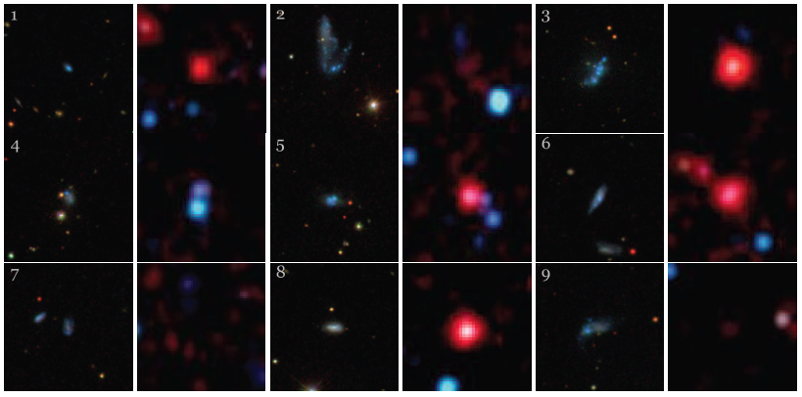
Can dwarf-dwarf interactions trigger an AGN?
Need to look to the X-Ray and
Radio Continuum …
NuSTAR Observations (queued)
XMM Newton Observations (approved)
JVLA Continuum Observations (queued)
Coming soon!
Satyapal+14
Sabrina Stierwalt (NRAO)
Notes:
He2-10: narrow band HST/NICMOS imaging at 1.87um to trace ionized gas through Paschen alpha emission; contours VLA 8.5 GHz (3.5 cm)
Mrk709: left SDSS image; right SDSS image, Chandra hard X-ray point source (cyan cross) and 95% positional accuracy (cyan circle), VLA 7.4 GHz
Xray and Radio obs more sensitive to BHs with low Eddington ratios
Can set upper limit to Xrays expected from XRBs in SF gals from Mstar and SFR
Radio flux can exceed how ionizing radiation you expect to come from a reasonable number of O stars, can give you spectral index (although not for Mrk 709 since only had 5 and 7.5 GHz so not enough range plus large uncertainties)

Slide 18
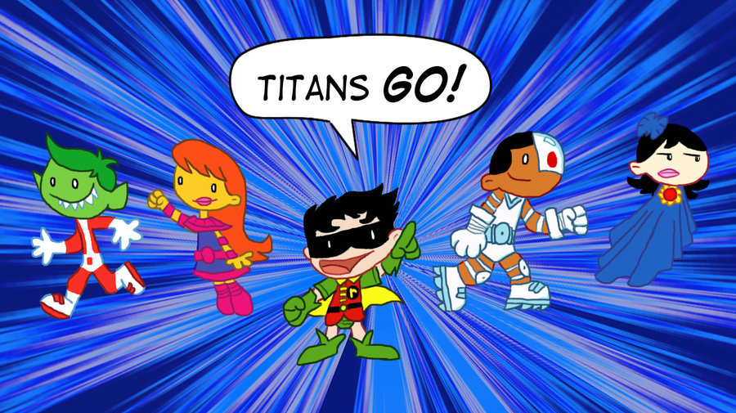
The study of dwarf-dwarf interactions as a population is so far mostly uncharted territory.
TiNy Titans is a detailed panchromatic effort to understand star formation, feedback and other ISM physics in interacting dwarf galaxies as a population throughout a variety of interaction stages.
Sabrina Stierwalt (NRAO/UVa)
Notes:
This field is just starting to catch some attention with DES survey of dwarfs, ISM in dwarf galaxies …
We are just now mobilizing this effort. I’l let you decide who is who in this image …

Slide 19
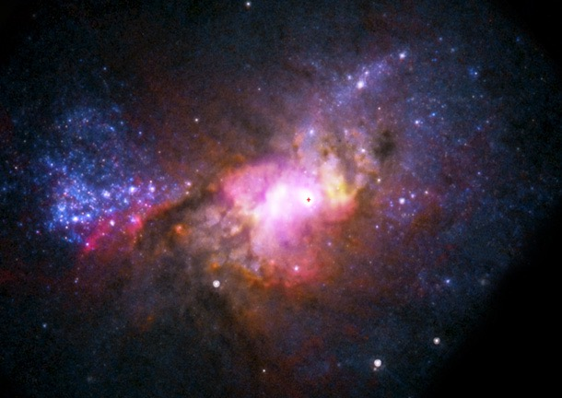
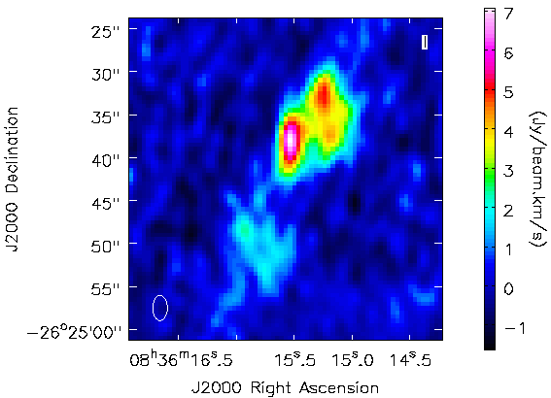
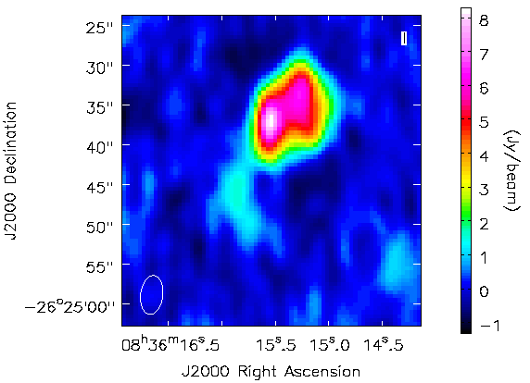
Do we find rogue intergalactic molecular clouds?
A Rogue Molecular Cloud?
CARMA Observations: 12CO(1-0) & 12CO(2-1)
ALMA Cycle 3 Proposal:
(PI: Stierwalt)
Reines et al. 2011
12CO(1-0) 12CO(2-1)
Sabrina Stierwalt (NRAO/UVa)
Notes:
CO in dwarfs is HARD (Schruba work?) but here is what we are doing …
He2-10 is 12 Mpc away (900 km/s) and 7-8 kpc across; pink likely Ha (ionized gas) while blue/orange are broadband optical continuum
Found in a Chandra study of dwarf starbursts to have extended, diffuse X-ray emission
Grant tremblay asks what is size scale of CO cloud? Marla asks how we know it has no stars if it overlaps with the stellar distribution of the main galaxy

Slide 20
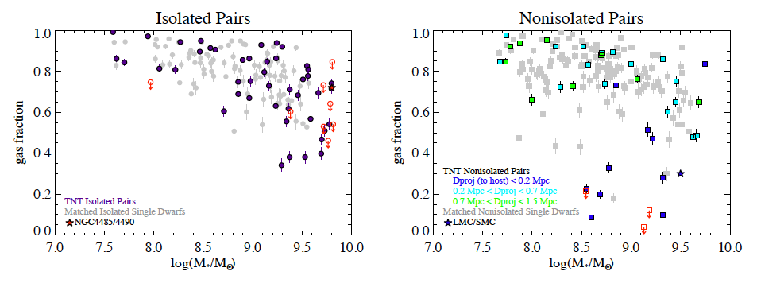
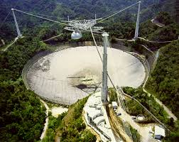
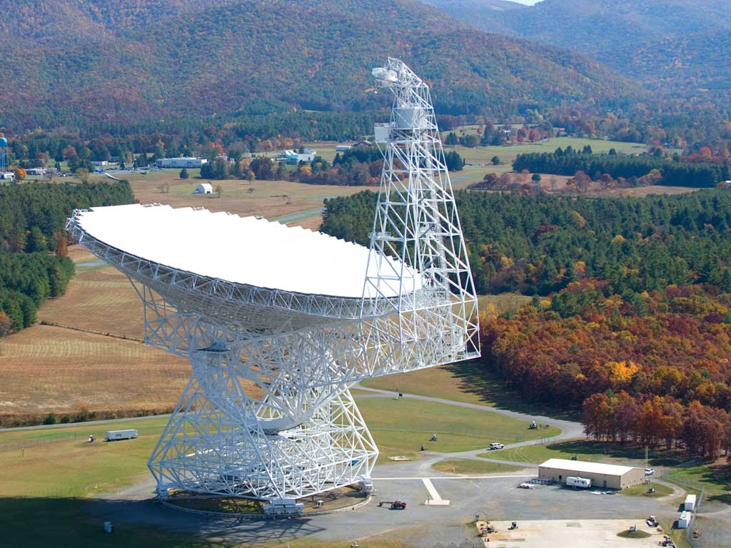
Why are gas fractions not depleted despite higher star formation rates?
Isolated dwarf galaxy pair
Isolated single dwarf galaxy
(ALFALFA)
Sabrina Stierwalt (NRAO)
Notes:
Animate this to show one group of points at a time
What do we predict? Actually predict fgas to be lower because they are not holding onto their gas or they’ve processed it
Scenarios that could explain it: single dwarfs are actually merger remnants
What are gas fractions from Andrew’s sample KGB?

Slide 21
Why are gas fractions not depleted despite higher star formation rates?
(ALFALFA)
Stierwalt et al. 2015
Mergers between dwarfs don’t turn off SF. Massive galaxy neighbors do.
Sabrina Stierwalt (NRAO/UVa)
Notes:
Put 200 kpc in context – is that distance to M31?
What do we predict? Actually predict fgas to be lower because they are not holding onto their gas or they’ve processed it
Scenarios that could explain it: single dwarfs are actually merger remnants
What are gas fractions from Andrew’s sample KGB?
Add info about Fox+14 work and math on adding back in the ionized gas

Slide 22

Why are gas fractions not depleted despite higher star formation rates?
VLA: 175 hours
rms ~ 0.47 mJy/bm
4.6” resolution
N_{HI} ~ 1.9 x 10²⁰ cm⁻²
PI: Stierwalt
Clemens+98
Sabrina Stierwalt (NRAO)
Notes:
Bipolar outflow due to SN blowout in NGC4490, going on for 6e8 year, 56 kpc in extent
Don’t think gas is primordial because changes sign in velocity above and below galaxy axis and because elongated morphology
Don’t think gas is stripped by interaction because distribution is symmetric
Where is the MW?

Slide 23



Preliminary Results (4 pairs): Diffuse component contributes 20-50% of neutral HI gas mass
Why are gas fractions not depleted despite higher star formation rates?
21cm
Sabrina Stierwalt (NRAO/UVa)
Notes:
Change this title to the answer! Make YT movie?
EVLA maps of higher column density gas compared with global HI masses show …
And this is seen in our pairs that cover a range of merger stages (i.e. projected separations)

Slide 24

TNT Results: Low mass galaxy interactions are an important mode of star formation.
1) Starbursts are not just triggered at the end of the merger!
Stierwalt et al. 2015
2) Mergers between dwarfs is an important mode of star formation.
3) Mergers between dwarfs don’t turn off SF. Massive galaxy neighbors do.
Fraction of non Sfing Dwarfs
0% Isolated Paired
8% Nonisolated Paired
0% Isolated Singles
5% Nonisolated Singles
Starburst Fraction
20% Isolated Paired
20% Nonisolated Paired
6% Isolated Singles
8% Nonisolated Single
Sabrina Stierwalt (NRAO/UVa)
Notes:
So if we look in more detail at which of our pairs are doing the starbursting we find …

